Slide 1

Welcome to ISPD 2014
ACM International Symposium on Physical Design

Slide 2
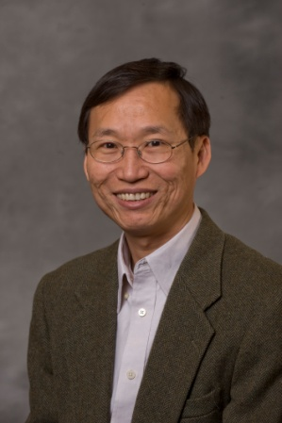
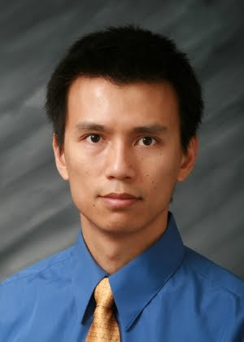
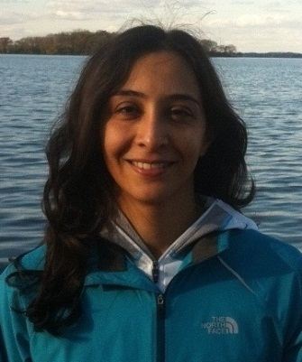
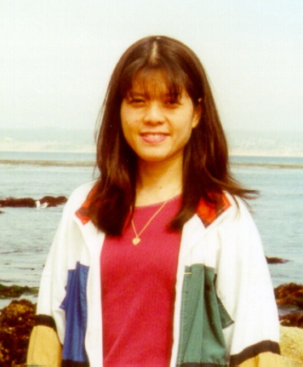
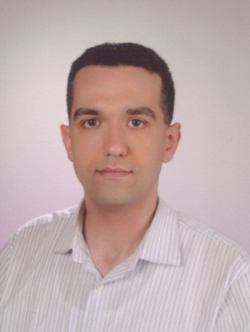
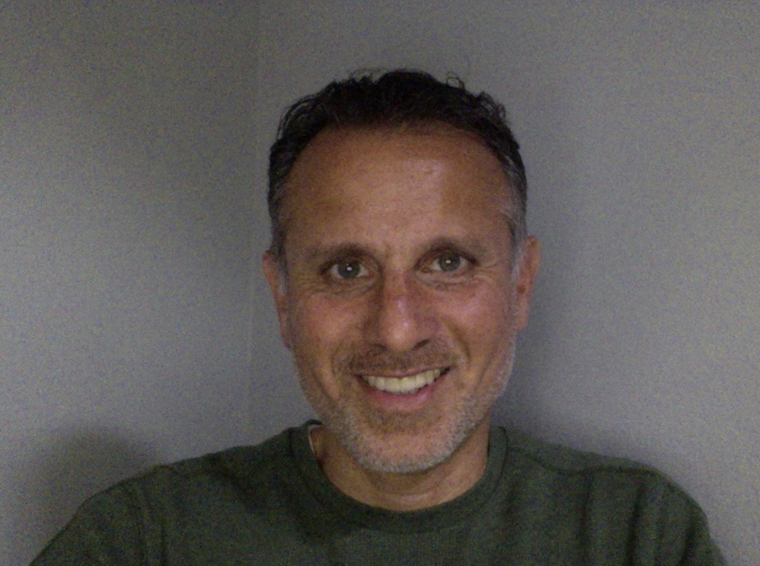
Symposium Organization
General Chair
Cliff Sze
IBM Research
TPC Chair
Azadeh Davoodi
Univ. of Wisconsin
Steering Committee Chair
Cheng-Kok Koh
Purdue Univ.
Publications Chair
Evangeline Young
Chinese Univ. of Hong Kong
Publicity Chair
Mustafa Ozdal
Intel
Contest Chair
Ismail Bustany
Mentor Graphics
Notes:
.

Slide 3
Hotel Logistics
Complimentary internet access in guest rooms and meeting room (Heron Ballroom – 1/F)
Breakfast at Snowy Egret – 2/F
Plate lunches at Snowy Egret on Monday and Tuesday, sandwich lunch on Wednesday at Heron Ballroom
Plate dinners at Snowy Egret for Monday
Tuesday banquet will be at the bigger side of Ballroom
Coffee breaks will be just outside
Your badge will also serve as meal tickets

Slide 4
Technical Program Committee
Azadeh Davoodi
University of Wisconsin
Chair
Tom Spyrou (Altera)
David Newmark (AMD)
Jackey Yan (Cadence)
Natarajan Viswanathan (IBM)
Cheng Zhuo (Intel)
Ismail Bustany (Mentor Graphics)
Tsung-Yi Ho (National Cheng Kung University)
Yu-Yen Mo (Oracle)
Guojie Luo (Peking University)
Dwight Hill (Synopsys)
Bill Swartz (TimberWolf Systems / University of Texas – Dallas)
Atsushi Takahashi (Tokyo Institute of Technology)
Charles C. C. Liu (TSMC)
Malgorzata Marek-Sadowska (UCSB)
Marcelo de Oliveira Johann (Universidade Federal do Rio Grande do Sul)
Stephan Held (University of Bonn)
Laleh Behjat (University of Calgary)
Markus Olbrich (University of Hannover)
Evangeline Young (The Chinese University of Hong Kong)

Slide 5
Technical Program
52 abstracts submitted, 40 submissions approved for review, authors from
  USA, Canada, China, Hong Kong, Japan, Taiwan, Germany, Spain, Russia
Double-blind review process
  212 reviews (58 from external reviewers)
  At least 5 reviews per submission
  Papers selected in face-to-face meeting on Nov 21, 2013
  Thank Cadence to provide the meeting room
  Summarizing key issues raised in TPC meeting added to the reviews for authors
14 accepted papers (35% acceptance rate)

Slide 6
Symposium Logistics
Speakers
  Check in with your Session Chair and load your slides prior to your session
  Keep on time
  All slides will be posted (as PDF files) on the ISPD website; if not okay, please inform your Session Chair
Session Chairs
  Know your speakers, help to load slides in advance
  Keep your sessions on time
Audiences
  Please set your cell phones to silent/vibration mode
  Questions are encouraged, interruptions are okay! Please identify yourself before asking questions
  Microphone at center is for questions.

Slide 7
Best Paper Award Candidates
Session 1: Cell Density-driven Detailed Placement with Displacement Constraint (Wing-Kai Chow, Jian Kuang, Xu He, Wenzan Cai and Evangeline F. Y. Young)
Session 3: Placement-Driven Partitioning for Congestion Mitigation in Monolithic 3D IC Designs (Shreepad Panth, Kambiz Samadi, Yang Du and Sung Kyu Lim)
Session 4: Clock Tree Resynthesis for Multi-corner Multi-mode Timing Closure (Subhendu Roy, Pavlos M. Mattheakis, David. Z. Pan and Laurent Masse-Navette)

Slide 8


2014 ACM International Symposium on Physical Design
Best Paper Award
Presented to
Subhendu Roy, Pavlos M. Mattheakis, Laurent Masse-Navette, and David Z. Pan
For the paper
“Clock Tree Resynthesis for Multi-corner Multi-mode Timing Closure”
Cheng-Kok Koh
Steering Committee Chair
Cliff C. N. Sze
General Chair
Azadeh Davoodi
Technical Program Chair
March 30 – April 2, 2014

Slide 9
Detailed Routing-Driven Placement Contest
Organized by Mentor Graphics and a colleague from academia:
  Ismail Bustany (Contest Chair)
  Vlad Yutsis
  David Chinnery
  Joseph Shinnerl
  Wen-Hao Liu
  Clive Ellis
  John Jones
Strong support from Shankar Krishnamoorthy, Chief Scientist, Integrated Circuits Implementation Division, Mentor Graphics.
18 initial registrations from Brazil, Canada, China, Germany, Hong Kong, Taiwan, and the United States.
12 α-binary submissions, 9 final submissions (7 valid).
Sponsored by IEEE CEDA and industrial partners.
Winners to be announced Wednesday morning (Session 8).

Slide 10
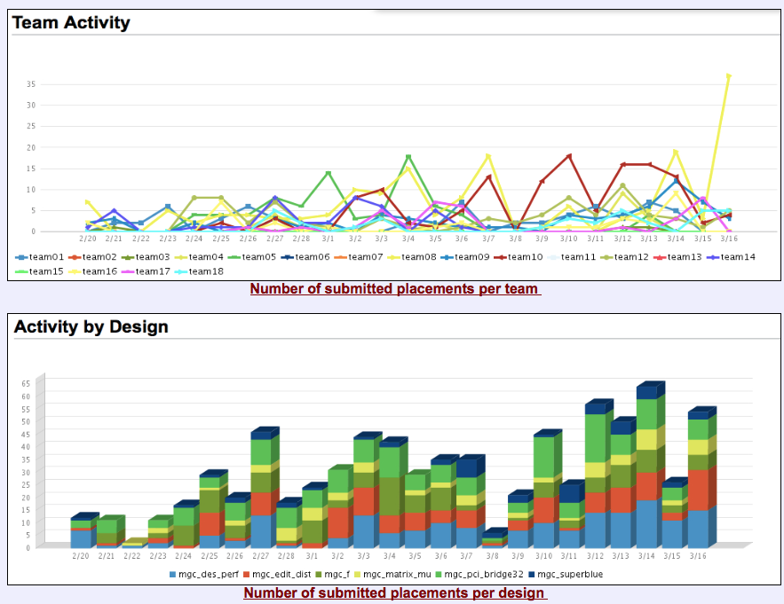
http://www.ispd.cc/contests/14/ispd2014_contest.html

Slide 11












Sponsors and Supporters
Technical
Sponsor:
Technical
co-sponsor:
Industry Financial Sponsors:

Slide 12
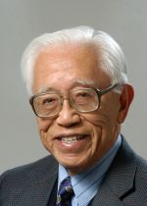
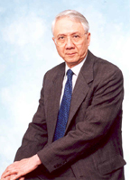
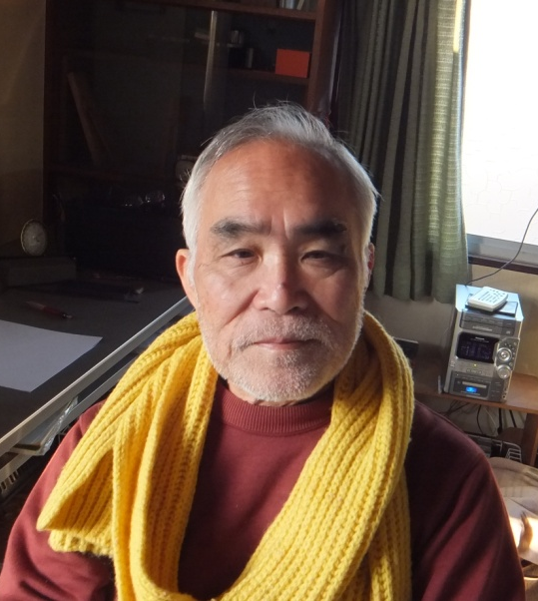
Paying Tributes to Giants in Physical Design
Express appreciation to our pioneers
Trace their contributions
Explore directions along their steps
Link senior/junior researchers together
Commemoration for Prof. Ernest Kuh in 2011
Commemoration for Prof. Chung-Laung Liu in 2012
Commemoration for Prof. Yoji Kajitani in 2013
ISPD Lifetime Achievement Award

Slide 13
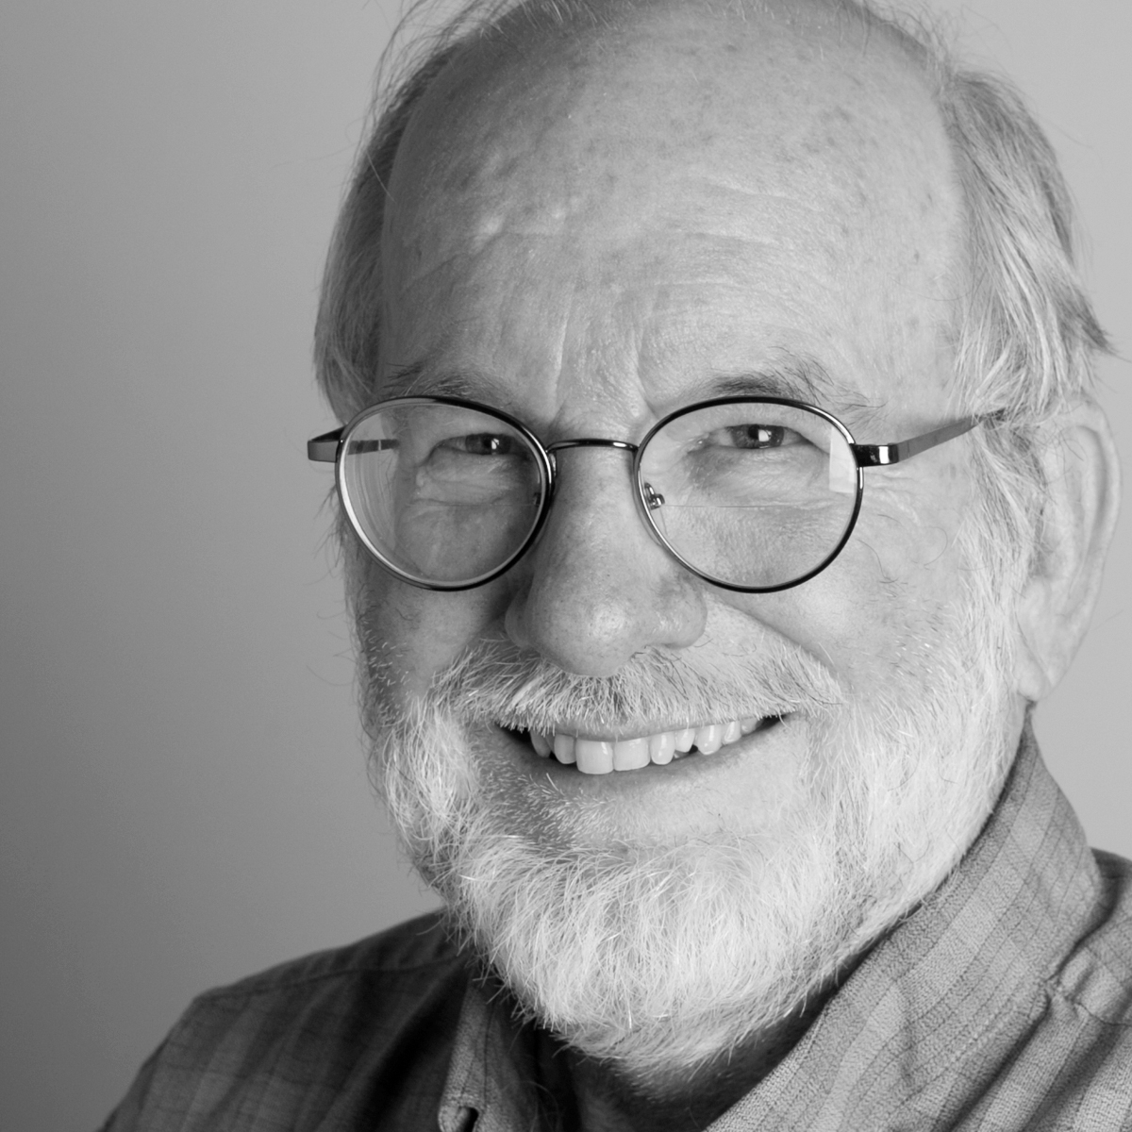
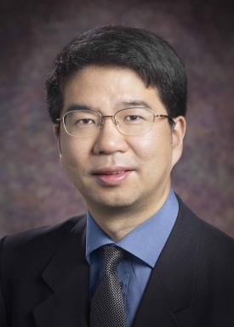
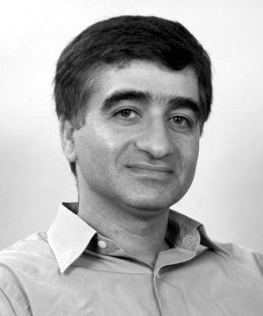
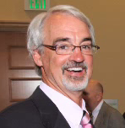
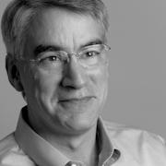
2014 ISPD Lifetime Achievement Award:
Dr. Bryan Preas
Session 6: Commemoration for Dr. Preas
Jason
Cong
UCLA
Massoud Pedram
USC
Mike
Lorenzetti
Mentor Graphics
Scott
Elrod
PARC
Tuesday Dinner Banquet @ 6:00-8:30pm
Hosted by: Cheng-Kok Koh
Guest Speaker: Bryan Preas
“Smart Matter Systems: An Introduction Through Examples”

Slide 14
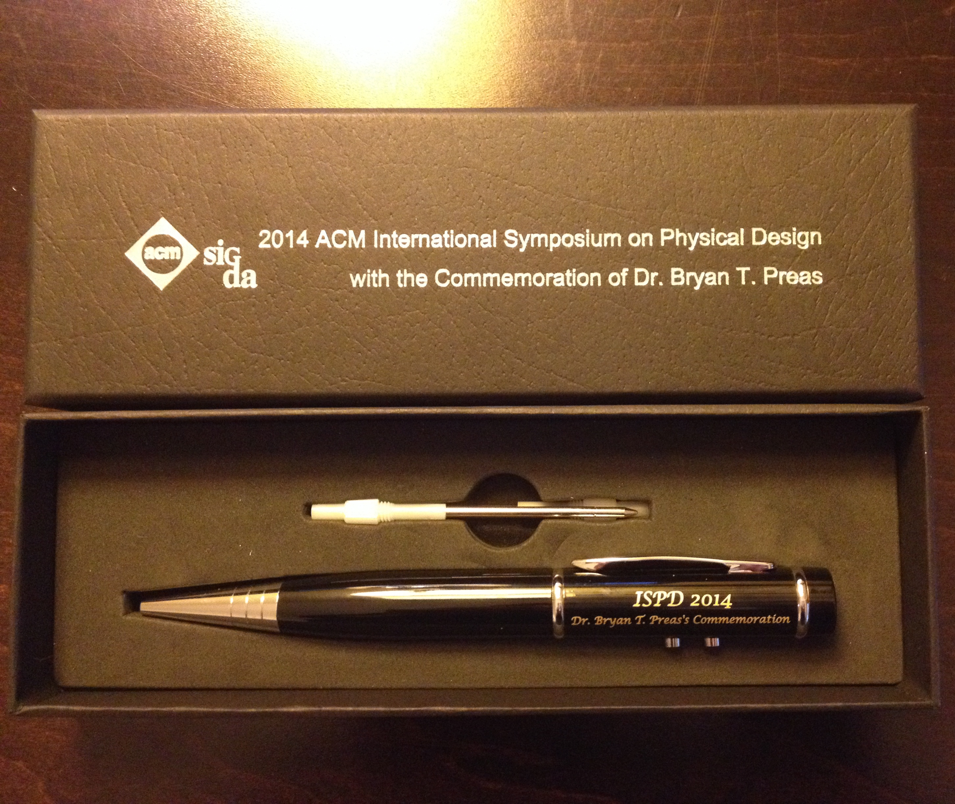
Souvenir for Tribute to Dr. Bryan Preas

Slide 15
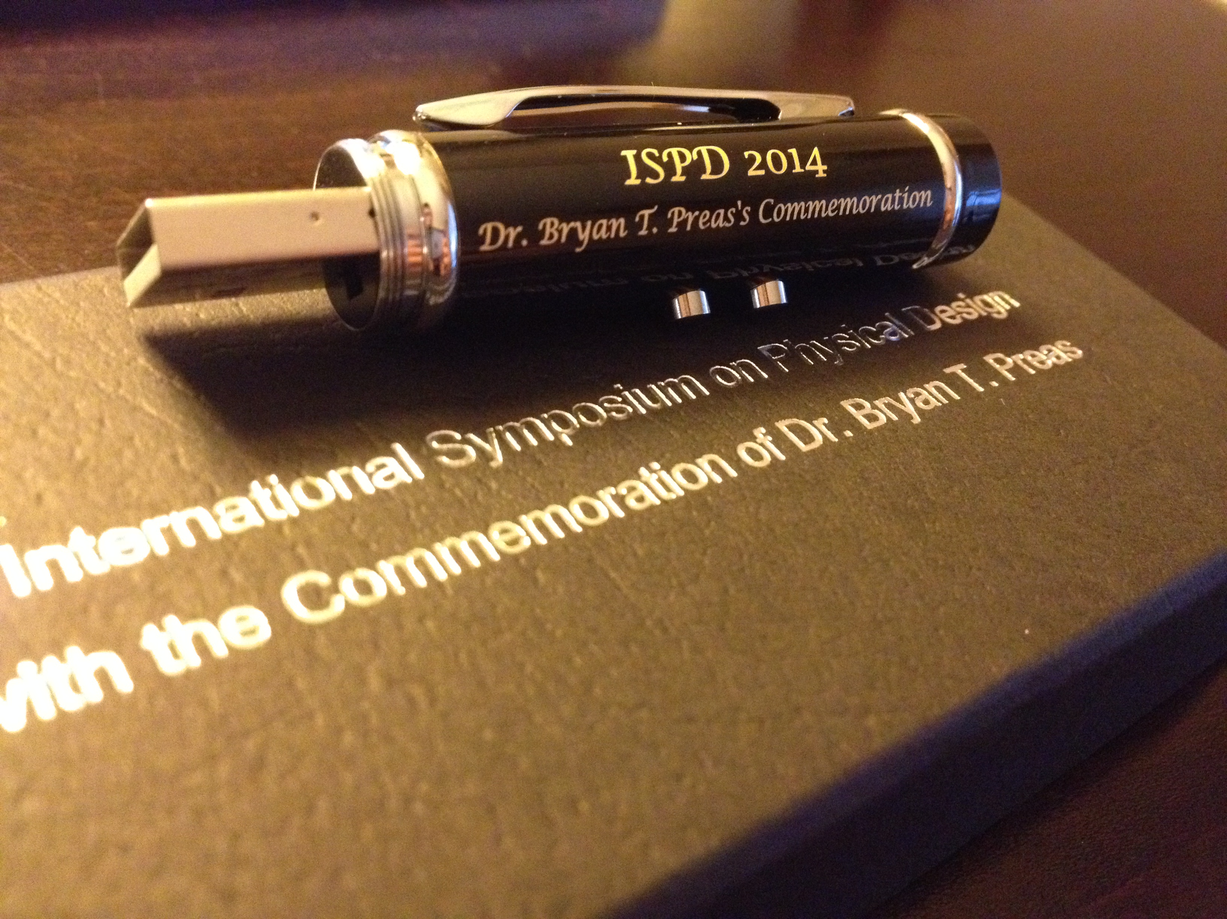
In the pen
16 GB USB 2.0 drive
Laser pointer*
LED flashlight*
Rechargeable*
Softcopy of the ISPD14 proceedings

Slide 16
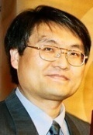
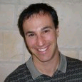
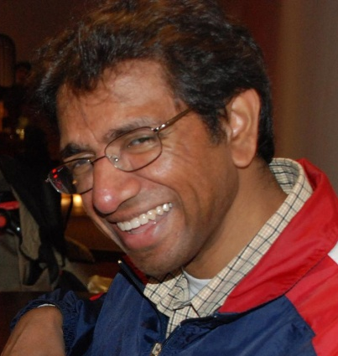
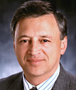
Steering Committee
Cheng-Kok Koh
Purdue Univ.
Chair
Jason Cong
UCLA
Yao-Wen Chang
National Taiwan Univ.
Charles Alpert
Cadence
Prashant Saxena
Synopsys
Jacob Greidinger
Mentor Graphics

Slide 17
Invited Talks
Industry
  ARM, Cadence, IBM, Intel, Mentor Graphics, Synopsys, TSMC, Xilinx
Academia
  National Tsing Hua University,
  Peking University,
  Stanford University,
  University of California-Riverside

Slide 18
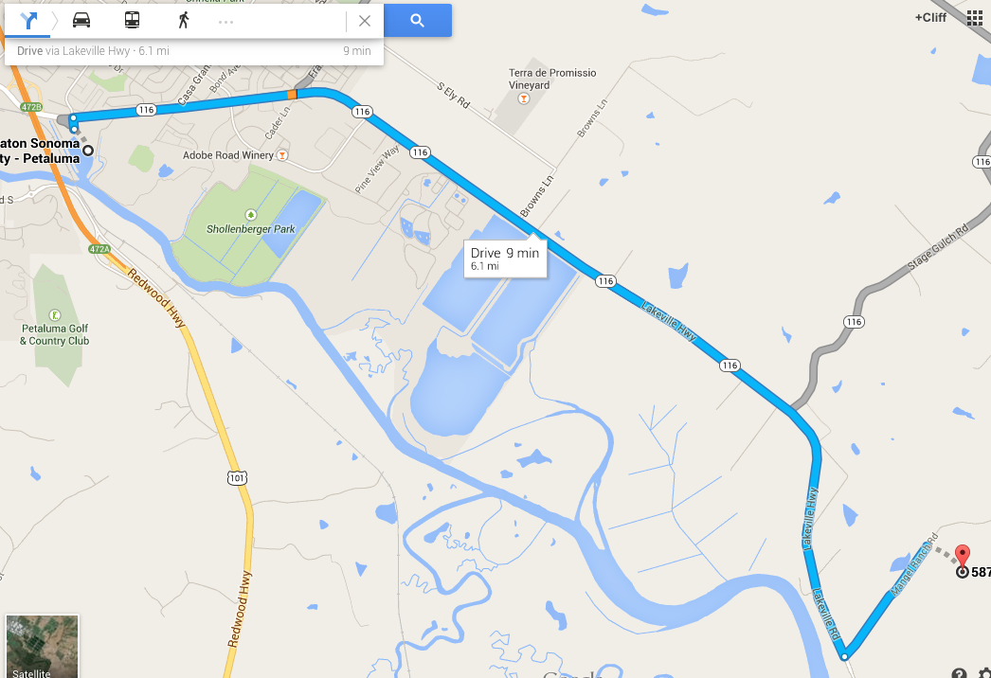
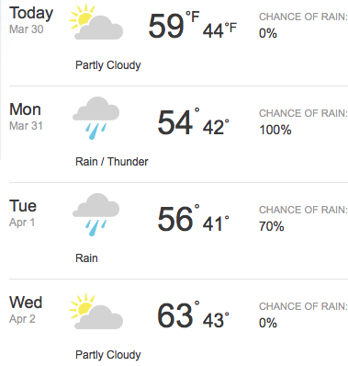
Winery Cave Tour and Tasting
(Wednesday 2:00-3:30pm)
Details TBA on closing
20 people replied and will join us
Please let me know if you can provide your car for carpool

Slide 19
ISPD 2014

Slide 20
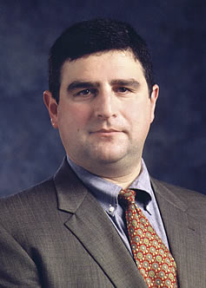
Keynote
Hardware Cyber Security
Responsible for identifying and developing product opportunities for EDA in adjacent, systems-oriented markets.
Prior to joining Mentor Graphics in 1990, Leef was responsible for design automation at Silicon Graphics, where his team created revolutionary high-speed simulation tools to enable design of high speed 3D graphics chips that defined state-of-the-art in visualization, imaging, gaming and special effects for a decade.
Prior to 1987, Leef managed a CAE/CAD organization at Microchip Inc. From 1982 to 1987 he worked at Intel Corp. developing functional and physical design and verification tools for major 8- and 16-bit microcontroller and microprocessor programs. Serge holds a BSEE and MSCS from Arizona State University.
Serge Leef Vice President,
New Ventures General Manager,
System-Level
Engineering Division

