Slide 1
ISPD 2014 Detailed Routing-Driven Placement Contest:
Benchmarks with Sub-45nm Technology Rules
Vladimir Yutsis
Ismail Bustany
David Chinnery
Joseph Shinnerl
Wen-Hao Liu - National Tsing Hua University
Mentor Graphics
www.ispd.cc/contests/14/ispd2014_contest.html

Slide 2
Outline
Motivation
Sample design rules
Benchmark suite characteristics
Placement Submission Procedure
Evaluation metrics
Results
Acknowledgements

Slide 3
1. Motivation

Slide 4
Motivation
Increasing complexity of design rules
  miscorrelation between global and detailed routing
  traditional placement approaches rendered inadequate
  Robert Aitken’s talk on physical design
Example routability challenges for placement
  Netlist: High-fanout nets, data paths, timing objectives
  Floorplan: Placement utilization, irregular placeable area, narrow channels between blocks
  Routing constraints: blockages, layer restrictions,
  pin geometry
  Design rules: Min-spacing, edge-type, end-of-line
Make typical design rules available in a benchmark suite and evaluate placement using detailed routing as the quality arbiter.

Slide 5
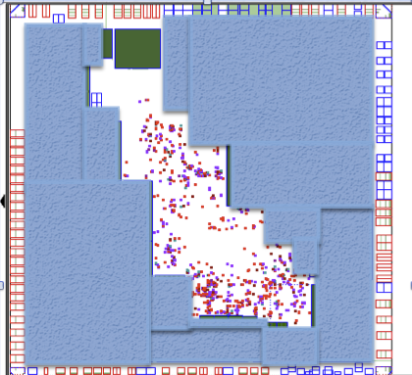
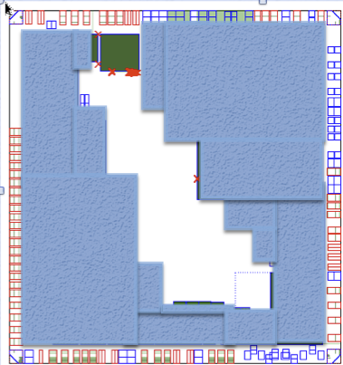
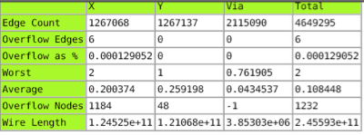
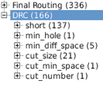
Global/Detailed Routing Miscorrelation Example
GR congestion map
Final DRC violations

Slide 6
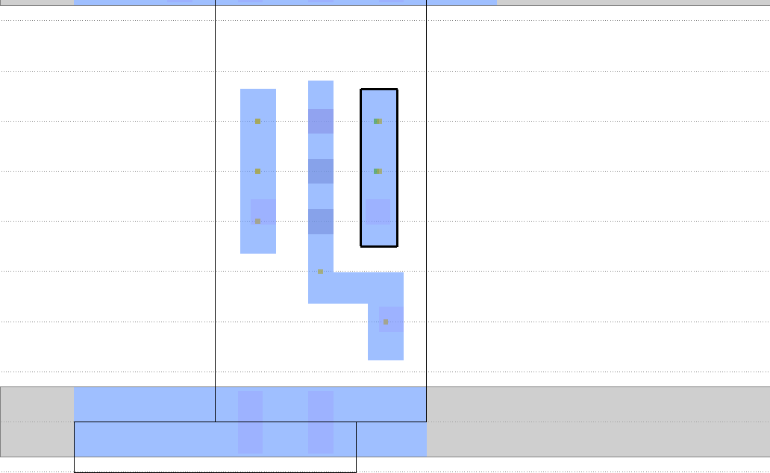
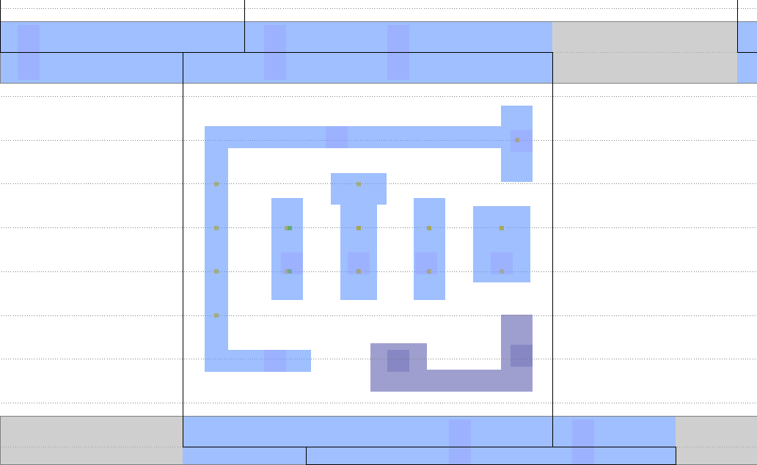
Pin Geometry Challenges
Dense pins
  Complex DRC rules: cut space, minimum metal area,
  end-of-line rules, double patterning rules, etc.
  Challenging to pre-calculate routable combinations
Easy to route
Harder to route
many tracks available
2 tracks available

Slide 7
2. Sample design rules

Slide 8
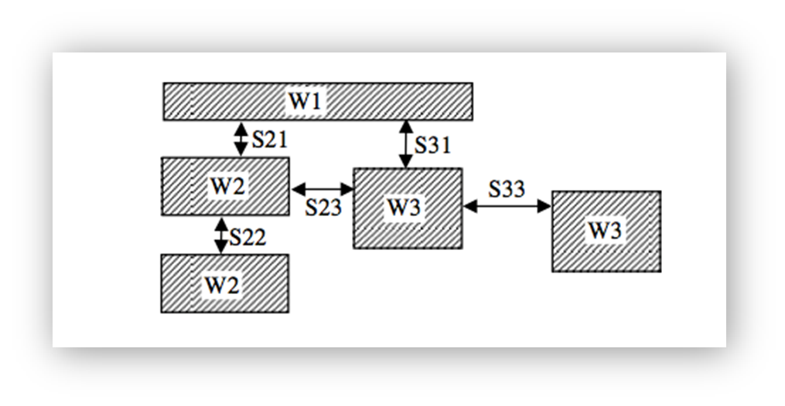
Minimum Spacing Rule
There is a required minimum spacing between any two metal edges.
The minimum spacing requirement depends on:
  The widths of the two adjacent metal objects.
  The parallel length between the two adjacent metal objects.
parallel lengths between adjacent metal objects

Slide 9
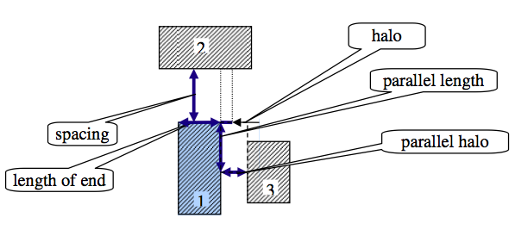
End of Line Rule
EOL spacing applied to objects 1 and 2:
  As object 3 overlaps the parallel length from the top of edge 1, EOL spacing between objects 1 and 2 will be required.
  Object 3 must remain outside the parallel halo.
2
3
1

Slide 10
Non-Default Routing (NDR) Rule
Non-default routing rules may specify:
  Increased wire spacing for a net
  Increased wire width for a net
  Increased via (cut) number at selected junctions
NDR may be assigned to a cell pin for wires
or vias connecting to it
NDR may or may not accompany increased pin width
or specific non-rectangular pins
NDRs are specified in the floorplan DEF file but
may be assigned to a pin in the cell LEF file

Slide 11
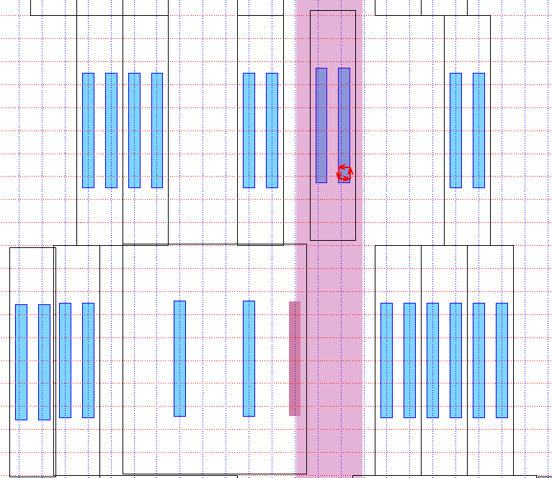
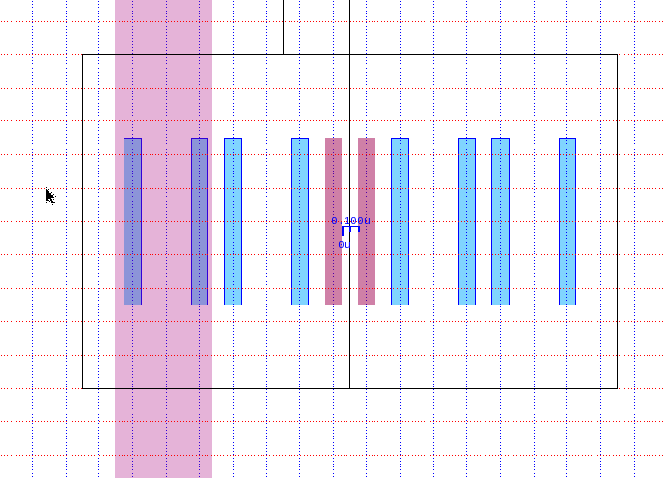
Blocked Pin Access Violation
A blocked pin cannot be reached
by a via or wire without violations.
Metal1 pins under metal2 stripe are not accessible by via1 vias
Metal2 pins with NDR assigned
are placed too close to each other
Metal2 pin overlaps metal2 stripe

Slide 12
3. Benchmarks

Slide 13
Industry standard data format
Inputs:
  Floorplan DEF with unplaced standard cells, net connectivity,
  fixed I/O pins and fixed macro locations, and routing geometry
  Cell LEF file detailing physical characteristics of the standard cells including pin locations and dimensions, macros, and I/Os
  Technology LEF file detailing design rules, routing layers, vias,
  and placement site types
  Flat Verilog gate-level netlist with cells, I/Os, & net connectivity
  (same netlist information as in floorplan DEF)
Outputs from contestant’s placement tool:
  Globally placed DEF with all standard cells placed
    No changes allowed in cell sizes or connectivity

Slide 14
Benchmark Suite A
5 designs adapted from ISPD 2013 gate-sizing contest provided by Intel
2 NDR and cell-utilization variants for each test case
Rectangular floorplans with no macros
10 benchmark designs (2 blind):
 |  |  |  | Standard Cell Area
Design | # Cells | # Nets | # I/Os | Utilization Variants
mgc_des_perf | 112,644 | 112,878 | 374 | 85%, 90%
mgc_edit_dist | 130,661 | 133,223 | 2,574 | 40%, 43%
mgc_fft | 32,281 | 33,307 | 3,010 | 50%, 83%
mgc_matrix_mult | 155,325 | 158,527 | 4,802 | 79%, 80%
mgc_pci_bridge_32 | 30,675 | 30,835 | 361 | 84%, 85%

Slide 15
Benchmark Suite A continued …
65nm cell library
Added representative sub-45nm design rules:
edge-type, min spacing, EOL, NDR, etc.
Pin-area utilizations per cell around 20%
Two test cases have L-shaped output pins on
8% of cells; one test case has them on 2% of cells
To increase routing difficulty:
  Cells were downsized to minimum area
  Output pin of one cell on M2 to check
  ability to prevent intersection with PG rail
  Only 3 or 4 routing layers available: M2, M3, M4, and M5
    Represents designs with fewer layers to reduce cost

Slide 16
Benchmark Suite B
5 designs adapted from the DAC 2012 routability-driven placement contest provided by IBM
Added 28nm design rules
Pin-area utilizations per cell from 2.7% to 3.1%
All pins rectangular (no L-shaped pins)
Cells were left at their original sizes
Routing layers were restricted to metal layers
M1, M2, M3, M4, M5, M6, and M7
  To increase routing difficulty M7 was not allowed
  on mgc_superblue12 and mgc_superblue19

Slide 17
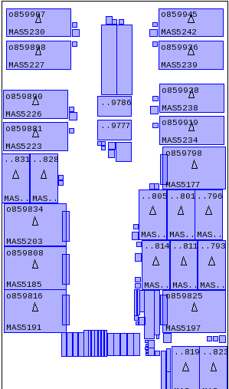
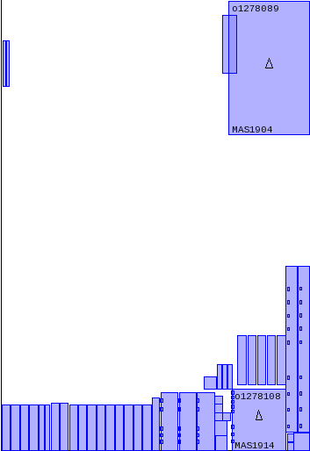
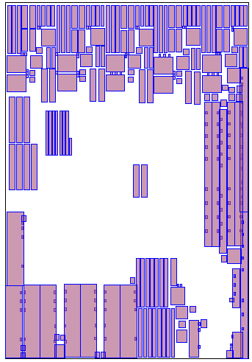
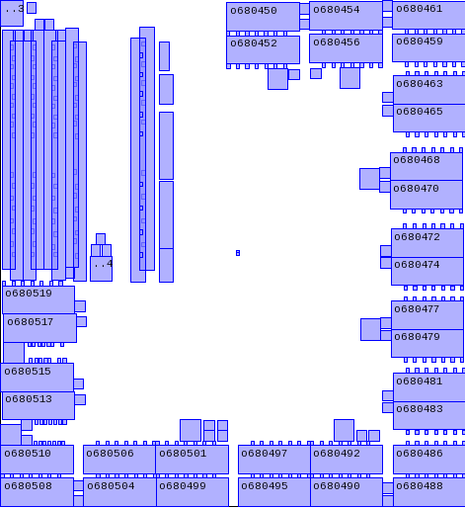
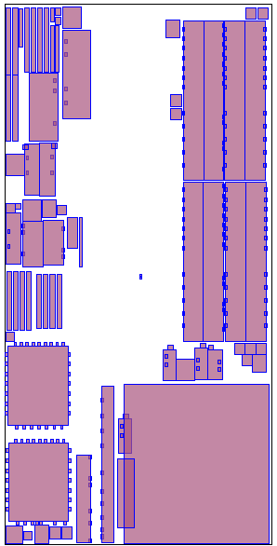
Benchmark Suite B continued …
5 test cases (2 blind):
 |  |  |  |  | Area Utilization
Design | # Macros | # Cells | # Nets | # I/Os | Std. Cells | Std. Cells + Macros
mgc_superblue11 | 1,458 | 925,616 | 935,731 | 27,371 | 43% | 73%
mgc_superblue12 | 89 | 1,286,948 | 1,293,436 | 5,908 | 44% | 57%
mgc_superblue14 | 340 | 612,243 | 619,697 | 21,078 | 55% | 77%
mgc_superblue16 | 419 | 680,450 | 697,458 | 17,498 | 47% | 74%
mgc_superblue19 | 286 | 506,097 | 511,606 | 15,422 | 52% | 81%
mgc_superblue11
mgc_superblue12
mgc_superblue14
mgc_superblue16
mgc_superblue19
Floorplans with macros (not to scale)

Slide 18
Power/Ground (PG) Mesh
Dense PG meshes have been inserted in all benchmarks adding to routing difficulty and increasing realism
Each routing layer has uniformly spaced PG rails
parallel to its preferred routing direction
Rail thickness is constant on each layer but varies by layer
PG routing-track utilization varies across layers and designs
Suite A metal layer | M1 | M2 | M3 | M4 | M5
PG routing track utilization | 11% | 6% | 27% | 24% | 30%
Suite B metal layer | M1 | M2 | M3 | M4 | M5 | M6 | M7
PG routing track utilization | 0% | 1% | 5% | 8% | 5% | 9% | 5%

Slide 19
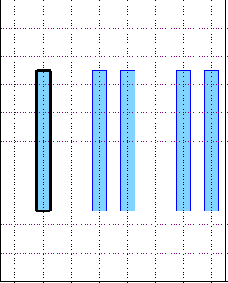
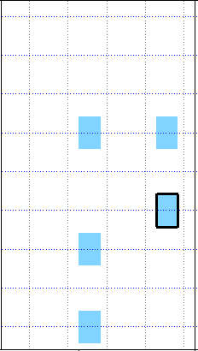
Standard Cell Libraries
Suite A:
65nm technology
Routing pitch 200nm
10 tracks per cell row
All standard cells are single-row high
Suite B:
28nm technology
routing pitch 100nm
9 tracks per cell row
All standard cells are single-row high
Routing pitch 200nm
Typical
Suite A
standard
cell
Routing pitch 100nm
Row height 2000nm
Pin height 1000nm
Row height 900nm
Pin height 84nm
Pin width 56nm
Typical Suite B
standard cell
Pin width 100nm

Slide 20
4. Placement submission
procedure

Slide 21
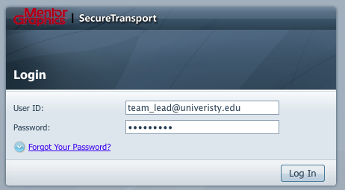
DEF Placement
Submission Procedure
Visit https://mst.mentorg.com/
Login with support-net account email and password

Slide 22
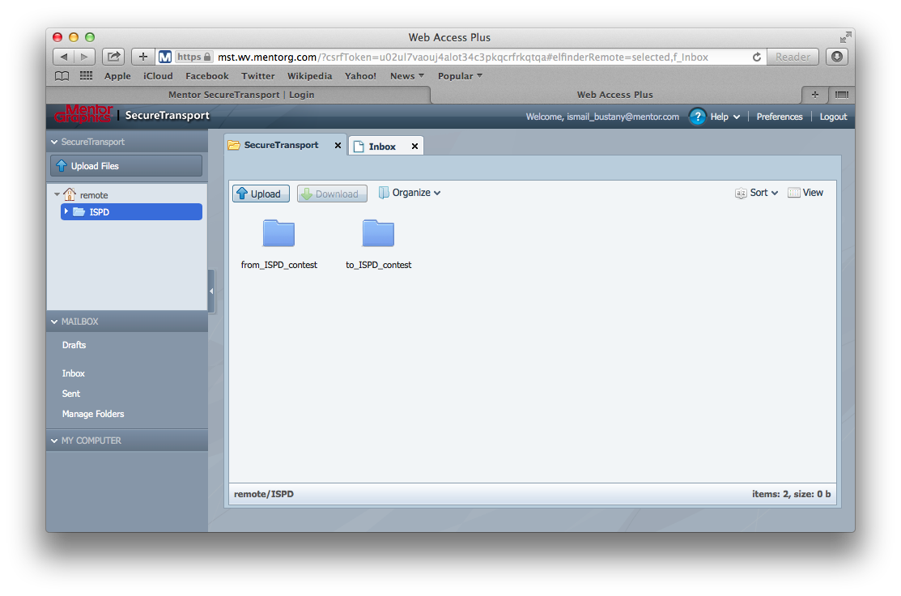
DEF Placement
Submission Procedure
Upload DEF placement
Retrieve results: placement legalization, global routing, detailed routing metrics and images
NOTE: Team accounts will remain active for research and comparative studies … still getting placement submissions this morning!

Slide 23
5. Evaluation

Slide 24
Final Placement Score
S = S_{DP} + S_{DR} + S_{WL} + S_{CPU}
Each of the following unscaled quantities contributes
to each scaled total score S for a test case:
DP : average legalization displacement in standard cell
row heights of 10% most displaced of all cells
DR : square root of the number of detailed-routing violations,
as routing and DRC violation counts vary significantly
WL : routed wirelength reported by detailed router
CPU : total run time for placement (team binary) +
legalization and routing (Olympus-SoCTM)
Simple affine scaling f_{aff} : [a,b] → [0,25]
is used for all categories except DR:
f_{aff} (t ) = 25(t – a)/(b – a), where a ≤ t ≤ b.

Slide 25
Placement Legalization
Olympus-SoCTM placement legalization fixed any of these issues in submitted design.def files:
Overlaps between cells or between cells and blockages
Cells not aligned on the standard cell rows
Cells with incorrect orientation
Cell pins that short to the PG mesh
Blocked cell pins that are inaccessible due to the PG mesh
DRC placement violations between standard cells
Significant legalization displacements are penalized (S_{DP} score).

Slide 26
Final Placement Score continued …
S = S_{DP} + S_{DR} + S_{WL} + S_{CPU}
WL and DR are normalized by the median unscaled scores
over all valid placements for the given design
A placement is invalid if any of the following occurs:
DP ≥ 25, CPU ≥ CPU_{max}, or GR ≥ GR_{max}.
  Global routing (GR) score is used only
  to terminate “hopeless” entries:
    Suite A: GR_{max}= 1.75%, CPU_{max}= 24 hrs
    Suite B: GR_{max}= 0.25%, CPU_{max}= 36 hrs for superblue12 & 19, 24 hrs for other benchmarks
  An invalid placement is assigned a total score of 50
A few changes to the originally announced scoring
were necessary for fairness and resource constraints:
  WL upper limit decreased from 5x to 1.5x the median
  GR edge-congestion limit to trigger early termination
  Failure penalty (maximum score) reduced from 100 to 50

Slide 27
6. Results

Slide 28
Participation statistics
18 initial registrations:
  Asia: China, Hong Kong, Taiwan
  Europe: Germany
  North America: Canada, USA
  South America: Brazil
9 final binary submissions (2 could not be evaluated):
  Team 1: National Chiao Tung University - Taiwan
  Team 3: National Central University - China
  Team 5: National Taiwan University - Taiwan
  Team 8: National Taiwan University - Taiwan
  Team 9: Chinese Univ. of Hong Kong - Hong Kong
  Team 10: University of Waterloo/University of Calgary - Canada
  Team 16: Tshinghua University - China
  Team 17: University of Texas at Austin - USA
  Team 18: University of Michigan - USA

Slide 29


The Prize! ☺
The allotment of the prize money is split between a default prize value and an additional (optional) prize for providing source code to foster an academic infrastructure for research. For instance, the first prize would total $3000 if the source code is made openly available for academic research.
Rank | Default Prize | Additional Open-Source Prize | Total Prize
1st | $1000 | $2000 | $3000
2nd | $750 | $1500 | $2250
3rd | $500 | $1000 | $1500

Slide 30
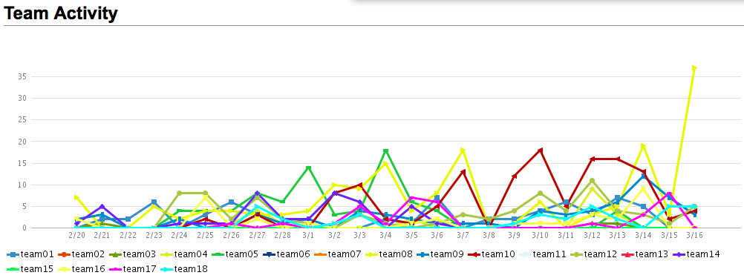
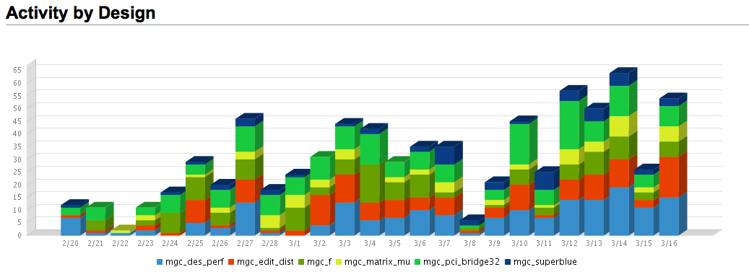
Teams’ Activity During Contest

Slide 31
Rankings During the Contest
http://ispd.cc/contests/14/ispd2014_contest.html

Slide 32
On to Final Rankings …

Slide 33
Relative DR Scores
– Smaller is Better!
DR scores only for designs that
made it through detailed routing!

Slide 34
Relative DR Scores
– Top Five Teams …

Slide 35
Relative Total Scores
– Smaller is Better!

Slide 36
Relative Total Scores
– Top Five Teams …

Slide 37
Relative Total Scores
– Top Three Teams …

Slide 38
Relative Total Scores
– Top Two Teams …
Seg fault!
0.33% GR edge violations >
0.25% threshold!
Team01 beat Team10 on 11 benchmarks!
Team10 had only 0.02% GR edge violations on superblue12!
Team10 beat Team01 on 4 benchmarks!

Slide 39
Final Rankings!
Very competitive results with significant improvements as the contest progressed. Congratulations to all teams.
Each of the top five teams had at least one benchmark with better detailed routing (DR) score than all other teams!
Equal 1st: Team 1 & Team 10
3rd: Team 9
4th: Team 8
5th: Team 17
Equal 6th: Team 3 & Team 16
Team | Number of Unroutable Designs | Number of Designs with Best DR Score
Team 1 | 2 | 5
Team 3 | 11 | 0
Team 8 | 5 | 2
Team 9 | 2 | 4
Team 10 | 0 | 2
Team 16 | 11 | 0
Team 17 | 6 | 1

Slide 40
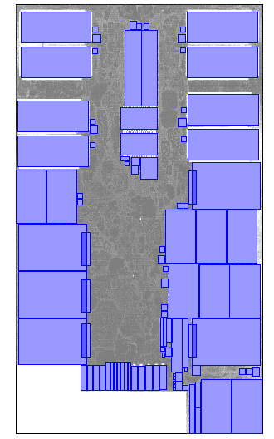
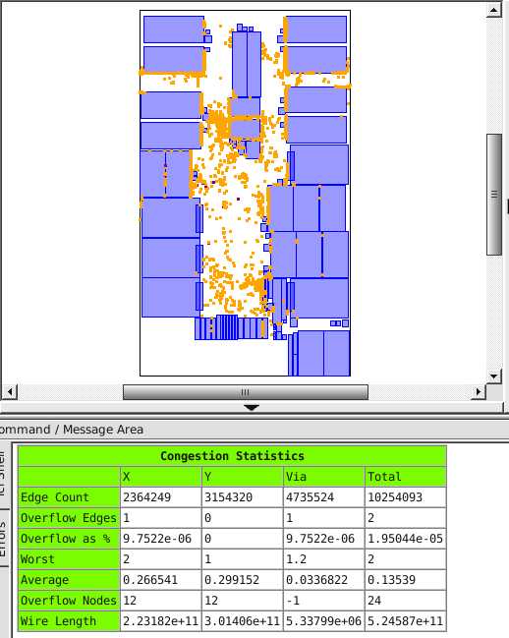
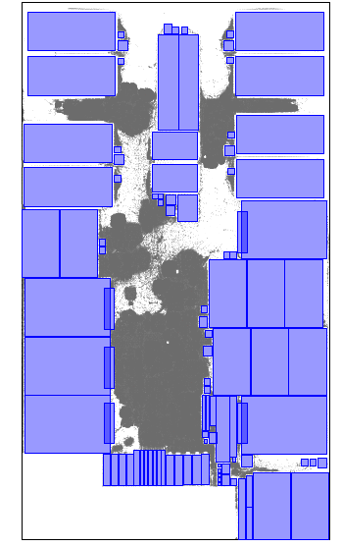
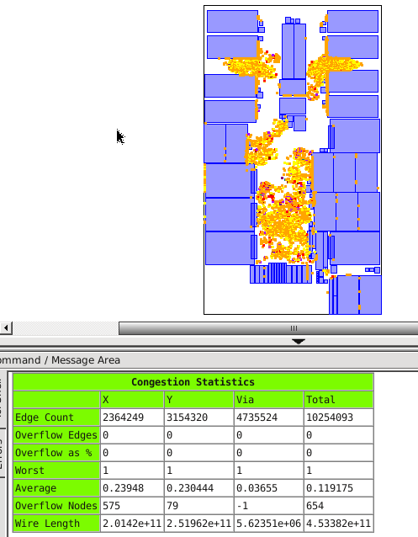
Issues for future contests
Cell spreading is needed for timing optimization,
as cell sizing and buffering will increase area usage
mgc_superblue11 placement and GR congestion
significantly
worse routing
congestion
with 90% max utilization, total detail routed wire length 53.6m
with 95% max utilization, total detail routed wire length 46.3m

Slide 41
7. Acknowledgements

Slide 42
Acknowledgements
Many thanks to the following colleagues for valuable insights and help
(in alphabetical order):
  Chuck Alpert
  Yao-Wen Chang
  Wing-Kai Chow
  Chris Chu
  Azadeh Davoodi
  Andrew B. Kahng
  Shankar Krishnamoorthy
  Rajan Lakshmanan
  Igor L. Markov
Professor Evangeline Young and her student Wing-Kai Chow generously provided their RippleDP detailed placer to the contest.
Dr. Wen-Hao Liu generously provided his NCTUgr global router to the contest.
Special thanks to the IEEE/CEDA for sponsoring the contest
and to Professor Yao-Wen Chang for lobbying for our support.
  Alexandre Matveev
  Mustafa Ozdal
  Cliff Sze
  Prashant Varshney
  Natarajan Viswanathan
  Alexander Volkov
  Benny Winefeld
  Evangeline Young

Slide 43
Contest Organizers
Mentor Graphics Corporation
Ismail Bustany – contest chair
Vladimir Yutsis
David Chinnery
Joseph Shinnerl
John Jones
Igor Gambarin
Clive Ellis
National Tsing Hua University
Wen-Hao Liu

Slide 44
Backup slides

Slide 45
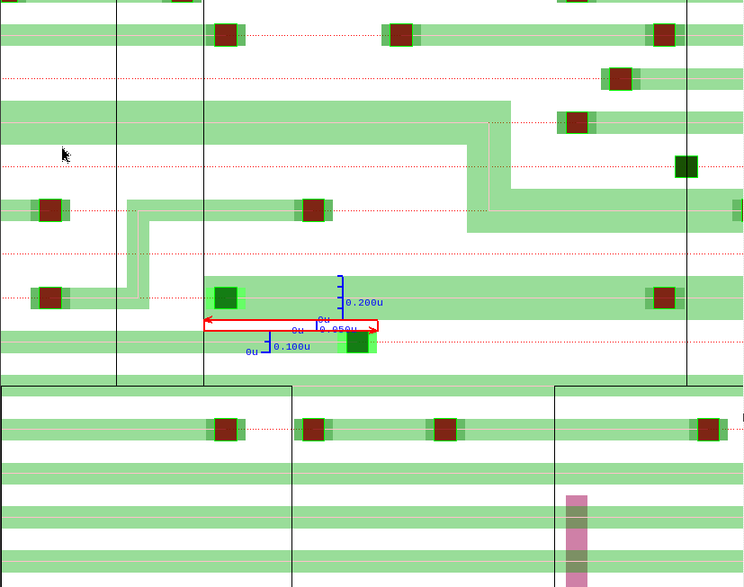
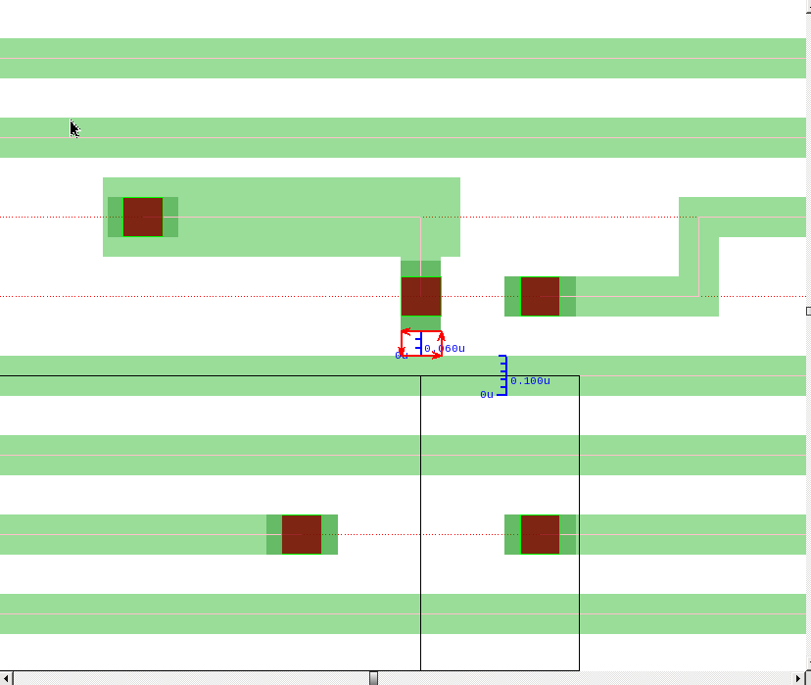
Min Spacing and End-Of-Line
Spacing Violation Examples
Example minimum spacing and EOL spacing violations between routing objects in congested areas. Many such violations are in the vicinity of pins assigned an NDR rule.

Slide 46
Standard Cell Libraries
Suite A:
65nm technology
Routing pitch 200nm
10 tracks per cell row
All standard cells are single-row high
Suite B:
28nm technology
routing pitch 100nm
9 tracks per cell row
All standard cells are single-row high
Routing pitch 200nm
Typical
Suite A
standard
cell
Routing pitch 100nm
Row height 2000nm
Pin height 1000nm
Row height 900nm
Pin height 84nm
Pin width 56nm
Typical Suite B
standard cell
Pin width 100nm

Slide 47
Common Design Rules in
Physical LEF Data for Suite A
Most cell pins are located on metal1 layer,
and are 0.5 pitches wide and 5 pitches high.
NDR with double wire width and double wire spacing
assigned to all nets with fanout > 10.
Standard cell ms00f80: driving pin is promoted to metal2 layer to check ability of placement to prevent intersection with PG rails.
Standard cell ao22s01: output pin near edge on metal1, but has edge-type constraint with 2x spacing (0.2um).

Slide 48
Design Rules Variants in Physical LEF Data for Suite A
Standard cell oa22f01: Promoted output pin “o” to metal2 and imposed 2x width, 2x spacing, 2-cut vias EM_NDR.
This restriction should be observed within 1.0 um (i.e. 5 pitches) of the output pin, afterwards it is switched to the default rule.
There are two variants of this rule:
    Double width (0.2um) for pin “o” and edge-type
    spacing 0.2um assigned to edge next to pin “o”,
    with EM_NDR double wire width and double wire spacing.
    Single-width L-shaped pin for “o”.

Slide 49
Physical LEF Data Scenarios for Suite A
  Based upon the design rules variants mentioned in the previous slide, there are three scenarios of physical LEF data provided in this benchmark:
  Scenario 1: cell.lef contains rules 1-4.
  Scenario 2: cell.lef contains rules 1-4 and rule 5.I.
  Scenario 3: cell.lef contains rules 1-4 and rule 5.II.

