Slide 1
Design Synthesis and Optimization for Automotive Embedded Systems
Qi Zhu
University of California, Riverside
ISPD 2014
April 2, 2014
Notes:
Synthesis is more on the software side

Slide 2
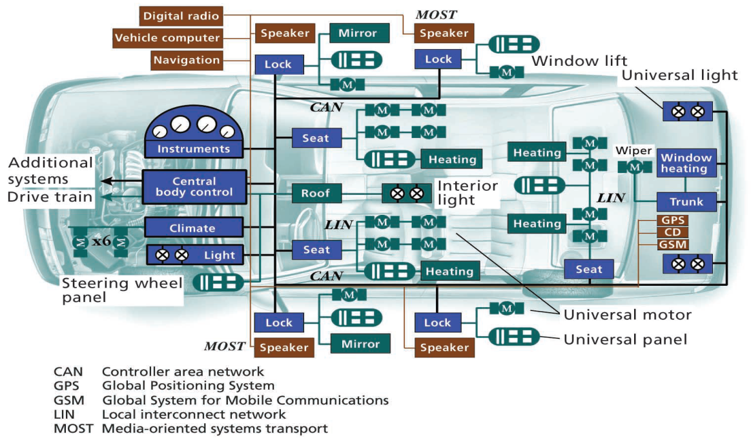
More Intelligent Vehicles – Active and Passive Safety
by Leen and Effernan – IEEE Computer
Notes:
Trend: more intelligent, from passive safety to active safety
This is being driven by the advancement of the automotive embeddedsystems

Slide 3
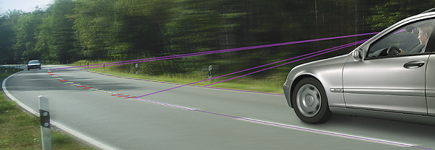
Active Safety Example – Lane Departure Warning (LDW)
LDW wil warn the driver if he or she is on the verge of inadvertently drifting out of the lane. Using a CMOS Camera and an image processing algorithm, this driver assistance system registers the course of the lane in relation to the vehicle. The system "sees", as it were, the course of the road and where the car is going. If the warning algorithm detects an imminent leaving of the current driving lane, the system warns the driver with haptic, kinestatic, or acoustical feedback. Possible warning alerts can be a trembling in the steering wheel, a vibrating seat or a virtual washboard sound. Production from 2005.
(Source: Continental website)

Slide 4
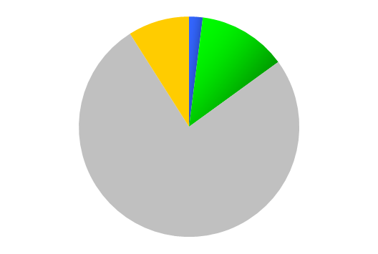
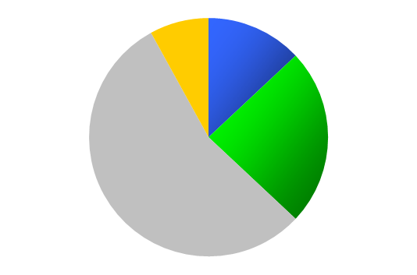
Challenges in Automotive: Electronics and Software Shifting the Basis of Competition
100M Lines of Code (+9900%)
Fuel Cell
More electronics and software
More distributed, more contention
90% of all future innovations will be on electronics systems
~
Wheel Motor
~
…
Hybrid PT
Electric Brake
Software $
2%
ACC
DoD
…
Value from Electronics & Software
Other $
Electronics $
13%
Software $
$1182 (+196%)
Other $
9%
OnStar
Rear Vision
GDI
8%
13%
BCM
OBD II
Passive Entry
50 ECUs (+150%)
…
EI
ABS
HI Spd Data
Side Airbags
Electronics $
24%
...
TCC
Rear aud/vid
Head Airbags
…
…
Mechanical $
76%
Mechanical $
$400
20 ECUs
…
55%
EGR
CDs
1M LOC
Electric Fan
…
1970s
1980s
1990s
AVG.
2000s
AVG.
2010s
2020s
ABS: Antilock Brake System
ACC: Adaptive Cruise Control
BCM: Body Control Module
DoD: Displacement On Demand
ECS: Electronics, Controls, and Software
EGR: Exhaust Gas Recirculation.
GDI: Gas Direct Injection
OBD: Onboard Diagnostics
TCC: Torque Converter Clutch
PT: Powertrain
Vehicle Integration
System Connection
Subsystem Controls & Features
Forefront of Innovation

Slide 5
More Distributed System, More Sharing Among Functions
Post-2014
function17
function16
function15
function14
to 2012/14
function13
function12
function11
function10
to 2010/12
function9
function8
function7
function6
function5
Pre-2004
ACC
Stabilitrak 2
Onstar emergency notification
Speed-dependant volume
Subsystem
Brake
HVAC
Body
Steering
Suspension
Object detection
Environment sensing
Infotainment
Occupant
protection
Exterior lighting
Occupant Information
Engine
Transmiss.
Telematics
Courtesy: GM Research

Slide 6
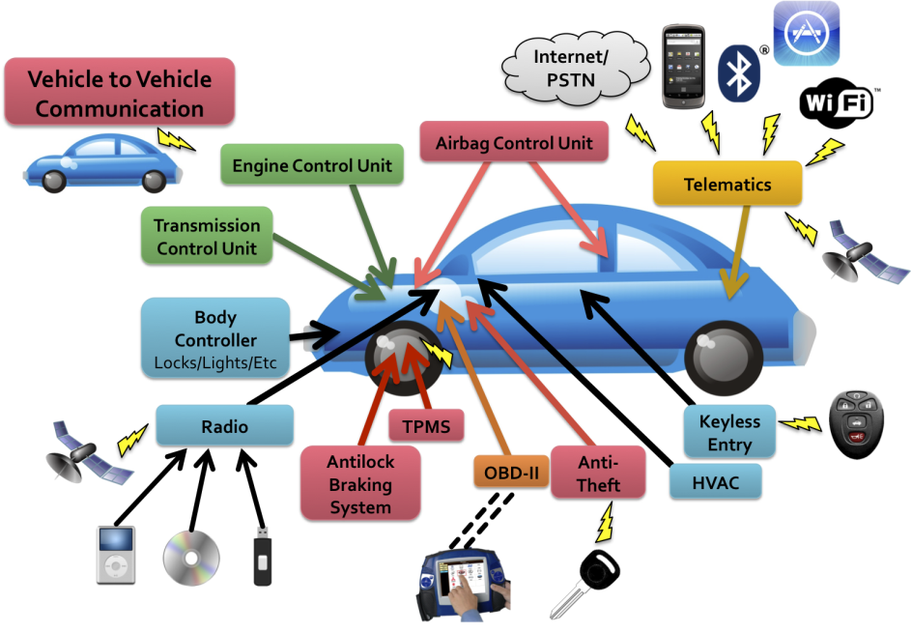
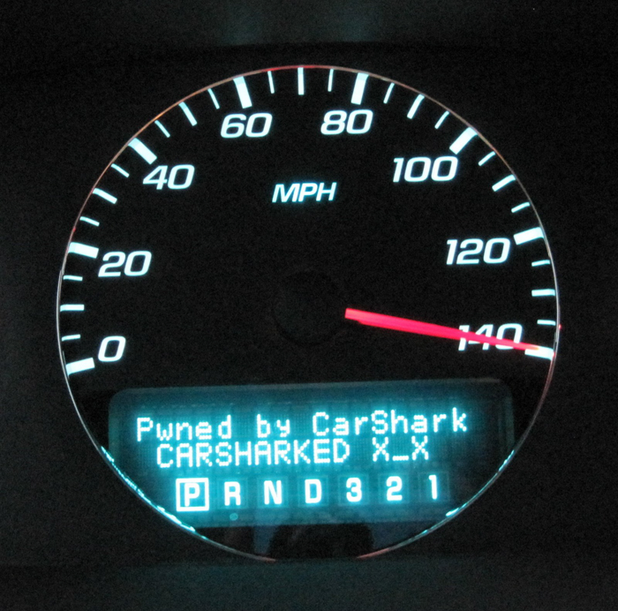
Automotive Security

Slide 7
Challenges in Automotive: Methodologies and Tools
More problems in vehicle electronic systems:
  50% of warranty costs related to electronics and software.
  Recalls related to electronic systems tripled in past 30 years.
  Hard to diagnose: more than 50% of the ECUs replaced are technically error free.
Methodologies and tools are needed for
  Modeling, analyzing and verifying complex system behavior with formal models.
  Synthesizing models to implementation while maintaining functional correctness and optimizing non-functional metrics such as performance, reliability, cost, security, energy, extensibility.
  Addressing multicore and distributed platforms.
Notes:
What these trends lead to … more problems and need of more methodologies and tools

Slide 8
AUTOSAR Architecture
SW-C Description
SW-C Description
SW-C Description
SW-C Description
AUTOSAR SW-C 1
AUTOSAR SW-C 2
AUTOSAR SW-C 3
AUTOSAR SW-C n
Virtual Functional Bus
System Constraint Description
ECU Descriptions
Deployment tools
ECU1
ECU2
ECU3
AUTOSAR SW-C 1
AUTOSAR SW-C 2
AUTOSAR SW-C 3
AUTOSAR SW-C n
RTE
RTE
RTE
Basic Software
Basic Software
Basic Software
Gateway
Notes:
Automotive community has been trying to address such challenges.
AUTOSAR (AUTomotive Open System ARchitecture) is an open and standardized automotive software architecture, jointly developed by automobile manufacturers, suppliers and tool developers.

Slide 9






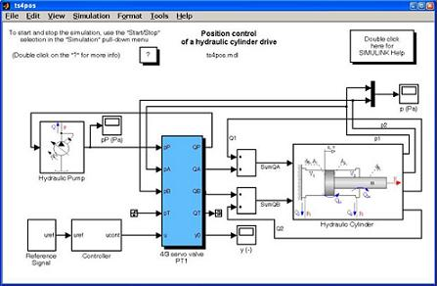
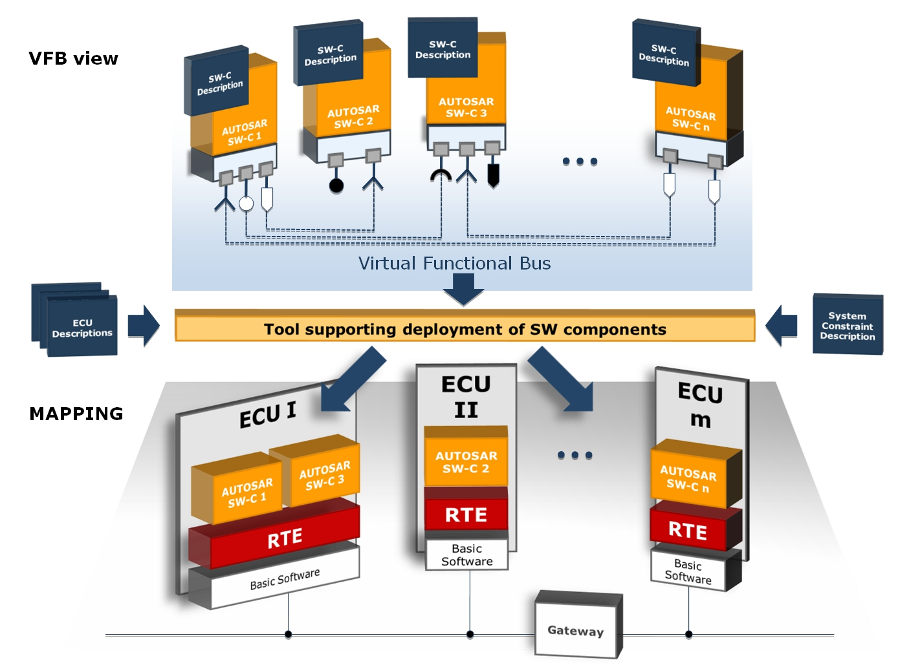

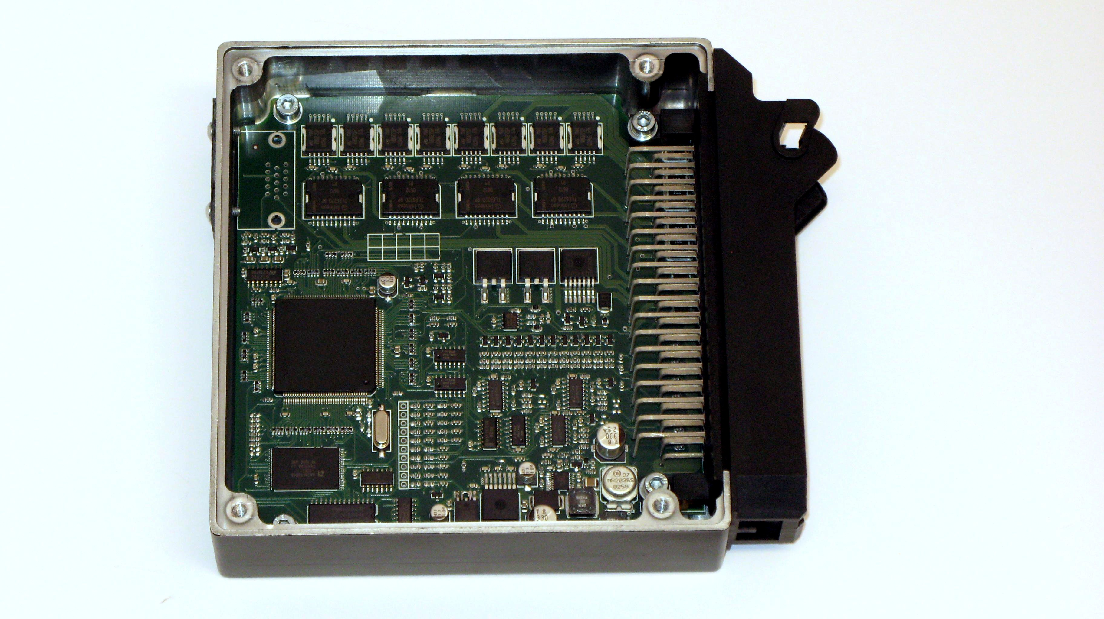
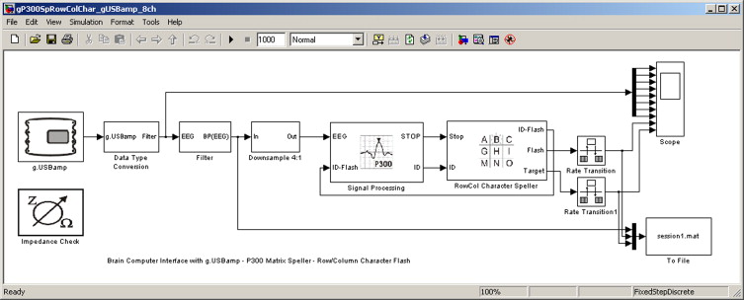

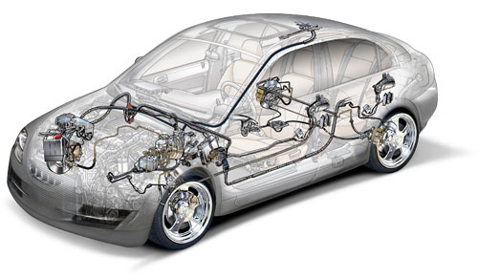
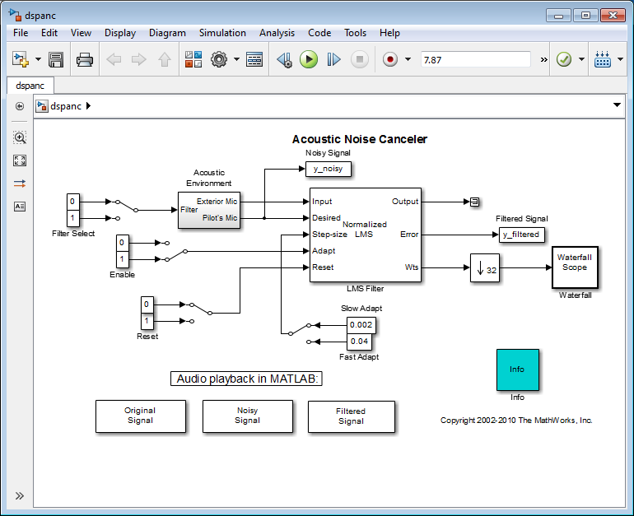
Typical Automotive Supply Chain
From functional models to runnable (code) implementations, to task models deployed onto architecture platform.
Suppliers
AUTOSAR component
protecting IP
OEMs
Task code
SR (Simulink) models
(courtesy: Fabio Cremona)
Notes:
Separation of concerns also dictated by the supply chain model:…

Slide 10
Functional model
Input interface
Output interface
s₁
s₂
s₄
signal
f₁
f₂
f₃
f₄
period
is_trigger
precedence
Functional model
s₃
function
period
activation mode
Jitter constraint
s₅
f₅
f₆
deadline
Notes:
Technically, what is the problem here:

Slide 11
Architecture model
s₁
s₂
s₄
f₁
f₂
f₃
f₄
Functional model
s₃
s₅
f₅
f₆
ECU₁
ECU₂
ECU₃
Architecture model
OSEK₁
bus
CAN₁
speed (b/s)
ECU
clk speed (Mhz)
register width

Slide 12
Mapping
s₁
s₂
s₄
f₁
f₂
f₃
f₄
Functional model
s₃
s₅
f₅
f₆
Software tasks model
task₁
SR₁
task₂
msg₁
task₃
task₄
task
msg₂
message
period
priority
WCET
activ.mode
resource
CANId
period
length
transm. mode
is_trigger
WCBT
ECU₁
ECU₂
ECU₃
Architecture model
OSEK₁
CAN₁

Slide 13
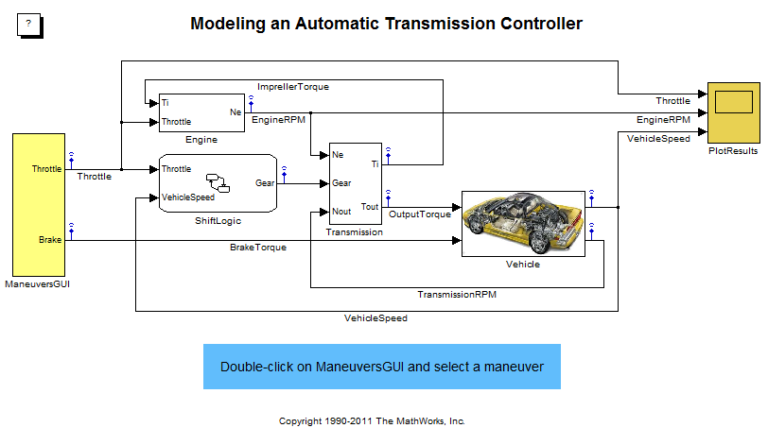






Model-Based Design and Synthesis
Functional Model
Task gen.
Software Tasks Model
$$τ_{2}$$
$$τ_{3}$$
$$τ_{1}$$
$$τ_{4}$$
$$τ_{5}$$
$$τ_{6}$$
Task mapping
Architecture Model
CPU 1
CPU 2
…
CPU k

Slide 14
Automotive Design Requirements
Primary | Secondary | What is captured | Metrics unit
Performance/ Time | End-to-end latency | time distance between two events (related to stability and performance) | milliseconds
 | Jitter | maximum delay of a periodic signal with respect to ideal reference | milliseconds, or % of period,
 | Input coherency | time distance between two events/samples from multiple sensors observing the same object/phenomenon | milliseconds
Dependability | Reliability | expectation on failure, related to warranty cost impact | expected time between failures MTTF or fault rate (number of faults per hour)
 | Availability | percentage of uptime | MTTF/(MTTF+MTTR)
 | Safety | which faults can be tolerated and which cannot. Related to fault tolerance, fail safe vs fail operational | number of components/cutset that must fail for the system to fail
 | Extensibility | room for functional additions (e.g. Complement to resource utilization) | fraction of resource utilization available for future use
Cost
 | Piece cost (life cycle cost) |  | $
 | Degree of Reuse | ability to design/deploy using preexisting solutions, (SW or HW components, schedules and configurations) | number of units deployed
 | Scalability | suitability for a range of content level (while cost-effective) | number of programs or product lines

Slide 15
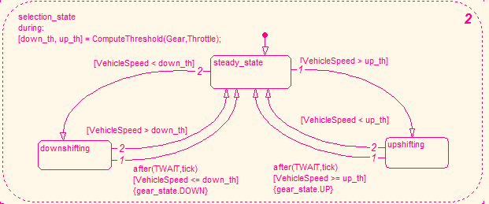
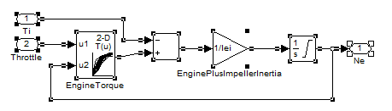
Task Generation from Functional Model
Synchronous Reactive Semantics
Stateflow (FSMs) block
Dataflow block

Slide 16








Multi-task Generation of Synchronous Finite State Machines
1
e₁: 2ms
S₁
$θ$₁ : e₁ / a₁
0.25ms
S₂
e₁: 2ms
S₁
e₂: 5ms
$θ$₁ : e₁ / a₁
S₃
0.25ms
$θ$₃ : e₁ / a₃
0.3ms
$θ$₂ : e₂ / a₂
$θ$₄ : e₂ / a₄
0.2ms
S₂
0.5ms
2
e₂: 5ms
2
S₁
1
S₃
$θ$₃ : e₁ / a₃
$θ$₂ : e₂ / a₂
0.3ms
$θ$₄ : e₂ / a₄
0.2ms
S₂
0.5ms
(a) Single task implementation
S₃
Task Period: 1ms
(b) Multi-task implementation
Task Period: 2ms, 5ms

Slide 17
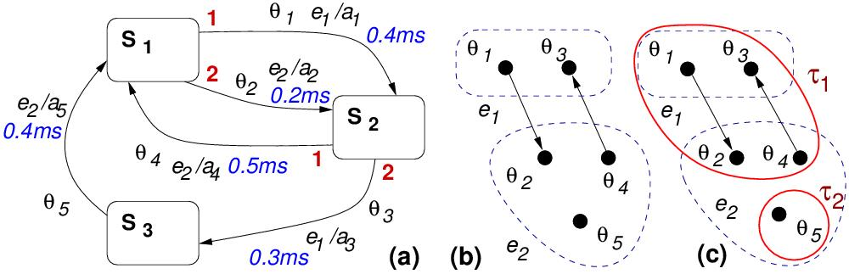
Multi-task Generation of FSMs
4-cycle conflicts
(a) Original FSM
(b) Partitioned model based on events
(c) Mixed-Partitioned model

Slide 18
















General Partitioned Model
e₁: 2ms
S₁
1
e₂: 3ms
$θ$₁ : e₁ / a₁
2
$θ$₂ : e₂ / a₂
0.4ms
Partition is valid as long as there are no cycles
0.2ms
$θ$₅ : e₂ / a₅
$θ$₄ : e₂ / a₄
S₂
0.4ms
0.5ms
1
2
S₃
$θ$₃ : e₁ / a₃
0.3ms
$$θ_{1}$$
$$θ_{1}$$
$$θ_{2}$$
…
$$θ_{1}$$
$$θ_{3}$$
T₁: 1ms
$$θ_{2}$$
T₁: 1ms
T₁: 2ms
$$θ_{3}$$
$$θ_{3}$$
$$θ_{2}$$
$$θ_{4}$$
$$θ_{4}$$
$$θ_{4}$$
$$θ_{5}$$
$$θ_{5}$$
$$θ_{5}$$
T₂: 1ms
T₂: 3ms
T₂: 1ms

Slide 19
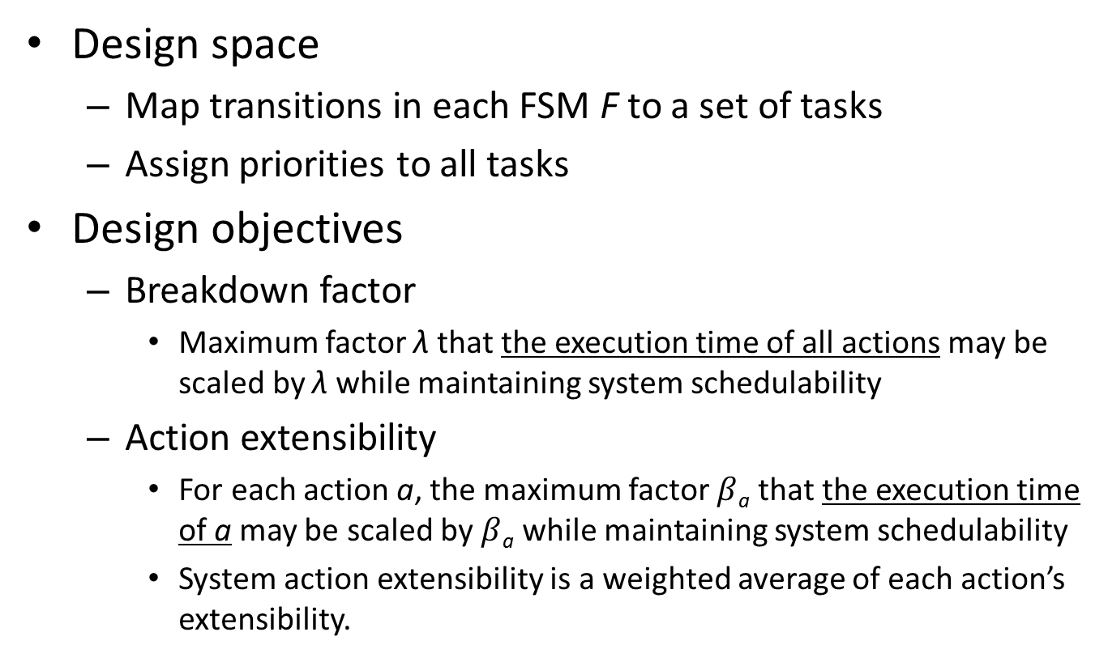
FSM Task Implementation Optimization
Design space
  Map transitions in each FSM F to a set of tasks
  Assign priorities to all tasks
Design objectives
  Breakdown factor
    Maximum factor λ that the execution time of all actions may be scaled by λ while maintaining system schedulability
  Action extensibility
    For each action a, the maximum factor $β$_{a} that the execution time of a may be scaled by $β$_{a} while maintaining system schedulability
    System action extensibility is a weighted average of each action’s extensibility.
[ Qi Zhu, Peng Deng, Marco Di Natale and Haibo Zeng, “Robust and Extensible Task Implementations of Synchronous Finite State Machines”, DATE 2013. ]

Slide 20
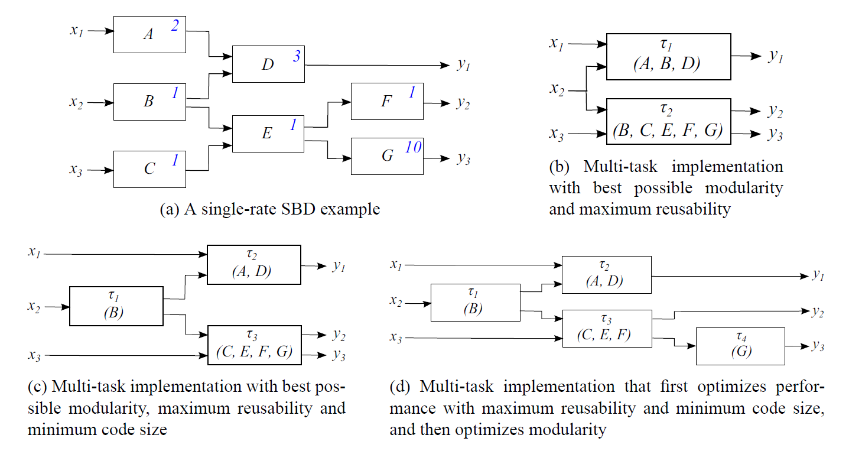
Task Generation of Macro Dataflow Blocks (Synchronous Block Diagram)

Slide 21
System-level Mapping for Distributed Automotive Embedded Systems
Functional Model
Architectural Model
IR
Sensor
ECU₁
ECU₂
BUS₁
Wheel
Sensor
Fusion
Task
Object
ID Task
Brake
Actuator
BUS₂
Nav.
Task
ECU₃
ECU₄
Signals
Objectives and
Constraints
Mapping
- Allocation
Signal to Message
Priority
Period
……
Design Space Exploration
- Latency
Utilization
……
Modeling

Slide 22
Model-Based Design and Synthesis
Functional Model
Task gen.
Software Tasks Model
$$τ_{2}$$
$$τ_{3}$$
$$τ_{1}$$
$$τ_{4}$$
$$τ_{5}$$
$$τ_{6}$$
Task mapping
Architecture Model
CPU 1
CPU 2
…
CPU k

Slide 23
Task Mapping onto Distributed Platform
Address metrics: end-to-end latency and system extensibility.
Based on mathematical programming and heuristics.
Challenges: formulation and efficiency.
Focus on analytical worst case analysis for CAN-based systems with periodic tasks and messages.
Problems | 1: Allocation & Priority Assignment | 2: Period Assignment | 3: Extensibility Optimization
Design Variables | Allocation, Priority, Signal Mapping | Period | Allocation, Priority, Signal Mapping
Objective | Latency | Latency | Extensibility
Approach | Mixed integer linear programming (MILP) | Geometric programming (GP) | MILP & Heuristic

Slide 24
Task Allocation and Priority Assignment
300ms
10ms
20ms
40ms
40ms
40ms
T1
T2
T3
1
S1
1
S4
Function
Model
20ms
1
40ms
20ms
S2
20ms
100ms
S5
T4
20ms
T5
3
T6
2
S3
2
M2
2
1
20ms
20ms
Task to ECU
Signal packing
Message to bus
Priority
M1
T7
S6
3
2
M3
ECU1
ECU2
ECU3
Architecture
Model
BUS1
BUS2

Slide 25
Two-step Algorithm Flow
Constraints:
End-to-end latency on given paths
Utilization bound on ECUs and buses
Objective:
Sum of latencies on given paths
Design inputs:
Task worst case execution times
Signal lengths
Task and signal periods
Architecture topology, bus speeds
Step1:
Assign task allocation
(using MILP)
Heuristic:
Task and signal priorities
Step2:
Assign signal packing, task and message priorities
(using MILP)
[Wei Zheng, Qi Zhu, Marco Di Natale and Alberto Sangiovanni-Vincentelli, “Definition of Task Allocation and Priority Assignment in Hard Real-Time Distributed Systems”, RTSS 2007. ]
[Qi Zhu, Haibo Zeng, Wei Zheng, Marco Di Natale and Alberto Sangiovanni-Vincentelli, “Optimization of Task Allocation and Priority Assignment in Hard Real-Time Distributed Systems”, ACM TECS, 2012]

Slide 26
Security-Aware Task Mapping for CAN-based Distributed Systems
When retrofitting CAN architectures with security mechanisms, MACs (message authentication codes) may be added to CAN messages to protect against masquerade and replay attacks.
However, adding MAC bits to a design may not lead to optimal or even feasible systems due to limited CAN message sizes and timing constraints.
In this work, we designed an optimal MILP formulation and a heuristic for optimizing task allocation, signal packing, MAC key sharing, and priority assignment, while meeting both the end-to-end latency constraints and security constraints.
[Chung-Wei Lin, Qi Zhu, Calvin Phung, Alberto Sangiovanni-Vincentelli, “Security-Aware Mapping for CAN-Based Real-Time Distributed Automotive Systems”, ICCAD 2013]

Slide 27
Summary
Model-based synthesis for automotive embedded systems
  Functional model with different semantics: FSMs, dataflow, heterogeneous and hierarchical models.
  Multicore and distributed architecture platform.
  Task generation and task mapping need to be addressed in a holistic framework.
    Functional correctness (affected by timing).
    Other non-functional requirements on performance, reliability, power, thermal, security, extensibility, etc.

Slide 28
Problem 1: Allocation & Priority Assignment
300ms
10ms
20ms
40ms
40ms
40ms
T1
T2
T3
1
S1
1
S4
Function
Model
20ms
1
40ms
20ms
S2
20ms
100ms
S5
T4
20ms
T5
3
T6
2
S3
2
M2
2
1
20ms
20ms
Task to ECU
Signal packing
Message to bus
Priority
M1
T7
S6
3
2
M3
ECU1
ECU2
ECU3
Architecture
Model
BUS1
BUS2

Slide 29
Experimental Results
Active safety application in GM experimental vehicle.
Function Model
41 Tasks
83 Signals
171 paths with 100ms to 300ms deadlines
Using MILP based synthesis
(single-bus option)
Initial: total latency > 24000 ms, do not satisfy E2E latency constraints.
After Step1: total latency = 12295 ms, satisfy all constraints.
After Step2: total latency = 4928 ms.
Mapping
ECU1
ECU2
...
ECU20
ECU21
...
Architecture Model
9 ECUs
single-bus or dual-bus
...
ECU61
ECU62
...

Slide 30
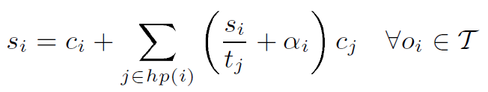
Problem 2: Period Assignment
Design variables are task and message periods.
Allocation and priorities of tasks and messages are given.
Utilization and end-to-end latency constraints.
Task worst case response time:
Approximate the
ceiling function
Geometric Programming

Slide 31
Iterative Algorithm Flow
Iteratively change α_{i}
Parameters
  maxIt – max. # iterations
  errLim – max. permissible relative error between r and s
Start
all α_{i} = 1;
ItCount = 0;
ItCount++;
(s, t) = GP(α);
Calculate r;
e_{i} = (s_{i} – r_{i})/r_{i};
max(|e_{i}|) < errLim
OR
ItCount > maxIt
(GP)
s
α = 1
No
α_{i} = α_{i} - e_{i}
r
(Fixpoint)
Yes
t
End

Slide 32
Experimental Results
GP optimization meets all deadlines in 1st iteration
Solution time: 24s
Maximum error reduced from 58% to 0.56% in 15 iterations
Average error reduced from 6.98% to 0.009%
[Abhijit Davare, Qi Zhu, Marco Di Natale, Claudio Pinello, Sri Kanajan and Alberto Sangiovanni-Vincentelli, “Period Optimization for Hard Real-time Distributed Automotive Systems”, DAC 2007. ]

Slide 33


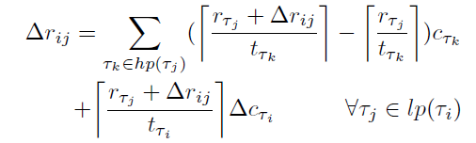
Problem 3: Extensibility Optimization
Extensibility metric: function of how much the execution time of tasks can be increased without violating constraints.
Same design variables as in allocation & priority assignment. Constraints on utilization and end-to-end latency.
Utilization constraints (linear):
Latency constraints (non-linear):

Slide 34
MILP and Heuristic Hybrid Algorithm
Initial Task and Signal Priority (heuristics)
Initial Task Allocation
(MILP approximation)
one signal per msg
utilization constr.
latency constr. w/o extensibility factor
Signal Packing and Message Allocation
(weight-based heuristic)
Task Re-allocation
(greedy heuristic w/ incremental changes)
Task and Message Priority Assignment
(iterative heuristic)
Reach Stop Condition?
No
Yes
End

Slide 35
Experimental Results
Parameter K to trade off between extensibility and latency.
manual
K=0
K=0.1
K=0.5
K=0.2
[Qi Zhu, Yang Yang, Eelco Scholte, Marco Di Natale and Alberto Sangiovanni-Vincentelli, “Optimizing Extensibility in Hard Real-Time Distributed Systems," RTAS 2009.]
[Qi Zhu, Yang Yang, Marco Di Natale, Eelco Scholte and Alberto Sangiovanni-Vincentelli, “Optimizing the Software Architecture for Extensibility in Hard Real-Time Distributed Systems“, IEEE TII, 2010.]

Slide 36
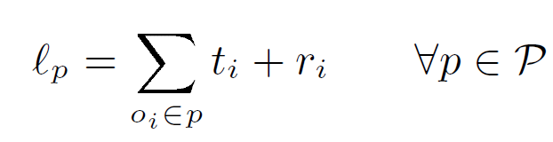
End-to-End Latency
R₁
R₂
R₃
o₁
o₂
o₃
t₁
…
t₂
…
t₃
…
t₁
r₁
o₁
t₂
r₂
o₂
t₃
r₃
o₃
End-to-End Latency
For each object in the path, add
  Period (t_{i})
  Worst case response time (r_{i})

Slide 37
Task Worst Case Response Time
Tasks: periodic activation and preemptive execution.
Interference from higher priority tasks on the same ECU
o_{i}
Period (t_{i})
Response Time (r_{i})
Computation time
Interference time

Slide 38





Task Worst Case Response Time Formulation
Task i and j need to be one the same ECU k.
Task j needs to have higher priority than i.

