Slide 1
2014 ISPD Lifetime Achievement Award:
Dr. Bryan Preas

Slide 2
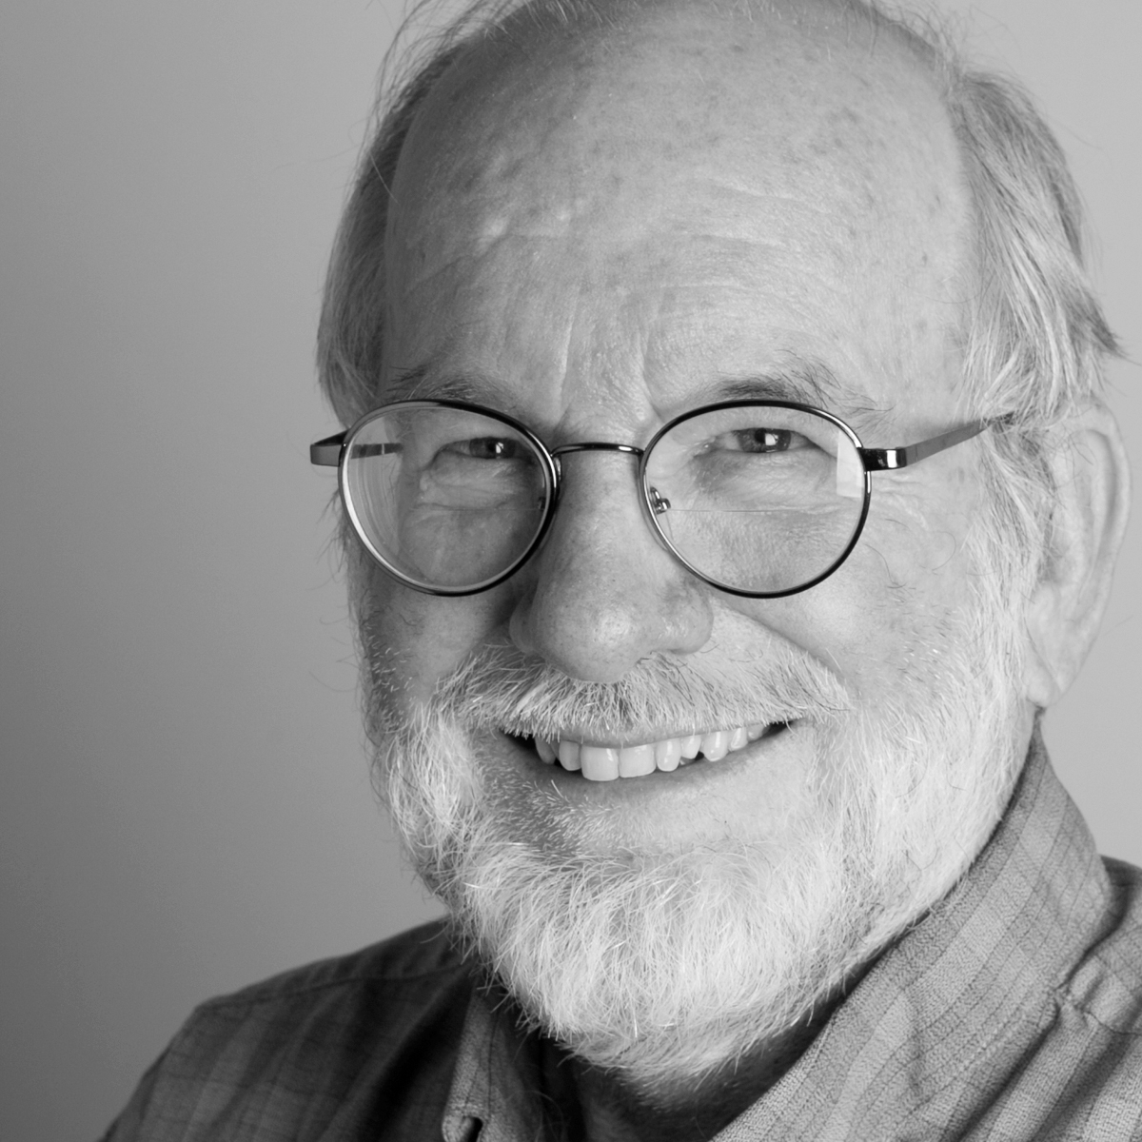
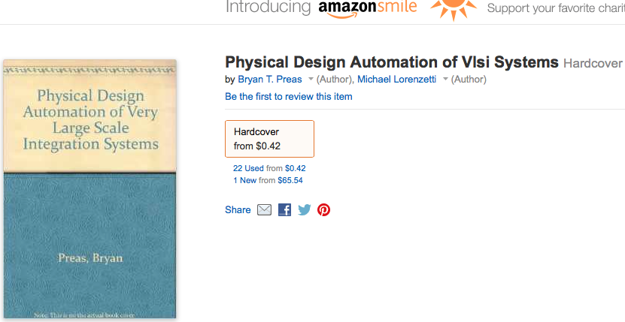
2014 ISPD Lifetime Achievement Award:
Dr. Bryan Preas
40+ years of experience in VLSI systems and EDA
  Principal scientist at Palo Alto Research Center (PARC)
  Area manager at PARC 83-90
  VP of R&D VR Information System
  Bell labs, Sandia National Lab, etc…
General Chair of DAC 95
  DAC EC teams for years
ACM fellow
Editor of the first PD book in 1988
Proceedings on CD-ROM

Slide 3
2014 ISPD Lifetime Achievement Award:
Dr. Bryan Preas
Founder of DAW
General chair of the first 2 physical design workshops
  1987 Hilton Head, SC
    Organized the Place-Off portion of the first workshop (w/ Ken Roberts)
  1989 Long Beach, CA
    Prepared placement benchmarks of the second workshop (w/ Dwight Hill)

Slide 4
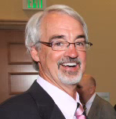
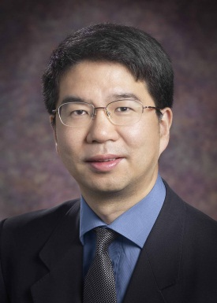
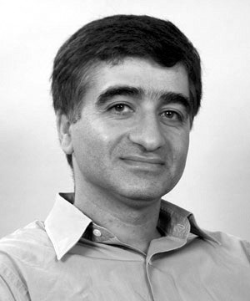
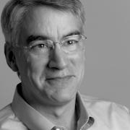
2014 ISPD Lifetime Achievement Award:
Dr. Bryan Preas
Session 6: Commemoration for Dr. Preas
Mike
Lorenzetti
Mentor Graphics
Jason
Cong
UCLA
Massoud Pedram
USC
Scott
Elrod
PARC

