Slide 1
Making a Difference in EDA – A Thank You to Bryan Preas for His Contributions to the Profession
Michael J. Lorenzetti, Ph.D.
April 1, 2014

Slide 2
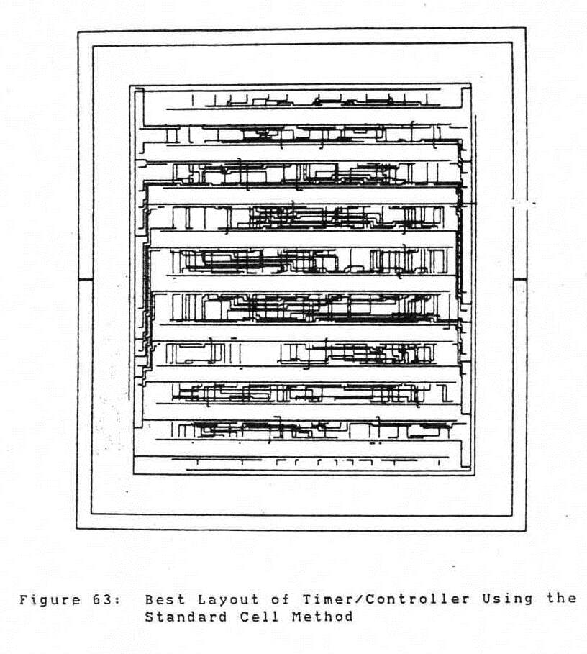
Gate Array and Standard Cell Layouts

Slide 3
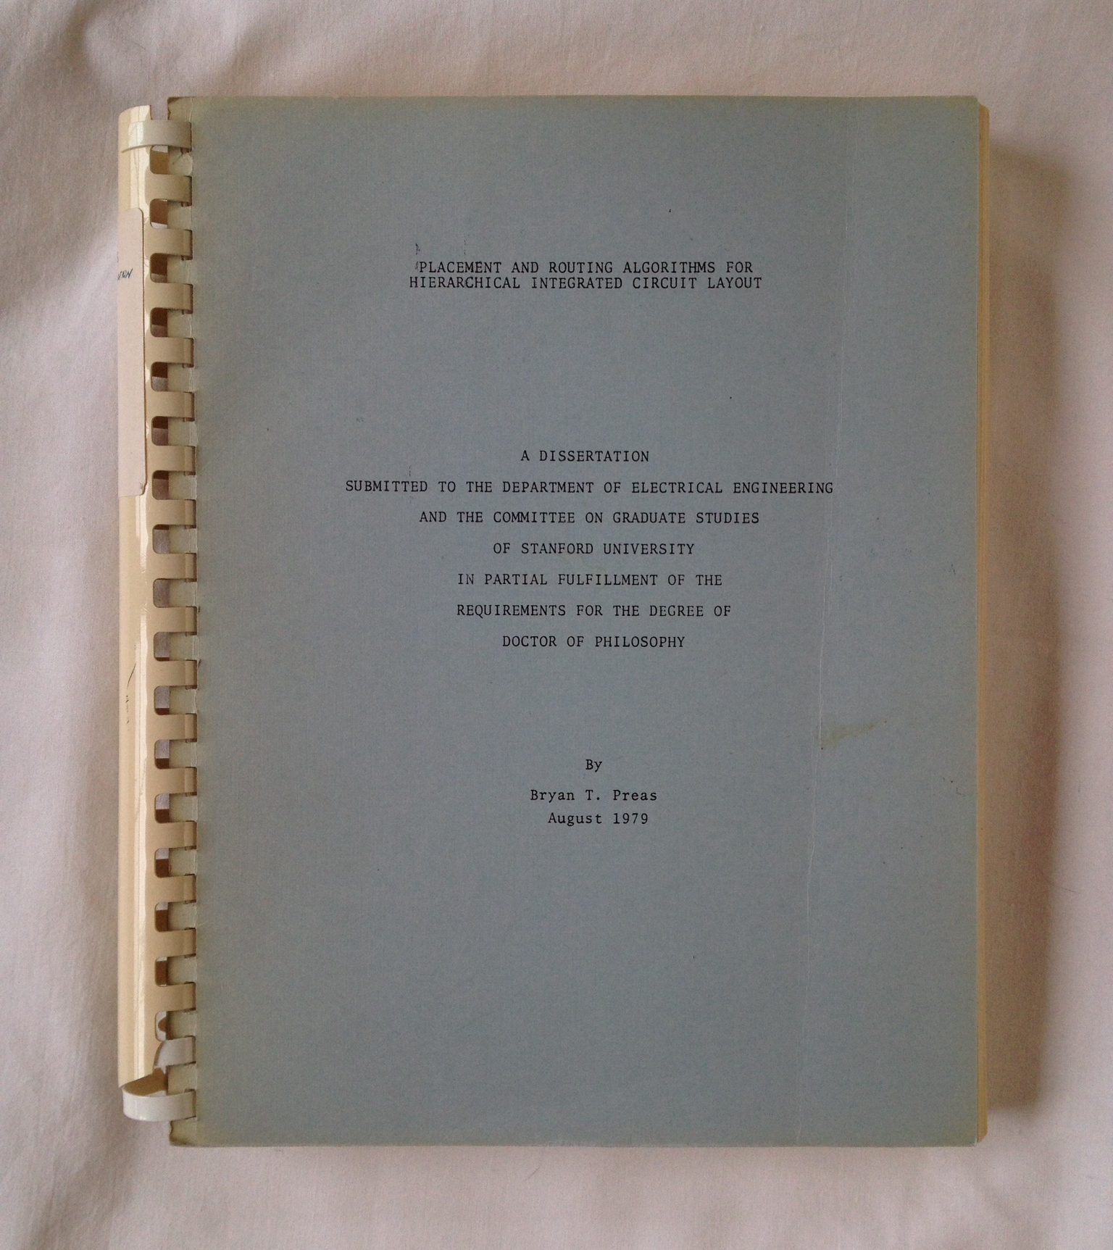
Dissertation August 1979

Slide 4
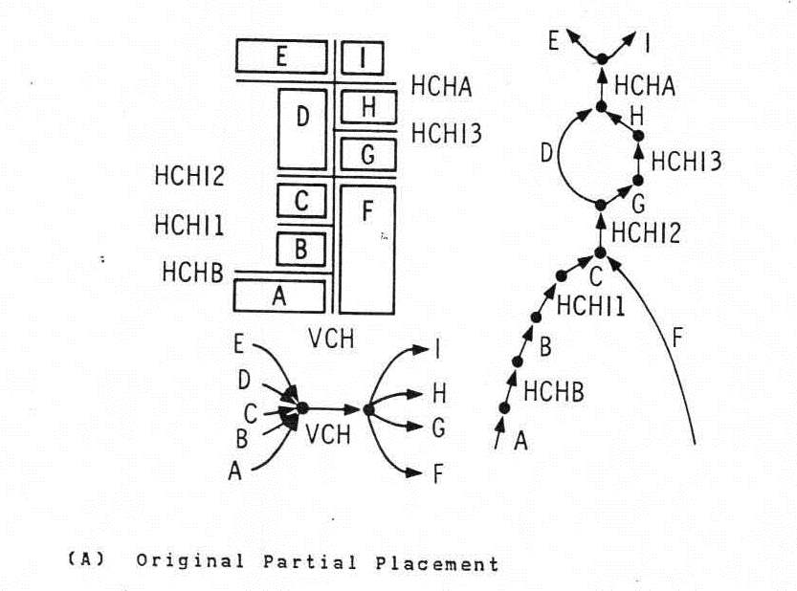
Structured Custom Layout

Slide 5
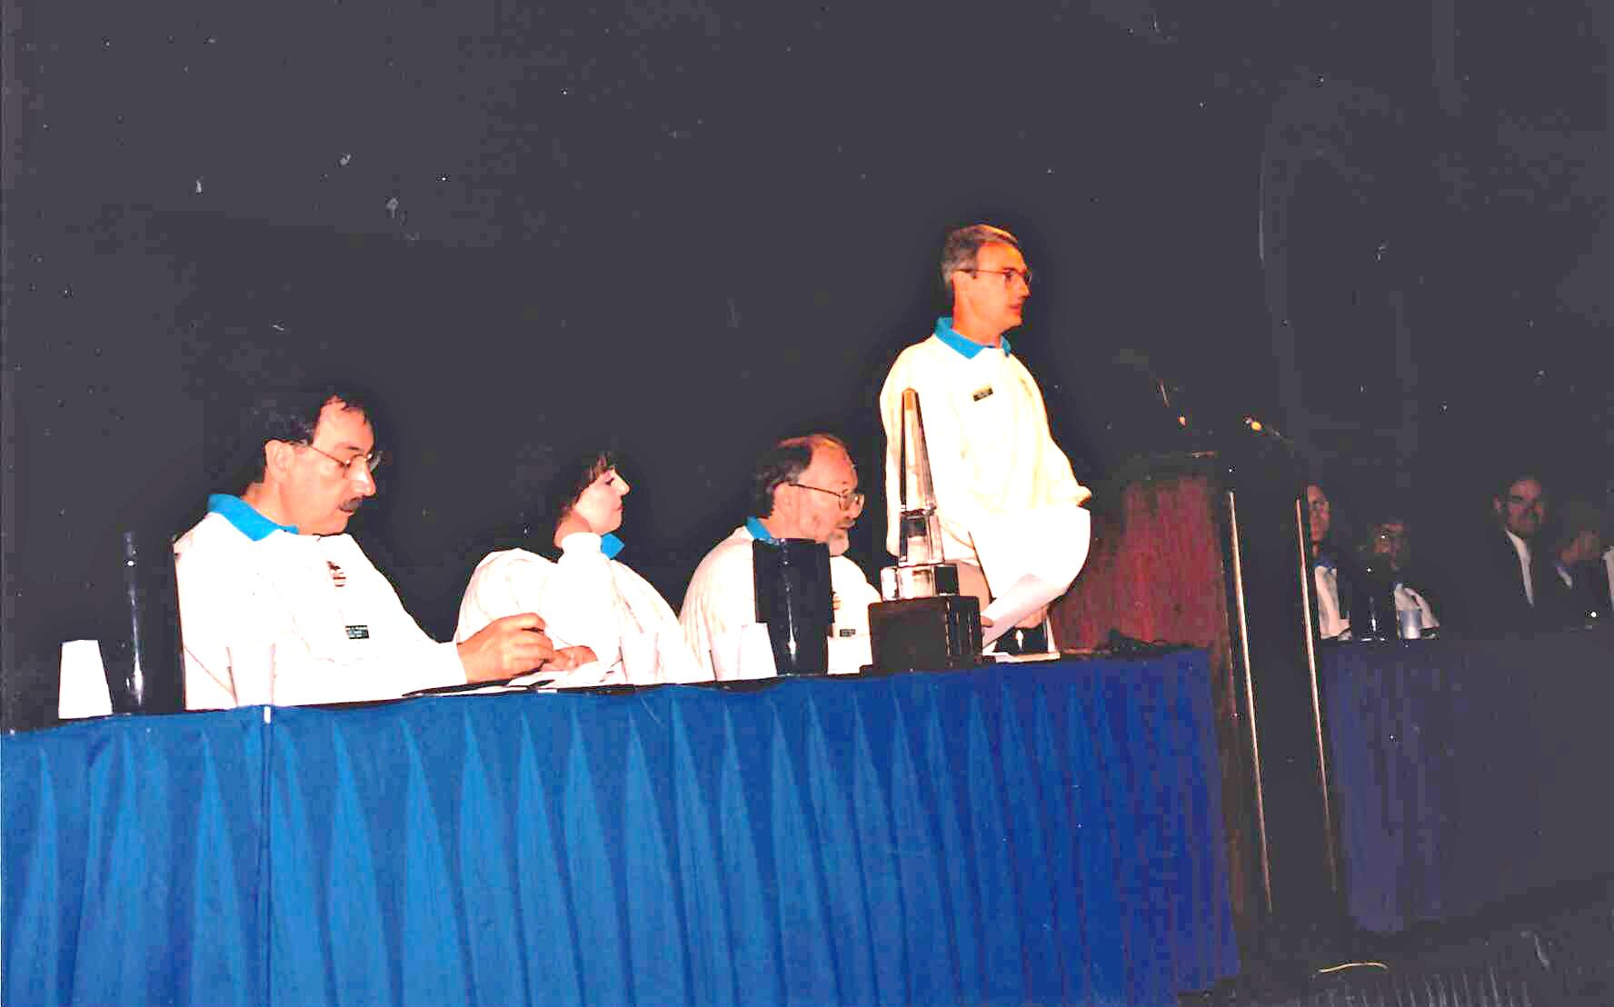
DAC

Slide 6
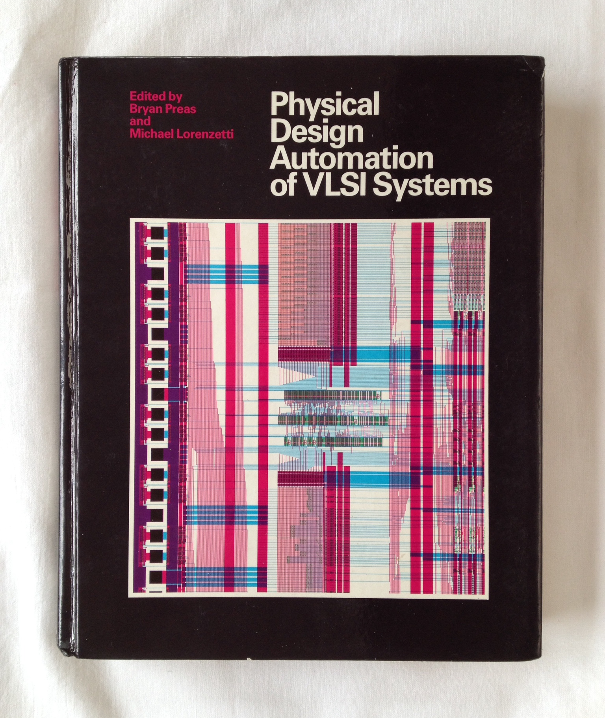
Textbook

Slide 7
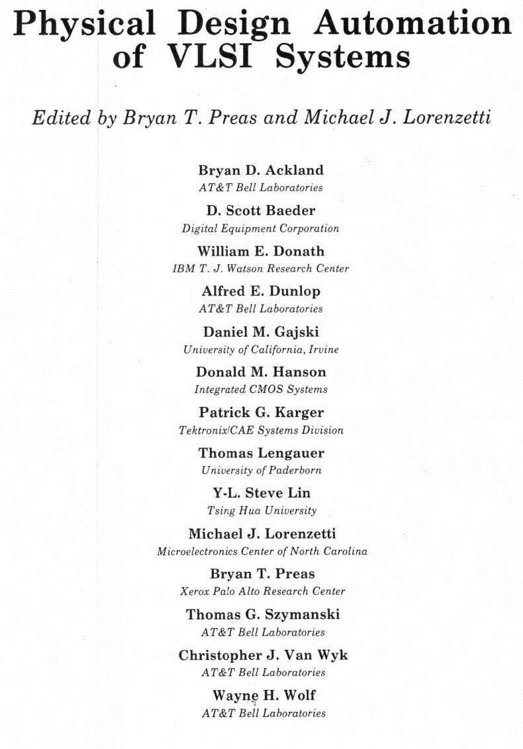
Textbook Authors

Slide 8
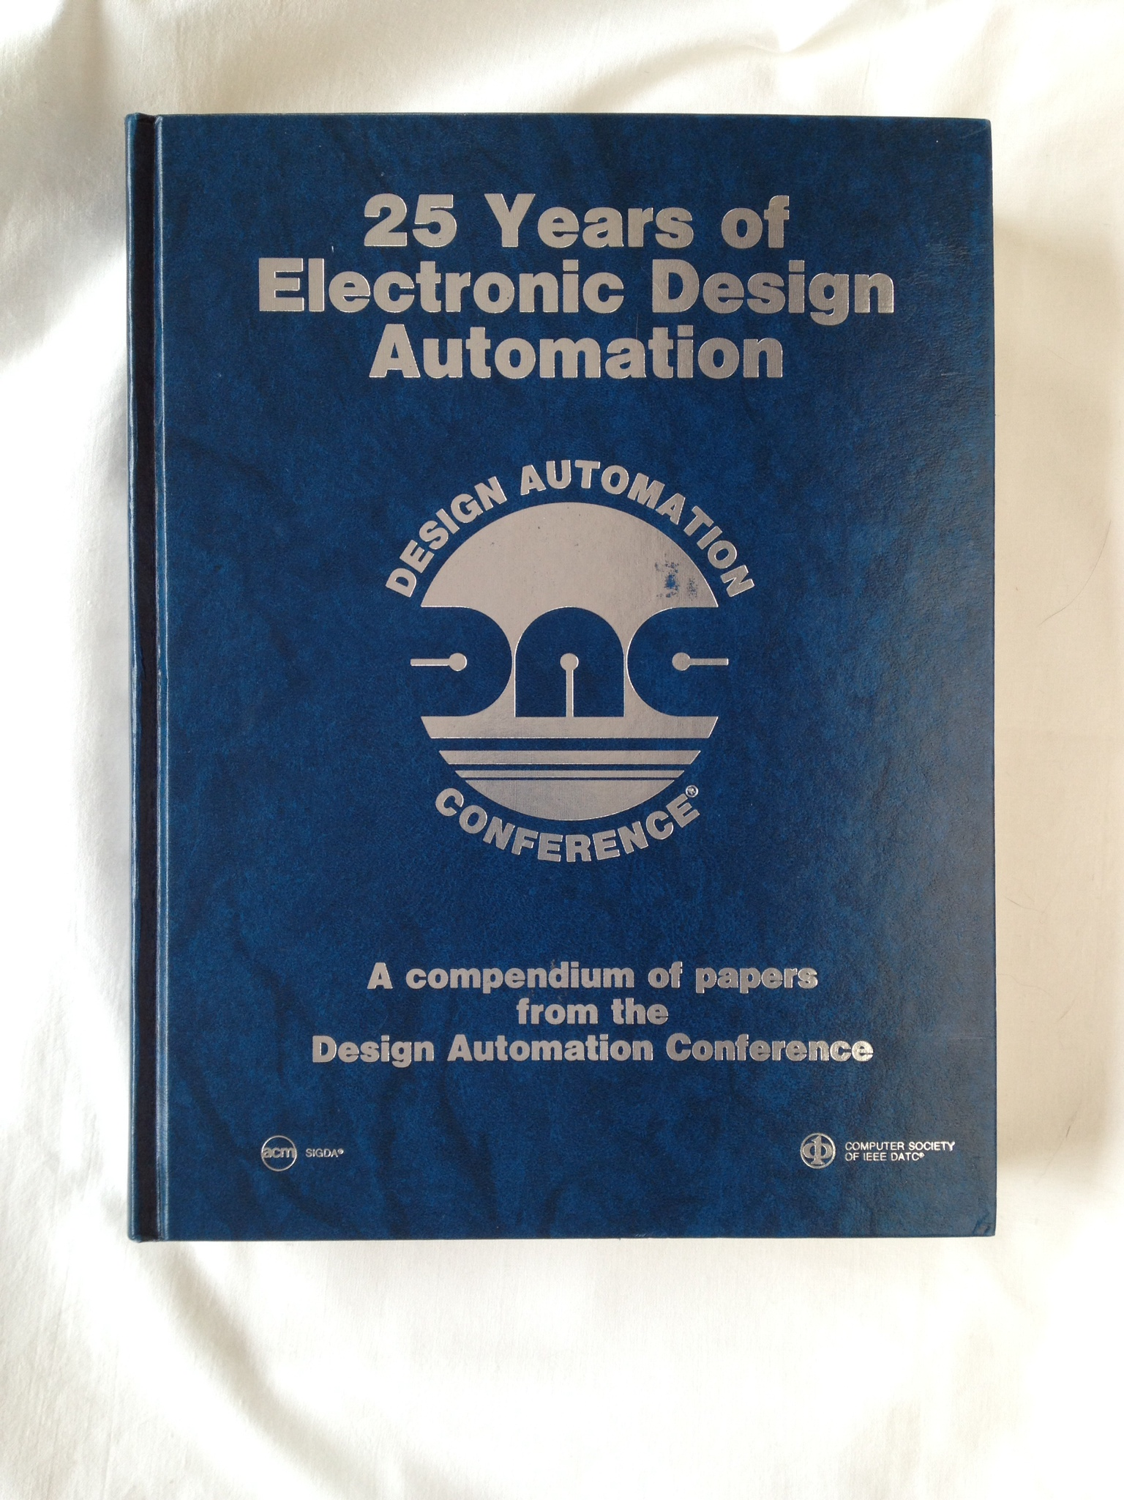
25 Years of DA Compendium
Physical Design
Simulation and Test
Synthesis, Systems and User Interface

Slide 9
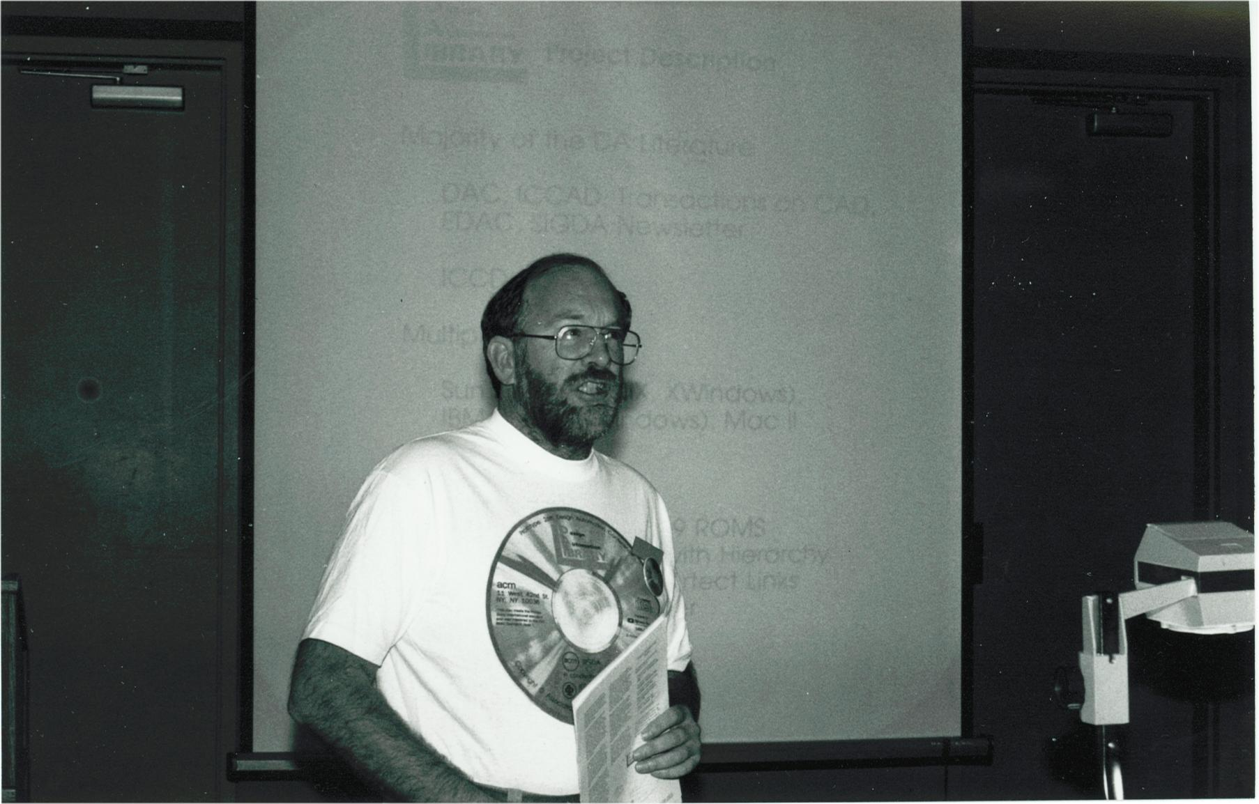
DALibrary Proposal

Slide 10
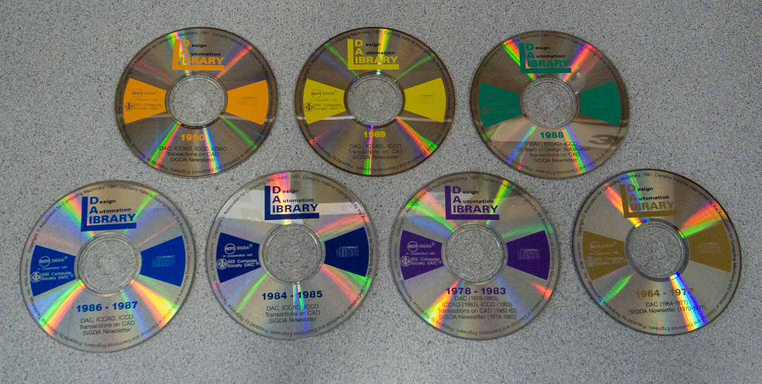
DA Library

Slide 11
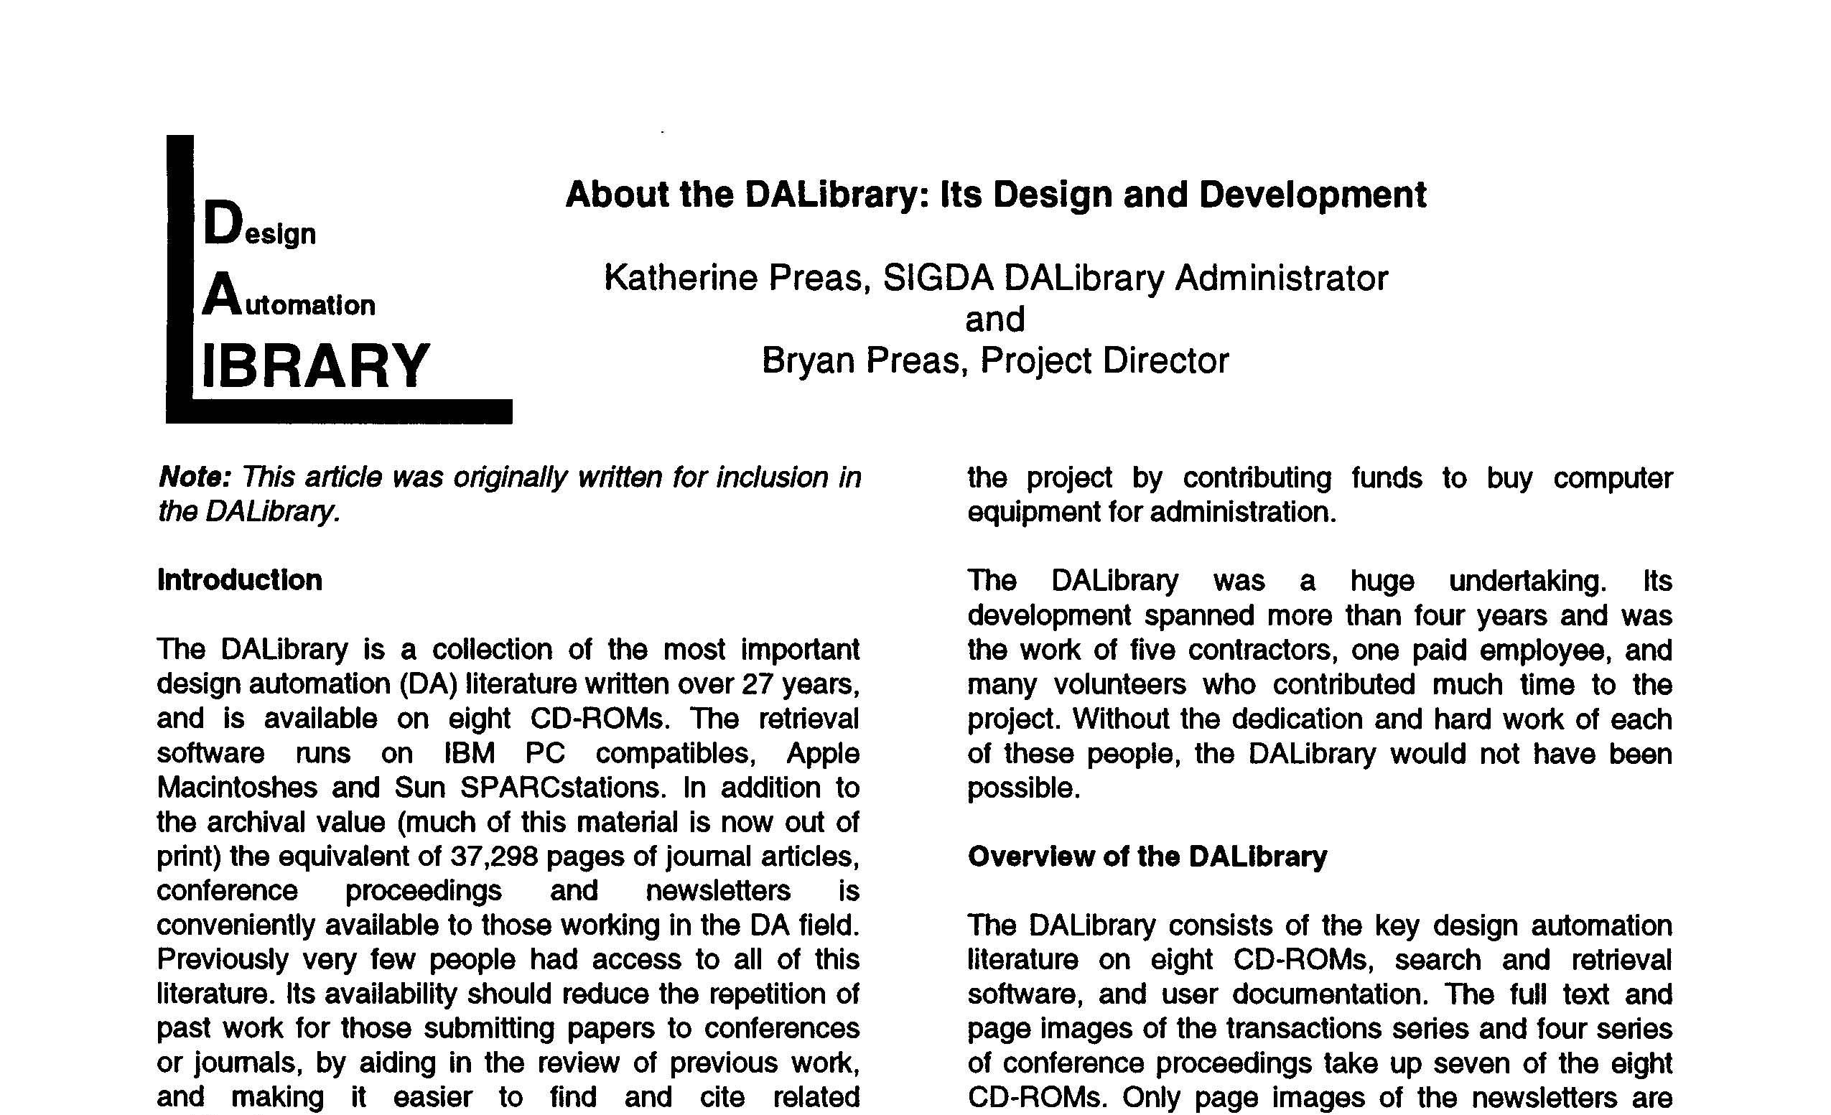
DA Library Design and Development
[from SIGDA Newsletter, vol 22, Number 1]

Slide 12
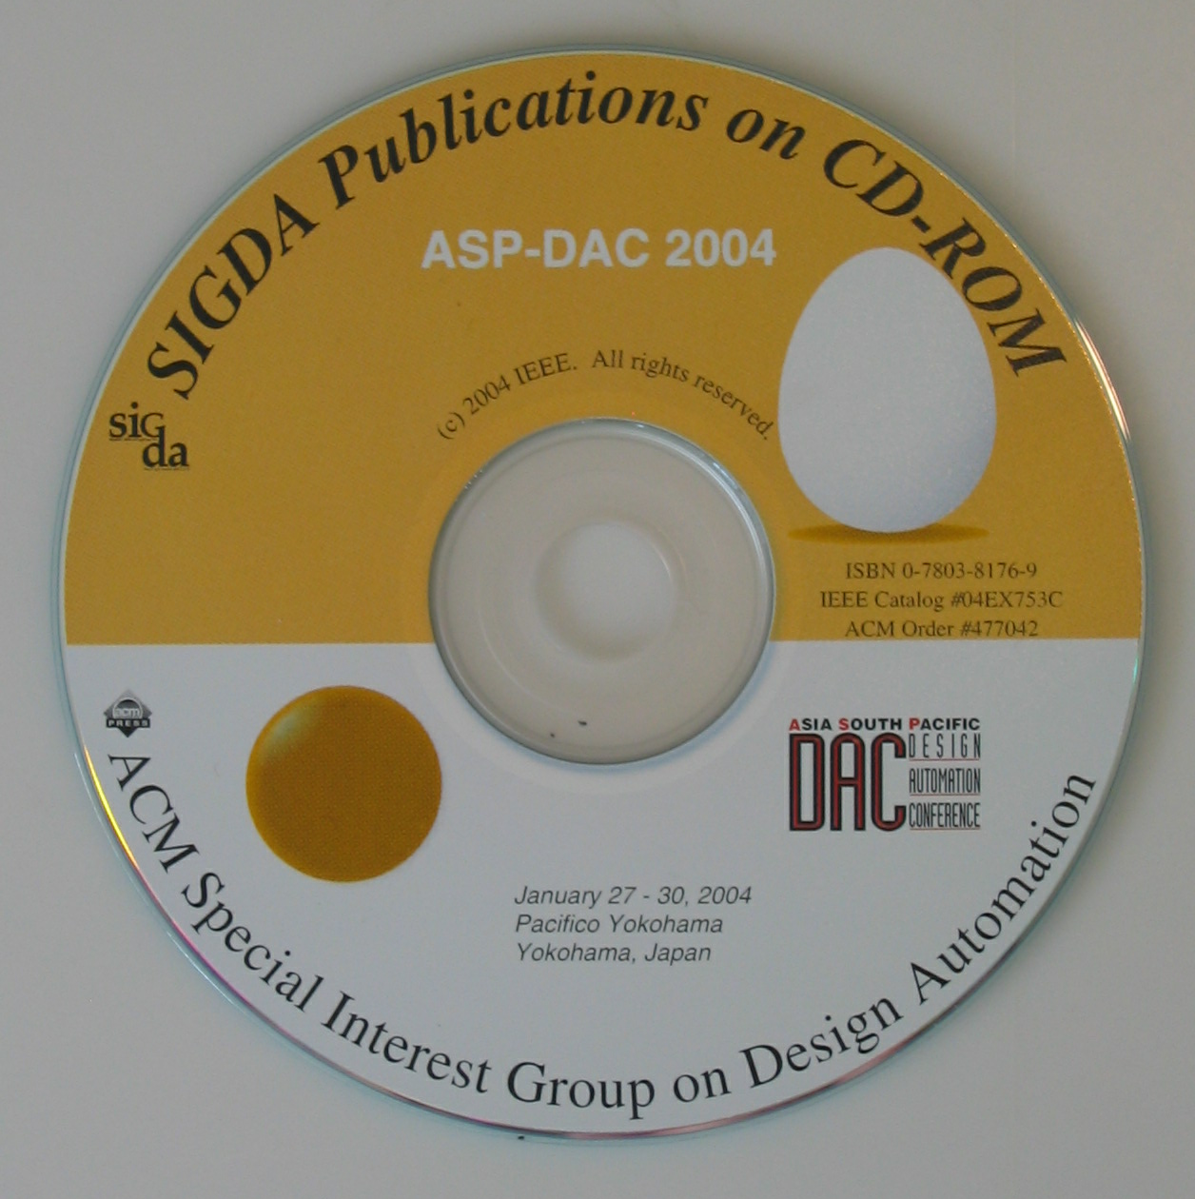
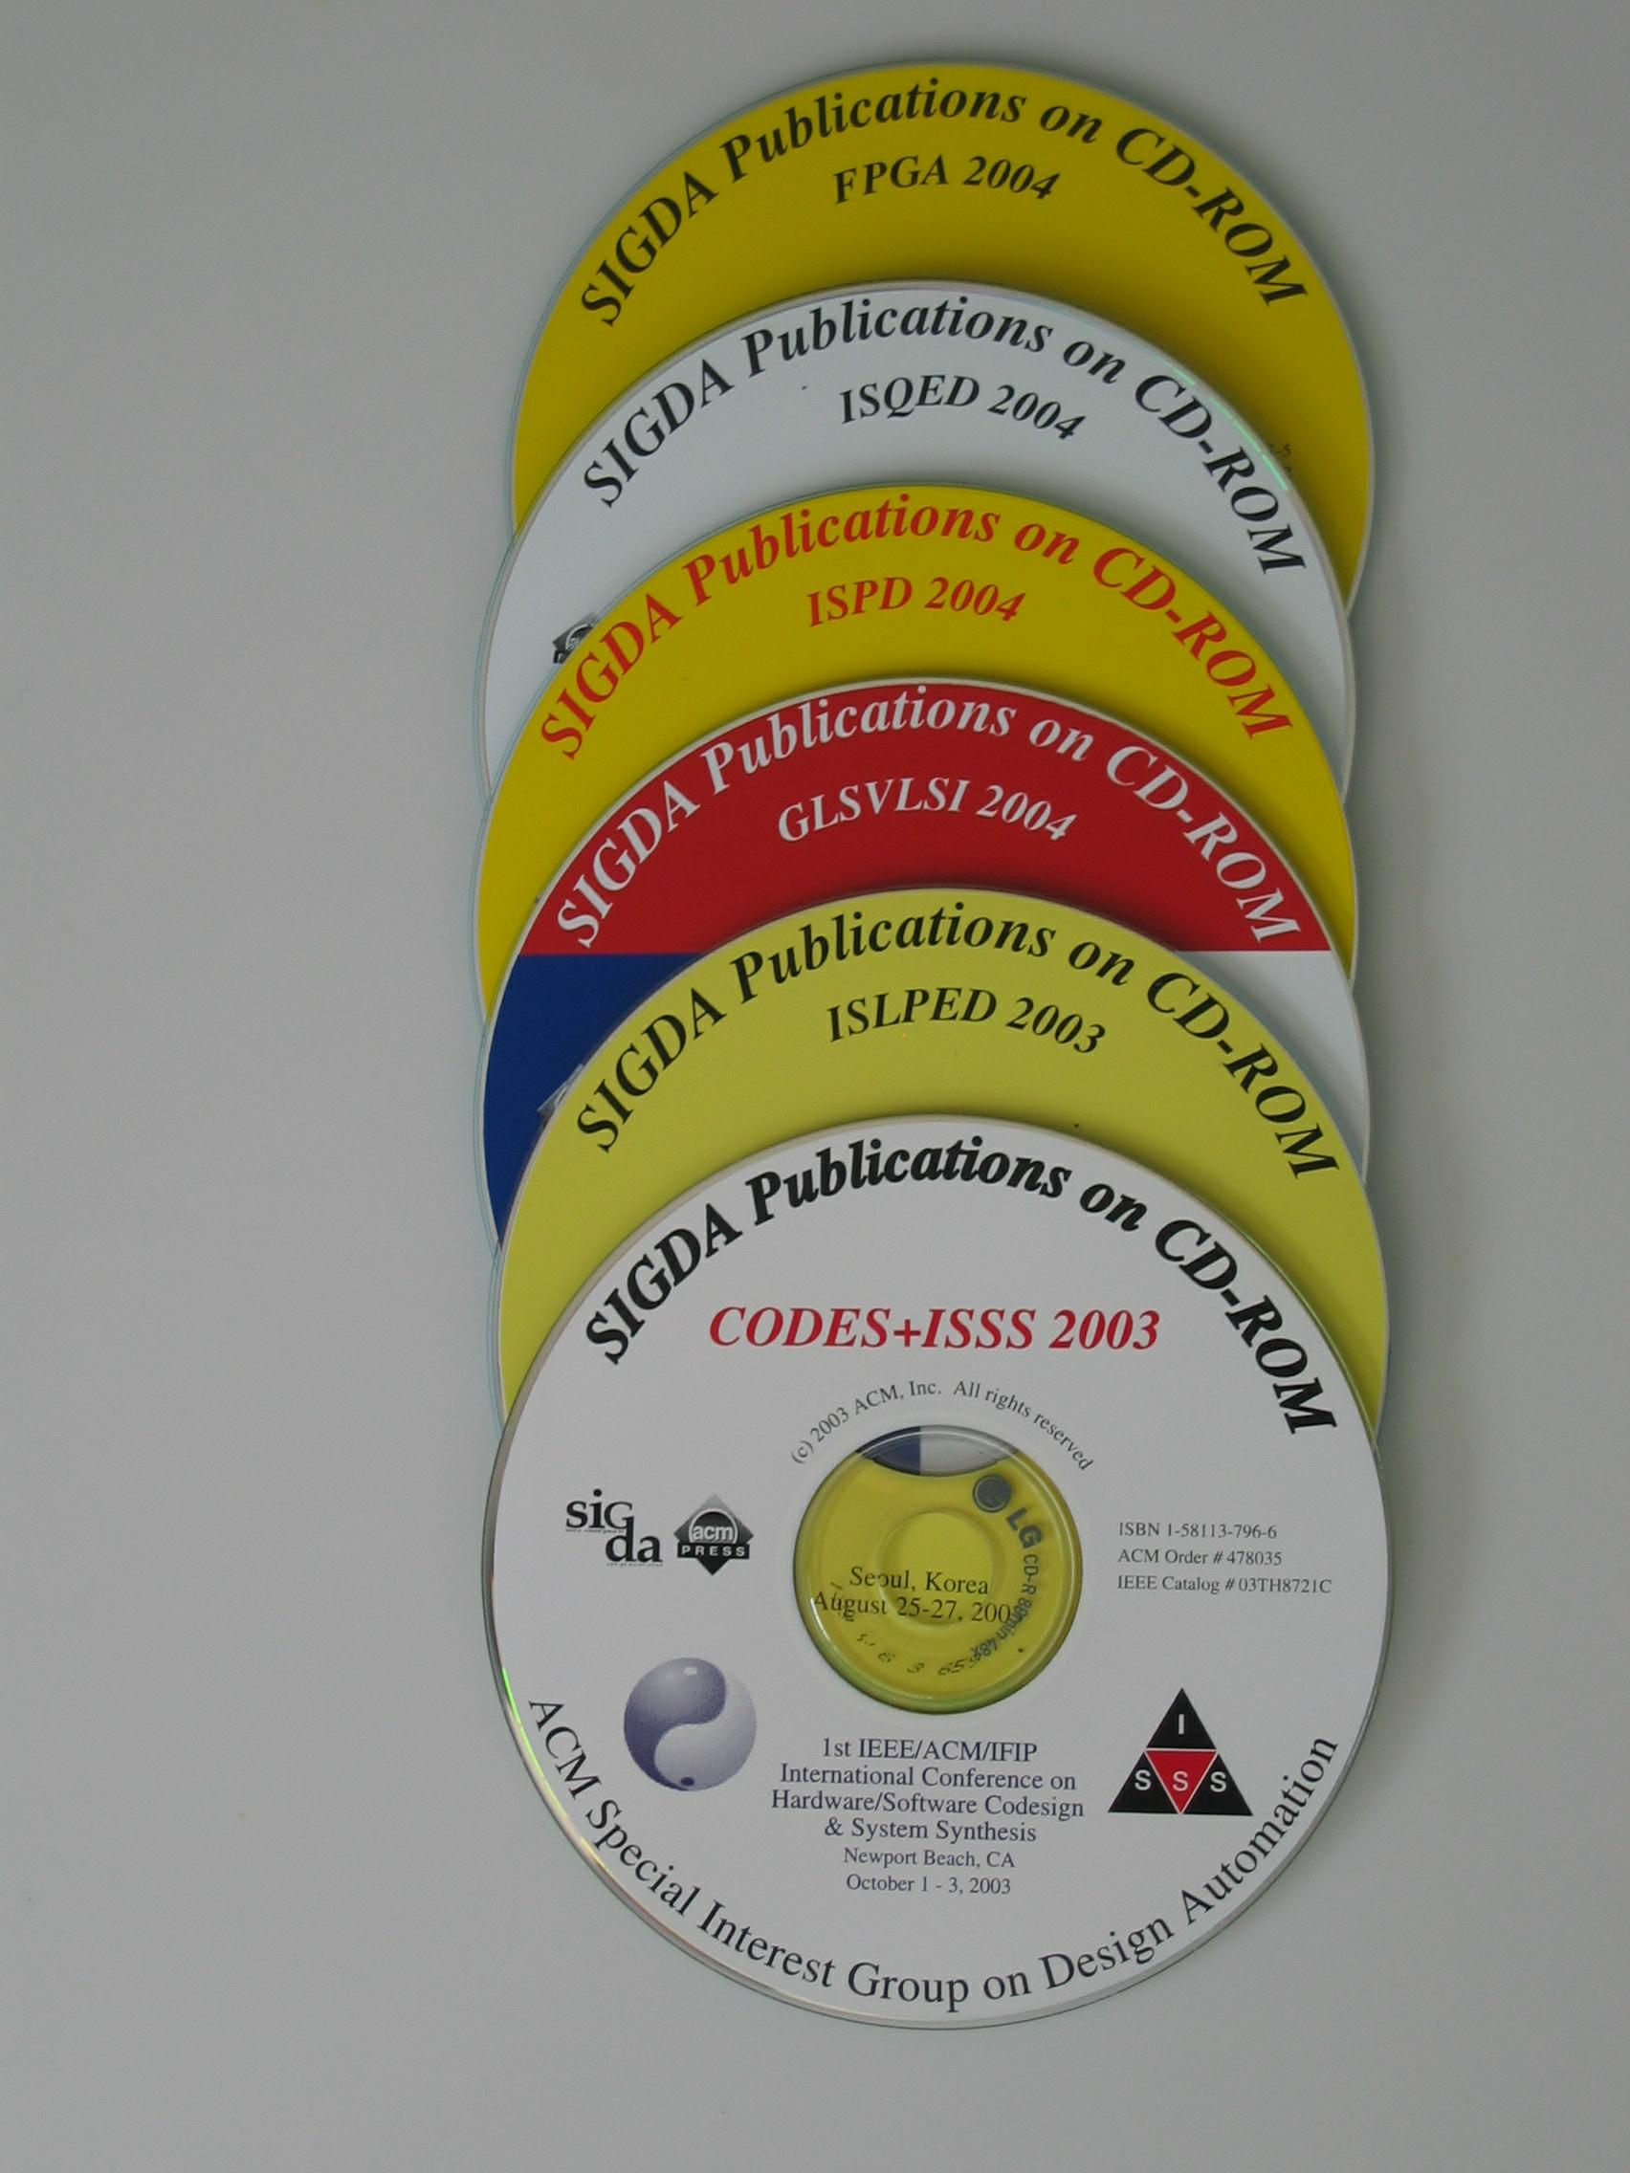
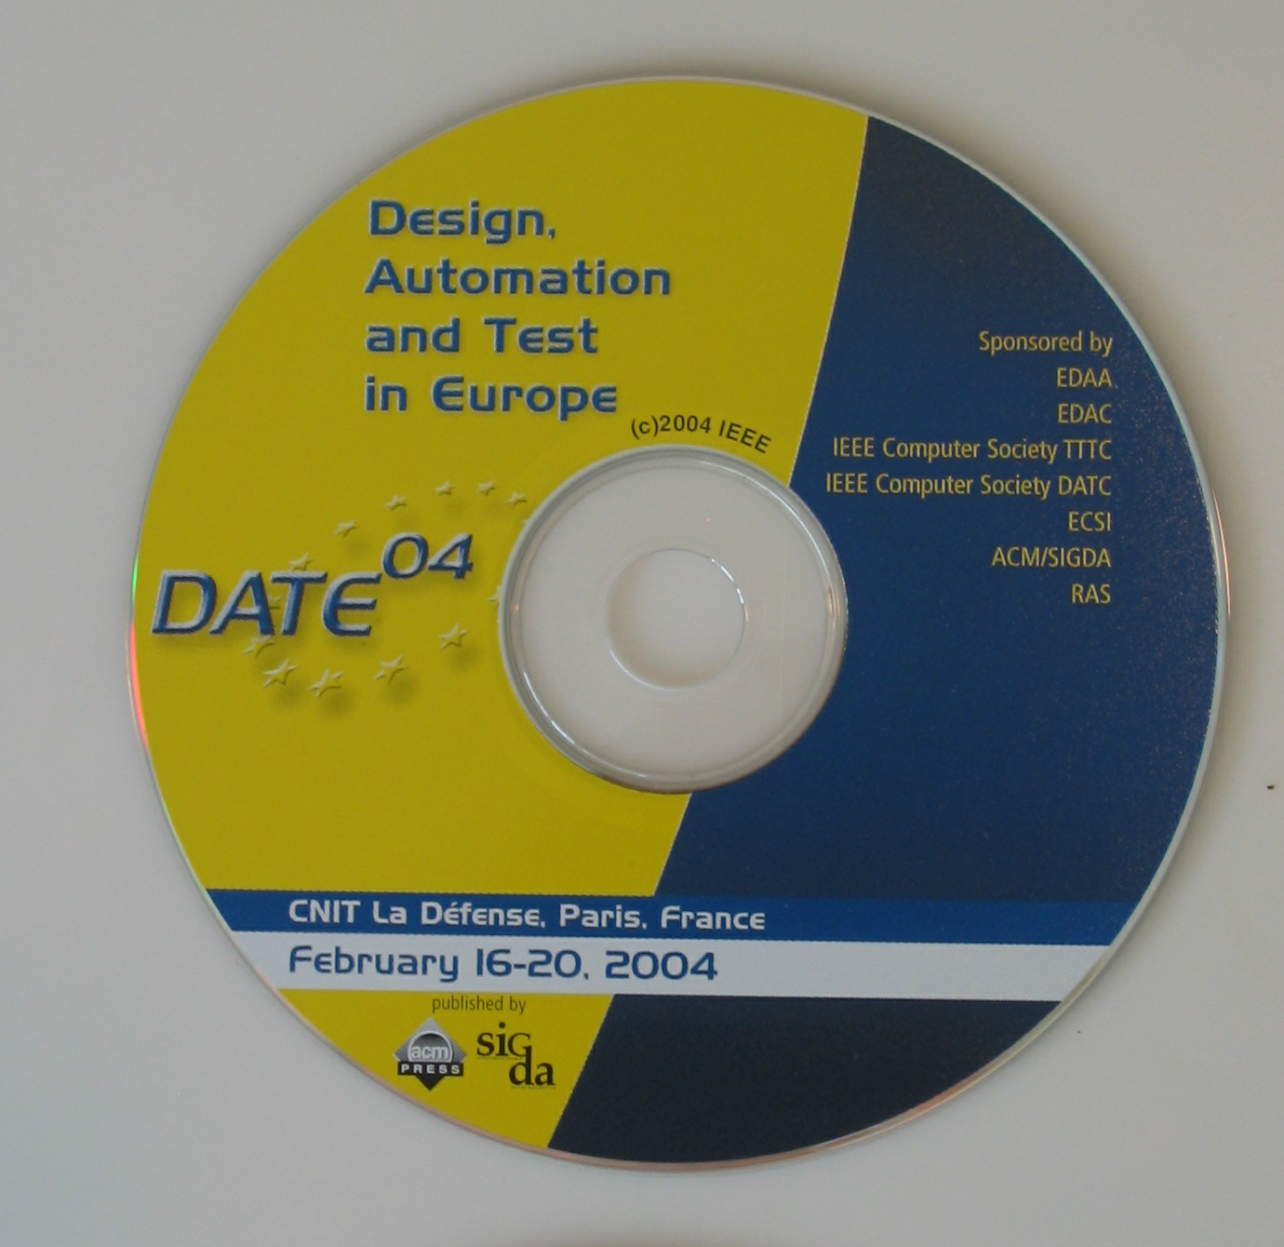
SIGDA Publications on CD-ROM

Slide 13
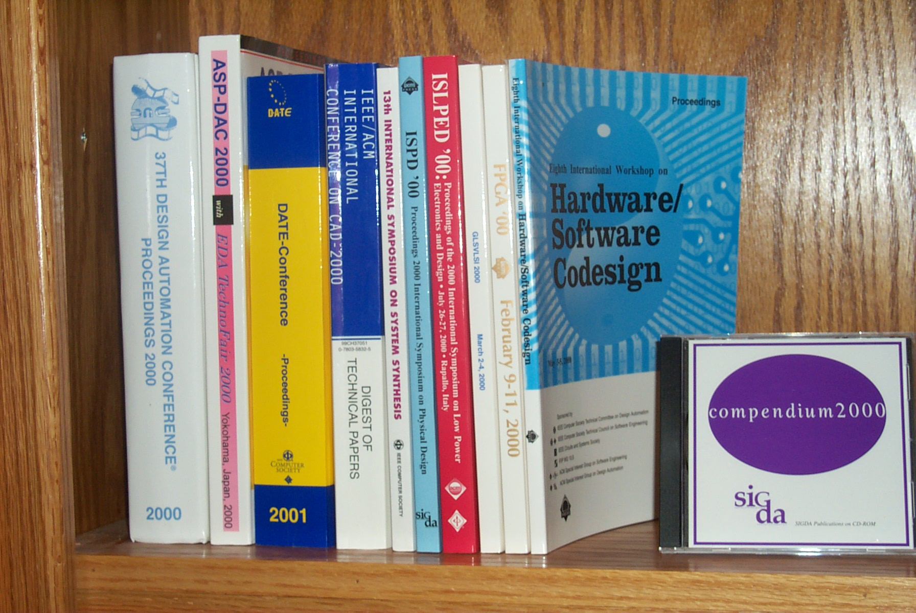
CD ROM Compendium

Slide 14
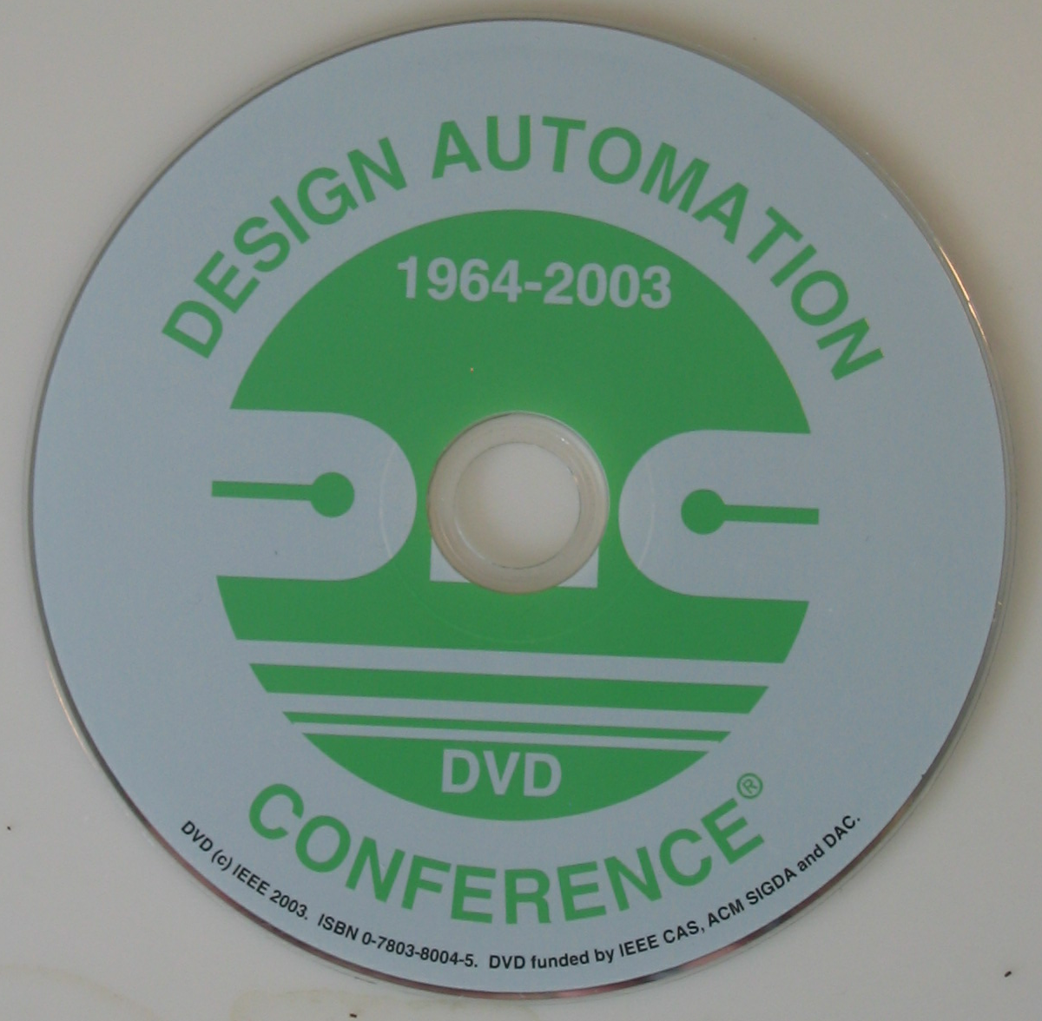
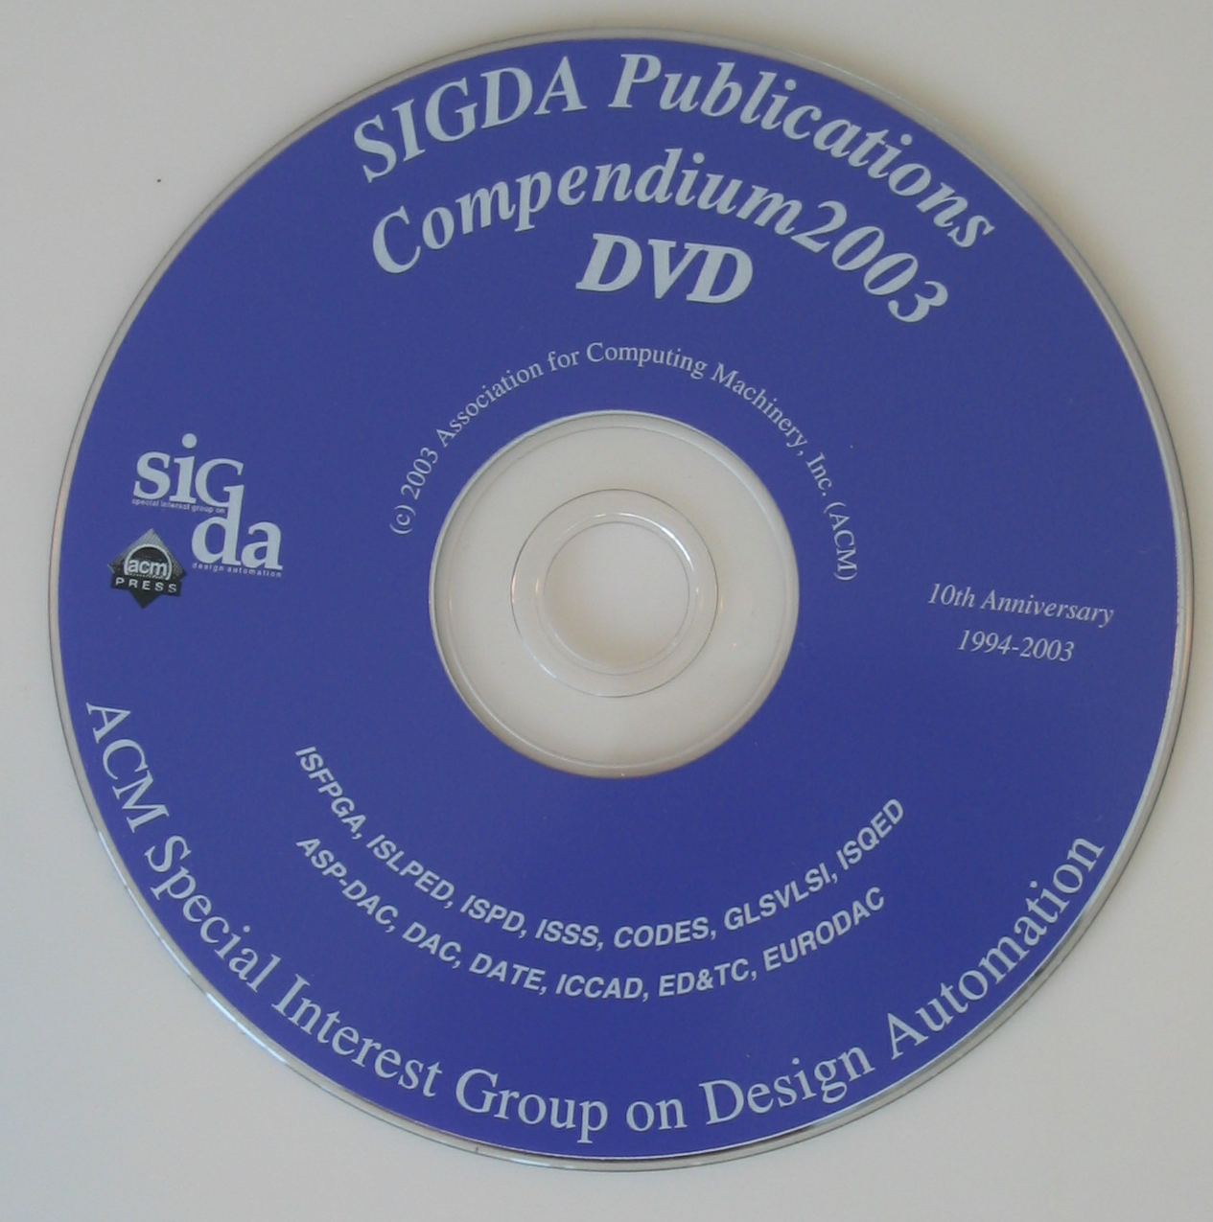
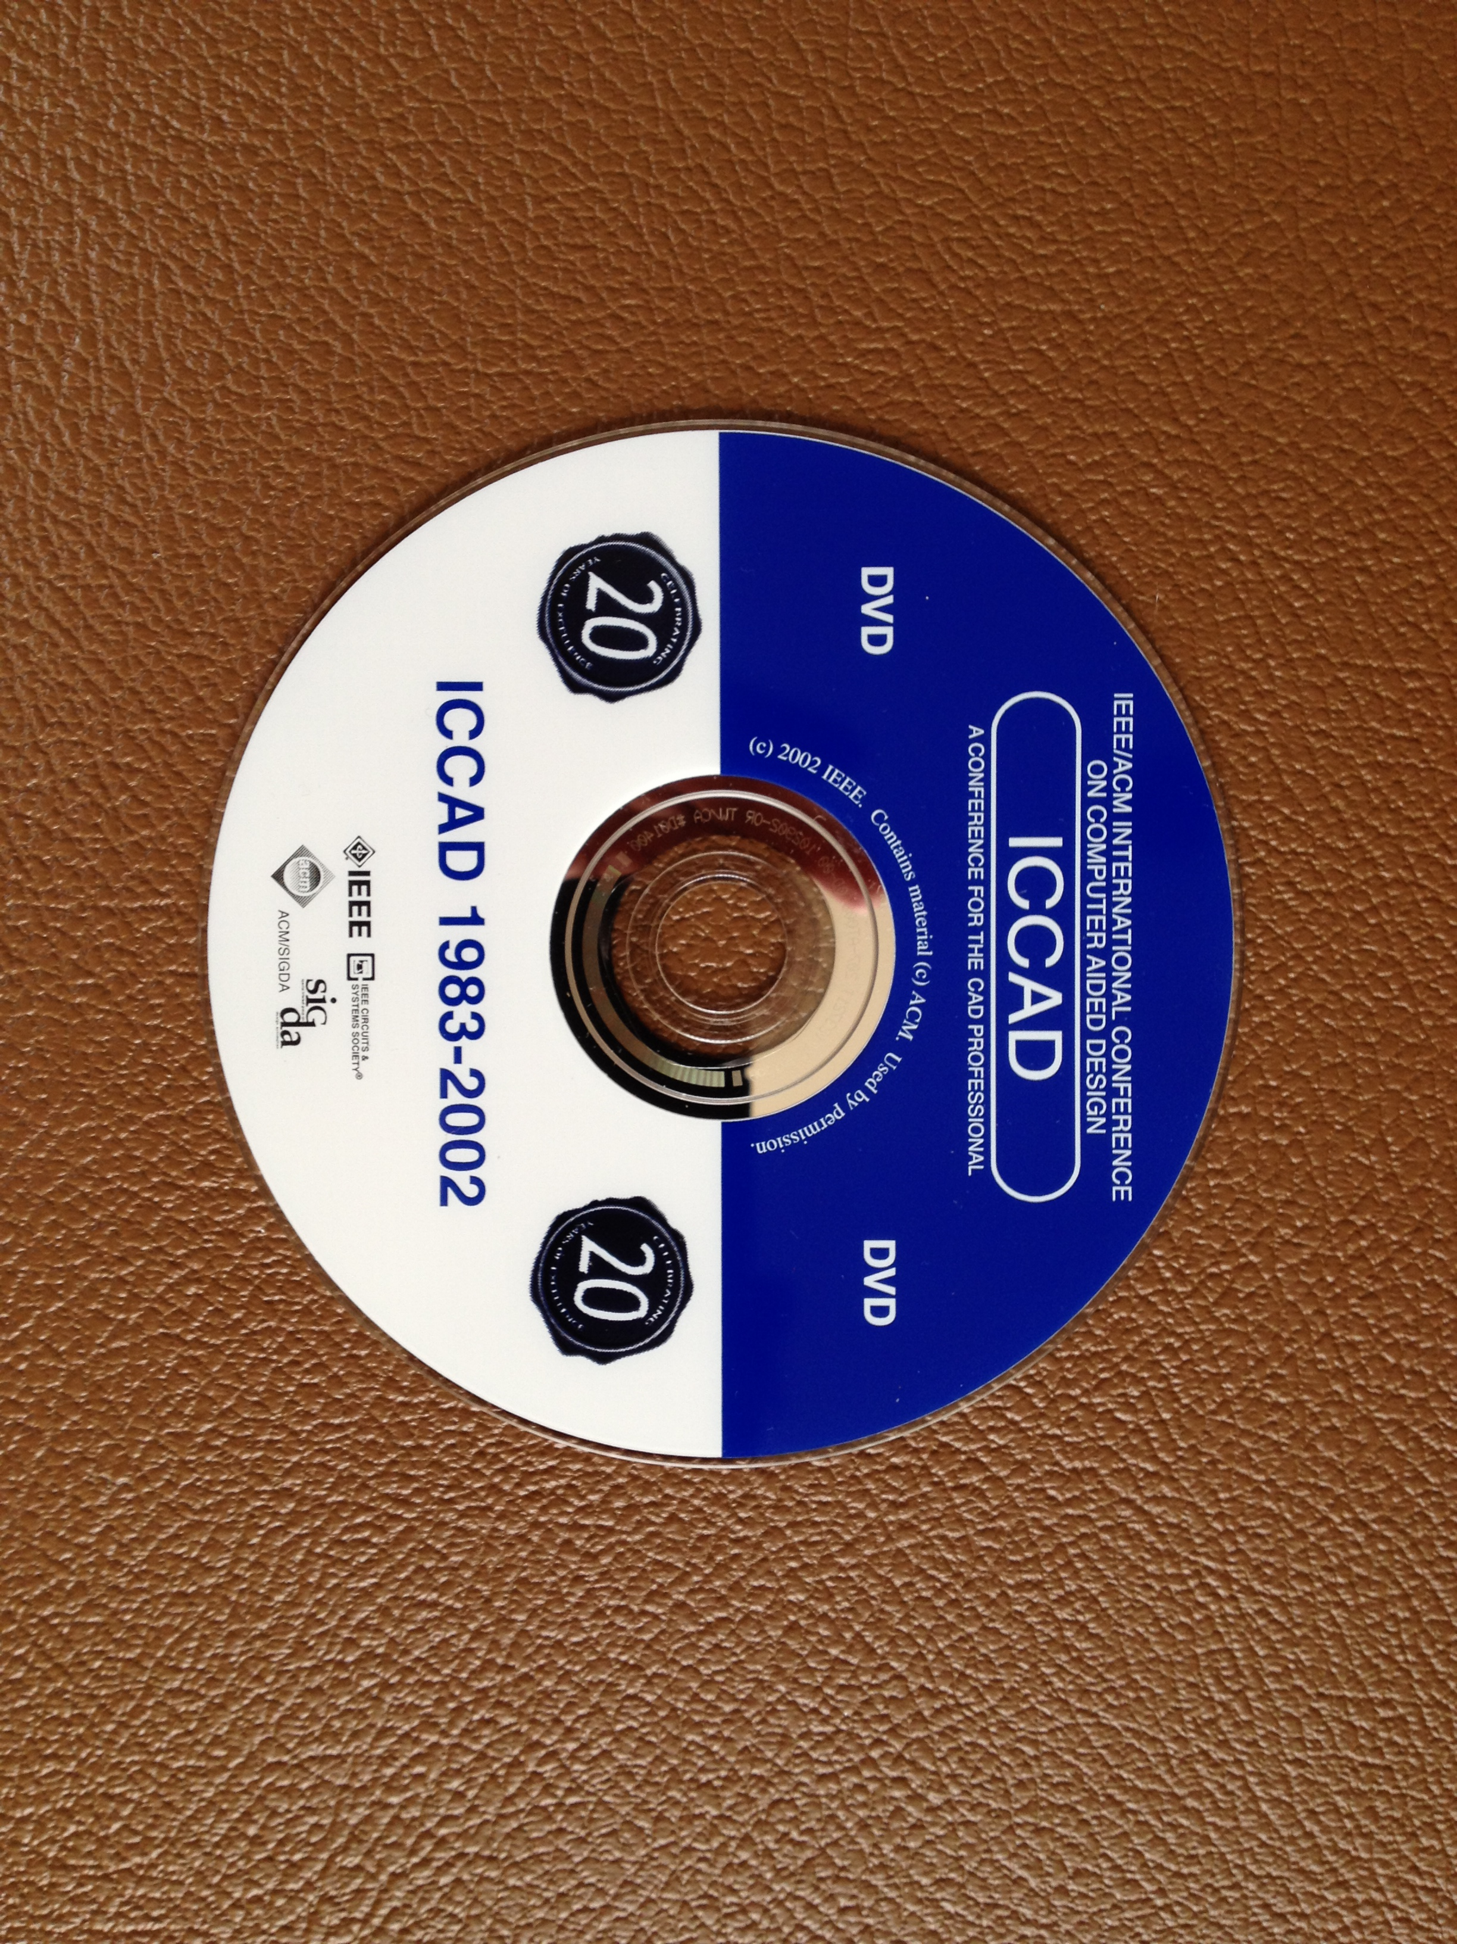
SIGDA Publications on DVD

Slide 15
Benchmark Origins
Preas, B., Benchmarks for Cell-Based Layout Systems in 24th Design Automation Conference Proceedings, pp 319-320, 1987
D. D. Hill, B. Preas, Benchmarks for Cell Synthesis, Proc. 27th Design Automation Conf., 1990, pp. 317-320.

Slide 16
SIGDA Benchmark Program 1989
Place and Route……Physical DA Workshop ‘87 & MCNC Workshop ’88
Module Generation………………………………Physical DA Workshop 1989
Logic Synthesis……………………….……MCNC Workshop, 1987 and 1989
Symbolic Layout & Compaction…………………..…MCNC Workshop 1986
Test Generation (combinational logic)………………………………ISCAS 85
Test Generation (sequential logic)………………………………..ISCAS 1989
High Level Synthesis…………………………………..SIGDA Workshop 1989
[source: SIGDA Newsletter, vol19, number 1]

Slide 17
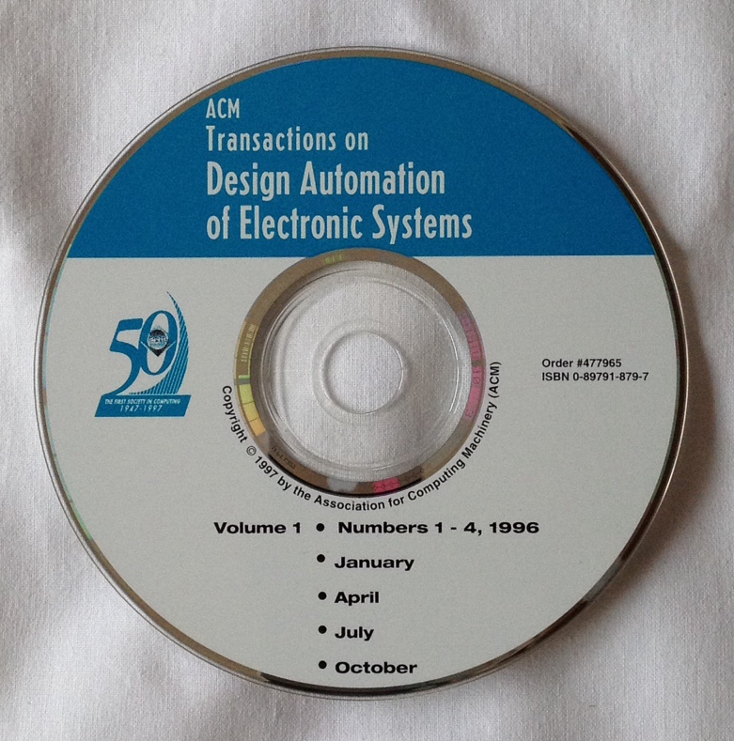
TODAES
Proposed SIGDA electronic submission journal in 1991
Recruited first editor in 1994
First issue 1996

Slide 18
SIGDA Program Impacts
Textbook
DALibrary → Electronic Publications
Workshop organizing
Instituted Benchmark Program
Proposed and Launched the new SIGDA journal (TODAES)
Scholarship and Travel Grant Expansion

Slide 19
DAC Volunteer 1982 - 1997
1982 – Publicity Chair
1983-1984 – Audio-Visual Chairman
1985 – 1993 Technical Program Committee Member
1989 Publications Chair
1990 Exhibits Technical Program Chair
1991 Finance Chair
1992 - 1993 Technical Program Chair
1994 Vice Chair
1995 General Chair 32nd DAC
1996 Past Chair
1997 Electronic Systems Industry Chair

Slide 20
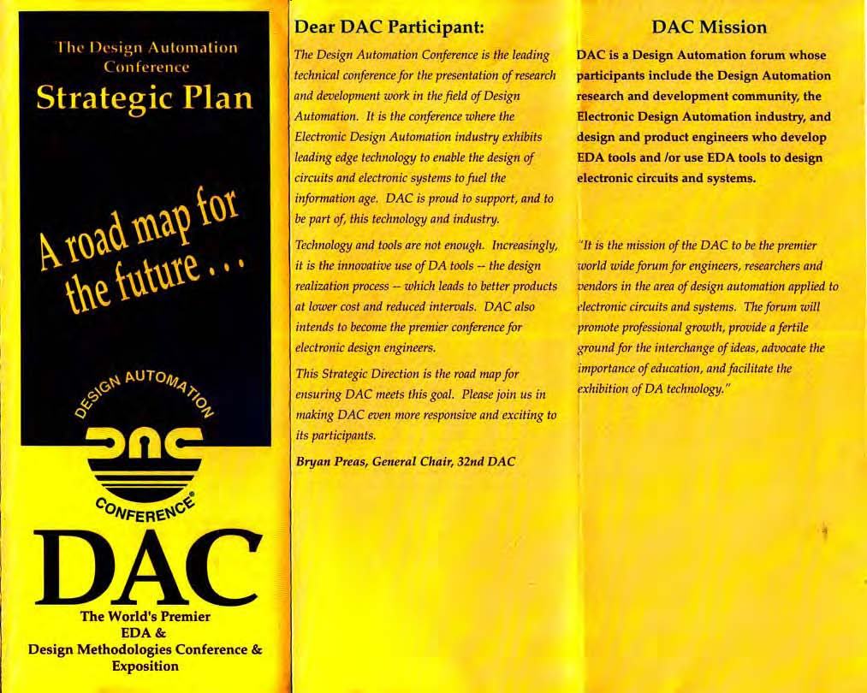
DAC Strategic Plan
“It is the mission of the DAC to be the premier
world wide forum for engineers, researchers and
vendors in the area of design automation applied to
electronic circuits and systems. The forum will
promote professional growth, provide a fertile
ground for the interchange of ideas, advocate the
importance of education, and facilitate the
exhibition of DA technology.”

Slide 21
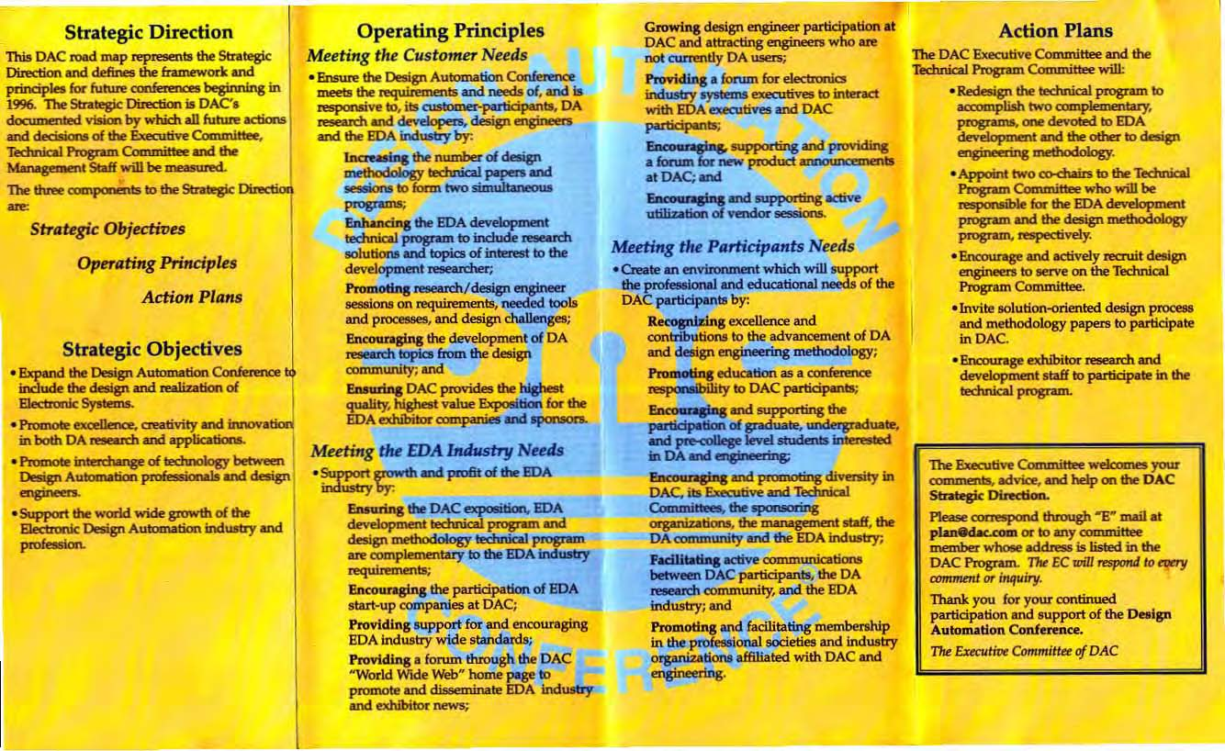
DAC Strategic Plan – con’t
Appoint two co-chairs to the Technical
Program Committee who will be
responsible for the EDA development
program and the design methodology
program, respectively.

Slide 22
DAC Impacts
25 years of DA Compendium
First Proposed the User Track in 1991 and drove it to be a permanent part of DAC
Strategic Planning Committee in 1995
Put DAC on Web in 1995
Panel Sessions

Slide 23
Summary
25 Years of Electronic Design Automation
Physical Design Automation Text Book
Started the DA Library
Started the Benchmark System
Organized Countless Workshops
Pushed Forward the Scholarship and Travel Grant Programs
First Proposed the DAC Designer Track
Drove the DAC Strategic Plan
DAC Web Page

