Slide 1
From Design to Design Automation
Jason Cong
Chancellor’s Professor, UCLA
Director, Center for Domain-Specific Computing
cong@cs.ucla.edu
http://cadlab.cs.ucla.edu/~cong
Notes:
1

Slide 2
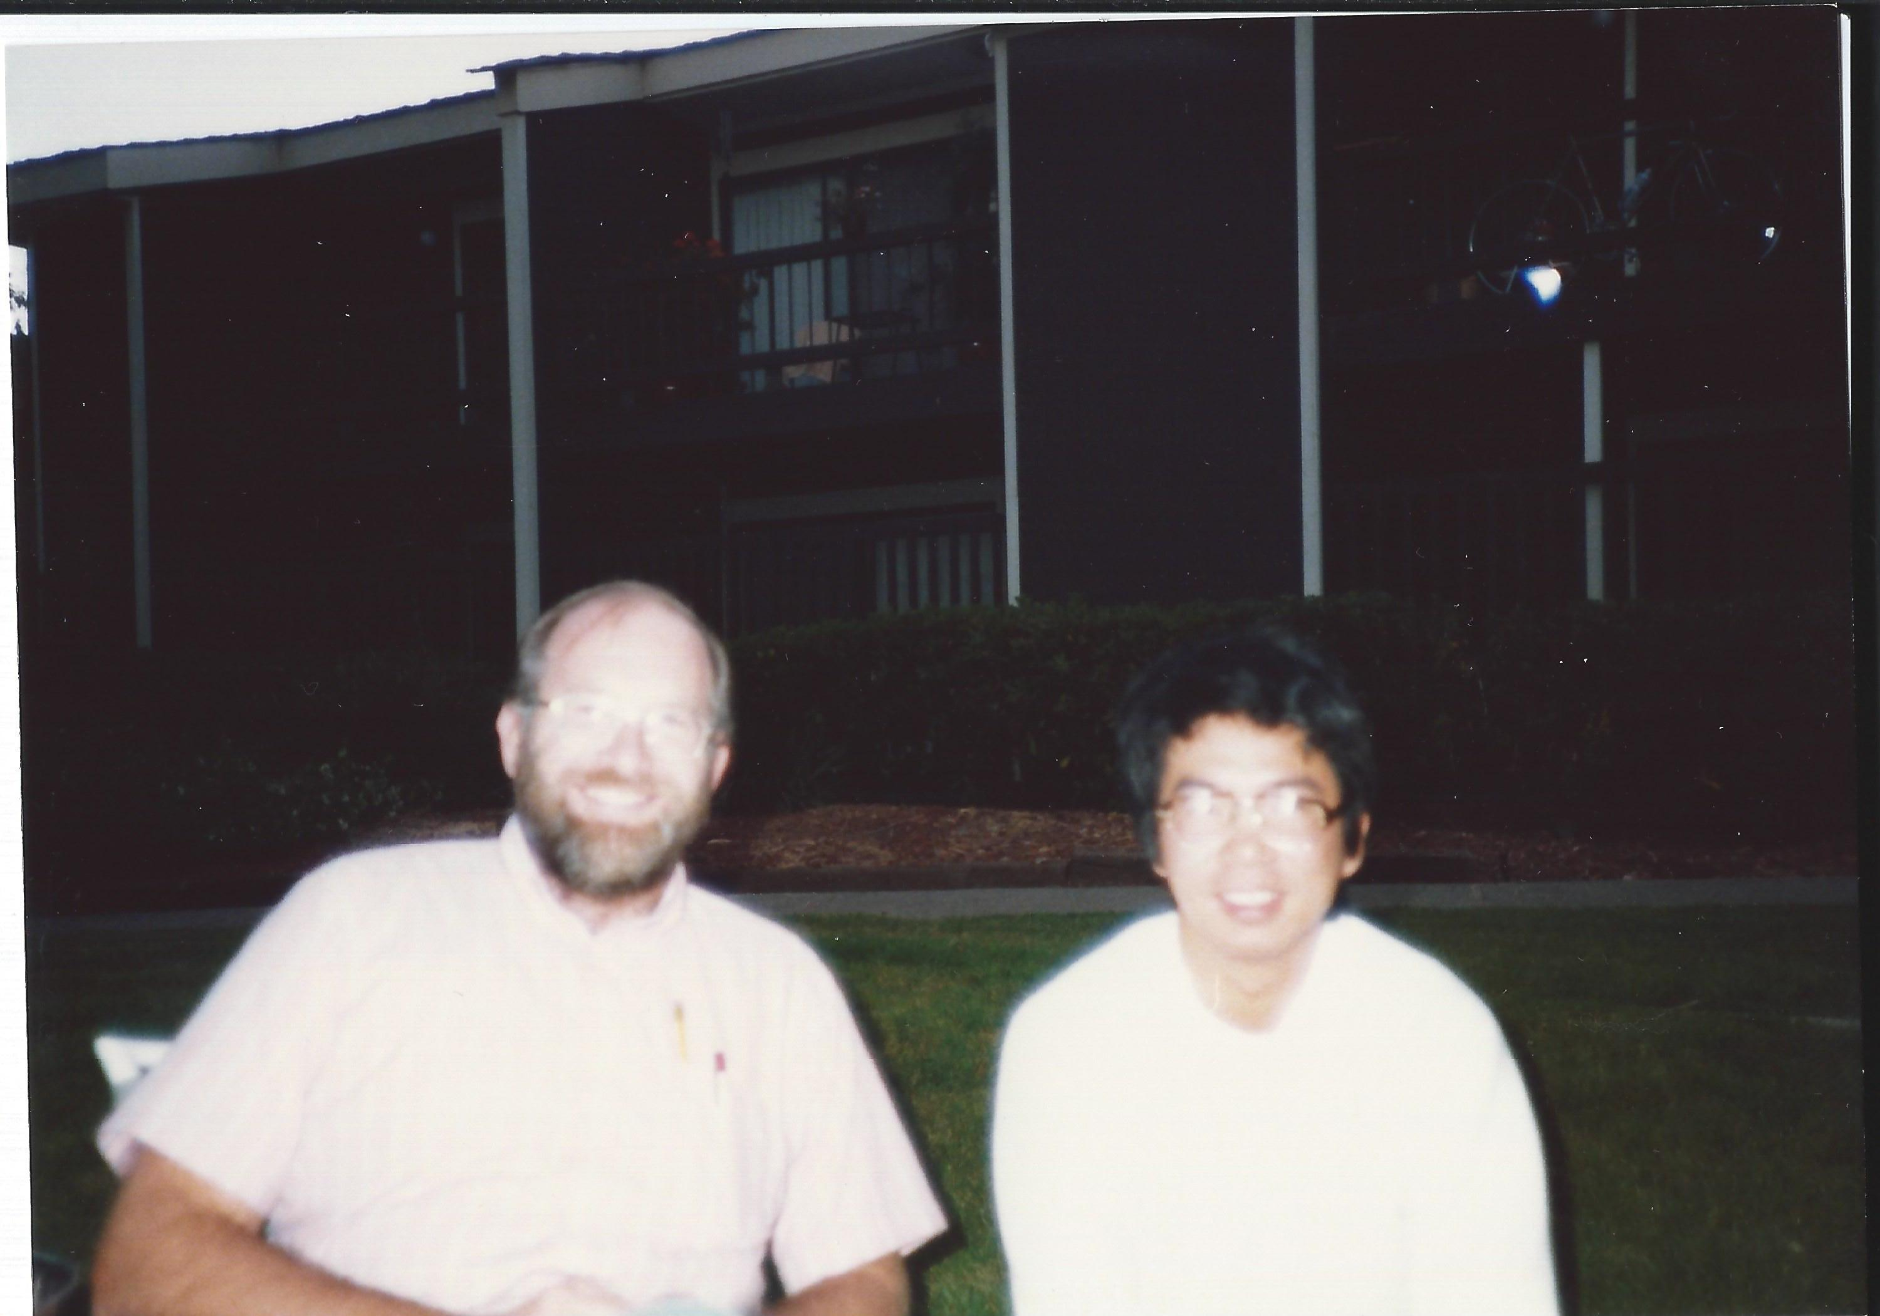
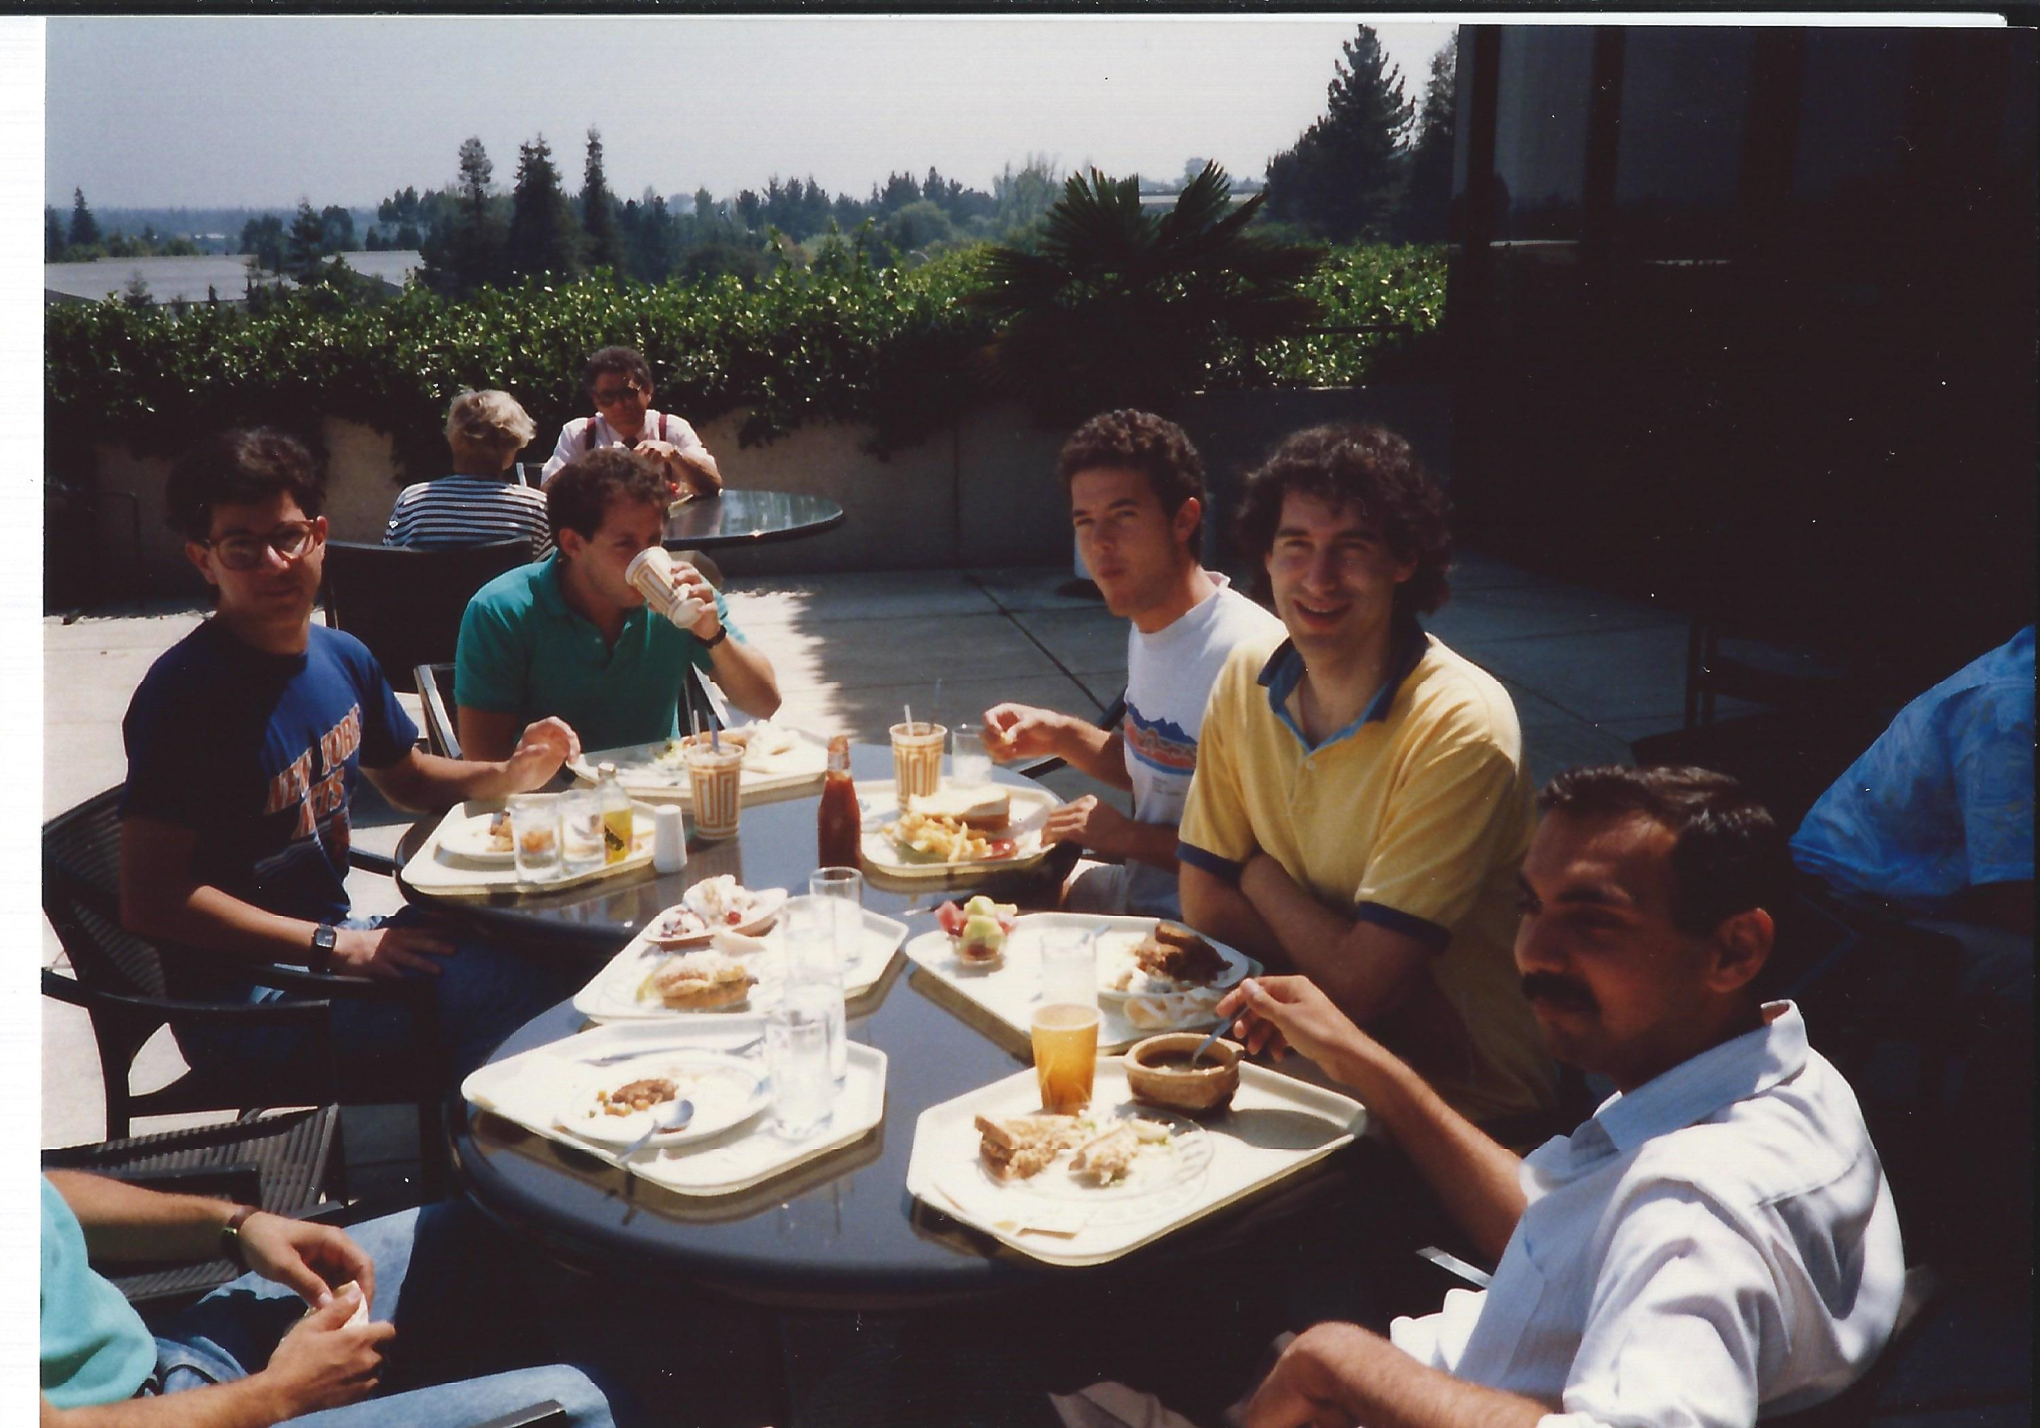
My Summer Internship at Xerox PARC in 1987

Slide 3

Three-layer channel routing
My First EDA Paper – ICCAD’1987
Channel Density d
    Max. # of crossings over all columns
Lower Bound
    Two layer: d
    Multi-layer [d/L]
    (L: # of horizontal layers)
Layer Assignment
    HVH

Slide 4
A Two-Layer Channel Routing Solution
2
1
5
6
3
4
4
3
2
5
t₁
t₂
t₃
t₄
t₅
t₆
1
2
3
4
2
6
6
4
2

Slide 5
Transformation to 3-Layer Channel Routing Solution
t_{2k-1} →k-th track on layer 1
t_{2k} →k-th track on layer 2
2 1 5 6 3 4 4 3 2 5
t₁
t₂
t₅
t₆
t₃
t₄
1 2 3 4 2 6 6 4 2
Horizontal Track Assignment
No horizontal wire violation!
Folded track pair may cause vertical constraint violation
Track permutation – two-processor scheduling problem
Adjacent via removal – shortest path formulation

Slide 6
My First Month at PARC
I was eager to apply combinatorial optimization techniques to more physical design problems …
But Bryan asked me to learn to use the DATools to do a design
DATools at Xerox PARC was state-of-art
  HDL specification and schematic entry
  Floorplan
  Placement
  Global routing
  Details routing
  DRC and LVS …
All written in objected oriented programming style

Slide 7
My Second Month – Looking where the tool chain needs most improvement
Standard cell design methodology became popular
SC placer Timberwolf was just released, and very successful
SC glabol routing was lagging behind
Highland system (UTMC, 1984)
  Builds a minimum spanning tree for each net.
  Edge cost = f(w_length, ch_density, ft's).
Timberwolf (UCBerkeley, 1985)
  Builds a minimum spanning tree for each net based on wire lengths.
  Does simulated annealing with t=0 to improve choices of net segments.
DATools system (Xerox PARC, 1986)
  Minimizes the total number of feedthroughs.
Mowchenko & Ma (Univ. of Alberta, 1987)
  Applies an extended left edge algorithm to each channel.Placement improvement step: swap adjacent cells.

Slide 8
Better SC Global Routing Problem Formulation
Connect every net using the minimum area.
  Step 1. Determine feedthroughs
  (i) to complete connections:
row 3
row 3
row 2
FT
row 2
row 1
row 1
(ii) to reduce total channel density
row 3
row 3
row 2
FT
row 2
row 1
row 1

Slide 9
More on Problem Formulation
Step 2. Determine net segments -- to reduce total channel density.
  A net segment: a pair of pins of the same net in the same channel.
Solution techniques:
Iterative deletion.
A much simplified connection graph yet guaranteeing optimality

Slide 10
My Third Month: Implementation
--Comparisons with Timberwolf4.2
Timberwolf G-router
global routing
Timberwolf Placer
Placement
DATools
G-router
global routing
The algorithm is deterministic --- you need to run it only once to obtain good results.

Slide 11
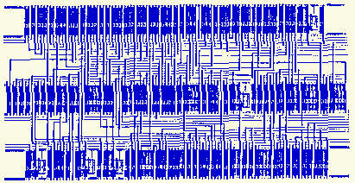
Immediate Rewards from Internship
One publication: Standard Cell Global Routing By Iterative Deletion [Cong-Preas, ICCAD’88]
Excitement to see my algorithm produce a real layout
A big layout by Tektronix plotter

Slide 12
A Life-Time Lesson
As a researcher in EDA, there is a tremendous benefit to be gained from involving VLSI circuit and system designs
  First-hand experience in formulation of new EDA problems
  Development of practical and impactful solutions
A big impact to my career development

Slide 13
Three Examples from My Career
BOOLEAN MATCHING FOR LUT-BASED FPGA SYNTHESIS
3D IC PHYSICAL DESIGN
HIGH-LEVEL SYNTHESIS

Slide 14
Example 1: Boolean Match for FPGA Synthesis with Complex PLBs
FPGAs become popular in early 1990s
Most FPGA synthesis algorithms map circuits into uniform-size LUTs
  Including our early work, e.g. FlowMap
But real FPGAs have complex PLBs
XC4K
F
x
H
G

Slide 15
Example: Mapping to XC4K CLB
Given a function f(0,1,2,3,4,5) where
  a = 1’ + 3, b = 1 + 3
  f = 0’245b’ + 0’245’b + 0’145b + 012’5’a + 0’2’4’5a + 025b + 0’2’5’a’ + 045a’ + 05’b’
How many XC4K CLBs are needed to implement f(0,1,2,3,4,5) ?

Slide 16
Example: Mapping to XC4K CLB (Cont’d)
3
The Boolean matching result
1
F
2
0
5
H
G
4

Slide 17
Boolean Matching Algorithm for XC4K CLB
Characterization based on functional decomposition
  f (X) = H ( F (X1) , G (X2) ),
  f(X) = H ( F (X1) , G (X2) , x ),
  f(X) = H (F(X1,x), G(X2), x ),
  f(X) = H (F(X1,x), G(X2,x), x ).
Conditions
  F and G input sizes ≤ 4
Result: matched all “difficult examples” (over 1,700) from Xilinx
  Best known tool produced only about 70% match
XC4K CLB
F
x
H
f(X)
G

Slide 18
Application to Architecture Evaluation
-- for MCNC benchmarks
Experiment: enumerate all K-input functions
XC4K CLB can implement
  98% of 6-input functions
  88% of 7-input functions

Slide 19
Application to Architecture Evaluation
(logic capability v.s. silicon area)
F
3,4,5
F
H1
H
XC5K
24-48 Memory cells
( > 4 or 5 inputs)
XC4K CLB
40 Memory cells
( > 5 inputs)
G
G
S
3,4
F
H
XC4K(0,4,3)
24 Memory cells
( > 4 inputs)
XC4K(3/4,4,2)
28,36 Memory cells
( > 4 inputs)
H
G
G

Slide 20
Example 2: 3D IC Physical Design
Motivations
  DARPA wanted to demonstrate 3D IC technology
  Intel wanted to understand the benefit of 3D architectures

Slide 21
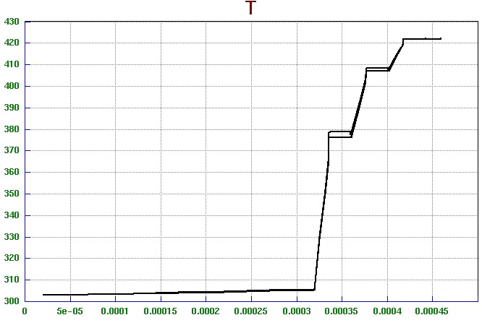
Thermal Challenges in 3-D ICs
Studied 3D IC Technologies from MIT Lincoln Lab
Key Challenge of 3-D IC Design:
  Higher power density due to the higher device density
  Inter-layer dielectric layers are poor thermal conductors
High Temperature Effects:
  Longer interconnect delays
  Functional failure
T
150ºC
135ºC
100ºC
30ºC
Si 1
Z
Si 2
Si 4
Si 3
Temperature increases dramatically along the Z direction
Notes:
One of the biggest challenge for 3-D IC design is the high temperature. It has already been an issue for 2-D chips. When it comes to the 3-D ICs, firstly, the power density in 3-D IC is much higher than the 2-D IC since the device density is higher. Also, the dielectric layer between the device layers are poor thermal conductors. Therefore the thermal problem in 3-D IC is even worse. Look at this figure, we can see that the temperature will increase dramatically along the z direction.
The high temperature will make the interconnect delay longer and even cause functional errors. Therefore, a 3-D IC design tool will have to consider the thermal problem.

Slide 22


Thermal-Aware 3D Physical Design Flow at UCLA (2002 – 2005)
Netlist (LEFDEF)
Design constraints
Technology
Thermal-Driven
3D Floorplanner
Thermal
Simulation
Open
Access
Compact
Thermal
model
Thermal-Driven
3D Placement
Timing
Analysis
Thermal-Aware
3D Router w/
Thermal Via Planning
Parasitic
Extraction
CIF/GDSII
Layout
Verification
Notes:
This is the overall framework of the whole 3D physical design flow.
We collaborated with CFD Research corporation on this project. They are responsible for the thermal profiling part and we mainly focus on the tool development.
The inputs include netlist, design constraints, such as timing and temperature constraints, and target 3D technology.
The design flow will go through floorplanning, placement and routing.
The system will output either CIF or GDSII and we will rely on external tools for design verification.
In this talk, I will cover the thermal-driven 3D routing with via planning in detail and will also briefly talk about the floorplanning algorithm.

Slide 23
3D Physical Design Flow (IBM, UCLA, and PSU)
(2006 – 2008)
Layer & Design Rules (LEF)‏
Cell & Via* definitions (LEF)‏
Netlist (HDL or DEF)‏
PSU
UCLA
Thermal-Driven 3D Floorplanner
3D RC extraction
3D OA
Timing
Interface
Tech. Lib
Thermal-Driven 3D Placer
EinsTimer
Ref. Lib
Design
3D DRC & 3D LVS
3D Global Router
Tier Export
Tier Import
Thermal-Via Planner
Layout (GDSII‏)
Detailed Routing by Cadence Router
2D OA
10/8/2007
UCLA VLSICAD LAB
23

Slide 24
3D Physical Design Evaluation (1/3)
Design driver: single-core LEON3
  Synthesized with NCSU standard cell library for MITLL 180nm silicon on insulator (SOI) 3D Integration technology
Statistics of the synthesized LEON3
  #cell = 95061
    Area = 11.05 mm²
  #net = 97880
  #I/O = 150

Slide 25
3D Physical Design Evaluation (2/3)
Chip area (utilization = 80%)
  2D implementation: 3.72 x 3.72 mm2
  3-tier 3D implementation: 2.15 x 2.15 mm2
Comparisons
 |  | HPWL (mm) | routed WL (mm) | #TSV | utilization
2D |  | 11.23 | 17.11 | N/A | 0.80
3D | Bottom tier | 2.26 | 3.33 | 0 | 0.80
 | Middle tier | 3.57 | 4.5 | 729 | 0.81
 | Top tier | 2.2 | 2.96 | 1191 | 0.81
 | Total | 8.03 | 10.79 | 1920 | 0.81

Slide 26
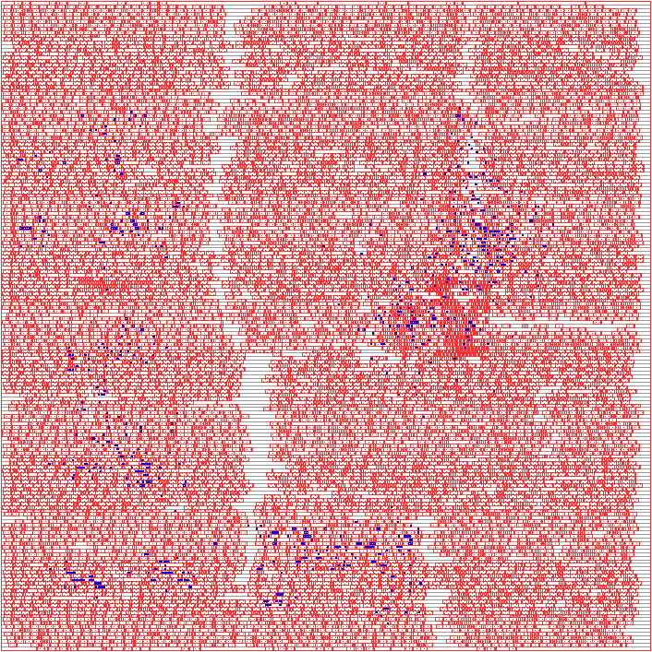
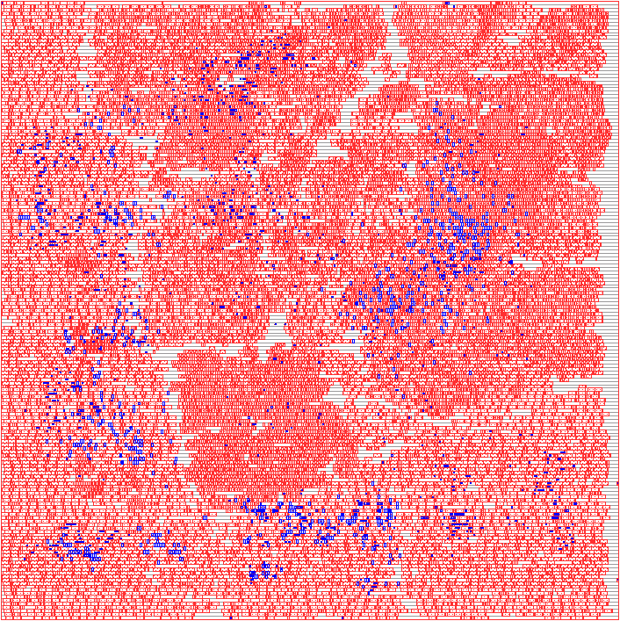
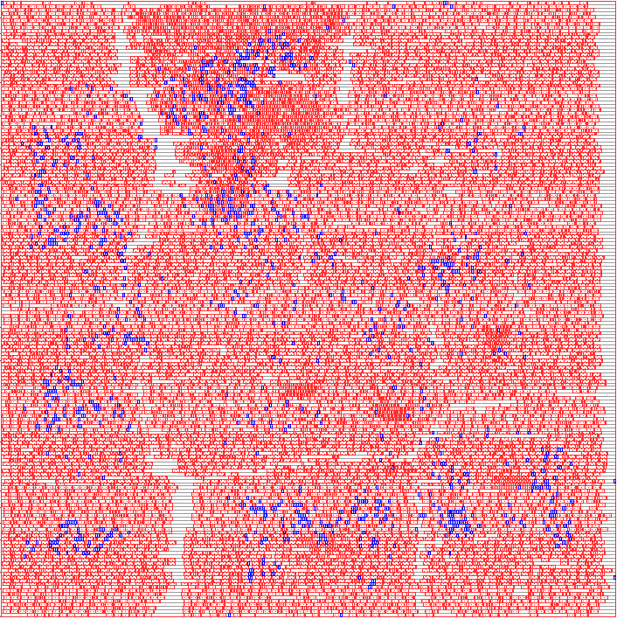
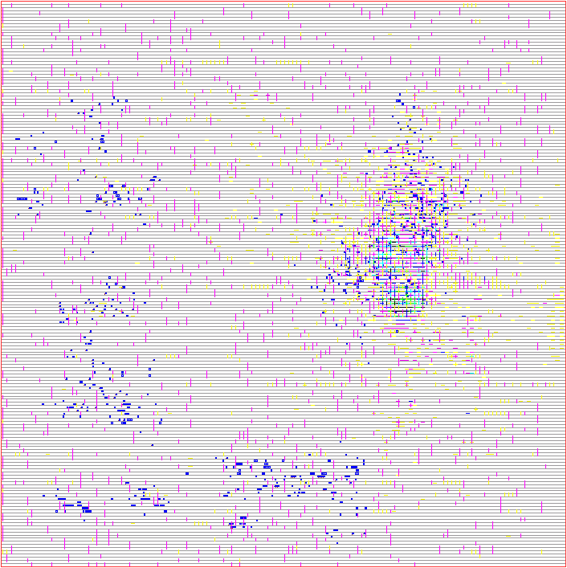
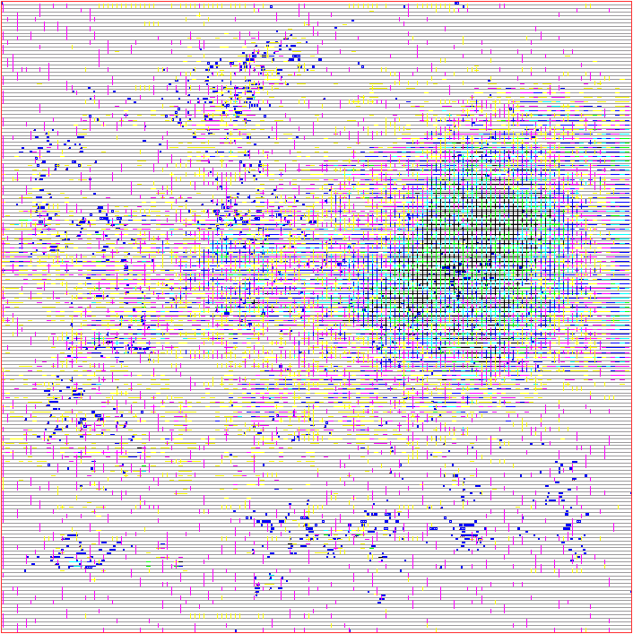
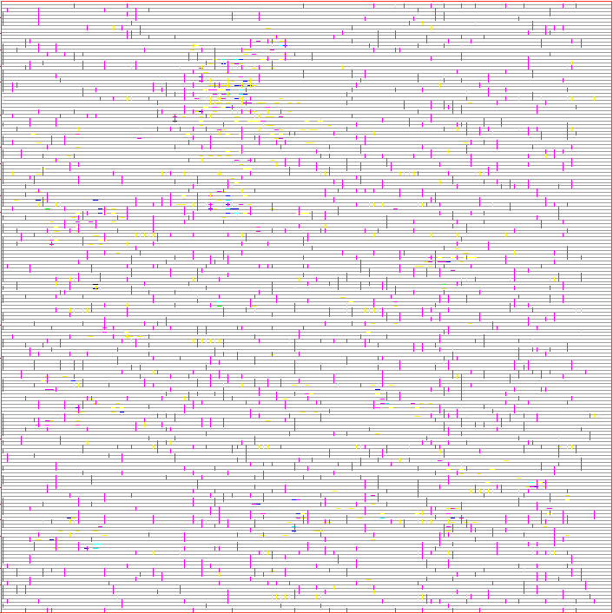
3D Physical Design Evaluation (3/3)
Bottom tier
Middle tier
Top tier
cells (red)
& TSVs (blue)
Routing congestions

Slide 27
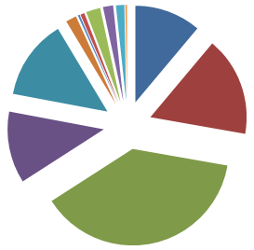
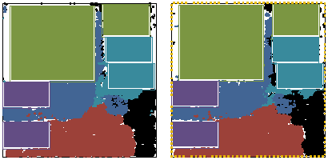
Flat 3D Placement
Other
Core
Debug support
Register file
HPWL = 0.99 (m)
#TSV = 3835
Placement (bottom layer, top layer)
TLB memory
Cache memory
UCLA VLSICAD LAB
27

Slide 28
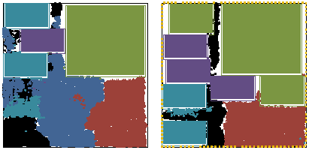
Processor Core Restricted
Other
Core
Debug support
Register file
HPWL = 1.09 (m)
#TSV = 1715
Placement (bottom, top)
TLB memory
Cache memory
UCLA VLSICAD LAB
28

Slide 29
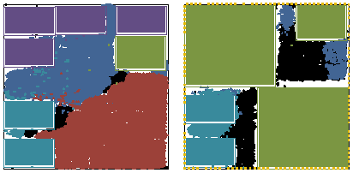
Register File Restricted
Other
Core
Debug support
Register file
HPWL = 1.20 (m)
#TSV = 845
Placement (bottom, top)
TLB memory
Cache memory
UCLA VLSICAD LAB
29

Slide 30
Temperature Map
Before Thermal Via Insertion
After Thermal Via Insertion

Slide 31
Example 3: High-Level Synthesis
In early 2000’s, Synopsys was abandoning their Behavior Compiler
We started research on high-level synthesis
  SOC design was prevailing – embedded processors + customized logic
  E.g. Xilinx Virtex-Pro (with embedded PowerPC core) and Altera Stratix (with Nios)

Slide 32
xPilot: Behavioral-to-RTL Synthesis Flow [SOCC’2006]
Behavioral spec.
in C/C++/SystemC
Code transformation & optimization
  Loop unrolling/shifting/pipelining
  Strength reduction / Tree height reduction
  Bitwidth analysis
  Memory analysis …
Platform
description
Frontend
compiler (LLVM)
Behavior synthesis & optimizations
  Scheduling
  Resource binding, e.g., functional unit binding register/port binding
SSDM
μArch-generation & RTL/constraints generation
  Verilog/VHDL/SystemC
  FPGAs: Altera, Xilinx
  ASICs: Magma, Synopsys, …
RTL + constraints
FPGAs/ASICs

Slide 33
xPilot was Licensed to AutoESL for Commercialization
Design Specification
C/C++/SystemC
User Constraints
Common Testbench
AutoPilotTM
Platform-based & communication-centric ESL synthesis
Automated ESL-to-GDSII silicon compilation
Rapid platform-based system-level exploration
More than 10X design productivity gain
Simulation, Verification, and Prototyping
Compilation &
Elaboration
ESL Synthesis
Advanced Code
Transformation
Behavioral & Communication
Synthesis and Optimizations
Platform
Characterization
Library
=
RTL HDLs &
RTL SystemC
Timing/Power/Layout
Constraints
FPGA
Prototype
ASICs/FPGAs
Implementation
Notes:
AutoPilot provides a novel platform-based, communication-centric ESL synthesis flow that automatically generates high-quality RTL
code from behavior-level and system-level C/C++/SystemC, which we believe is “The Easiest Path from ESL to Silicon”.
System-level designers can simply use C, C++, or SystemC to describe the system functionalities and behaviors, and these descriptions together with the user constraints can be directly passed to our AutoPilot synthesis tool.
AutoPilot goes through three major steps to synthesize the high-level untimed or partially-timed behavioral specifications to fully-timed RTLs.
Front-end compilation and elaboration to parse in your input design and analyze the semantics of the hardware-specific constructs in SystemC.
Advanced and aggressive code transformations to optimize the C/C++ or SystemC code.
Afterwards, we do core synthesis and optimizations. The synthesis process is platform-dependent and communication-centric. We consider both behavior and communications, and optimizes logics and interconnects simultaneously.
The outputs from AutoPilot include the RTL HDLs in either VHDL or Verilog and the timing/power/layout constraints to guide the downstream RTL synthesis and physical design tools. We also generate the RTL SystemC for simulation and verification. The idea is that we can use the same SystemC testbench to check the functional equivalence of the original C/System spec and the synthesized RTL.
Overall, AutoPilot delivers the following key benefits to the ESL designers.
It provides platform-based & communication-centric synthesis
It offers automated esl-to-gdsii silicon compilation
It helps rapid system-level “what-if” analysis and exploration
As a result, AutoPilot enables more than 10x design productivity gain

Slide 34
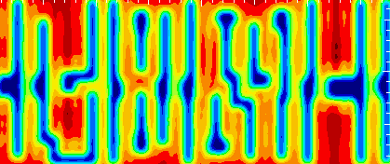
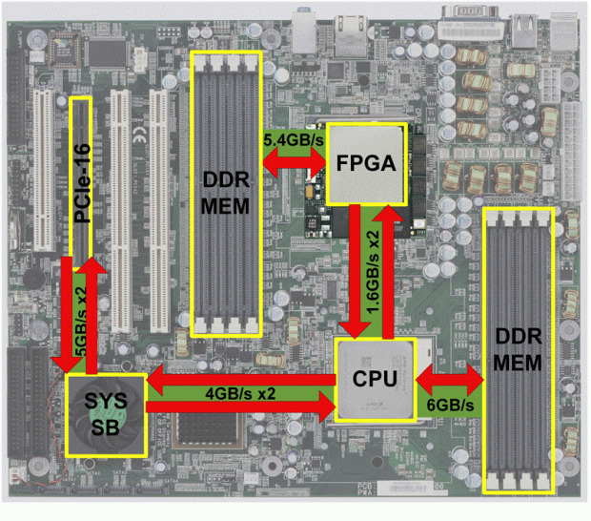
We were also the First Users – E.g. Acceleration of Lithographic Simulation with AutoPilotTM
Ι(x,y) = Σ λ_{κ} ∗
| Σ τ [ψ_{κ}(x−x₁, y−y₁) −
ψ_{κ}(x−x₂, y−y₁) + ψ_{κ}(x−x₂, y−y₂) − ψ_{κ}(x−x₁, y−y₂)] |²
Algorithm in C
Lithography simulation
  Simulate the optical imaging process
  Computational intensive; very slow for full-chip simulation
AutoPilotTM
Synthesis Tool
15X+ Performance Improvement vs.
AMD Opteron 2.2GHz Processor with automated compilation
XtremeData X1000 development system (AMD Opteron + Altera StratixII EP2S180)
Notes:
We’ve used AutoPilot to accelerate a lithographic aerial image simulation application, which is an essential component in most DFM (Design for Manufacturability) flows. The lithography simulation itself is a very computationally demanding process and often requires clusters with hundreds CPUs to achieve acceptable turn-around time.
The whole algorithm is written in 2226 lines of C code and synthesized by AutoPilot, which generates about 24K lines of VHDL code.
The accelerator has been implemented on XtremeData XD1000 development system. The development system uses a dual Opteron motherboard
and one of the Opteron processors is replaced by an XD1000 co-processor module. The XD1000 co-processor is built around an Altera Stratix II EP2S180. The FPGA co-processor communicates with the host Opteron CPU via the HyperTransport links.
To measure the performance speedup, we conduct experiments on a 200umx200um chip layout specified in GDSII format. The FPGA accelerated implementation runs 15x faster than the pure software implementation on an AMD Opteron 248 processor at 2.2GHz with a 4GB DDR memory.

Slide 35
Needs for Automated Loop Transformations
Loop over pixels
Loop over kernels
Loop over layout corners
Loop over kernels
Loop over layout corners
Loop over pixels
Loop interchange
Different kernels do not have much correlation, thus put to the outer loop
Fix one specific layout corner, loop over pixels for more regular data access

Slide 36
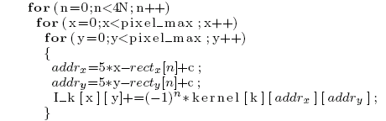
Need Automated Loop Unrolling
Loop unrolling is one option to express parallelism in those tools
The improvement by loop unrolling is limited due to port conflicts
  Data access of the same array cannot be scheduled to the same cycle due to port conflicts
  May increase the initial interval when both loop pipelining and loop unrolling is used
Loop unrolling

Slide 37
Needs of Automated Memory Partitioning
Unrolling did not solve the problem completely due to port conflictions
Need a multi-port (on-chip) mem with a large number of ports!
  Implement the multi-port mem via memory partitioning
Computing tasks can be done in parallel once we get the multiple data in parallel
  Each PE is responsible for computing one partition of image
  Each PE composed of one partition of kernel and one partition of image partial sum
  Multiplexing logic gets the data from
  different partitions of kernel and provides
  the data for each PE
  To compute one partition of image,
  might also need the kernel data in
  other partitions
Kernel partition 1
Kernel partition 2
Computing Element
Computing Element
Image
Partial Sum partition 1
Multi
plexing
Logic
Image
Partial Sum partition 2
One partition
of Kernel
Kernel partition 4
Kernel partition 3
Computing Element
Computing Element
One partition of Image
Partial Sum
Image
Partial Sum partition 4
Image
Partial Sum partition 3
4-PE example

Slide 38
Outcome: AutoPilot Became Highly Competitive
E.g. Xilinx results before acquisition
Wireless MIMO Sphere Decoder
  ~4000 lines of C code
  Xilinx Virtex-5 at 225MHz
Compared to optimized IP
  11-31% better resource usage
Metric | RTL Expert | AutoPilot Expert | Diff (%)
LUTs | 32,708 | 29,060 | -11%
Registers | 44,885 | 31,000 | -31%
DSP48s | 225 | 201 | -11%
BRAMs | 128 | 99 | -26%
TCAD April 2011 (keynote paper)
“High-Level Synthesis for FPGAs: From Prototyping to Deployment”
Notes:
38

Slide 39
Concluding Remarks
I was very fortunate to have Bryan as my mentor in my internship at Xerox PARC
  Benefited immensely from Bryan’s vast experience, deep insight, and remarkable wisdom
  A long-term friendship
The truly important lesson that I learned from Bryan
  Go from design to design automation
  Gain first-hand knowledge and experience about needs from the designer’s perspective, to discover and formulate new EDA problems and develop impactful solutions.

Slide 40
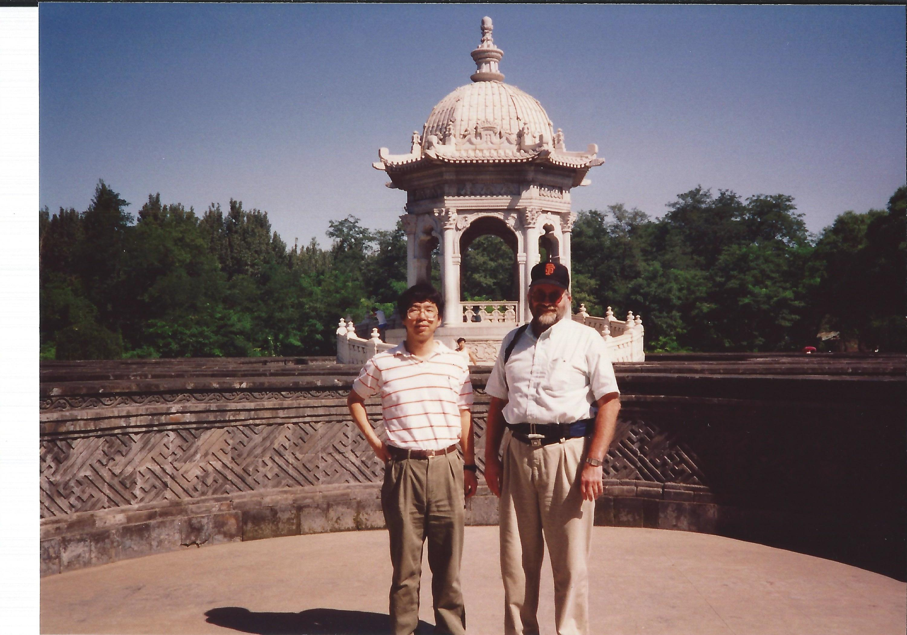
Guess Where This Picture Is Taken?

