Slide 1

Self-Aligned Double Patterning Aware Pin Access and Standard Cell Layout Co-Optimization
Xiaoqing Xu¹, Brian Cline², Greg Yeric²,
Bei Yu¹, David Z. Pan¹
¹University of Texas at Austin
²ARM Inc, Austin
Notes:
This is a co-work with ARM Austin, put an ARM logo

Slide 2
Outline
Introduction & Motivations
SADP-Aware Pin Access and Optimization
Experimental Results
Summary & Future work
Notes:
Beyond single patterning, limits of conventional lithography. Motivation on SADP and line-space array based layout decomposition
Rule based SADP-Aware Layout design -> SADP-Aware pin access.
Experimental results to demonstrate the effectiveness of our methodology… Summary and future work

Slide 3
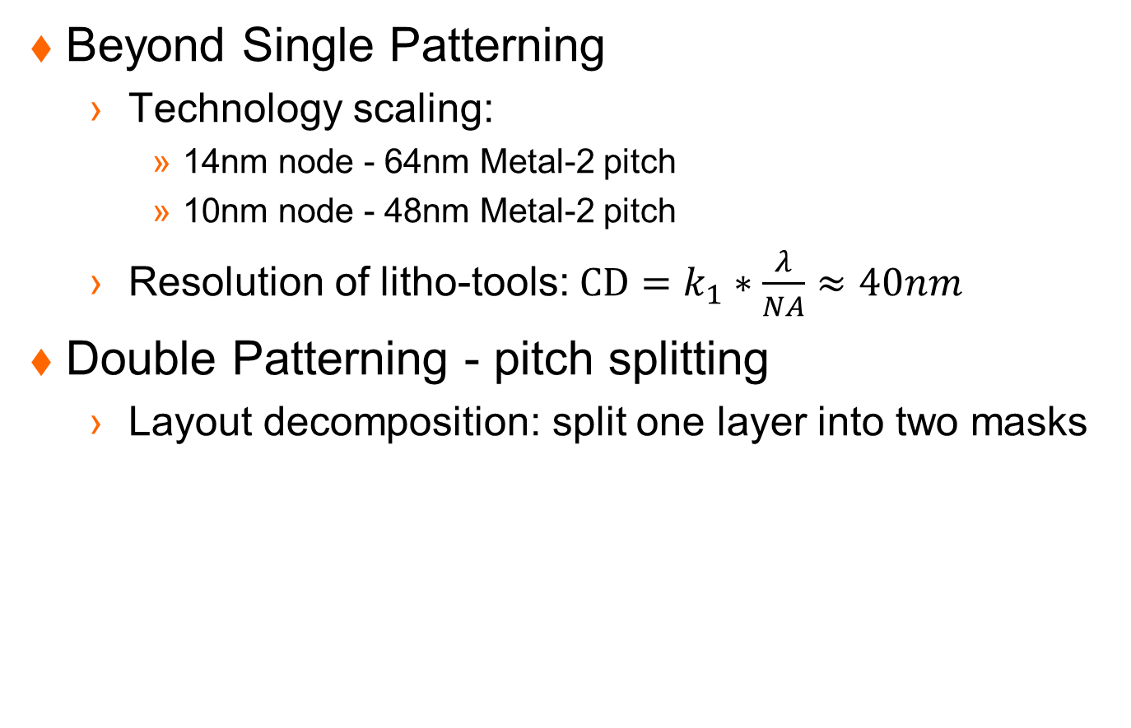
Need of Double Patterning
Beyond Single Patterning
  Technology scaling:
    14nm node - 64nm Metal-2 pitch
    10nm node - 48nm Metal-2 pitch
  Resolution of litho-tools: $CD=k_{1}∗\frac{λ}{NA}≈40nm$
Double Patterning - pitch splitting
  Layout decomposition: split one layer into two masks
MinPitch
2*MinPitch
Notes:
Beyond single patterning. Technology scaling on Metal-2 pitch …. Beyond 14nm node, we need double patterning for the Metal-2 layer
Why double patterning will further reduce the minimum pitch

Slide 4
Two Kinds of DPL
Litho-Etch-Litho-Etch (LELE)
Self-Aligned Double Patterning (SADP)
  Better overlay control, but more layout constraints
Main Mandrel
Additional Mandrel
Sub-Metal
Spacer
Trim Mask
Notes:
Space variation between tracks means parasitic capacitance variation, which leads to timing variation. For SADP, the space is defined by the width of spacer, which is more controllable.
The better overlay control is based on the assumption that the space between neighbor tracks are defined by the spacer width

Slide 5
SADP Layout Decomposition
Mandrel
Mandrel
Mandrel

Slide 6
Recap: Trim Mask is Single Patterned
(a)
(b)
(c)
(d)
Main Mandrel
Additional Mandrel
Sub-Metal
Spacer
Trim Mask
[G. Luk-Pat+, SPIE’13]
Notes:
We suppose the Metal-2 wires will be extreme regular in 10nm and beyond. Line-Space array based decomposition is an ideal candidate for the layout decomposition. Good overlay control and straightforward layout decomposition. However, this is based on the assumption that the Metal-2 regular layout is SADP-compatible.
Line-space array decomposition. SADP layout decomposition still needs the coloring stage. Assign different colors to neighbor tracks. To define the edge of some sub-metal, need to add additional mandrel if necessary. Group the spacer around the mandrel defined shapes. Finally, the trim mask helps to define the final shapes of layout. Basically, the geometric boolean operation Trim Mask NOT Spacer defines the final patterns.
It seems the trim mask, sometimes called cut mask, need to be carefully design so that it can be single patterned.

Slide 7












SADP-specific Design Rules
To ensure trim mask printability
$$l_{1}$$
$$l_{2}$$
$$l_{2}$$
$$l_{1}$$
OnTrackSpace $≥l_{1}$
OffTrackOverlap $≥l_{2}$
Mandrel
$$l_{4}$$
Trim Mask
$$l_{3}$$
Sub-Metal
$$l_{4}$$
$$l_{3}$$
Spacer
OffTrackSpace $≥l_{3}$
OffTrackoffset $≥l_{4}$ or $=0$
[Y. Ma+, SPIE’12], [G. Luk-Pat+, SPIE’13]
Notes:
Visualize all the design rules. OnTrackSpace = 32nm, OffTrackOverlap = 58nm, OffTrackSpace = 22nm, OffTrackOffset = 44nm. M2_pitch = 48nm,
Spacer_width = 24nm
We need to stress that these design rules originates from the single patterned trim mask. Explain more clearly!!!

Slide 8


Line-end Extension
To fix hot-spots on trim masks
Hot spot
Via-1
(a) OffTrackOverlap $≥l_{2}$
Mandrel
Trim Mask
Hot spot
Sub-Metal
Spacer
(b) OffTrackoffset $≥l_{4}$ or $=0$
Notes:
To further demonstrate the design rules, these design rules originate from the Line-space layout decomposition and the hot spots on trim masks
But interestingly, these hot spots are fixable if we allow for line-end extensions of Metal wires.
Moreover, to relate the line-end extension to the Metal-2 wires for pin access. Via-1 layers are demonstrated in the figures. Specifically, allowing for line-end extensions, we can not simply depend on the Via-1 position to determine the line-end position of Metal-2 wires.

Slide 9
Previous Work on SADP
SADP layout decomposition
  [H. Zhang+, DAC’11], [Y. Ban+, DAC’11]
  [Z. Xiao+, ISPD’12]
SADP-aware routing
  [M. Mirsaeedi+, SPIE’11], [J.-R. Gao+, ISPD’12]
  [C. Kodama+, ASPDAC’13], [Y. Du+, DAC’13]
However, not much on standard cell pin access which is very challenging (Keynote by Dr. Aitken)
Notes:
Add an additional step to physical design. Layout decomposition, well studied topic, similar to the LELE based layout decomposition
Layout decomposition can not resolve native conflicts. Incorporate the SADP awareness into early design stages, like detailed routing.
However, as far as we are concerned, there is no previous work on the local impact of SADP-aware routing.
To be more specific, detailed routing aims to connect each I/O pin of standard cells together. The local impact involves the local pin access of standard cells. In this work, we deal with the pin access design in standard cell level. If we aim to use SADP in Metal-2 layer, Metal-2 wires involves the cell design and detailed routing simultaneously.

Slide 10
Our Contributions
First work to address standard cell I/O pin access design/local routing at the cell level
We propose a MILP-based method to enable SADP-aware layout design for pin access and within-cell connections
Our method can maximize the pin access flexibility for the entire standard cell library
Notes:
Add an additional step to physical design. Layout decomposition, well studied topic, similar to the LELE based layout decomposition
Layout decomposition can not resolve native conflicts. Incorporate the SADP awareness into early design stages, like detailed routing.
However, as far as we are concerned, there is no previous work on the local impact of SADP-aware routing.
To be more specific, detailed routing aims to connect each I/O pin of standard cells together. The local impact involves the local pin access of standard cells. In this work, we deal with the pin access design in standard cell level. If we aim to use SADP in Metal-2 layer, Metal-2 wires involves the cell design and detailed routing simultaneously.

Slide 11
Outline
Introduction & Motivations
SADP-Aware Pin Access and Optimization
  Backtracking
  Pin Access Optimization
Experimental Results
Summary & Future work
Notes:
Beyond single patterning, limits of conventional lithography. Motivation on SADP and line-space array based layout decomposition
Rule based SADP-Aware Layout design -> SADP-Aware pin access.
Experimental results to demonstrate the effectiveness of our methodology… Summary and future work

Slide 12
Standard Cell Pin access
Metal-2 line-end position vs Via-1 position
Metal-2 line end extension
(a)
(b)
Metal-1 pin
Via-1
Metal-2 wire
Metal-2 extension
Notes:
We did not show the full layout of a cell, just the Metal-1 pins and Metal-2 wires for within cell connections.
Motivation for optimization:
For large design, need a automatic method to fix these rule violations.
Greedy may not be enough. The total amount of line-end extension is not minimized, which may leads to more coupling capacitance on Metal-2
For a specific cell and specific pin access style, we need to determine whether all rule violations are fixable
In standard cell level, it would be interesting to evaluate the pin access flexibility across the entire library

Slide 13
Pin Access and Std-Cell Layout Co-Opt (PICO)
Problem formulation
  Given cell layout, multiple I/O Pins for each cell, and multiple Hit Points for each I/O Pin
  Design all Valid Hit Point Combinations (Metal2) for each cell in library
Cell connection
Hit Point
Metal-1 pin
(a)
Routing track
(b)
Pin access
Via-1
Metal-2 extension
Metal-2 wire
(c)
(d)
Notes:
Important: stress “all”, because for one cell in the physical design, it may be instantiated for multiple times, but with different accessing style, which means it may use different hit point combinations to access the same cell. That’s why we wanna find all valid hit point combinations.
The cell layout of Metal-1 I/O pins and within-cell connections. The Metal-2 routing tracks are running horizontally.
The intersection between Metal-2 routing tracks and I/O pins become the hit point for that particular I/O pin. We need to emphasize that the Via1 (from M1 to M2) positions defined the position of HitPoints
The definition of Hit Point combination, a set of hit points, with one hit point for each I/O pin and assigned direction of each hit point, either from left to right or from right to left. Then, we have the initial pin access as shown in previous slide.

Slide 14
Proposed Solution
Cell Layout
PICO
I/O Pins
Hit Points
Hit Point Combination
search tree
PAO
Backtracking
reduce search space
1: Line-end extension minimization
2: Rules to linear constraints
Pin Access Optimization
3: MILP optimization

Slide 15


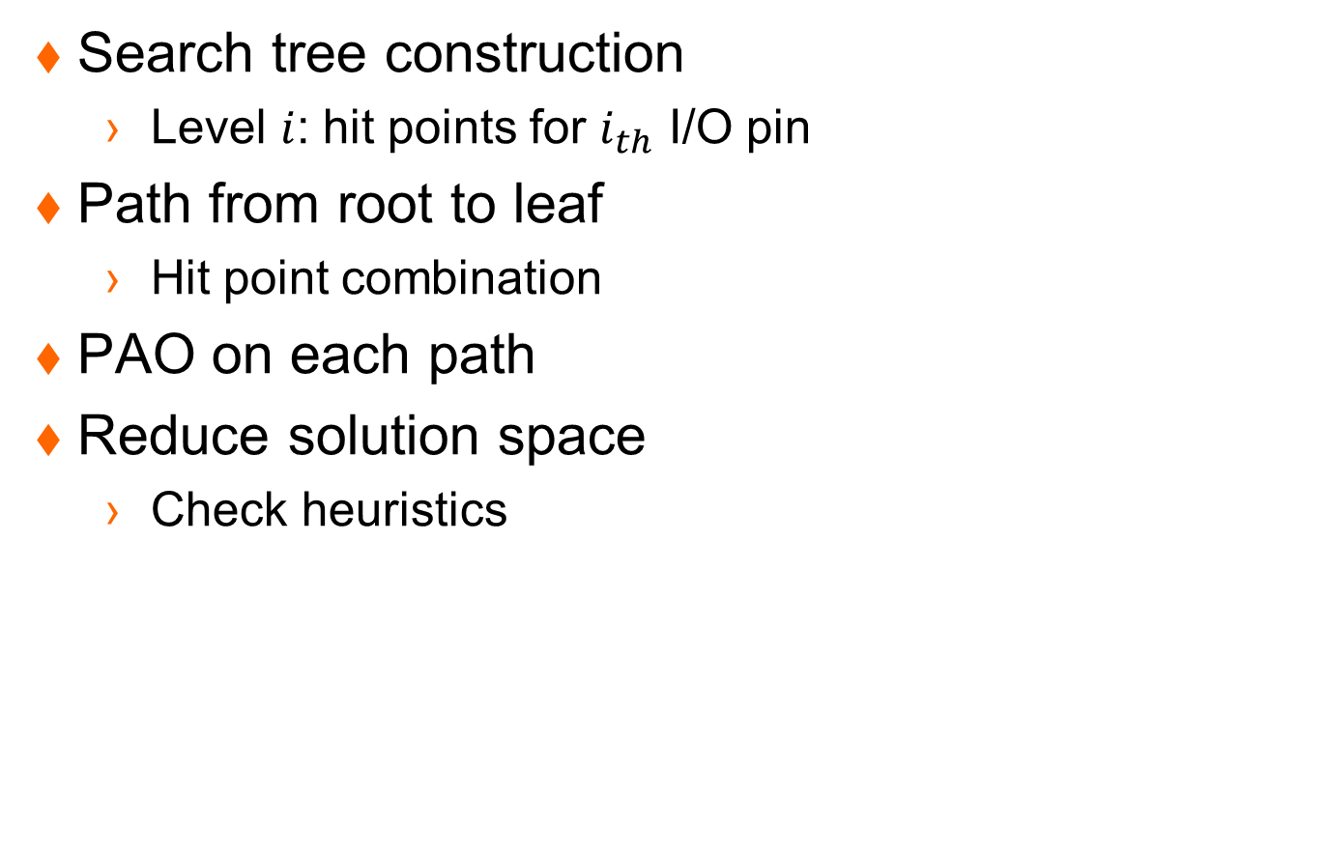







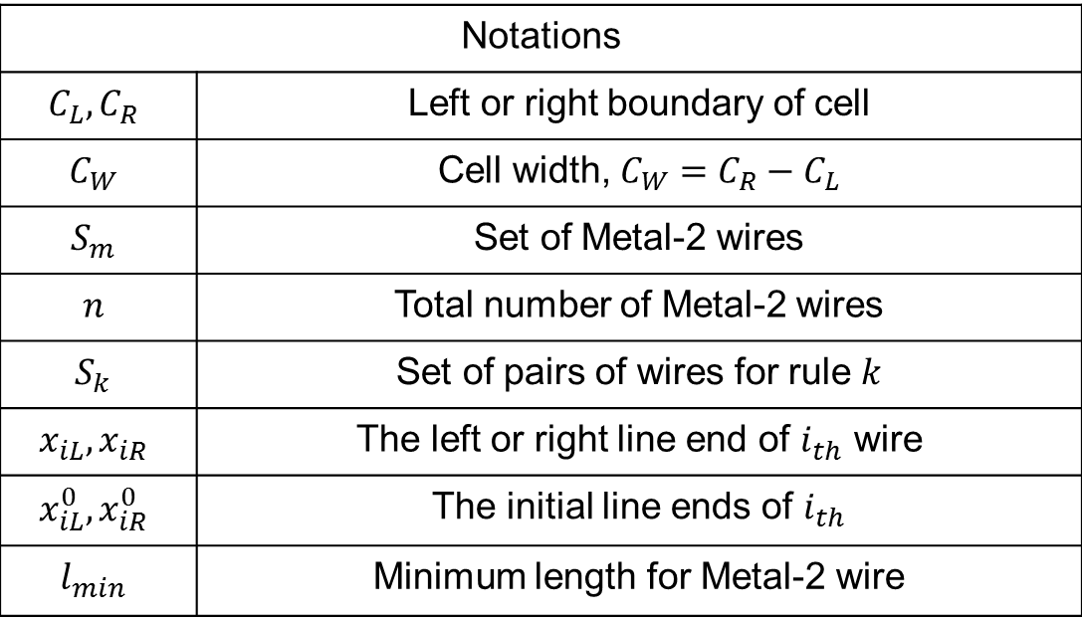




Backtracking for all Hit Points
Search tree construction
  Level $i$: hit points for $i_{th}$ I/O pin
Path from root to leaf
  Hit point combination
PAO on each path
Reduce solution space
  Check heuristics
$$S$$
I/O pin 1
$$p_{1}^{1}$$
$$p_{1}^{2}$$
$$p_{1}^{k_{1}}$$
I/O pin 2
$$p_{2}^{1}$$
$$p_{2}^{2}$$
$$p_{2}^{k_{2}}$$
I/O pin 3
$$p_{3}^{1}$$
$$p_{3}^{2}$$
$$p_{3}^{k_{3}}$$
I/O pin $m$
$$p_{m}^{1}$$
$$p_{m}^{2}$$
$$p_{m}^{k_{m}}$$
Notes:
Not equation but relation for Linear Programming
Tricky observation: the left edge can only be extended to left, the right edge can only be extended to right

Slide 16
Pin Access Optimization (PAO)
Problem formulation
  Given cell layout and a Hit Point Combination
  Evaluate the validness of the Hit Point Combination and design the Pin Access optimally
Pin access
(a)
(b)
Metal-1 pin
Via-1
Routing track
Metal-2 wire
Metal-2 extension
Notes:
We need to emphasize that the Via1 (from M1 to M2) positions defined the position of HitPoints

Slide 17









Mathematical Formulation
Objective function
  Line-end extension minimization
  Objective function:$\sum_{i=1}^{i=n}{ {(x_{iL}^{0}−x}_{iL})+(x_{iR}−x_{iR}^{0})}$
$$x_{iL}^{}$$
$$x_{iL}^{0}$$
$$i_{th}$$
$$j_{th}$$
$$x_{jR}^{0}$$
$$x_{jR}^{}$$
$$C_{L}^{}$$
$$C_{R}^{}$$
Notes:
Key observation: the left edge can only be extended to left, the right edge can only be extended to right

Slide 18












Mathematical Formulation – cont’d
Rules to constraints
  Basic rules
  SADP-specific rules
$$C_{L}{≤x}_{iL}^{}≤x_{iL}^{0}$$
$$x_{iR}^{0}≤x_{iR}≤C_{R}$$
$$x_{iR}−x_{iL}≥l_{min}$$
$$i_{th}$$
$$x_{iL}^{0}$$
$$x_{iR}^{0}$$
$$l_{1}$$
$$l_{2}$$
OnTrackSpace $≥l_{1}$
OffTrackOverlap $≥l_{2}$
$$l_{4}$$
$$l_{3}$$
OffTrackSpace $≥l_{3}$
OffTrackoffset $≥l_{4}$ or $=0$
Notes:
We only need to evaluate the local routing impact, namely pin access. Hence, the Metal-2 wires are restricted within the boundary of the standard cell. The minimum area rule of Metal-2 transfers to the minimum length rule because we set determined width for Metal-2 wire.

Slide 19














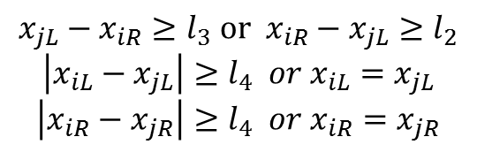






Mathematical Formulation – cont’d
SADP-specific rules
  Case 1
  Case 2
  Case 3
$$i_{th}$$
$$j_{th}$$
$$x_{jL}−x_{iR}≥l_{1}$$
$$x_{iL}^{0}$$
$$x_{iR}^{0}$$
$$x_{jL}^{0}$$
$$x_{jR}^{0}$$
$$x_{iR}−x_{jL}≥l_{2}$$
$$x_{jR}−x_{iL}≥l_{2}$$
$$\left|x_{iL}−x_{jL}\right|≥l_{4} or x_{iL}=x_{jL}$$
$$\left|x_{iR}−x_{jR}\right|≥l_{4} or x_{iR}=x_{jR}$$
$$i_{th}$$
$$x_{iL}^{0}$$
$$x_{iR}^{0}$$
$$j_{th}$$
$$x_{jL}^{0}$$
$$x_{jR}^{0}$$
$$i_{th}$$
$$x_{jL}−x_{iR}≥l_{3} or { x}_{iR}−x_{jL}≥l_{2}$$
$$\left|x_{iL}−x_{jL}\right|≥l_{4} or x_{iL}=x_{jL}$$
$$\left|x_{iR}−x_{jR}\right|≥l_{4} or x_{iR}=x_{jR}$$
$$x_{iL}^{0}$$
$$x_{iR}^{0}$$
$$j_{th}$$
$$x_{jL}^{0}$$
$$x_{jR}^{0}$$
Notes:
The trade-off between the constraints and flexibility of the SADP-specific design rules.
Linear programming formulation can not be directly applied here. F.-L. Heng+;ISPD’97, R. S. Ghaida+;TCAD’13

Slide 20

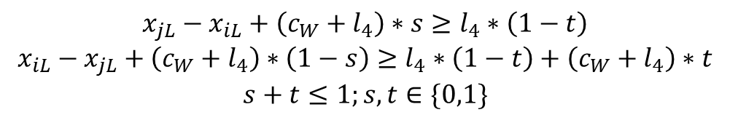

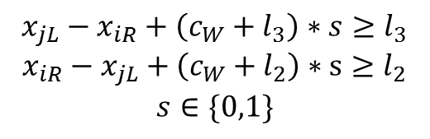

MILP Formulation (PAO)
Objective function:$\sum_{i=1}^{i=n}{ {(x_{iL}^{0}−x}_{iL})+(x_{iR}−x_{iR}^{0})}$
Linearize constraints: big-M transformation
  $∀x_{iL},x_{jR}⇒|x_{iL}−x_{jR}|≤c_{W}$ (value for “big-M”)
Remove “or” in constraints
  $$x_{jL}−x_{iR}≥l_{3} or x_{iR}−x_{jL}≥l_{2}$$
$$x_{jL}−x_{iR}+\left(c_{W}+l_{3}\right)∗s≥l_{3}$$
$$x_{iR}−x_{jL}+\left(c_{W}+l_{2}\right)∗s≥l_{2}$$
$$s∈\{0,1\}$$
$$\left|x_{iL}−x_{jL}\right|≥l_{4} or x_{iL}=x_{jL}$$
$$x_{jL}−x_{iL}+\left(c_{W}+l_{4}\right)∗s≥l_{4}∗\left(1−t\right)$$
$$x_{iL}−x_{jL}+\left(c_{W}+l_{4}\right)∗\left(1−s\right)≥l_{4}∗\left(1−t\right)+\left(c_{W}+l_{4}\right)∗t$$
$$s+t≤1;s, t∈\{0,1\}$$
Notes:
The key point: the integers in our formulation originates from the “or” relations of the constraints because we wanna make full use of the flexibility that SADP-specific design rules.

Slide 21
Recap of the Overall Flow
Cell Layout
PICO
I/O Pins
Hit Points
Hit Point Combination
search tree
PAO
Backtracking
reduce search space
1: Line-end extension minimization
2: Rules to linear constraints
Pin Access Optimization
3: MILP optimization

Slide 22
Experimental Results
Experimental setup
  Linux with 3.33GHz Intel(R) Xeon(R) CPU X5680
  Industrial 14nm library scaled to 10nm-dimensions
An example after PAO
(a)
(b)
Notes:
We use CBC as our MILP solver and all experiments are performed on a Linux machine with 3.33GHz Intel(R) Xeon(R) CPU X5680.
The width and space of Metal-2 wires are assumed to be 24nm. The spacer deposit width is set as 24nm.
For trim mask design, the minimum resist width and space are set as 44nm and 46nm, respectively.
The etch bias is set as 6nm

Slide 23
Experimental Results
Increase in Valid Hit Point Combinations
  More valid hit point combinations lead to more flexibility for routing

Slide 24
Experimental Results
Increase in ratio on the number of Valid Hit Point Combinations across the entire library

Slide 25
Experimental Results
Increase in ratio on the number of Valid Hit Points across the entire library
  Over 25% of cells have 20% or more increase
Notes:
To further evaluate the effectiveness of our algorithm, we have the definition of valid hit point, the hit point is defined to be valid if it can be access from both directions within some valid hit point combination.

Slide 26
Experimental Results – Run Time
Most cells finished within 500 seconds
Pin access design is one time computation
Notes:
For PAO, the ILP optimization can be finished within 0.1s

Slide 27
Summary & Future Work
Summary
  The impact of SADP has on local routing (Pin Access Design) is studied
  Pin Access and within-cell connections on Metal-2 are co-optimized
  Hit Points of different I/O pins are coupled
  Hit Point Combinations are important
Future work
  Pin access information extraction from PICO for standard cell library
  Handshake between pin access and routing

Slide 28
Thank you!
Q&A

Slide 29
Proposed Solutions
Design rule check and fix
Cell connection
Hit Point
(a)
Pin access
(b)
(c)
(d)
Metal-1 pin
Via-1
Routing track
Metal-2 wire
Metal-2 extension

Slide 30
Proposed solution
SADP-Aware Pin Access
PICO
1: I/O Pins & Hit Points
Cell Layout
2: Hit Point Combination: search tree
3: Backtracking: reduce search space
4: Pin Access Optimization
Pin Access Optimization
SADP design rules
1: Line-end extension minimization
2: Rules to linear constraints
3: MILP optimization
Pin access design

Slide 31
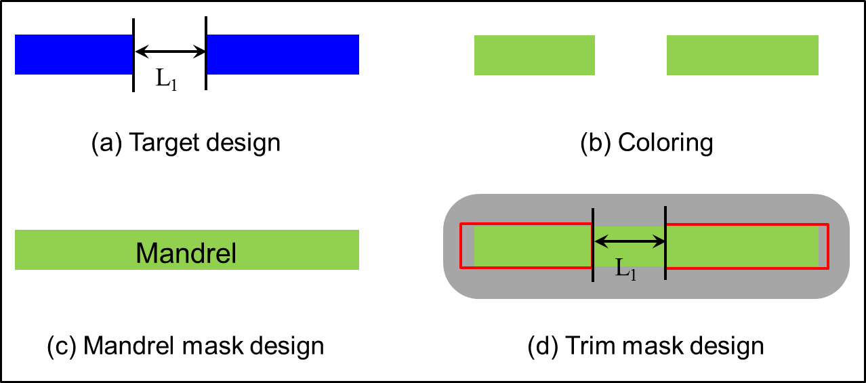
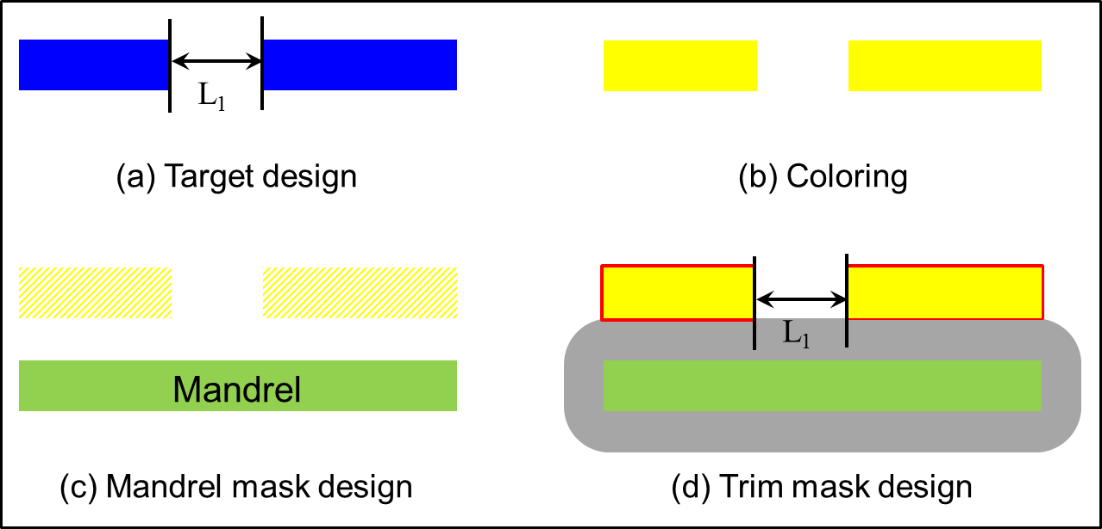
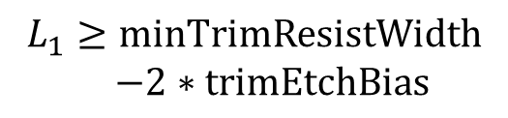
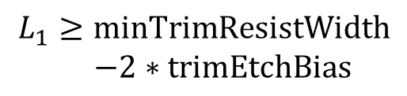
SADP-Aware Layout Design
SADP-Aware Design Rule (Case I: OnTrackSpace)
$$L_{1}≥minTrimResistWidth$$
$−2∗trimEtchBias$
$$L_{1}≥minTrimResistWidth$$
$−2∗trimEtchBias$

Slide 32
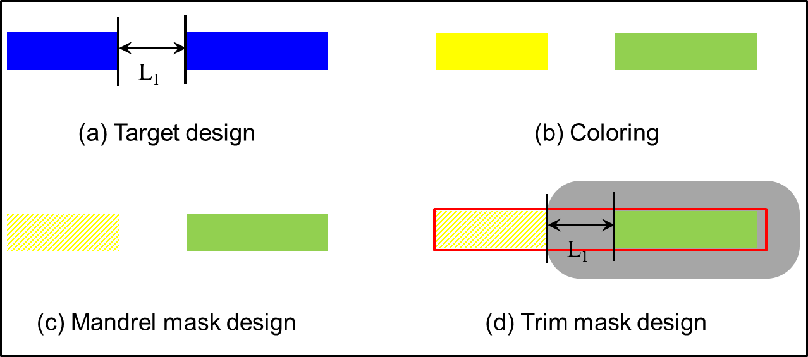
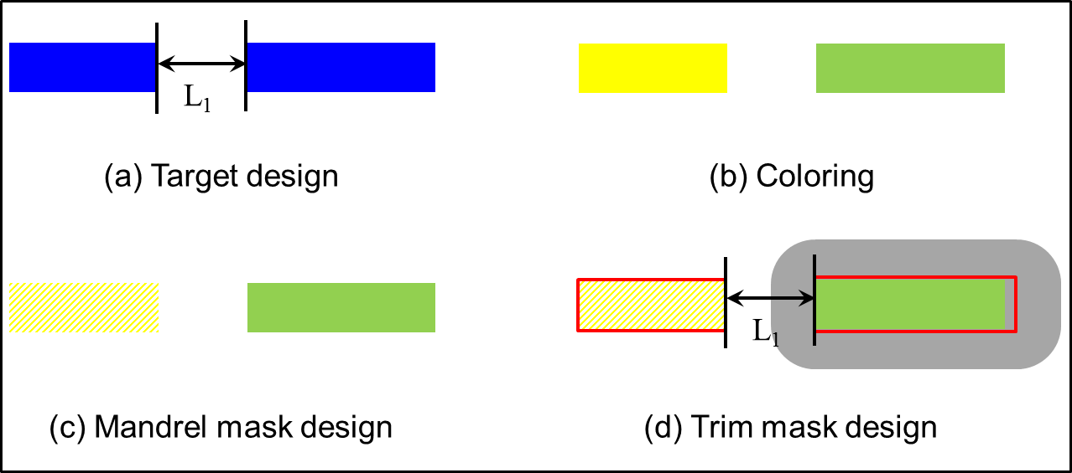
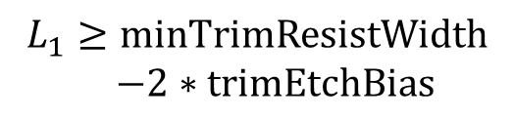

SADP-Aware Layout Design
SADP-Aware Design Rule (Case I, Cont’d)
$$L_{1}=SpacerDepositWidth$$
$$L_{1}≥minTrimResistWidth$$
$−2∗trimEtchBias$

Slide 33
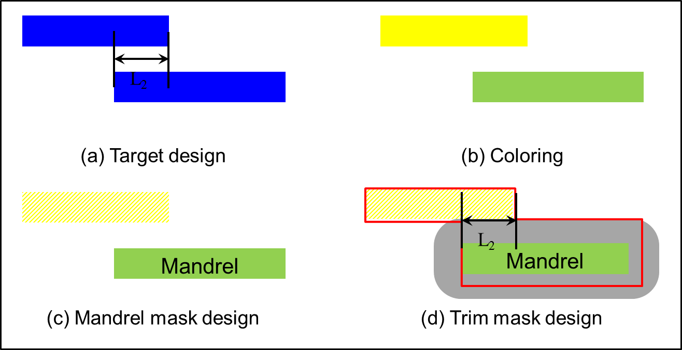
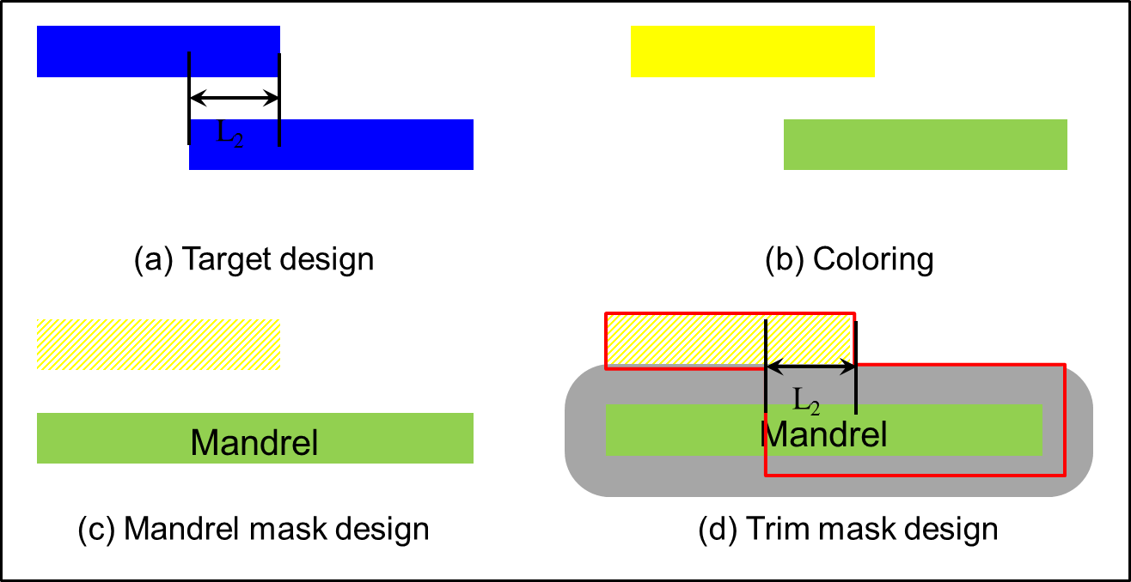
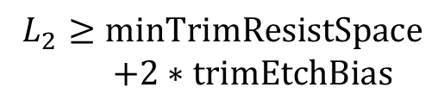
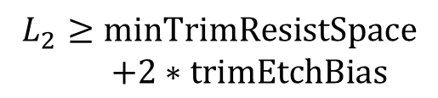
SADP-Aware Layout Design
SADP-Aware Design Rule (Case 2: OffTrackOverlap)
$$L_{2}≥minTrimResistSpace$$
$+2∗trimEtchBias$
$$L_{2}≥minTrimResistSpace$$
$+2∗trimEtchBias$
Notes:
Here, we need to mention the rounding effects during patterning. That gives us the minTrimResistSpace and minTrimResistWidth

Slide 34
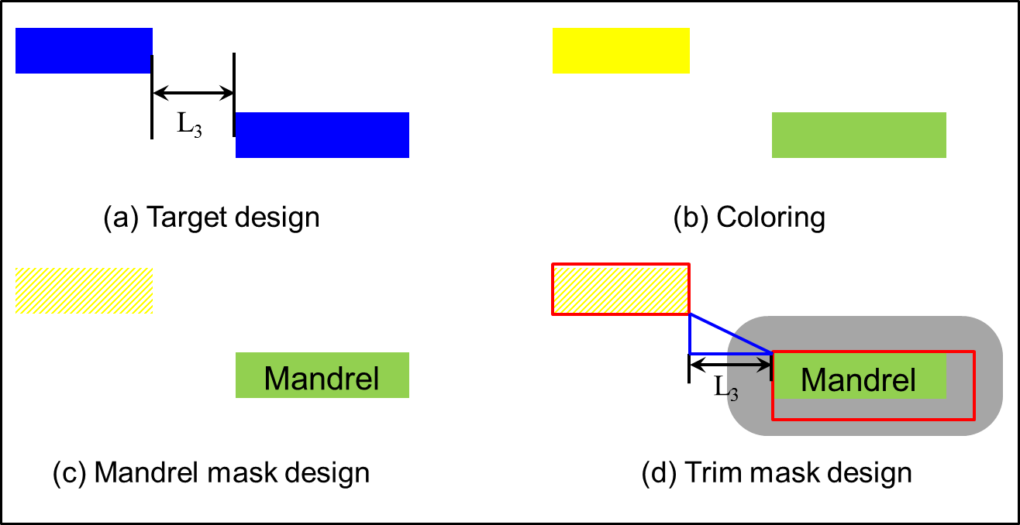
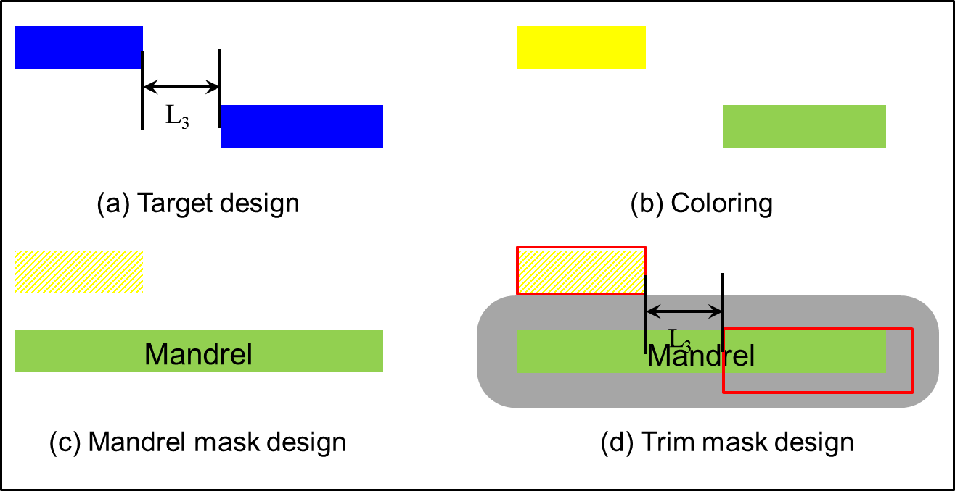


SADP-Aware Layout Design
SADP-Aware Design Rule (Case 3: OffTrackSpace)
$$L_{3}≥\sqrt{\begin{aligned}{\left(\begin{aligned}minTrimResistWidth \\ −2∗trimEtchBias\end{aligned}\right)}^{2} \\ −{SpacerDepositWidth}^{2}\end{aligned}}$$
$$L_{3}≥\sqrt{\begin{aligned}{\left(\begin{aligned}minTrimResistWidth \\ −2∗trimEtchBias\end{aligned}\right)}^{2} \\ −{SpacerDepositWidth}^{2}\end{aligned}}$$
Notes:
Hypotenuse (美[haɪ'pɑtənus])

Slide 35
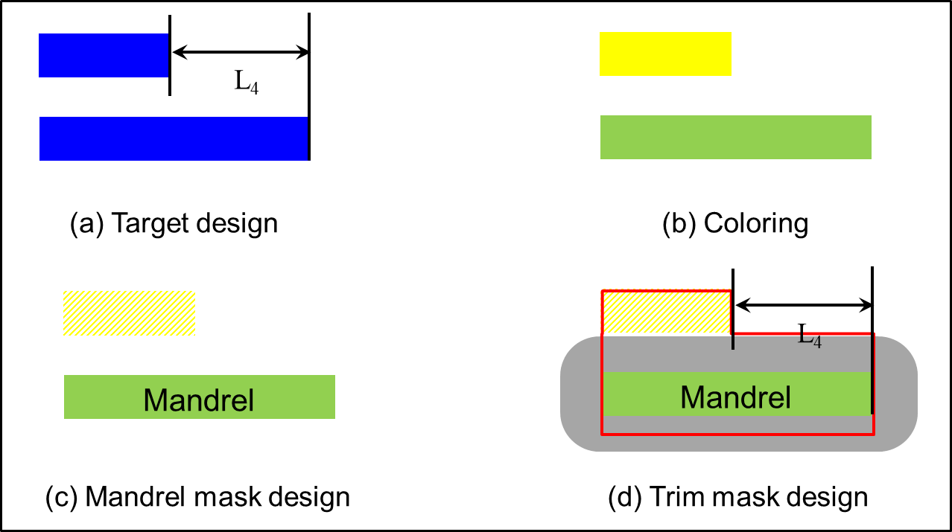
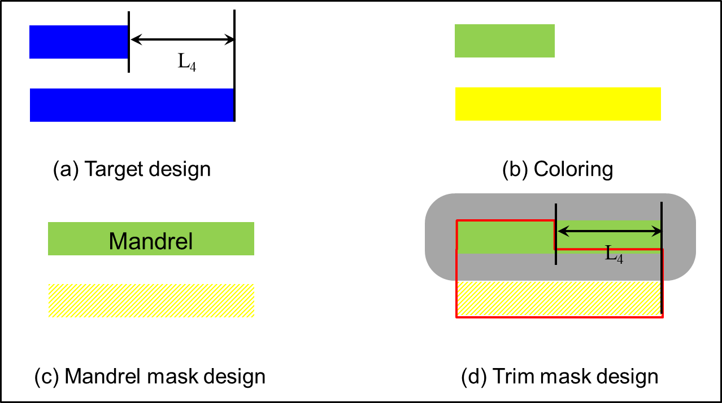
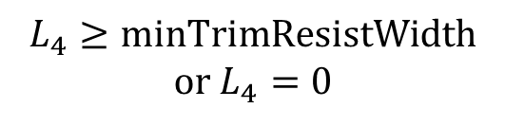
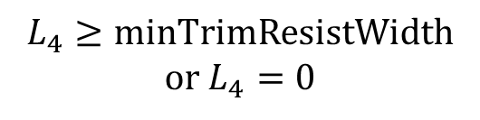
SADP-Aware Layout Design
SADP-Aware Design Rules (Case 4: OffTrackOffset)
$$L_{4}≥minTrimResistWidth$$
or $L_{4}=0$
$$L_{4}≥minTrimResistWidth$$
or $L_{4}=0$
Notes:
Here, we need to mention if we extend the line so as to align the line ends on neighbor tracks.
The tradeoff will be between parasitic capacitance and SADP-compliance

Slide 36
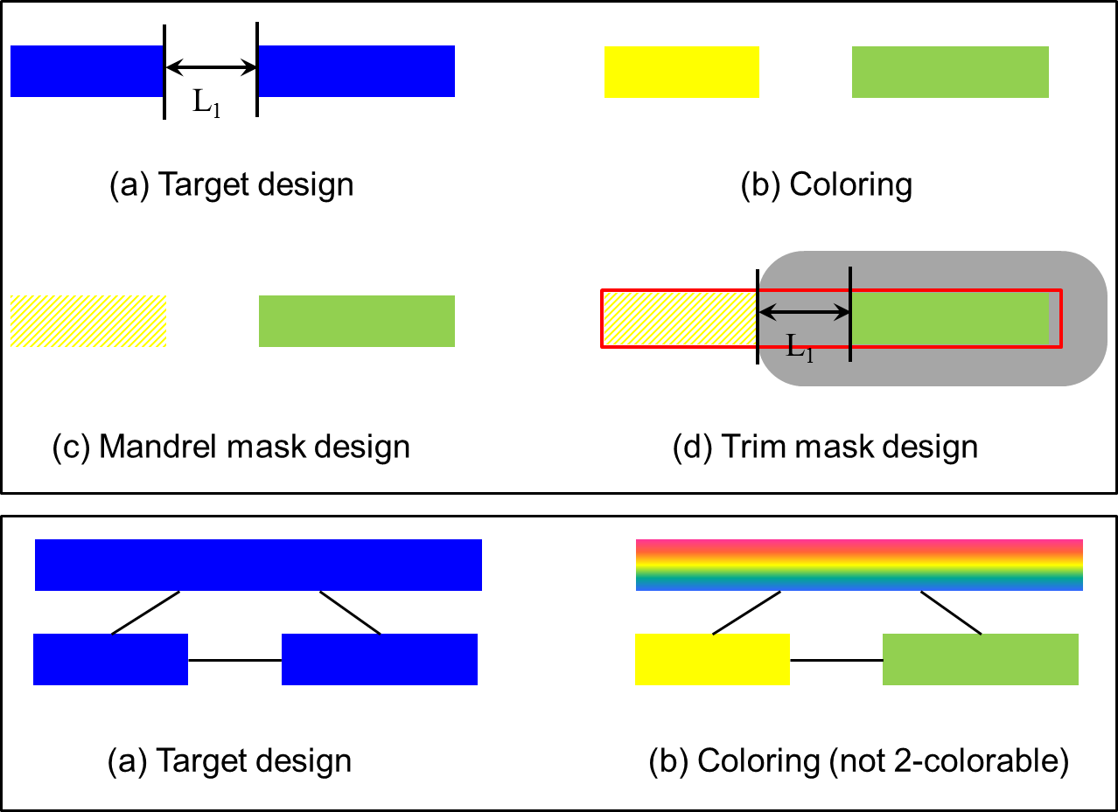
SADP-Aware Layout Design
SADP-Aware Design Rules – summary
  OnTrackSpace (L₁) >= 32 nm or OnTrackSpace (L₁) = 24nm
  OffTrackOverlap (L₂) >= 58 nm
  OffTrackSpace (L₃) >= 22 nm
  OffTrackOffset (L₄) >= 44 nm or OffTrackOffset (L₄) = 0 nm
Potential odd-cycle
Not decomposable
Notes:
Explain the idea of odd-cycle that is not decomposable

Slide 37
Pin Access Optimization
Mathematical formulation
  Line end extension minimization
Notations
$$C_{L},C_{R}$$ | Left or right boundary of cell
$$C_{W}$$ | Cell width, $C_{W}=C_{R}−C_{L}$
$$S_{m}$$ | Set of Metal-2 wires
$$n$$ | Total number of Metal-2 wires
$$S_{k}$$ | Set of pairs of wires for rule $k$
$$x_{iL},x_{iR}$$ | The left or right line end of $i_{th}$ wire
$$x_{iL}^{0},x_{iR}^{0}$$ | The initial line ends of $i_{th}$
$$l_{min}$$ | Minimum length for Metal-2 wire
Notes:
Explain each item in the table

