Slide 1

A Highly-Efficient Row-Structure Stencil Planning Approach for E-Beam Lithography with Overlapped Characters
Jian KUANG, Evangeline F. Y. Young
Department of Computer Science and Engineering
The Chinese University of Hong Kong
香 港 中 文 大 學

Slide 2

Outline
Introduction
Overall Flow
Sub-problems
Experimental Results
Conclusions

Slide 3
Outline
Introduction
Overall Flow
Sub-problems
Experimental Results
Conclusions

Slide 4
Next Generation Lithography
To replace optical lithography and multiple
patterning lithography
  mask cost is too high
Extreme Ultra-Violet (EUV)
Electron-Beam Lithography (E-Beam)
  both are not ready for mass production yet
EUV is delayed by technological difficulties
  such as mask blank defects
E-Beam suffers from low throughput
  bottleneck

Slide 5
E-Beam Lithography (EBL)
Maskless lithography technology
  shoot a beam of electrons onto a wafer
  and directly creates desired shapes there
  high resolution
  relatively lower cost, compared with the cost of masks
Writing time ~ number of shots
  reducing shot number can improve throughput

Slide 6
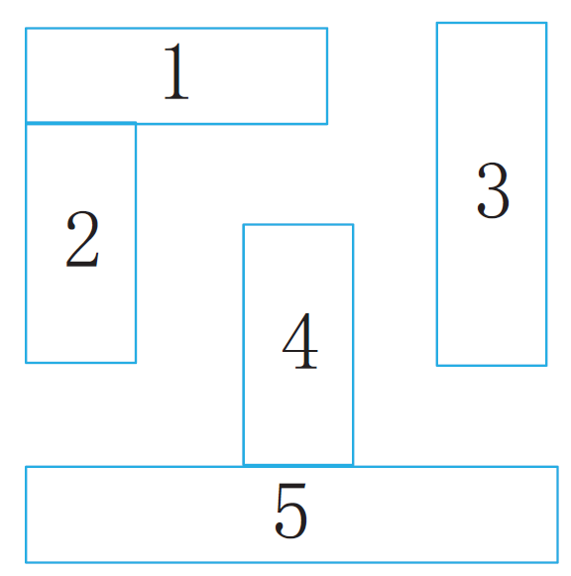
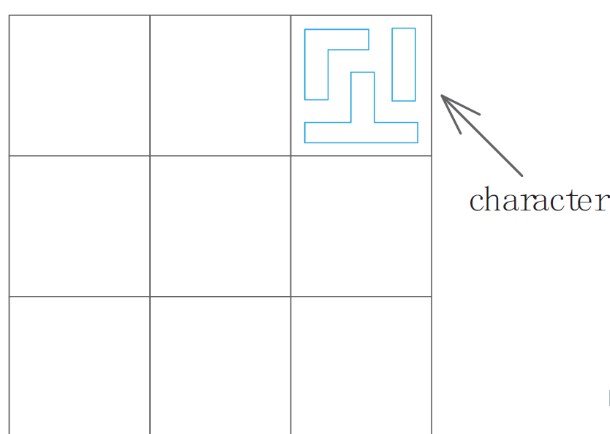
Character Projection
Variable Shaped Beam (VSB)
  every shot can only create one rectangle
  too slow for high-volume manufacturing
Character Projection (CP)
  various characters will be pre-designed
  characters can be placed on the stencil
  a character on the stencil needs only one shot
4 shots are saved

Slide 7
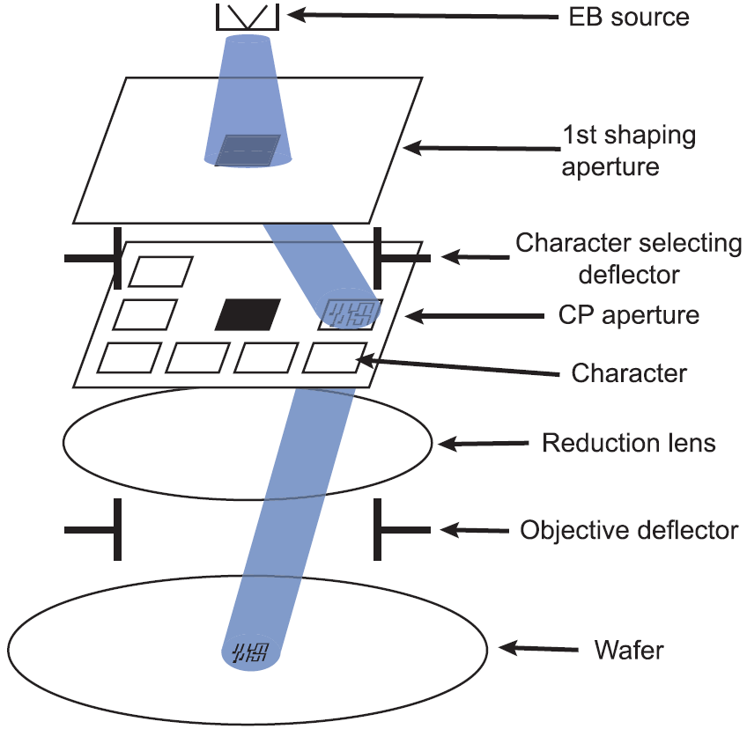
Stencil Planning
A set of characters are given
Stencil can only take a limited number of characters
Problem: select characters
and put them on the stencil,
to improve throughput
stencil
Figure source: Makoto Sugihara, Optimal Character-Size Exploration for Increasing Throughput of MCC Lithographic Systems. SPIE, 2009

Slide 8
Row-Structure Stencil with Overlapped Characters
A character has some blank areas surrounding it
  characters can be overlapped to share blank areas
  space can be saved on the stencil
When CP is applied to standard cell design
  all characters have the same size and uniform top
  and bottom blank areas
  only horizontal overlapping need to be considered
  row-structure

Slide 9
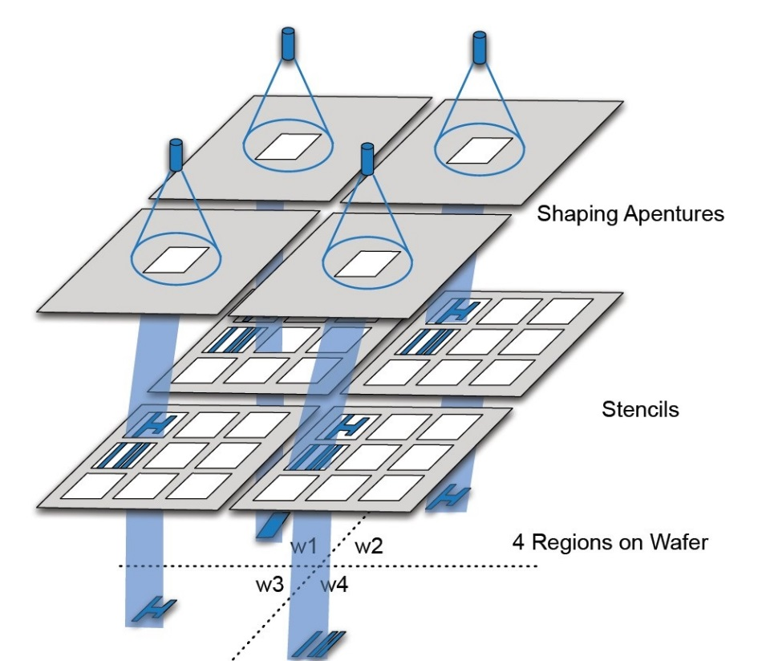
Multi-Column Cell (MCC) System
Layout is divided into regions
Writing time of layout=maximum writing time of each region
  throughput is improved greatly
Regions share the same
stencil design
  to reduce the complexity
We still have one stencil to design, but effects on different regions need to be considered simultaneously
Figure source: B. Yu, et. al. E-blow: e-beam lithography overlapping aware stencil planning for mcc system. In Proc. DAC, 2013.

Slide 10
Previous Works
Work by Yuan et. al. [1]
  the first systematic study
  greedy and heuristic methods
  slow, no global view
Work by Yu et. al. [2]
  Linear Programming + successive relaxation
  optimality loss because of rounding
  failed to differentiate conventional EBL and MCC system
Work by Chu et. al. [3]
  Stencil planning for flexible character design
[1] K. Yuan, et. al. E-beam lithography stencil planning and optimization with overlapped characters. TCAD, 31(2):167–179, Feb 2012.
[2] B. Yu, et. al. E-blow: e-beam lithography overlapping aware stencil planning for mcc system. In Proc. DAC, 2013.
[3] C. Chu, et. al. Flexible Packed Stencil Design with Multiple Shaping Apertures for E-Beam Lithography. In Proc. ASPDAC, 2014.

Slide 11
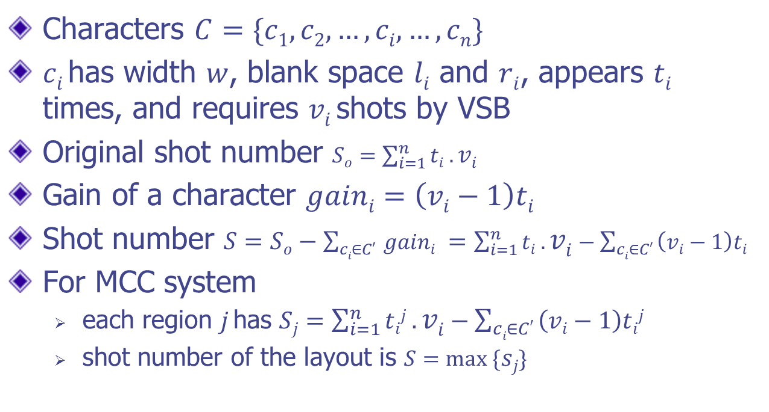
Notations
Characters $C=\{c1, c2,…,ci,…,cn\}$
$ci$has width $w$, blank space $li$ and $ri$, appears $ti$ times, and requires $vi$shots by VSB
Original shot number $So=\sum_{i=1}^{n}{ti .vi}$
Gain of a character $gaini=\left(vi−1\right)ti$
Shot number $S=So−\sum_{ci∈C′ }{gaini }=\sum_{i=1}^{n}{ti .vi}−\sum_{ci∈C′ }{\left(vi−1\right)ti }$
For MCC system
  each region $j$has $Sj=\sum_{i=1}^{n}{tij .vi}−\sum_{ci∈C′ }{\left(vi−1\right)tij }$
  shot number of the layout is $S=max ⁡\{sj\}$

Slide 12
Problem Formulation
Given a set C of characters, and a stencil of k rows and width W, select a subset of C and decide their positions in the rows of the stencil, such that the width of the stencil is not exceeded. The objective is to minimize the total shot number for the conventional EBL or for the MCC system.

Slide 13
Outline
Introduction
Overall Flow
Sub-problems
Experimental Results
Conclusions

Slide 14
Flow Chart
Character Selection
Row Distribution
Single Row Ordering
Do this for each row
Inter-row Swapping

Slide 15
Outline
Introduction
Overall Flow
Sub-problems
Experimental Results
Conclusions

Slide 16
Flow Chart
Character Selection
Row Distribution
Single Row Ordering
Do this for each row
Inter-row Swapping

Slide 17

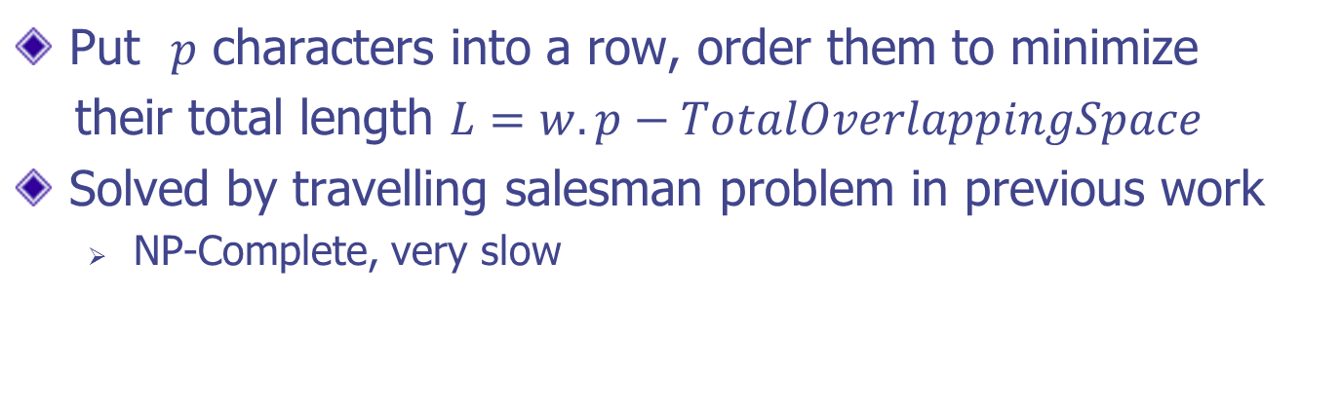
Single Row Ordering:
The Problem
Put $p$ characters into a row, order them to minimize
their total length $L=w.p−TotalOverlappingSpace$
Solved by travelling salesman problem in previous work
  NP-Complete, very slow

Slide 18
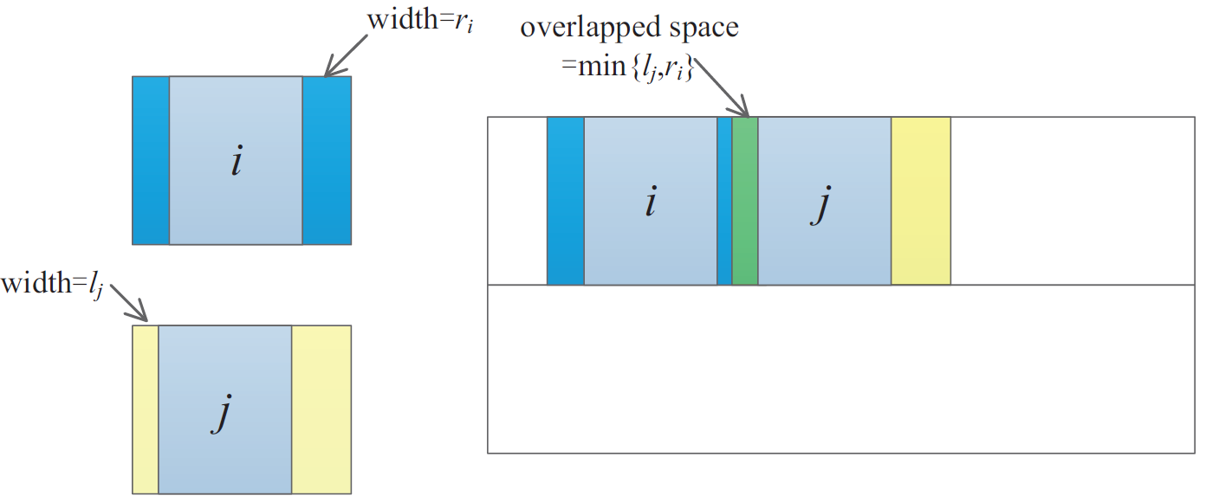
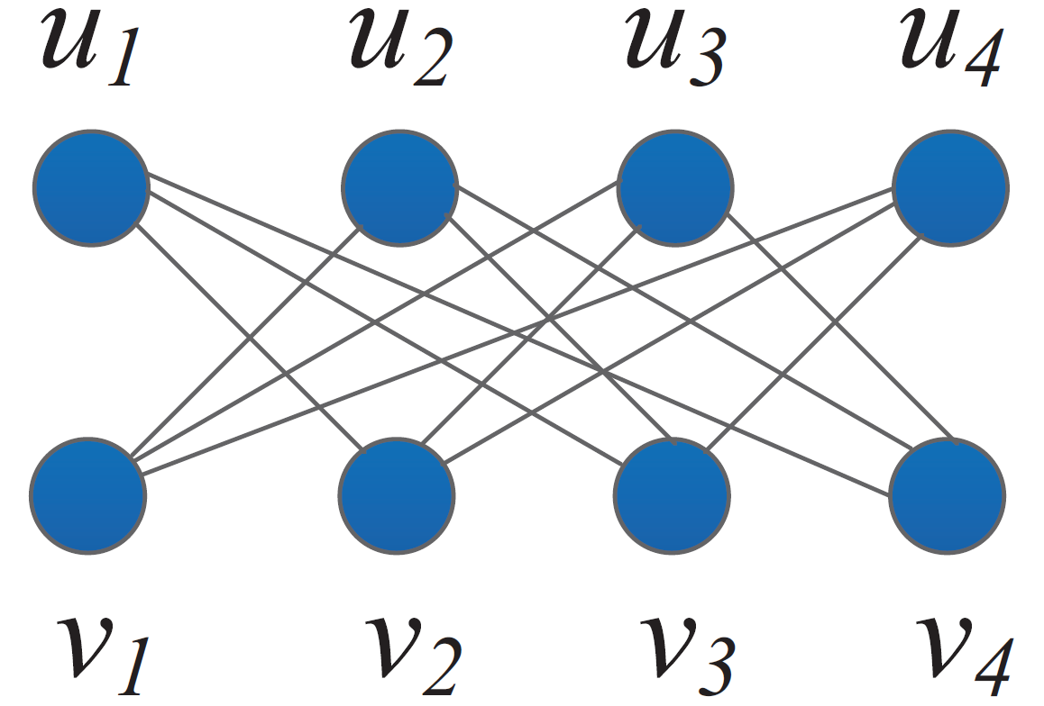
Single Row Ordering:
Our Method – Step 1
Step 1: Construct a graph G
  each character has two weighted nodes for left and right blanks
  weight of edge is the smaller one of the weights of two nodes

Slide 19
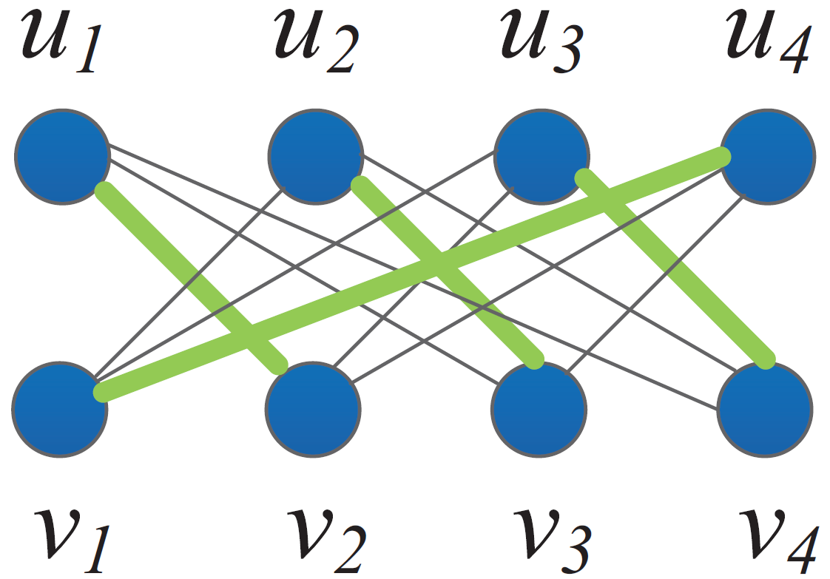
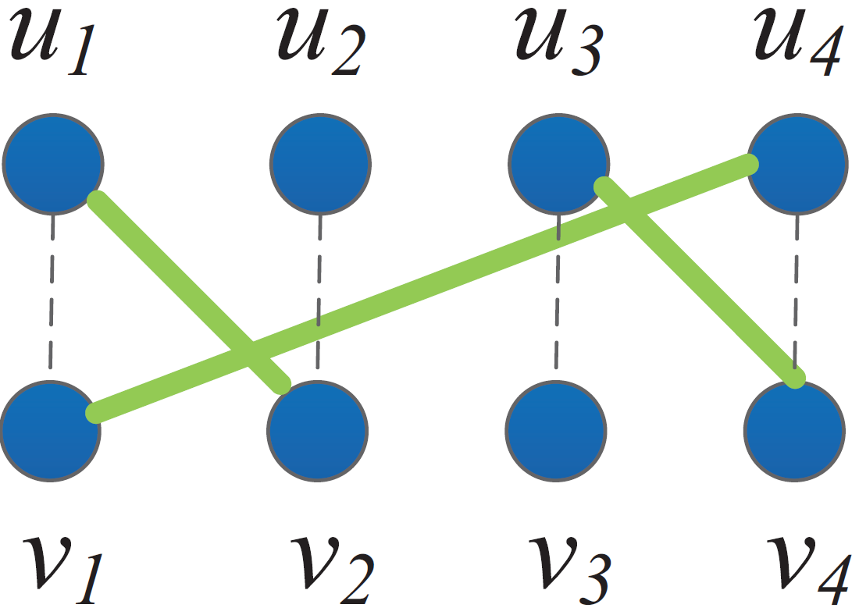
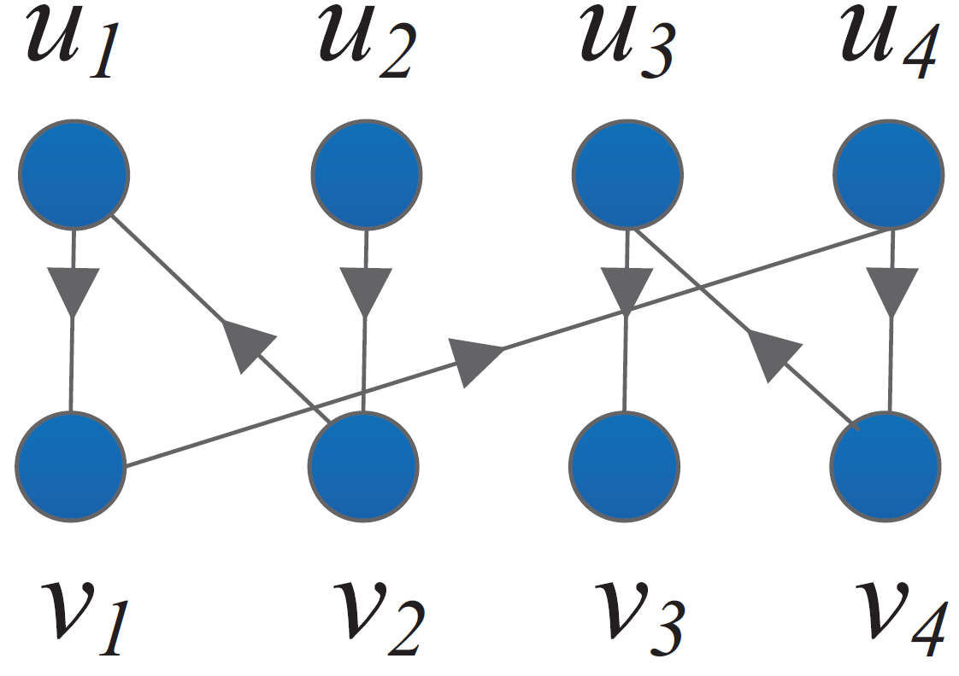

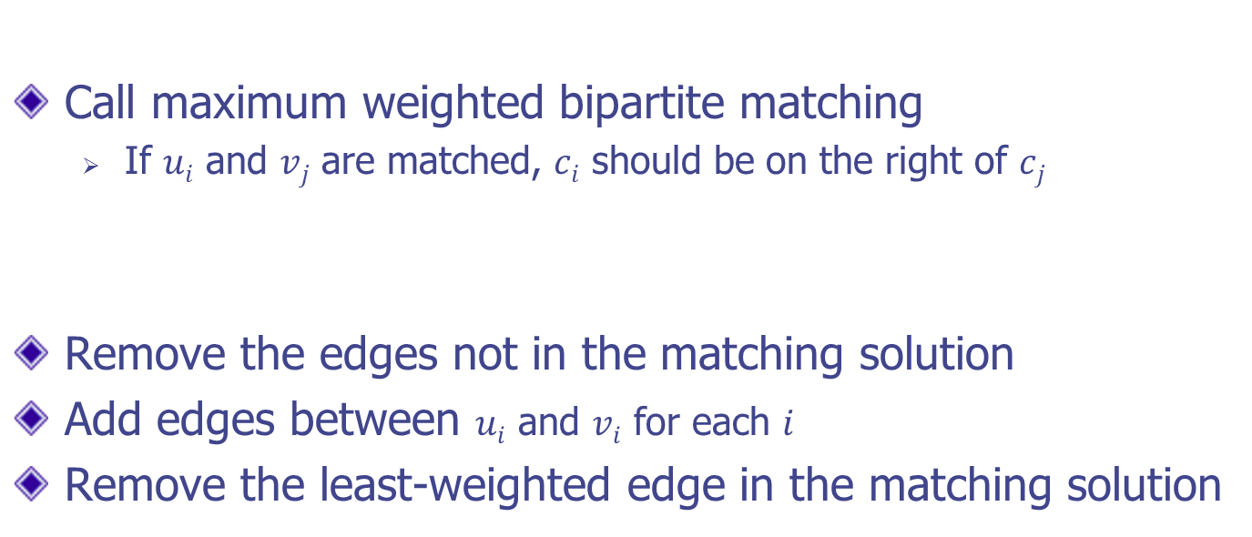

Single Row Ordering:
Matching
Call maximum weighted bipartite matching
  If $ui$ and $vj$ are matched, $ci$ should be on the right of $cj$
Remove the edges not in the matching solution
Add edges between $ui$ and $vi$ for each $i$
Remove the least-weighted edge in the matching solution
Check the directed path $p$from one degree-1 node to
another degree-1 node
  cell order: $c2→c1→c4→c3$

Slide 20
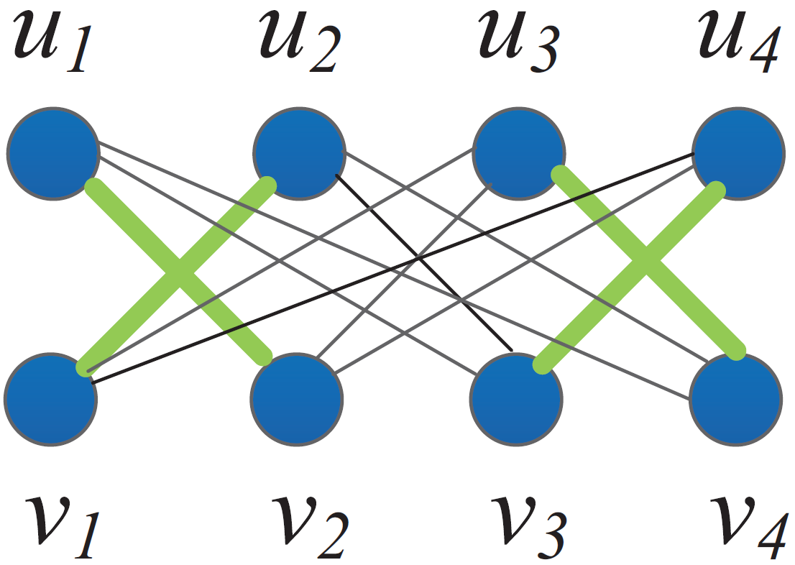
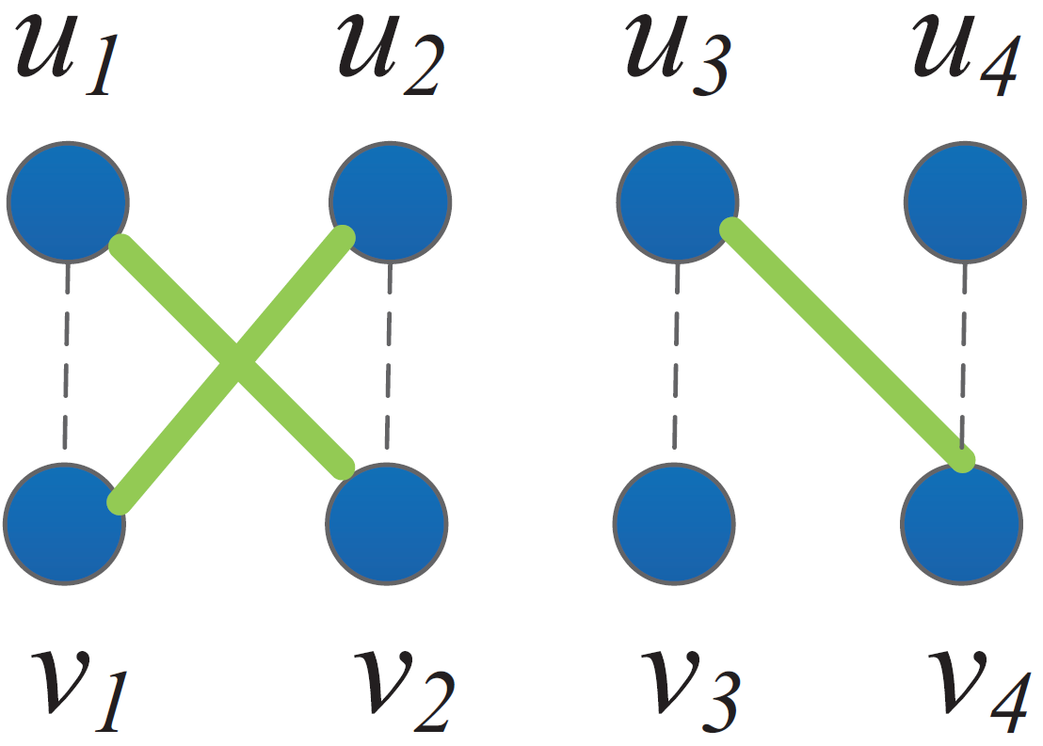
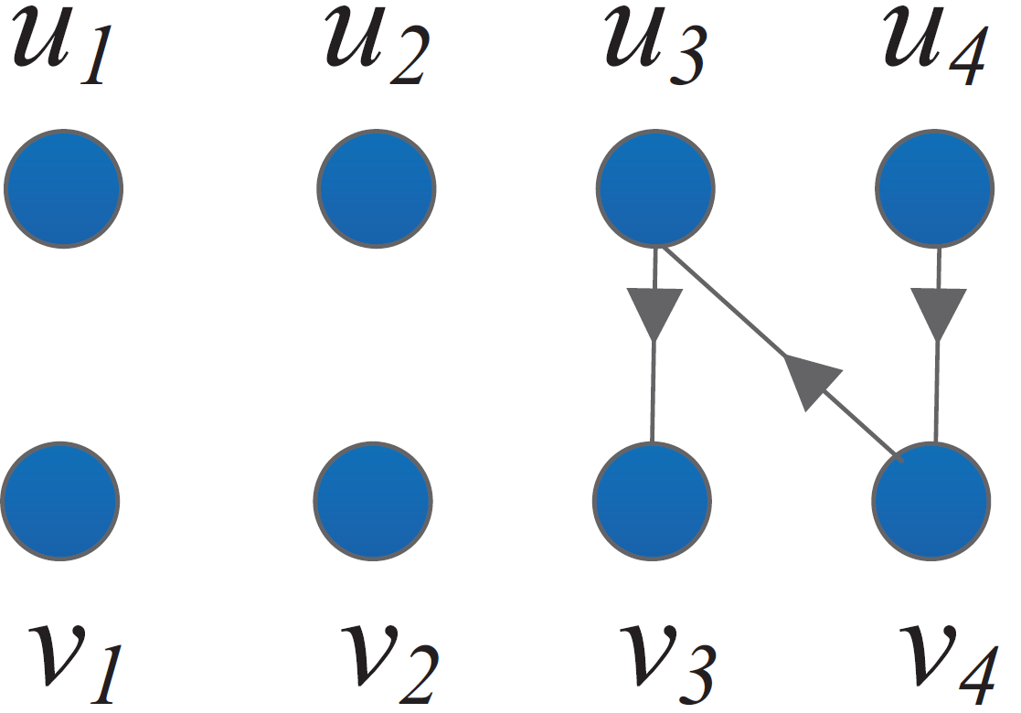

Single Row Ordering:
Failed Example with Matching
It only works when path $p$covers all nodes
It fails for this matching solution:

Slide 21
Single Row Ordering:
Our Method
Step 2: Let weight_{min} be the minimum weight among
all the nodes in G. Update the weight of every node v as
weight(v)− weight_{min}
Step 3: Remove those nodes with weight 0 and their
corresponding edges.
Step 4: Update all the edge weights according the new node weights to obtain graph G' .
THEOREM: When all the edges in G' are with equal weight (The Constraint), the maximum weighted matching on G' can always give a character ordering with the optimal overlapping space

Slide 22
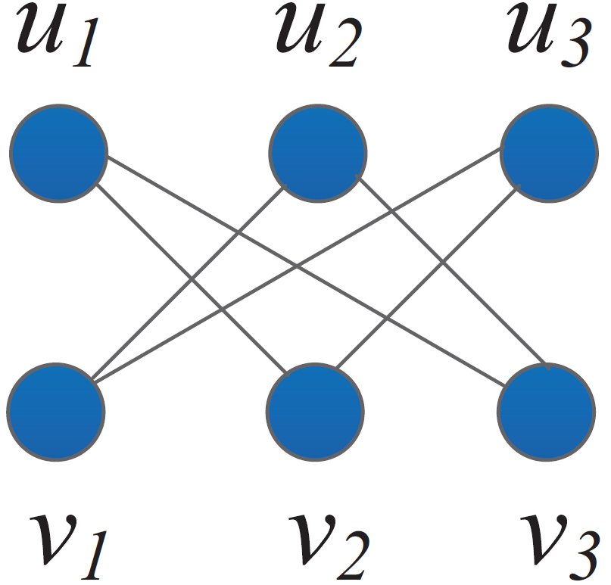
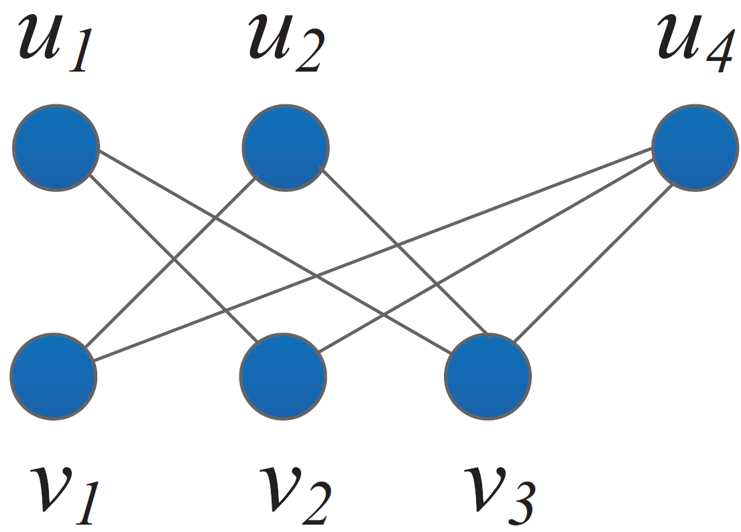
Single Row Ordering:
Proof
DS is the set of characters that have corresponding
nodes in both U and V
Case 1: |U| = |V| =|DS|,
optimal overlapping is (|DS|-1).w_{e}
Case 2: |U| ≠ |DS| or |V| ≠ |DS| ,
optimal overlapping is min{| U |, | V|} .w_{e}

Slide 23
Flow Chart
Character Selection
Row Distribution
Single Row Ordering
Do this for each row
Inter-row Swapping

Slide 24
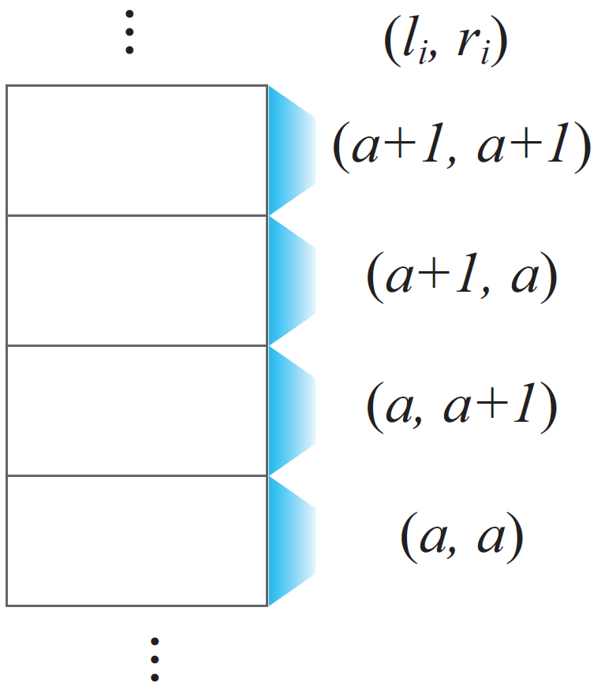
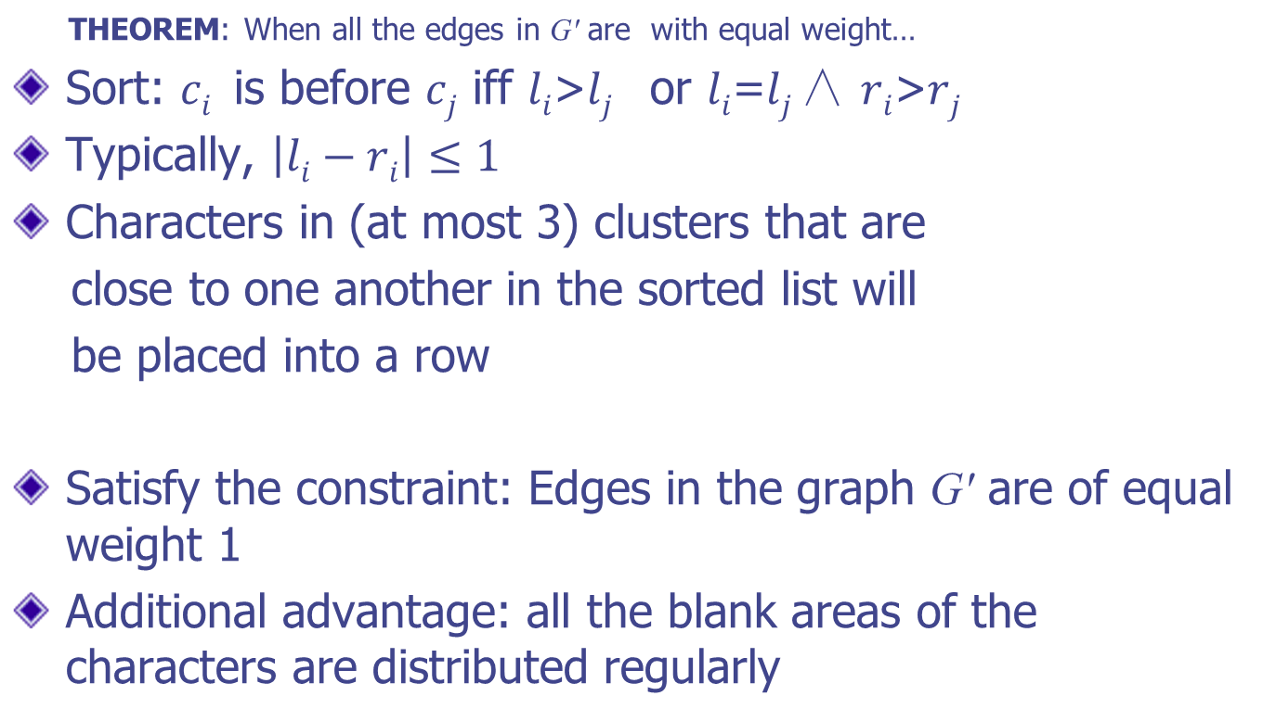
Constraint Satisfaction
THEOREM: When all the edges in G' are with equal weight…
Sort: $ci$ is before $cj$ iff $li$>$lj$ or $li$=$lj$∧ $ri$>$rj$
Typically, $\left|li−ri\right|≤1$
Characters in (at most 3) clusters that are
close to one another in the sorted list will
be placed into a row
Satisfy the constraint: Edges in the graph G' are of equal weight 1
Additional advantage: all the blank areas of the characters are distributed regularly

Slide 25
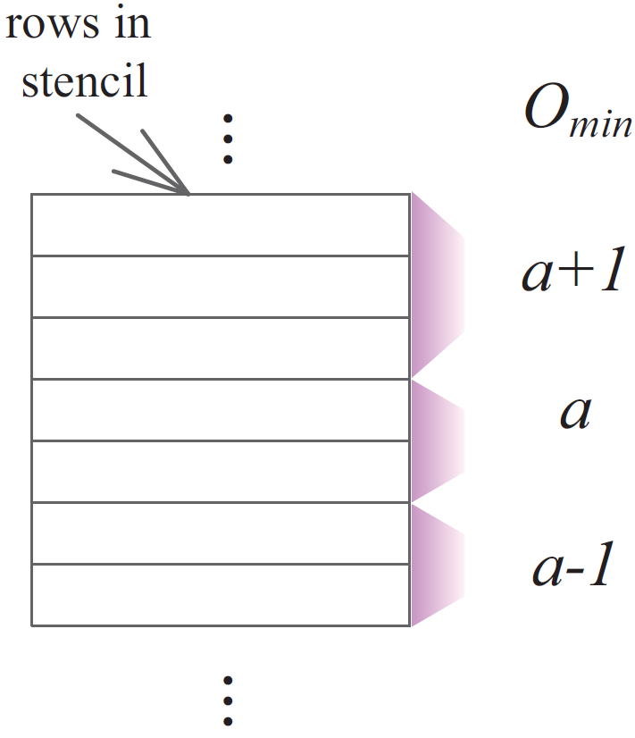
Redistribution
Rows are divided into groups
Unbalanced distribution of extra blanks in groups
Combine and utilize extra blanks with different types carefully to increase TotalOverlappingSpace

Slide 26
Flow Chart
Character Selection
Row Distribution
Single Row Ordering
Do this for each row
Inter-row Swapping

Slide 27
Swapping
A character in one row may be more useful in another row
Deterministic method instead of random method in previous work

Slide 28
Flow Chart
Character Selection
Row Distribution
Single Row Ordering
Do this for each row
Inter-row Swapping

Slide 29
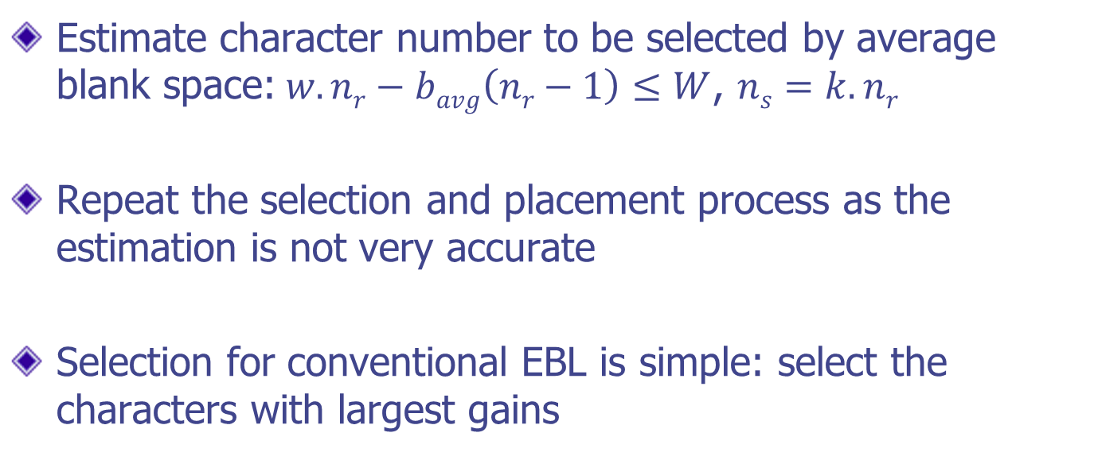
Selection
Estimate character number to be selected by average blank space:$w.nr−bavg\left(nr−1\right)≤W$, $ns=k.nr$
Repeat the selection and placement process as the estimation is not very accurate
Selection for conventional EBL is simple: select the characters with largest gains

Slide 30
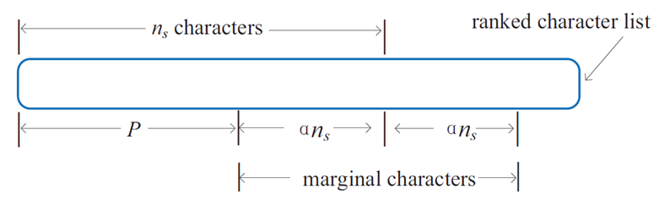
Selection for Marginal Characters
Select characters with highest total gains (summation of gains in different regions)? NO!
First select P containing characters with absolutely high total gains
α is a parameter
Update gains of marginal characters after select P, then select again

Slide 31
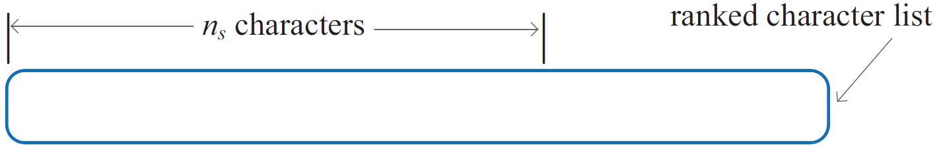
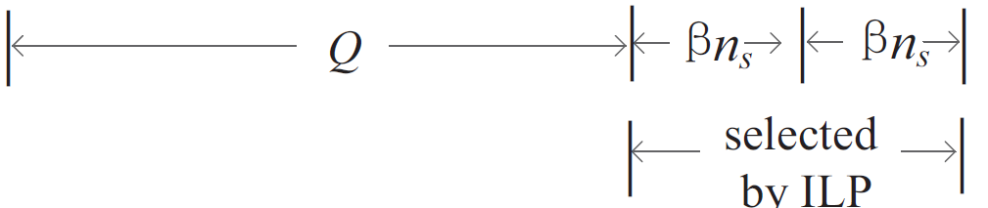
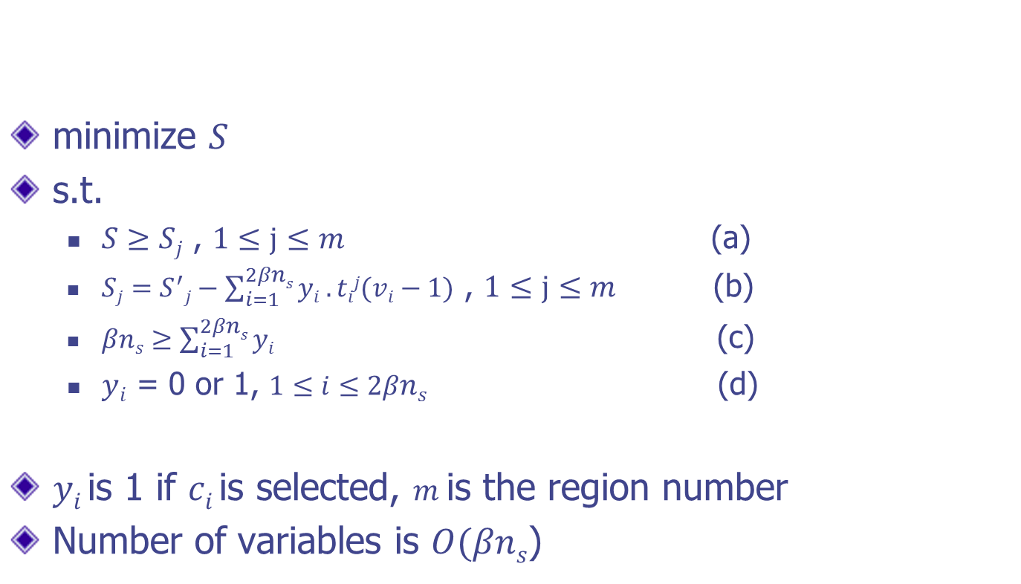
ILP Selection
minimize $S$
s.t.
  $S≥Sj$ , $1≤j≤m$ (a)
  $Sj=S^{′}j−\sum_{i=1}^{2βns}{yi .tij(vi−1)}$ , $1≤j≤m$ (b)
  $βns≥\sum_{i=1}^{2βns}{yi }$ (c)
  $yi$ = 0 or 1, $1≤i≤2βns$ (d)
  $yi$is 1 if $ci$is selected, $m$is the region number
Number of variables is $O(βns$)

Slide 32
Outline
Introduction
Overall Flow
Sub-problems
Experimental Results
Conclusions

Slide 33
Comparison with TCAD’12 Work
benchmark |  | TCAD′12 [1] |  | ours
data | r# | c# | s# | c# | s# | reduction(%)
1D-1 | 28 | 926 | 50809 | 940 | 19095 | 62.4
1D-2 | 27 | 854 | 93465 | 864 | 35295 | 62.2
1D-3 | 25 | 749 | 152376 | 757 | 69301 | 54.5
1D-4 | 24 | 687 | 193494 | 703 | 92523 | 52.2
1M-1 | 28 | 926 | 53333 | 938 | 39026 | 26.8
1M-2 | 27 | 854 | 95963 | 864 | 77997 | 18.7
1M-3 | 25 | 749 | 156700 | 758 | 138256 | 11.8
1M-4 | 24 | 687 | 196686 | 698 | 176228 | 10.4
1M-5 | 54 | 3629 | 255208 | 3660 | 204114 | 20
1M-6 | 52 | 3346 | 417456 | 3382 | 357829 | 14.3
1M-7 | 49 | 2986 | 644288 | 3016 | 568339 | 11.8
1M-8 | 47 | 2734 | 809721 | 2760 | 731483 | 9.7
Avg. | - | - | - | - | - | 29.6
[1] K. Yuan, et. al. E-beam lithography stencil planning and optimization with overlapped characters. TCAD, 31(2):167–179, Feb 2012.

Slide 34
Comparison with DAC’13 Work
 | DAC'13 [2] |  |  | ours
data | c# | s# | time(s) | c# | s# | reduction(%) | time(s) | speedup
1D-1 | 934 | 29536 | 3.18 | 940 | 19095 | 35.4 | 0.005 | 636×
1D-2 | 863 | 44544 | 3.31 | 864 | 35295 | 20.8 | 0.005 | 662×
1D-3 | 758 | 78704 | 6.98 | 757 | 69301 | 11.9 | 0.005 | 1396×
1D-4 | 699 | 107460 | 6.26 | 703 | 92523 | 13.9 | 0.005 | 1252×
1M-1 | 938 | 45243 | 4.61 | 938 | 39026 | 13.7 | 0.01 | 461×
1M-2 | 868 | 81636 | 6.79 | 864 | 77997 | 4.5 | 0.01 | 679×
1M-3 | 769 | 140079 | 13.76 | 758 | 138256 | 1.3 | 0.56* | 25×
1M-4 | 707 | 179890 | 12.44 | 698 | 176228 | 2 | 0.36* | 35×
1M-5 | 3650 | 227456 | 38.52 | 3660 | 204114 | 10.3 | 0.03 | 1284×
1M-6 | 3388 | 373324 | 53.45 | 3382 | 357829 | 4.2 | 0.03 | 1782×
1M-7 | 3044 | 570730 | 63.52 | 3016 | 568339 | 0.4 | 0.59* | 108×
1M-8 | 2799 | 734411 | 55.27 | 2760 | 731483 | 0.4 | 0.42* | 132×
Avg. | - | - | - | - | - | 9.9 | - | 704×
[2] B. Yu, et. al. E-blow: e-beam lithography overlapping aware stencil planning for mcc system. In Proc. DAC, 2013.
* ILP selection is activated

Slide 35
Outline
Introduction
Overall Flow
Sub-problems
Experimental Results
Conclusions

Slide 36
Conclusions
The problem is divided into four subproblems that are solved efficiently
Both conventional EBL and the MCC system are considered
Experiment results demonstrate our efficiency and effectiveness
Significant improvement of throughput
Remarkable speed-up

Slide 37
Thanks!
jkuang@cse.cuhk.edu.hk

