Slide 1
Current Density Aware Power Switch Placement Algorithm for Power Gating Designs
Speaker: Zong-Wei Syu
Dep. of EE, National Cheng Kung University
Date: 2014/04/01

Slide 2
Outline
Introduction
Preliminaries
Problem Formulation
Partition Based Placement Algorithm
  Simplify Model
  Partition and Select Power Switches
  Placement of Power Switches
Framework of Our Methodology
Experimental Results
Conclusion

Slide 3
Outline
Introduction
Preliminaries
Problem Formulation
Partition Based Placement Algorithm
  Simplify Model
  Partition and Select Power Switches
  Placement of Power Switches
Framework of Our Methodology
Experimental Results
Conclusion

Slide 4
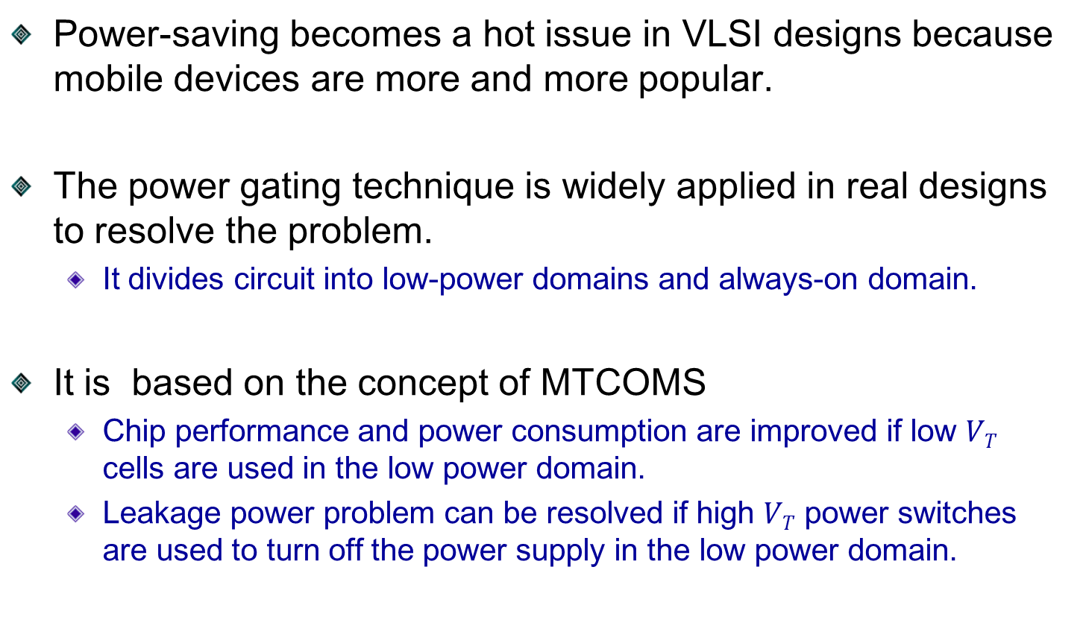
Introduction
Power-saving becomes a hot issue in VLSI designs because mobile devices are more and more popular.
The power gating technique is widely applied in real designs to resolve the problem.
  It divides circuit into low-power domains and always-on domain.
It is based on the concept of MTCOMS
  Chip performance and power consumption are improved if low $VT$ cells are used in the low power domain.
  Leakage power problem can be resolved if high $VT$ power switches are used to turn off the power supply in the low power domain.
Notes:
Because mobile devices are more and more popular, Power consumption becomes a serious problem in VLSI design. To resolve the problem, power gating technique is widely applied by industry, it is base on the concept of MTCOMS
If low $VT$ cells are used in the low power domain, chip performance power consumption are improved. However, low $VT$ would induce serious leakage power. To resolve the problem, it use high $VT$ power switches to turn off the power in the low power domain.

Slide 5
Outline
Introduction
Preliminaries
Problem Formulation
Partition Based Placement Algorithm
  Simplify Model
  Partition and Select Power Switches
  Placement of Power Switches
Framework of Our Methodology
Experimental Results
Conclusion

Slide 6
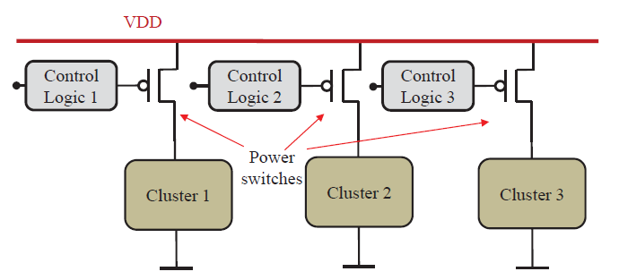
Two kinds of Power Gating Structures
Two kinds of architectures are proposed to implement power gating designs, which include “fine-grain” and “coarse-grain”.
Fine-grain structure
  Circuits in a low-power domain are divided into several clusters.
  One power switch is inserted into each cluster to control the power-on or power-off for the logic cells in the cluster.
  Design complexity increases.
Notes:
The power gating structures are divided into fine-grain and coarse-grain.
( There are two types of power gating structures, one is fine-grain, another is coarse-grain ) 跟上面挑一種講
The fine-grain structure divides the circuit into several clusters in low-power domain, each cluster has its own power switch, each power switch is connected to power supply and control power-on and power-off. But design complexity increases a lot. Thus, fine-grain structure is seldom used today.

Slide 7
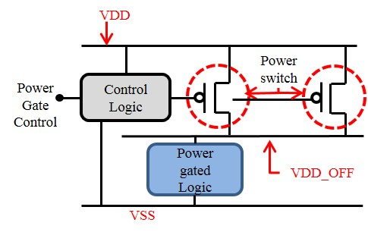
Two kinds of Power Gating Structures (Cont’d)
Coarse-grain structure
  It contains two kinds of power networks as follows:
    Global power network: denoted by VDD
    Local power network: denoted by VDD_OFF
  Power switches are connected between VDD and VDD_OFF.
  Circuits in the low power domain are connected to VDD_OFF.
Notes:
Another structure is called Coarse-grain structure. This power network of structure is divided into global power network and local power network. The global power network is denoted by VDD and the local power network is denoted by VDD_OFF. Power pads provide voltage to VDD. All power switches are connected between VDD and VDD_OFF, and controlled turn-on or turn-off by control circuit. VDD_OFF provides power to stand cells in a low power domain.

Slide 8
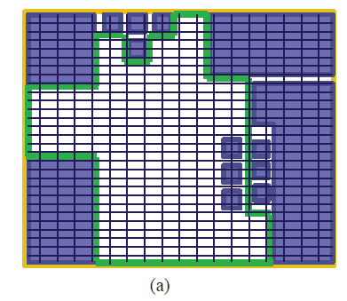
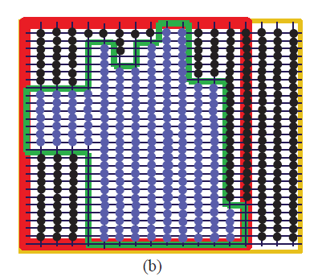
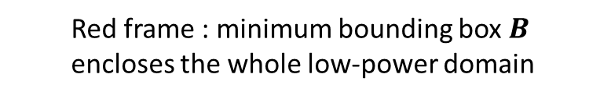
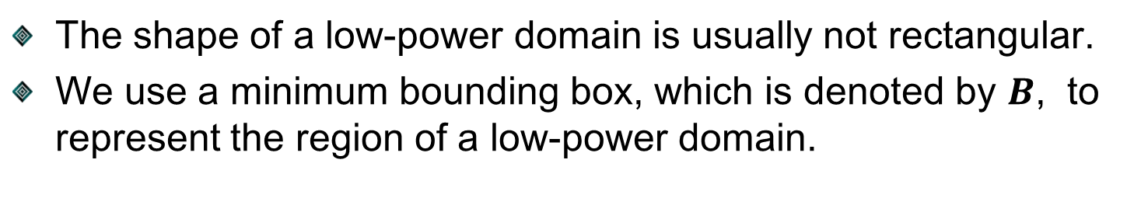
Bounding Box of a Low-Power Domain
The shape of a low-power domain is usually not rectangular.
We use a minimum bounding box, which is denoted by $B$, to represent the region of a low-power domain.
  Yellow frame : boundary of chip
  Blue square : always-on domain
  Green frame : low power domain region
  Red frame : minimum bounding box $B$ encloses the whole low-power domain
Notes:
The outline of a low power domain is usually not rectangular.
See figure (a) for example, the yellow frame is the boundary of chip, and blue squares denote blocks in always-on domain. After those blocks are placed, the shape of low power domain become irregular. Thus, we use a minimum bounding box B which encloses the low-power domain to represent power switch placement region shown as red frame in figure (b).

Slide 9
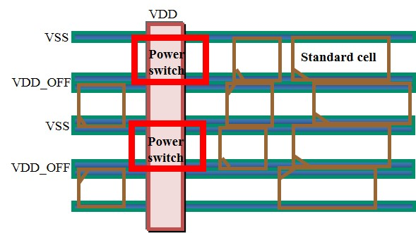
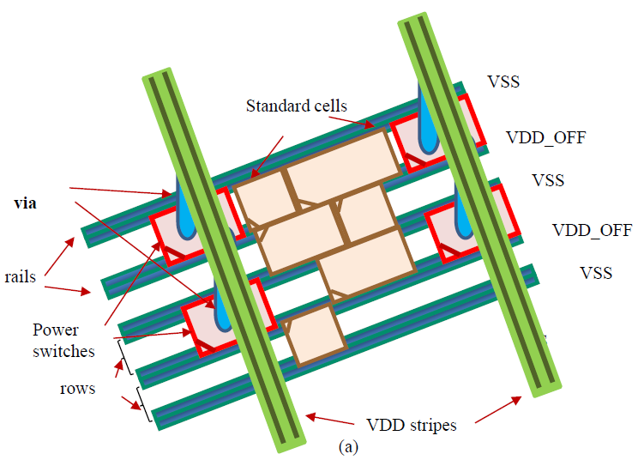
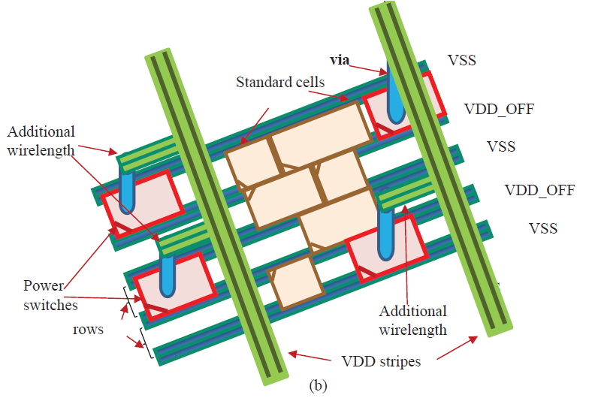
Legal Locations for Power Switches
Power switches have better to be placed at intersections between VDD stripes and VDD_OFF rows.
  Each power switch has three pins, which are VDD, VDD_OFF, and VSS, respectively
VSS
row
Power Switch
VDD
VDD_OFF
Otherwise, it will waste additional wirelength
Notes:
In order to reduce routing area, power switches have better to be placed at certain locations in a low-power domain. So we defined legal locations as crossed region between a row and a global VDD stripe. Each power switch has three pins, which are VDD, VDD_OFF, and VSS, respectively. See figure (a). If power switch locations are under global power stripes VDD, they can be connected to VDD through via without using additional metal wire, otherwise they will require additional wire length as shown in figure (b).

Slide 10
Outline
Introduction
Preliminaries
Problem Formulation
Partition Based Placement Algorithm
  Simplify Model
  Partition and Select Power Switches
  Placement of Power Switches
Framework of Our Methodology
Experimental Results
Conclusion

Slide 11
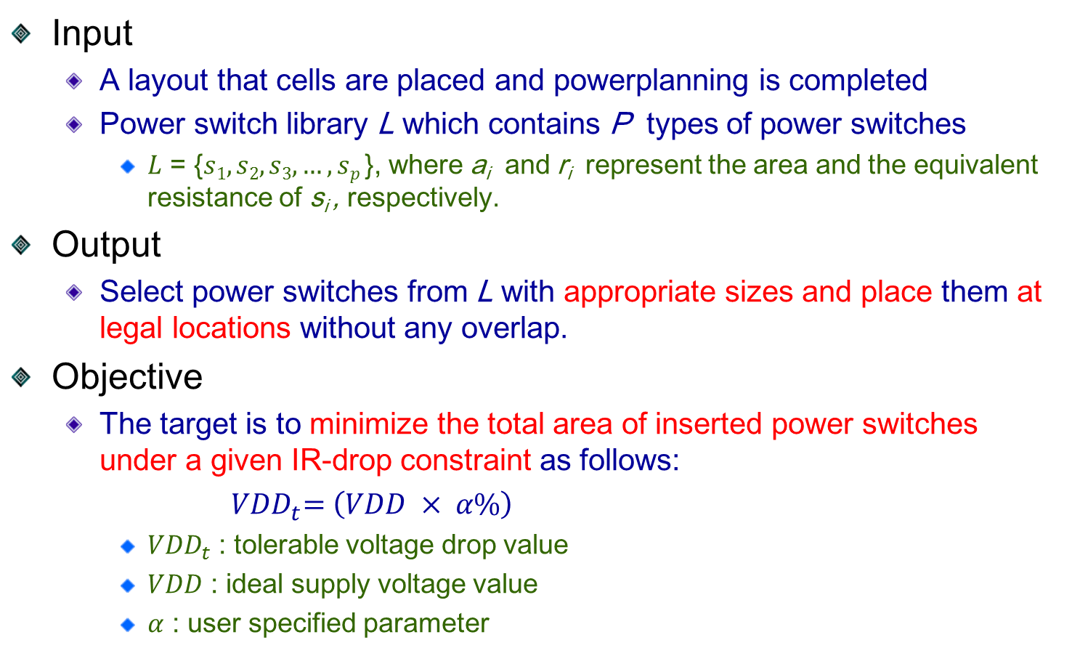
Problem Formulation
Input
  A layout that cells are placed and powerplanning is completed
  Power switch library L which contains P types of power switches
    $L$ = {$s1, s2, s3,…, sp$}, where a_{i} and r_{i} represent the area and the equivalent resistance of s_{i} , respectively.
Output
  Select power switches from L with appropriate sizes and place them at legal locations without any overlap.
Objective
  The target is to minimize the total area of inserted power switches under a given IR-drop constraint as follows:
  ${ VDD}_{t}=\left(VDD × α\%\right)$
    ${VDD}_{t}$ : tolerable voltage drop value
    $VDD$ : ideal supply voltage value
    $α$ : user specified parameter
Notes:
Here shows our Problem Formulation
The input section :
The s_{i} denotes one type of power switches.
The output section :
The objective section :

Slide 12
Outline
Introduction
Preliminaries
Problem Formulation
Partition Based Placement Algorithm
  Simplify Model
  Partition and Select Power Switches
  Placement of Power Switches
Framework of Our Methodology
Experimental Results
Conclusion

Slide 13

Simplified Model for Power Gating Designs
Propose a simplified model to approximate required power switches in a power gating design as follows:
  All nodes in a power mesh are consider as one signal node due to mass parallel-connection of power wires with low resistances.
  Each power switch is represented by a resistor
    The voltage-current relation of a power switch can be considered as linear based on the small-signal analysis.
  The equivalent resistance of power switches in a low power domain can be approximated by this model.
$Rtotal = Ri //Ri //R//Ri$ $//Ri$
VDD
…
…
…
R_{i}
R_{i}
R_{i}
R_{i}
R_{i}
VDD_OFF
Notes:
(In the beginning, if equivalent resistance of power switches in a low power domain can be obtain. We can estimate the precise number of power switches and satisfy the IR-drop constraint based on this value. However the power network is complexity, it is not easy to computed this value.
Thus, we propose a simplified model computing the equivalent resistance of power switches for power gating designs.
All nodes in a power mesh are consider as one signal node because of parallel-connection of power wires with low resistances. Here show original power switch structure based on observing Fig.1 in power gating and transform this figure(Fig.2)
The voltage-current relation of a power switch can be considered as linear, then it is replace by a resistor. Thus, this figure transforms to this figure .
So the power switch can be approximated equivalent resistance model.

Slide 14
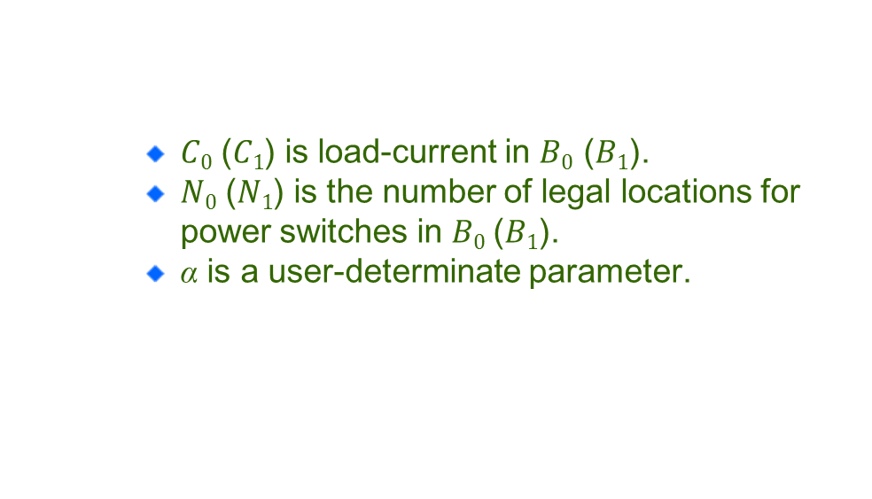
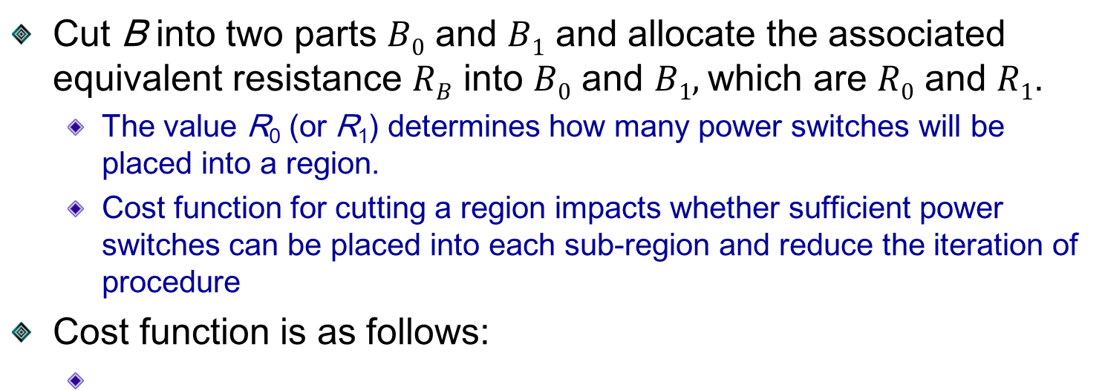
Cutting a Region and the Associated Resistance
Cut B into two parts $B0$ and $B1$ and allocate the associated equivalent resistance $RB$ into $B0$ and $B1,$which are $R0$ and $R1$.
  The value R₀ (or R₁) determines how many power switches will be placed into a region.
  Cost function for cutting a region impacts whether sufficient power switches can be placed into each sub-region and reduce the iteration of procedure
Cost function is as follows:
    $C0$ ($C1$) is load-current in $B0$ ($B1$).
    $N0$ ($N1$) is the number of legal locations for power switches in $B0$($B1$).
    α is a user-determinate parameter.
B₀
B₁
B
Notes:
Based on the model in previous slides. If the equivalent resistance of a region B is obtained, we use a partition base method to cut B into two parts $B0$ and $B1$ and allocate the associated equivalent resistance $RB$ into $B0$ and $B1$. But the cutline location affect whether sufficient power switches can be placed. So we need to cost function to determine the cutline. The main idea of our cost function is to make the load-current and number of legal locations of two regions as close as possible.
Here show our cost function
The first term makes power switches ensure each region have legal location for placing power switches.
The second term tries to reduce iterations number of the procedure.

Slide 15

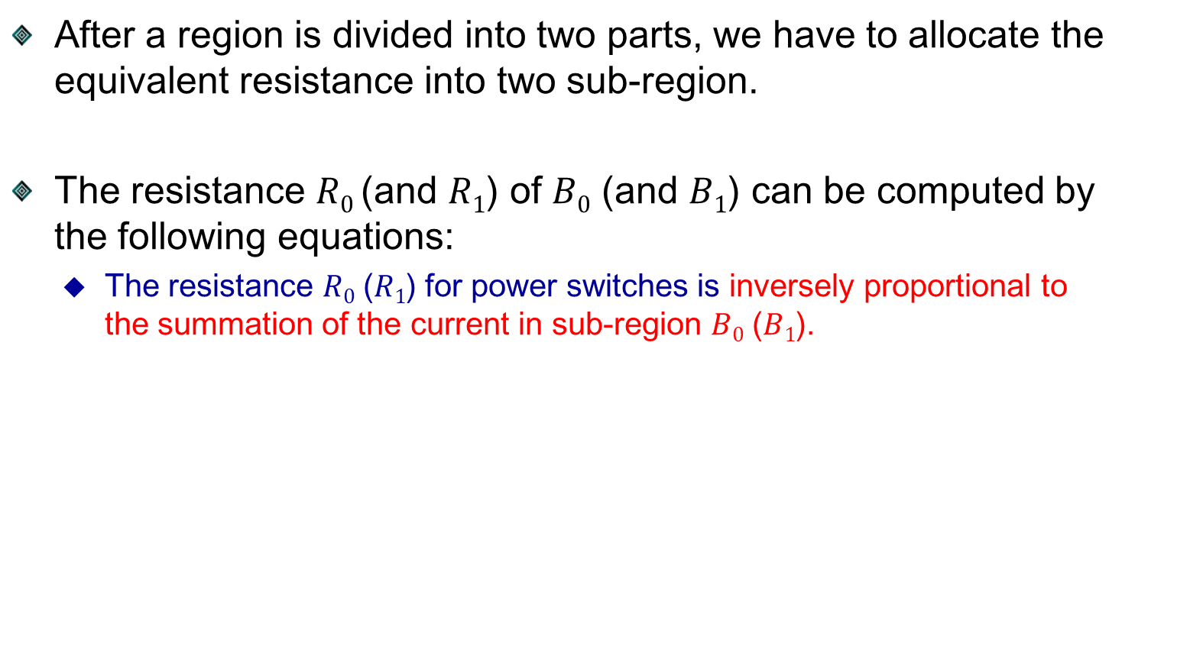
Cutting a Region and the Associated Resistance (cont’d)
  After a region is divided into two parts, we have to allocate the equivalent resistance into two sub-region.
  The resistance $R0$ (and $R1$) of $B0$ (and $B1$) can be computed by the following equations:
    The resistance $R0$ ($R1$) for power switches is inversely proportional to the summation of the current in sub-region $B0$ ($B1$).
  $$R0 = R_{B}\frac{C0+C1}{C0}$$
  $$R1 = R_{B}\frac{C0+C1}{C1}$$
Notes:
After a region is divided into two parts, we have to allocate the equivalent resistance into two sub-region.
Because the equivalent resistance for power switch is inversely proportional to the summation of the current and leakage in sub-region , then$R0$ ($R1$) can be computed by the following equations

Slide 16














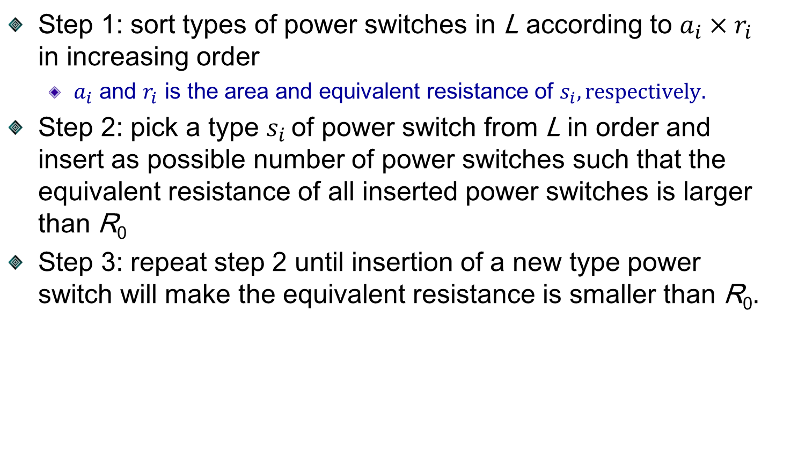

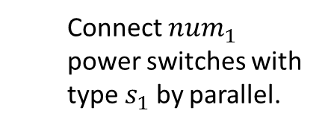

Select Power Switches
Step 1: sort types of power switches in L according to $a_{i}×r_{i}$ in increasing order
  $a_{i}$ and $r_{i}$ is the area and equivalent resistance of $s_{i}, respectively.$
Step 2: pick a type $s_{i}$ of power switch from L in order and insert as possible number of power switches such that the equivalent resistance of all inserted power switches is larger than R₀
Step 3: repeat step 2 until insertion of a new type power switch will make the equivalent resistance is smaller than R₀.
f
f
X
$$r_{1}$$
$$r_{2}$$
$$⋯$$
$$⋯$$
>
$r_{1}$’
$r_{2}$’
$$r_{3}$$
$$→$$
$r_{2}$’
$$R_{0}$$
$$≈$$
$r_{2}$’
$$R_{0}$$
<
$r_{1}$’
$r_{1}$’
Target equivalent resistance
  Connect ${num}_{1}$ power switches with type $s_{1}$ by parallel.
$${num}_{1}$$
$${num}_{2}$$
Notes:
After the resistance of each region is determined, this slide shows how to select suitable type and number of power switches from library to constitute the resistor.
Before inserting power switches, we choose types of power switches and sort by area times equivalent resistance from small to large. For example explanation select power switches. $R_{0}$is allocated equivalent resistance in the sub-region. First, we pick type $s_{1}$ of power switches from library and insert ${num}_{1}$ $s_{1}$ of power switches. The ${num}_{1}$ makes $r_{1}$’ closest to $R_{0}$ and larger than $R_{0}$. Next time pick type $s_{2}$ of power switches. The $r_{1}$’ and $r_{2}$’ parallel connection resistors is also larger than $R_{0}$. But we add a type $s_{3}$ of power switch that the parallel resistors is smaller than $R_{0}$. So the $R_{0}$ is approximated to $r_{1}$’ and $r_{2}$’ parallel connection .

Slide 17
Placement of Power Switches
Selected power switches of a sub-region are placed by the following procedure:
  Sort the legal locations of the sub-region according to their current loads in decreasing order
  Place the selected power switches into the legal locations in serial from large size to small size

Slide 18


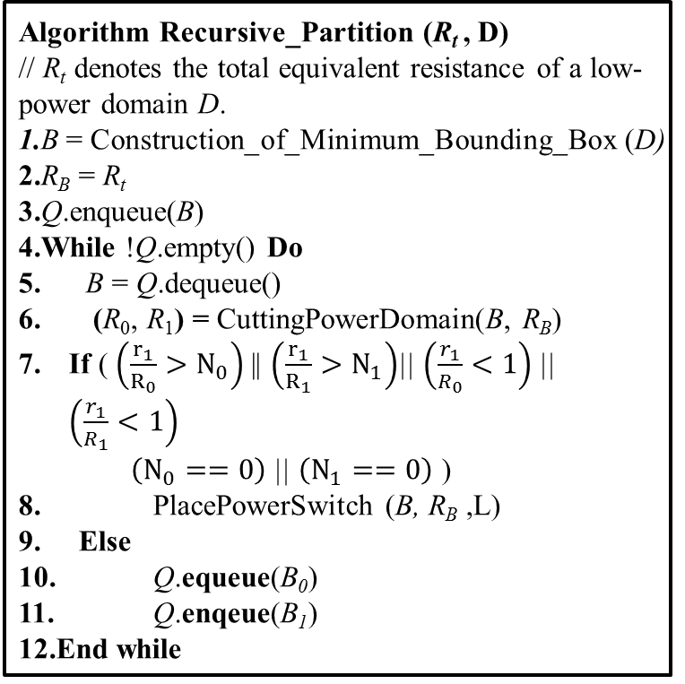
Partition Based Algorithm
Objective:
  Allocate power switches into a low-power domain $D$ with the equivalent resistance $Rt$
Algorithm Recursive_Partition (R_{t} , D)
// R_{t} denotes the total equivalent resistance of a low-power domain D.
1.B = Construction_of_Minimum_Bounding_Box (D)
2.R_{B} = R_{t}
3.Q.enqueue(B)
4.While !Q.empty() Do
5. B = Q.dequeue()
6. (R₀, R₁) = CuttingPowerDomain(B, R_{B})
If ( $\left(\frac{r_{1}}{R_{0}}>N_{0}\right)$|| $\left(\frac{r_{1}}{R_{1}}>N_{1}\right)$|| $\left(\frac{r_{1}}{R_{0}}<1\right)$|| $\left(\frac{r_{1}}{R_{1}}<1\right)$
$\left(N_{0}==0\right)$|| $\left(N_{1}==0\right)$ )
8. PlacePowerSwitch (B, R_{B} ,L)
9. Else
10. Q.equeue(B₀)
11. Q.enqeue(B₁)
12.End while
Cut line
$$R_{0}$$
$$R_{B}$$
$$R_{1}$$
Queue
Front
Back
Notes:
Here show our partition base algorithm. First, it allocates the bounding box B of a low-power domain D, and R_{B} is set as R_{t} , where R_{t} denote the total equivalent resistance of power switches in a low power domain.
Objective:
Allocate power switches into a low-power domain $D$ with the equivalent resistance $Rt$
Then previous slides shows how to divide a low power domain into two sub-regions and allocate R_{t} into two sub-region. If any sub-region doesn’t satisfy stop condition, the two sub-regions will be pushed into a queue. Next, a sub-region is pop from a queue. Then the cutline divides it into two sub-regions and the we check stop conditions. If they satisfy the stop conditions we will insert power switches. The algorithm will repeat until the queue is empty.

Slide 19


Partition Based Algorithm
Objective:
  Allocate power switches into a low-power domain $D$ with the equivalent resistance $Rt$
Algorithm Recursive_Partition (R_{t} , D)
// R_{t} denotes the total equivalent resistance of a low-power domain D.
1.B = Construction_of_Minimum_Bounding_Box (D)
2.R_{B} = R_{t}
3.Q.enqueue(B)
4.While !Q.empty() Do
5. B = Q.dequeue()
6. (R₀, R₁) = CuttingPowerDomain(B, R_{B})
If ( $\left(\frac{r_{1}}{R_{0}}>N_{0}\right)$|| $\left(\frac{r_{1}}{R_{1}}>N_{1}\right)$|| $\left(\frac{r_{1}}{R_{0}}<1\right)$|| $\left(\frac{r_{1}}{R_{1}}<1\right)$
$\left(N_{0}==0\right)$|| $\left(N_{1}==0\right)$ )
8. PlacePowerSwitch (B, R_{B} ,L)
9. Else
10. Q.equeue(B₀)
11. Q.enqeue(B₁)
12.End while
$$R_{0}$$
$$R_{1}$$
Queue
Front
Back

Slide 20
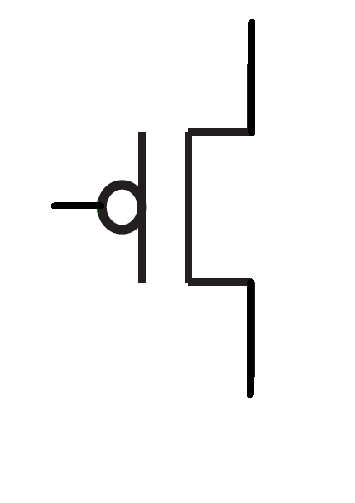


Partition Based Algorithm
Objective:
  Allocate power switches into a low-power domain $D$ with the equivalent resistance $Rt$
Algorithm Recursive_Partition (R_{t} , D)
// R_{t} denotes the total equivalent resistance of a low-power domain D.
1.B = Construction_of_Minimum_Bounding_Box (D)
2.R_{B} = R_{t}
3.Q.enqueue(B)
4.While !Q.empty() Do
5. B = Q.dequeue()
6. (R₀, R₁) = CuttingPowerDomain(B, R_{B})
If ( $\left(\frac{r_{1}}{R_{0}}>N_{0}\right)$|| $\left(\frac{r_{1}}{R_{1}}>N_{1}\right)$|| $\left(\frac{r_{1}}{R_{0}}<1\right)$|| $\left(\frac{r_{1}}{R_{1}}<1\right)$
$\left(N_{0}==0\right)$|| $\left(N_{1}==0\right)$ )
8. PlacePowerSwitch (B, R_{B} ,L)
9. Else
10. Q.equeue(B₀)
11. Q.enqeue(B₁)
12.End while
$$R_{0_0}$$
$$R_{0_0}$$
$$R_{0}$$
$$R_{0_1}$$
$$R_{0_1}$$
Cut line
Queue
$$R_{0}$$
$$R_{1}$$
Front
Back

Slide 21
Outline
Introduction
Preliminaries
Problem Formulation
Partition Based Placement Algorithm
  Simplify Model
  Partition and Select Power Switches
  Placement of Power Switches
Framework of Our Methodology
Experimental Results
Conclusion

Slide 22

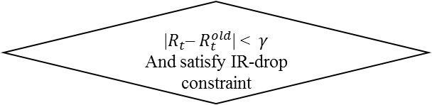

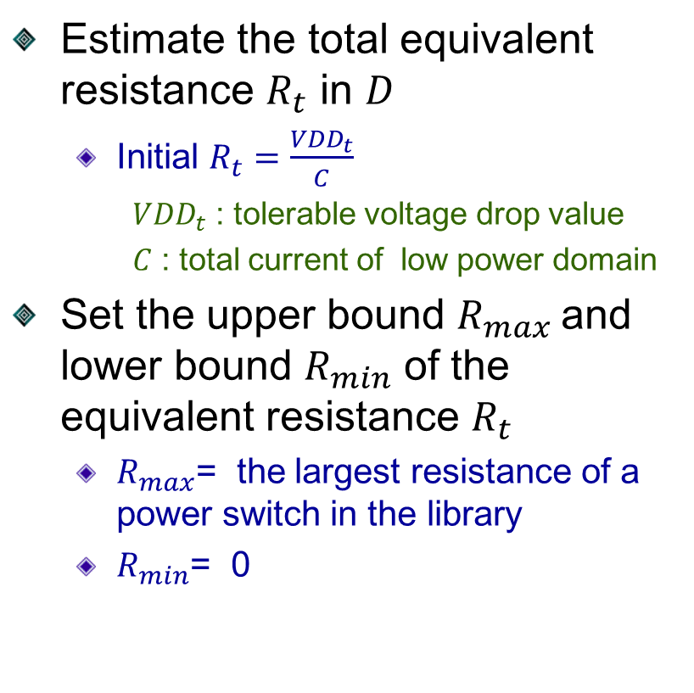
Framework of Our Methodology
Estimate the total equivalent resistance $R_{t}$ in $D$
  Initial $R_{t}=\frac{{VDD}_{t}}{C}$
    ${VDD}_{t}$ : tolerable voltage drop value
    $C$ : total current of low power domain
Set the upper bound $R_{max}$ and lower bound $R_{min}$ of the equivalent resistance $R_{t}$
  $R_{max}$= the largest resistance of a power switch in the library
  $R_{min}$= 0
Initialize the R_{t} , R_{max} , R_{m/in}
Recursive_Partition_Placemant (R_{t} ,D)
Place power switches into each sub-regions
$$\text{Static} \text{IR}\text{−}\text{drop} \text{analysis}$$
Satisfy IR-drop constraint ?
No
Yes
$R_{t}^{old}=R_{t},$R_{max} = $R_{t}$
$R_{t}$= (R_{max}+ R_{min})/2
$R_{t}^{old}=R_{t},$R_{min} = $R_{t}$
$R_{t}$= (R_{max}+ R_{min})/2
|$R_{t}$– $R_{t}^{old}$| < $γ$
And satisfy IR-drop constraint
No
Yes
End
Notes:
Here show the Framework of Our Methodology to place power switches. To minimize area of power switches and satisfy IR-drop, we require a precise a value of $R_{t}$. Thus we propose method to compute $R_{t}$. Since $R_{t}$ can not be obtain, we set $R_{t}$ initially. $R_{t}$ equals tolerable voltage drop value by total current of low power domain. At the same time, Set the upper bound $R_{max}$ and lower bound $R_{min}$ .

Slide 23
Framework of Our Methodology
Recursively partition low-power-domain into several sub-regions, and allocate the equivalent resistance of power switches into each sub-region.
Place power switches into each sub-region according to equivalent resistance.
Initialize the R_{t} , R_{max} , R_{m/in}
Recursive_Partition_Placemant (R_{t} ,D)
Place power switches into each sub-regions
$$\text{Static} \text{IR}\text{−}\text{drop} \text{analysis}$$
Satisfy IR-drop constraint ?
No
Yes
$R_{t}^{old}=R_{t},$R_{max} = $R_{t}$
$R_{t}$= (R_{max}+ R_{min})/2
$R_{t}^{old}=R_{t},$R_{min} = $R_{t}$
$R_{t}$= (R_{max}+ R_{min})/2
|$R_{t}$– $R_{t}^{old}$| < $γ$
And satisfy IR-drop constraint
No
Yes
End
Notes:
Based on current $R_{t}$.
Then, recursively partition low-power-domain into several sub-regions, and allocate the equivalent resistance of power switches .
Next , place power switches into each sub-region according to equivalent resistance.

Slide 24

Framework of Our Methodology
Analyze IR-drop based on the equation G $∙$V = I
  G denotes the conductance matrix.
  V denotes the vector of voltages.
  I denotes the vector of current loads.
Initialize the R_{t} , R_{max} , R_{m/in}
Recursive_Partition_Placemant (R_{t} ,D)
Place power switches into each sub-regions
$$\text{Static} \text{IR}\text{−}\text{drop} \text{analysis}$$
Satisfy IR-drop constraint ?
No
Yes
$R_{t}^{old}=R_{t},$R_{max} = $R_{t}$
$R_{t}$= (R_{max}+ R_{min})/2
$R_{t}^{old}=R_{t},$R_{min} = $R_{t}$
$R_{t}$= (R_{max}+ R_{min})/2
|$R_{t}$– $R_{t}^{old}$| < $γ$
And satisfy IR-drop constraint
No
Yes
End
Notes:
After power switches are insert to the low power domain, we use a IR-drop analyzer to estimate the quality of design.

Slide 25
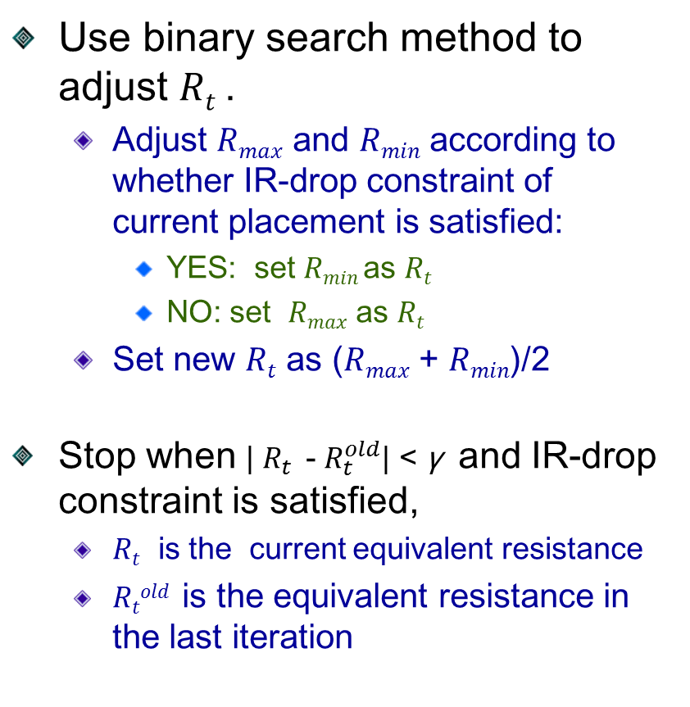
Framework of Our Methodology
Use binary search method to adjust $Rt$ .
  Adjust $Rmax$ and $Rmin$ according to whether IR-drop constraint of current placement is satisfied:
    YES: set $Rmin$as $Rt$
    NO: set $Rmax$ as $Rt$
  Set new $Rt$ as ($Rmax$ + $Rmin$)/2
Stop when | $R_{t}$ - $R_{t}^{old}$| < γ and IR-drop constraint is satisfied,
  $Rt$ is the current equivalent resistance
  $Rtold$ is the equivalent resistance in the last iteration
Initialize the R_{t} , R_{max} , R_{m/in}
Recursive_Partition_Placemant (R_{t} ,D)
Place power switches into each sub-regions
$$\text{Static} \text{IR}\text{−}\text{drop} \text{analysis}$$
Satisfy IR-drop constraint ?
No
Yes
$R_{t}^{old}=R_{t},$R_{max} = $R_{t}$
$R_{t}$= (R_{max}+ R_{min})/2
$R_{t}^{old}=R_{t},$R_{min} = $R_{t}$
$R_{t}$= (R_{max}+ R_{min})/2
|$R_{t}$– $R_{t}^{old}$| < $γ$
And satisfy IR-drop constraint
No
Yes
End
Notes:
Since initial $Rt$ is incorrect, we use binary search method to find precise $R_{t}$, the procedure is as follow in each iteration. Adjust $Rmax$ and $Rmin$ according to whether IR-drop constraint is satisfied.
The procedure will repeat until the absolute difference of $R_{t}$ in current iteration and previous iteration is small than a user defined γ value and satisfy IR-drop constraint.

Slide 26
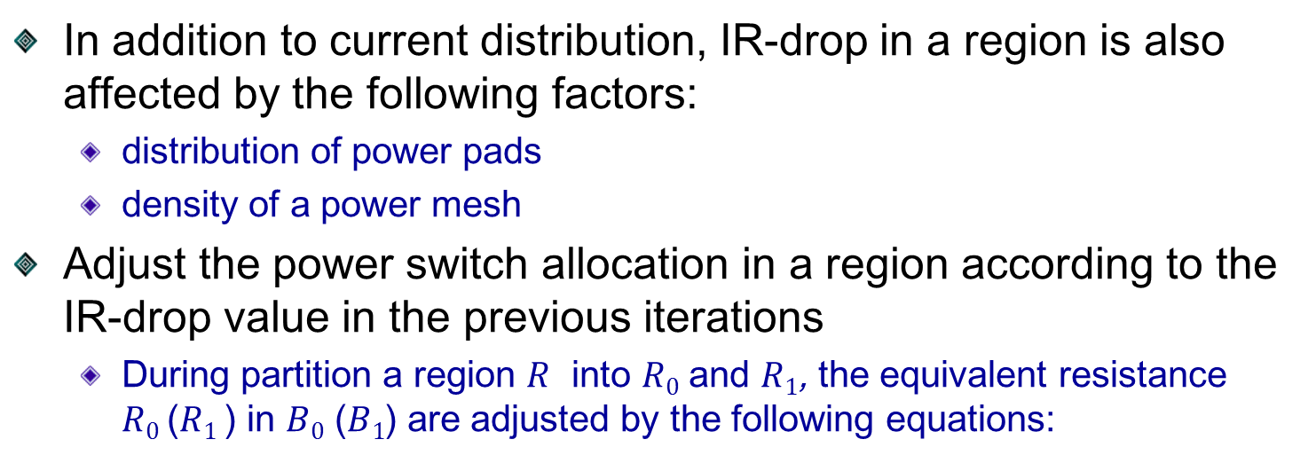
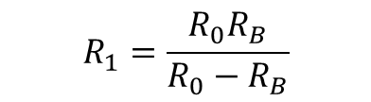


Modification of Allocation of Equivalent Resistance
In addition to current distribution, IR-drop in a region is also affected by the following factors:
  distribution of power pads
  density of a power mesh
Adjust the power switch allocation in a region according to the IR-drop value in the previous iterations
  During partition a region $R$ into $R0$ and $R1$, the equivalent resistance $R0$($R1$) in $B0$ ($B1$) are adjusted by the following equations:
$$R_{0}=\left\{\begin{aligned}R_{0}=\left(1+γ\frac{D_{0}}{D1}\right) ,if\frac{D_{0}}{D1}≥1 \\ R_{0}=\left(1−γ\frac{D_{0}}{D1}\right) ,otherwise\end{aligned}\right.$$
$$R_{1}=\frac{R_{0}R_{B}}{R_{0}−R_{B}}$$
  $D_{0}$ ($D_{1}$) denotes the average voltage drop value in $B_{0}$ ($B_{1}$)
  $γ$ is a user specified parameter
Notes:
In the partition base algorithm, we allocate power switches into sub-region according to the current in the sub-region. However, IR-drop is affected not only by current distribution but also by distribution of power pads and density of a power mesh.
To resolve this problem, we further adjust equivalent resistance of a sub-region according to the previous IR-drop value. The equation to adjust equivalent resistance is shown as follows. It will give it small equivalent resistance if the sub-region has a serious IR-drop value in the previous iterations.

Slide 27
Outline
Introduction
Preliminaries
Problem Formulation
Partition Based Placement Algorithm
  Simplify Model
  Partition and Select Power Switches
  Placement of Power Switches
Framework of Our Methodology
Experimental Results
Conclusion

Slide 28
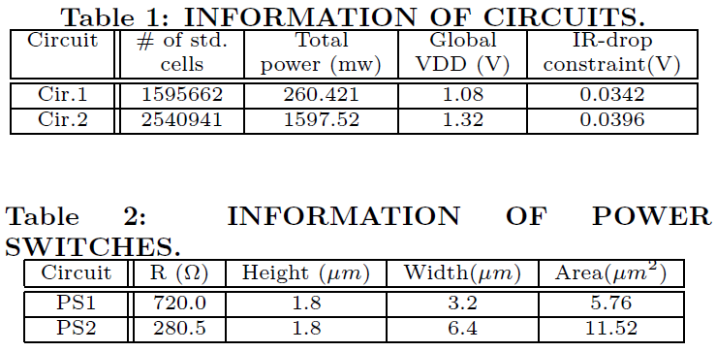
Experimental Results
Our algorithm is implemented by C++ programming language and compiled under g++4.6.2.
Our program is run under quad core CPU Intel(R) Xeon(R) E5520 2.27GHz and Cent OS 5.1 workstation with 62GB memory.
The power switches provided by GLOBAL FOUNDRIES 55nm physical libraries.
Notes:
TABLE 1 displays the information of the circuits and includes number of stand cells, total power, global VDD, and IR-drop constraint
TABLE 2 shows the information of the power switch and the height, width, and area of each power switch

Slide 29
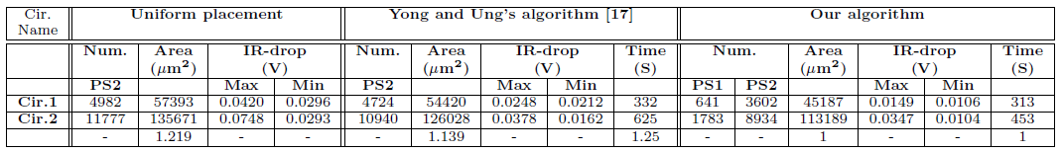
Experimental Results
Compare our algorithm with the uniform placement approach and Yong and Ung's algorithm.
  Uniform placement approach
    Evenly insert power switches at legal locations inside a placement region
  Yong and Ung's algorithm
    Define the effect region of a power switch, and place power switches into all legal regions
    Then remove those power switches if their effect regions are overlapped with others.
Notes:
The experimental results compare with the uniform placement approach and Yong and Ung's algorithm
Uniform placement approach is to evenly insert power switches at legal locations
Yong and Ung's algorithm defines the effect region of a power switch, and place power switches into all legal regions. If effect regions of power switches are overlapped, then remove those power switches.
The table show that our algorithm has better area and IR-drop than Uniform placement approach and Yong and Ung's algorithm.

Slide 30
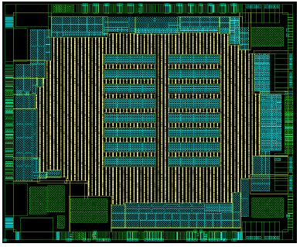
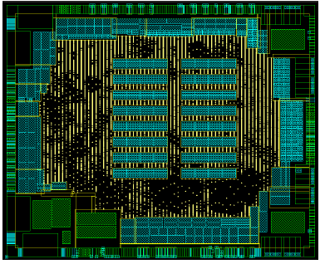
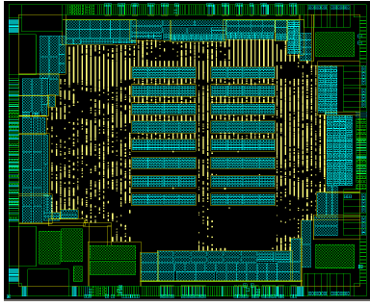
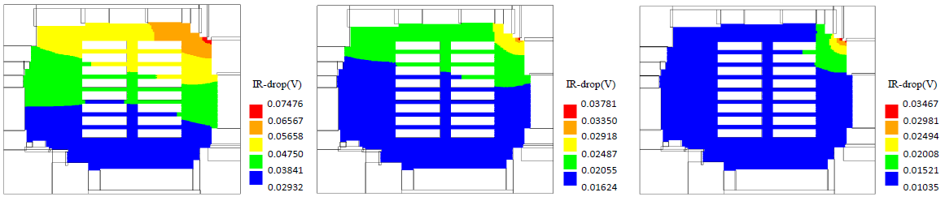
Experimental Results
Uniform placement approach
Yong and Ung's algorithm
Our algorithm
Placements of power switches and the associated IR-drop maps on Cir.2
Notes:
Here shows the distribution of power switches in real layout from IC compiler. The yellow point is the location of power switch. The following figures show the associate IR-drop maps. It shows we can use less power switches and satisfy the IR-drop constraint.

Slide 31
Outline
Introduction
Preliminaries
Problem Formulation
Partition Based Placement Algorithm
  Simplify Model
  Partition and Select Power Switches
  Placement of Power Switches
Framework of Our Methodology
Experimental Results
Conclusion

Slide 32
Conclusion
Propose an efficient and effective methodology to allocate power switches in power gating designs
  Propose a simple mode to approximate the equivalent resistance of power switches in a region
  Use the binary search method to find proper equivalent resistance in a low power domain
  Use recursively partition based method to allocate power switches
Demonstrate our method can insert less number of power switches and satisfy IR drop constraint comparing to other approaches in experimental results

Slide 33

End
Thank You For Your Attention

