Slide 1
Incremental Transient Simulation of
Power Grid
Chia Tung Ho, Yu Min Lee, Shu Han Wei,
and Liang Chia Cheng
March 30 – April 2, ISPD

Slide 2
Contact us
Chia Tung Ho
(CAD Dept. Macronix Intl. Co., Ltd. Hsinchu, Taiwan),
Yu Min Lee and Shu Han Wei
(ECE Dept., NCTU, Hsinchu, Taiwan),
Liang Chia Cheng
(ITRI, Hsinchu, Taiwan)
Email:{chiatungho@mxic.com.tw, yumin@nctu.edu.tw, littlelittle821@gmail.com, aga@itri.org.tw}

Slide 3
Outline
Introduction
Related Techniques
Incremental Transient Simulator
Experimental Results
Conclusions

Slide 4
Introduction

Slide 5
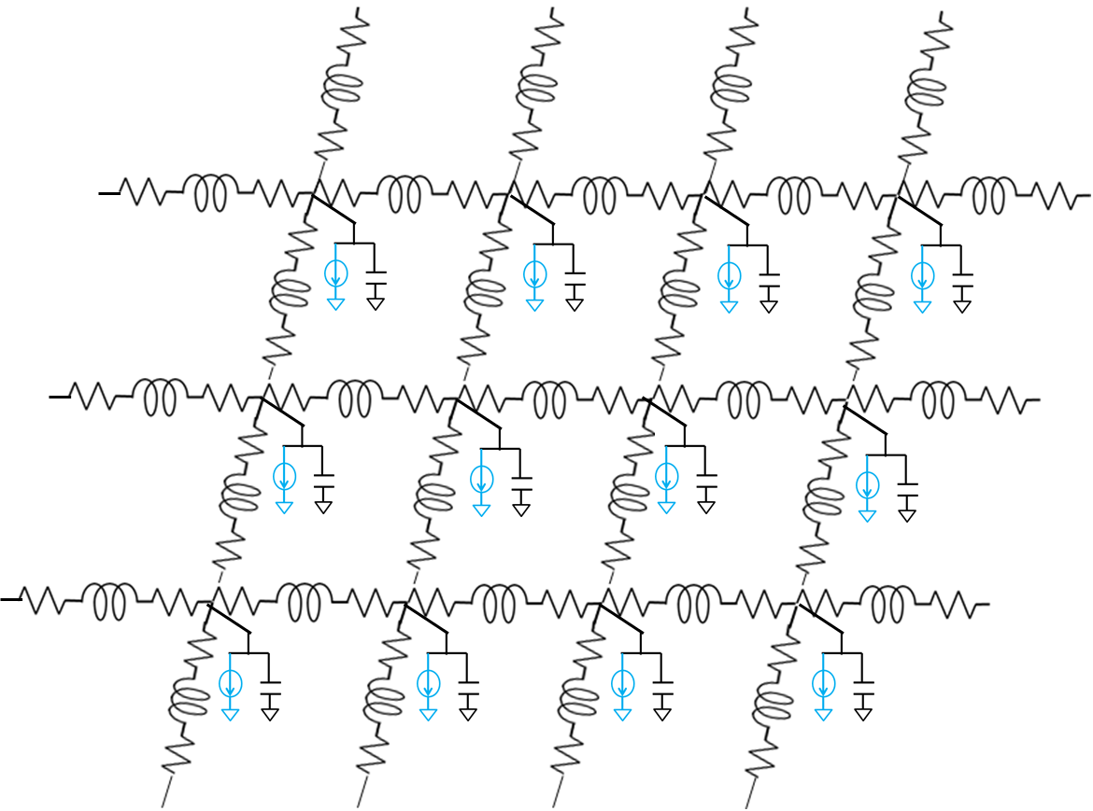
Back Ground
Power delivery network provides power to devices on a chip
Due to the advancement of VLSI technology, the power grid analysis becomes a challenging task.
Power Grid Model
Notes:
1 . 電源供應網路為提供Power給晶片中的元件
隨著超大型積體電路技術的發展，電源供應網路分析在現代變為一具有挑戰性的任務，對於電源供應網路的暫態分析更是如此。
超低電壓、3D IC、低功率設計為現今非常熱門的設計，在這些的設計中，其對於電源雜訊更加的脆弱，3D IC 更有高電源密度的問題，電源供應網路分析日漸重要。

Slide 6

Power Grid Design
Wire sizing
- Change element values
Topology optimization
- Increase or decrease the tracks
  Designer often changes power grid locally, and needs a faster incremental analyzer to
  update the influence of IR drops and $L\frac{di}{dt}$ noises in each design iteration.
Reference: J. Singh and S. S. Sapantnekar. Partition-based algorithm for power grid design using locality.
IEEE TCAD, 25(4):664–677, 2006.
Notes:
電源供應網路設計
Wire Sizing 調變Wire 的粗細
拓樸結構改變
在設計時，設計者經常更動電源供應網路，此時需要一快速的暫態增量分析去更新IR drops 和電感雜訊對電路的影響

Slide 7
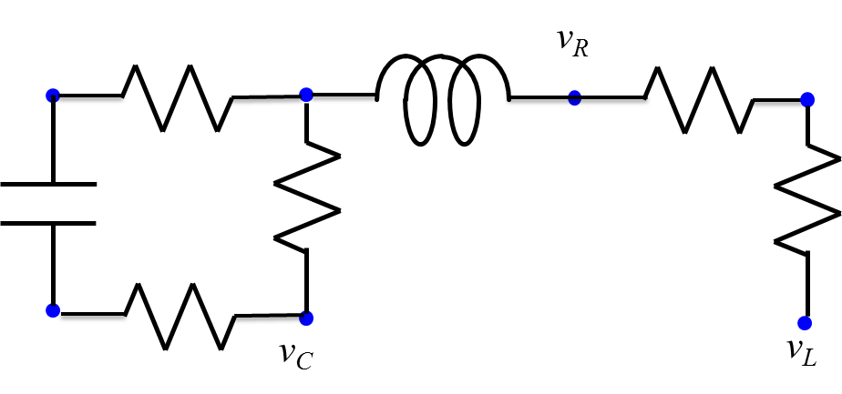
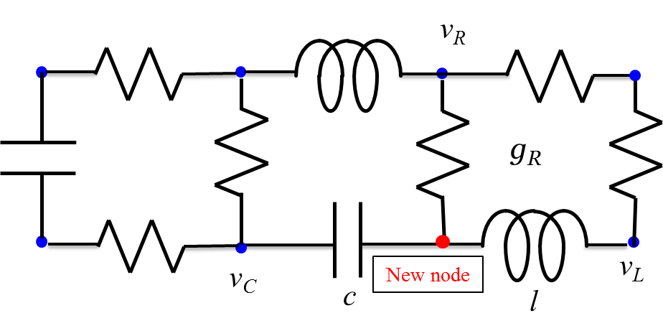
Contributions
To manipulate the modified topology
  Pseudo-node value estimation method is proposed to build artificial original electrical values of added nodes
    Consider capacitances, inductances, and resistances

Slide 8
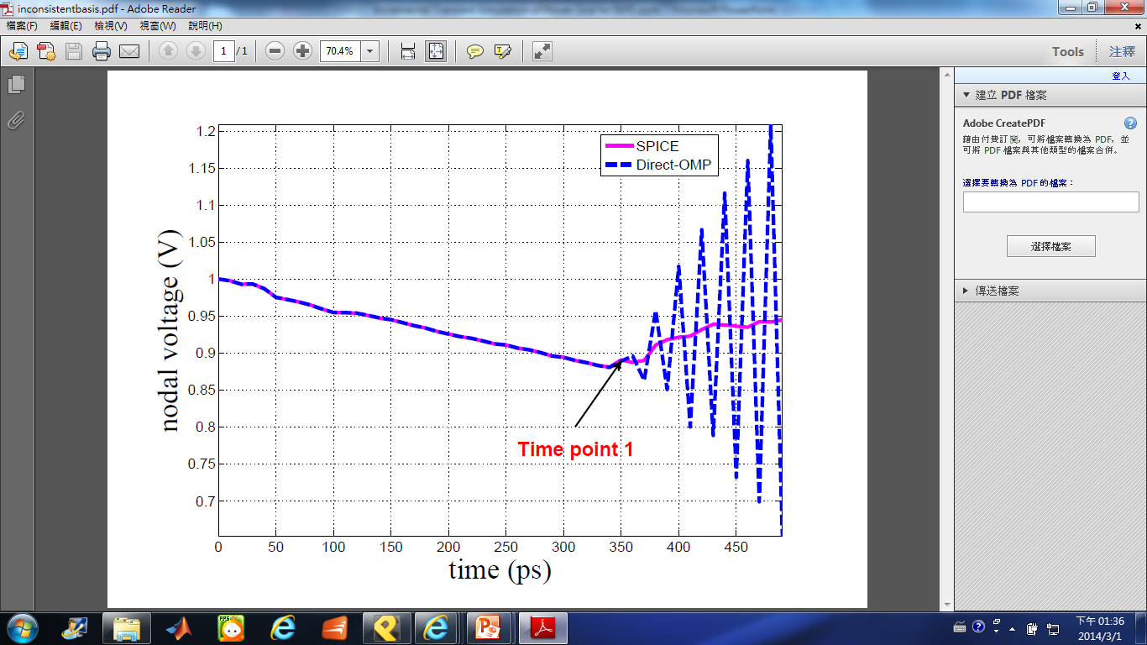
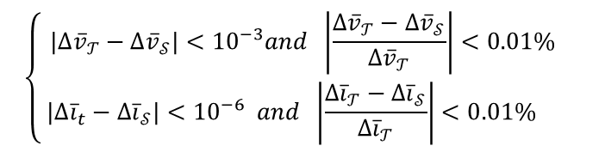


Contributions
To improve the accuracy and ease the inconsistent basis issue
  Basis-set adjustment criterion
Basis set $𝓣$
Basis set $𝓢$
Here, it is a case with 40 thousands nodes and the
number of bases is changed from 16 to 53 at time
point 1.
$$\left\{\begin{matrix}{|∆\overline{v}}_{𝒯}−∆{\overline{v}}_{𝒮}|<{10}^{−3}and \left|\frac{{∆\overline{v}}_{𝒯}−∆{\overline{v}}_{𝒮}}{{∆\overline{v}}_{𝒯}}\right|<0.01\% \\ { |∆\overline{i}}_{t} − {∆\overline{i}}_{𝒮}|<{10}^{−6} and \left|\frac{{∆\overline{i}}_{𝒯}−∆{\overline{i}}_{𝒮}}{∆{\overline{i}}_{𝒯}}\right|<0.01\% \end{matrix}\right.$$

Slide 9
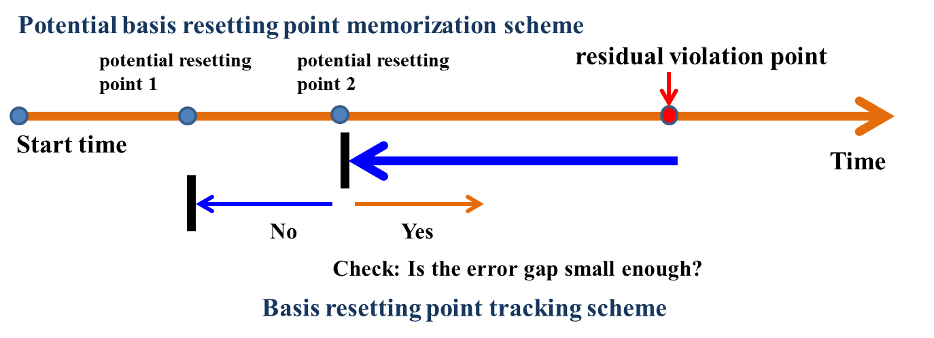
Contributions
To enhance the efficiency of simulation
  Adaptive error control procedure
    Choose suitable time points for adjusting the basis set
    Avoid the wasteful use of computational power.

Slide 10
Related Techniques

Slide 11
Related Techniques
Circuit Equations (MNA)
Hierarchical Analysis of Power Grid
Incremental Steady-State Simulation
  OMP
  MA-OMP

Slide 12
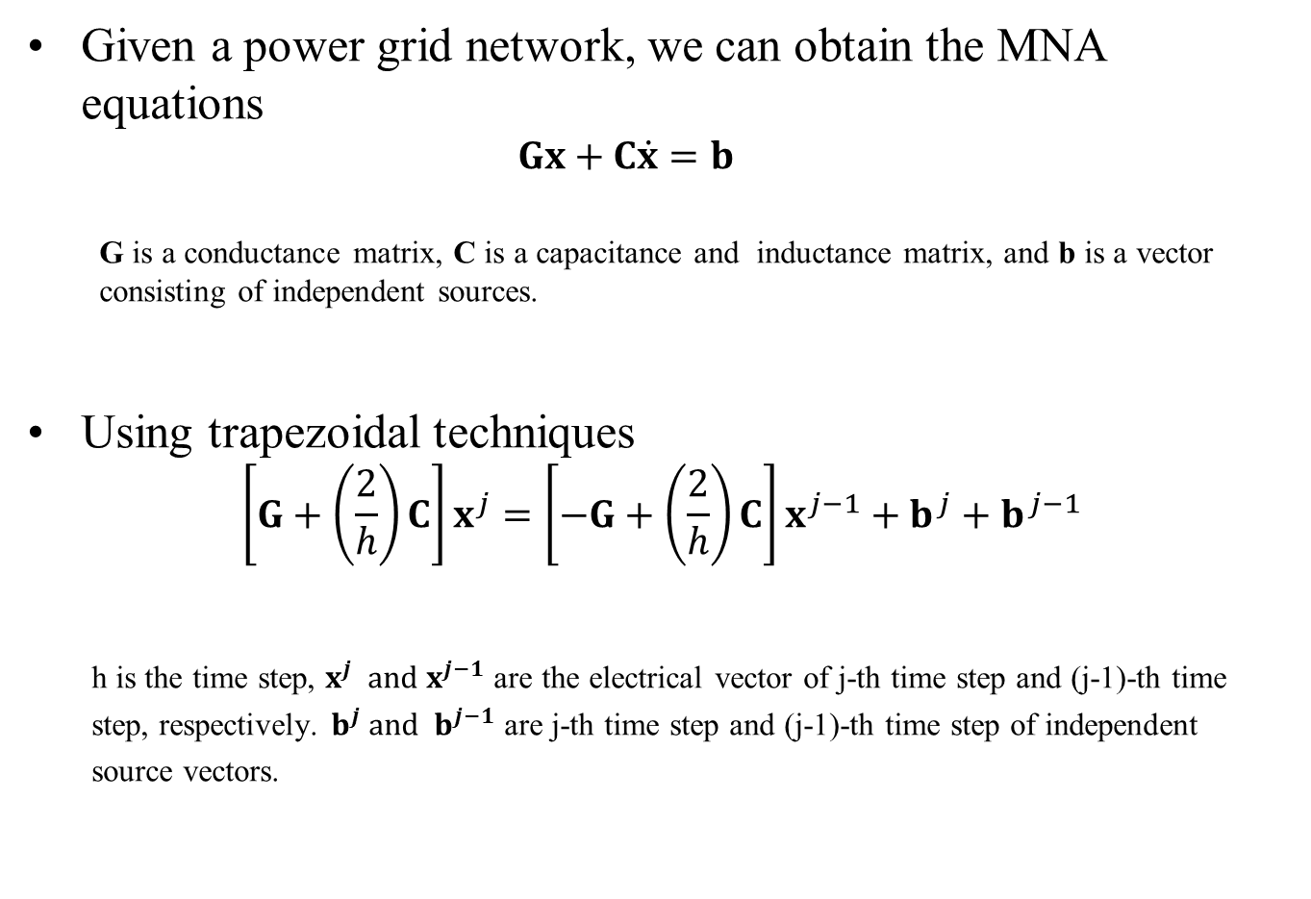
Circuit Equations (MNA)
Given a power grid network, we can obtain the MNA equations
  $$Gx+C\dot{x}=b$$
  G is a conductance matrix, C is a capacitance and inductance matrix, and b is a vector consisting of independent sources.
Using trapezoidal techniques
  $$\left[G+\left(\frac{2}{h}\right)C\right]x^{j}=\left[−G+\left(\frac{2}{h}\right)C\right]x^{j−1}+b^{j}+b^{j−1}$$
h is the time step, $x^{j}$ and $x^{j−1}$ are the electrical vector of j-th time step and (j-1)-th time
step, respectively. $b^{j}$ and $b^{j−1}$ are j-th time step and (j-1)-th time step of independent
source vectors.

Slide 13
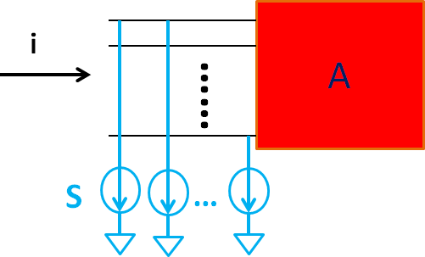
Hierarchical Analysis of Power Grid
Given a power network, we divide the network into several blocks as below
(A₁,S₁)
(A₂,S₂)
(A₃,S₃)
(A₄,S₄)
(A₅,S₅)
(A₆,S₆)
global links
Macro Model(A,S)
(A₇,S₇)
(A₈,S₈)
(A₉,S₉)
i = AV+S
ports
Reference: M. Zhao, R. V. Panda, S. S. Sapatnekar, and D. Blaauw. Hierarchical analysis of power
distribution networks. IEEE TCAD, 21(2):159–168, 2002.

Slide 14
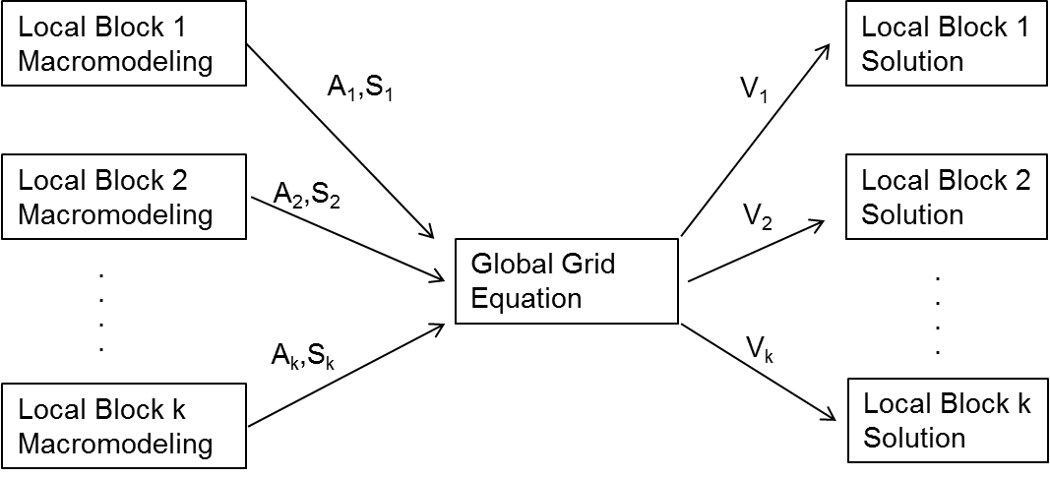

Hierarchical Analysis of Power Grid
Global equations
$$\left(G_{g}+\frac{2}{h}C_{g}\right)x_{g}^{j}=\left(−G_{g}+\frac{2}{h}C_{g}\right)x_{g}^{j−1}−S^{j}+u_{g}^{j−1}+u_{g}^{j}$$
Here, $x_{g}^{j}$ and $x_{g}^{j−1}$ are the electrical variable vectors of ports at j-th and (j-1)-th time step, respectively. ${u_{g}^{}}_{}^{j}$ and ${u_{g}^{}}_{}^{j−1}$ are consist of global independent sources at j-th and (j-1)-th time step. $S^{j}$ consists of local equivalent current source vectors , S, in each block at j-th time step.
Reference: M. Zhao, R. V. Panda, S. S. Sapatnekar, and D. Blaauw. Hierarchical analysis of power
distribution networks. IEEE TCAD, 21(2):159–168, 2002.

Slide 15

OMP
After changing the original network, $\overline{x}=x+∆x$. Due to the locality characteristic of power grid, we know $∆x$ is a sparse electrical vector.
$$\overline{G}\overline{x}=\overline{b}$$
$$\overline{G}∆x=\tilde{b} , \tilde{b}≝\overline{b}−\overline{G}x$$
As a result, we can utilize orthogonal matching pursuit to recover $∆x$.
Entire grid
Element values
changed
Reference: P. Sun, X. Li, and M. Y. Ting. Efficient incremental analysis of on-chip power grid via sparse approximation.
In DAC, pages 676-681, 2011.

Slide 16

OMP
Algorithm
Let $r=\tilde{b}$ , the set of column vectors $\left\{\begin{matrix}{\overline{G}}_{1} & {\overline{G}}_{2} & \begin{matrix}⋯ & {\overline{G}}_{m}\end{matrix}\end{matrix}\right\}$, and the set of chosen vector set $T=∅$.
Using normalized inner product $c_{i}=\left|\frac{\left\langle {\overline{G}}_{i},r\right\rangle }{\left\langle {\overline{G}}_{i},{\overline{G}}_{i}\right\rangle }\right|$to pick column vectors. As $c_{i}$ exceeds threshold, put the column vectors into $T$.
Do least squares fitting by using the chosen vectors in $T$ and obtain $∆x$
Calculate the residual$r=\tilde{b}−\overline{G}∆x$
Determine whether it exceeds a user defined threshold. If it exceeds the threshold, go back to step 2.
Obtain the $\overline{x}=x+∆x$ and finish the program.
Reference: P. Sun, X. Li, and M. Y. Ting. Efficient incremental analysis of on-chip power grid via sparse approximation.
In DAC, pages 676-681, 2011.

Slide 17
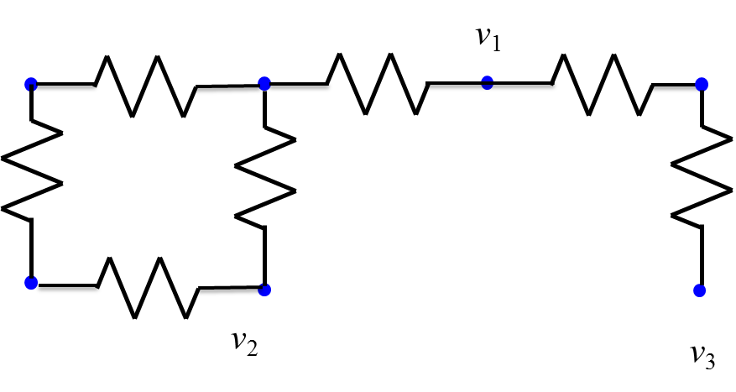
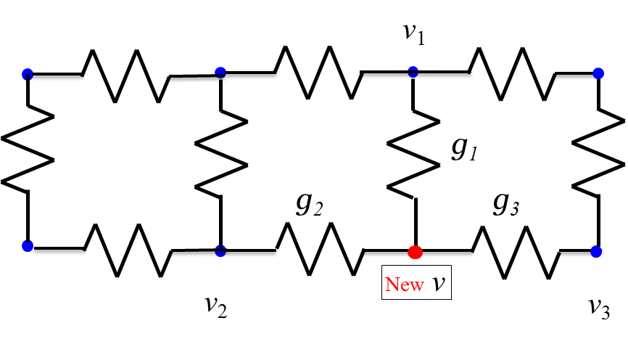
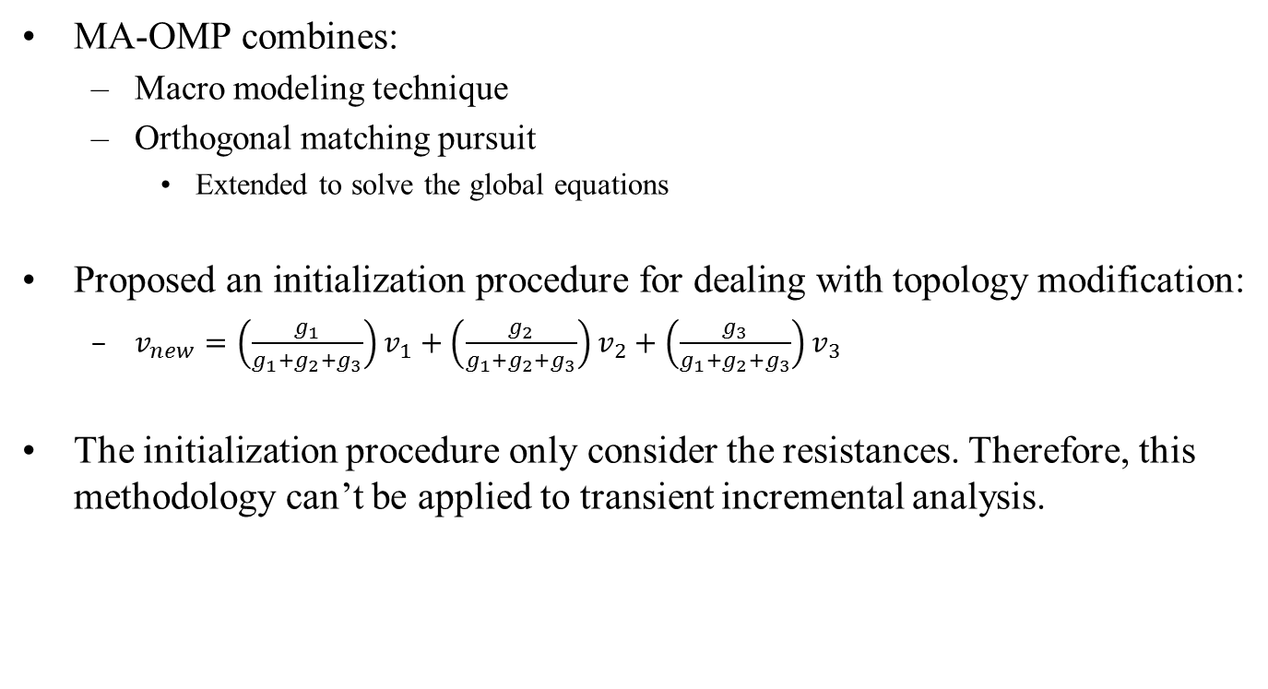
MA-OMP
MA-OMP combines:
  Macro modeling technique
  Orthogonal matching pursuit
    Extended to solve the global equations
Proposed an initialization procedure for dealing with topology modification:
  $v_{new}=\left(\frac{g_{1}}{g_{1}+g_{2}+g_{3}}\right)v_{1}+\left(\frac{g_{2}}{g_{1}+g_{2}+g_{3}}\right)v_{2}+\left(\frac{g_{3}}{g_{1}+g_{2}+g_{3}}\right)v_{3}$
The initialization procedure only consider the resistances. Therefore, this methodology can’t be applied to transient incremental analysis.
Reference: Y. H. Lee, Y. M. Lee, L. C. Cheng, and Y. T. Chang. A robust incremental power grid analyzer by macromodeling
approach and orthogonal matching pursuit. In ASQED, pages 64-70, 2012.

Slide 18
Incremental Transient Simulator

Slide 19
Incremental Transient Simulator
Flow Chart
Graph Information Reconstruction
Pseudo-Node Value Estimation for Added Nodes
Basis Set Adjustment Criterion
Adaptive Error Control Procedure

Slide 20
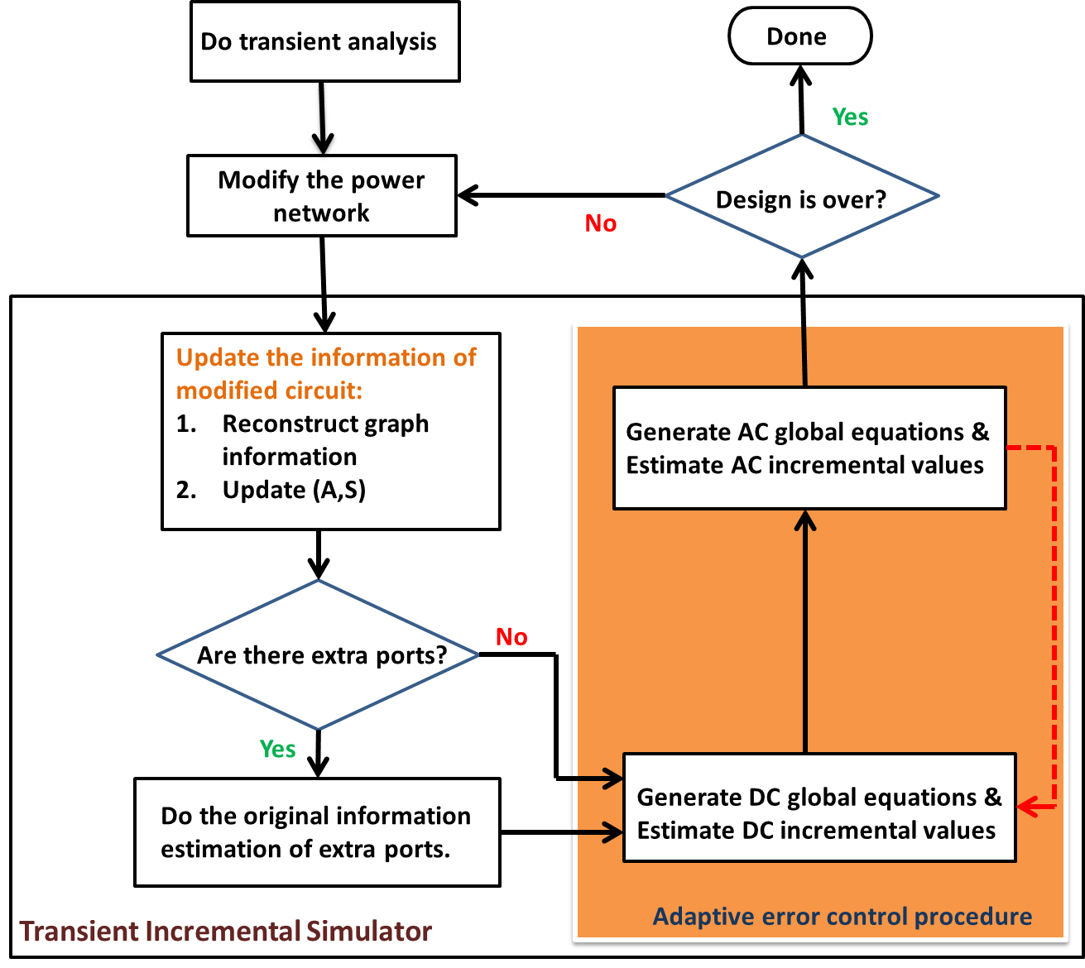

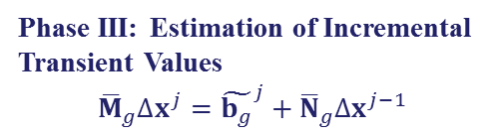
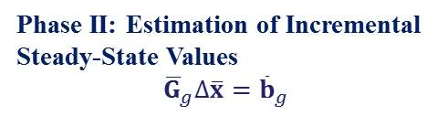
Flow Chart
Phase I: Establishment of
Required Information
Obtain ${\overline{G}}_{g}$ and ${\overline{C}}_{g}$
Phase III: Estimation of Incremental
Transient Values
$${\overline{M}}_{g}∆x^{j}={\tilde{b_{g}}}^{j}+{\overline{N}}_{g}∆x^{j−1}$$
Phase II: Estimation of Incremental
Steady-State Values
$${\overline{G}}_{g}∆\overline{x}={\overline{b}}_{g}$$
Here, ${\overline{M}}_{g}={\overline{G}}_{g}+\frac{2}{h}$ ${\overline{C}}_{g}$, ${\overline{N}}_{g}={−\overline{G}}_{g}+\frac{2}{h} {\overline{C}}_{g}$, and ${\tilde{b_{g}}}^{j}=−{\overline{M}}_{g}x^{j}+{\overline{N}}_{g}x^{j−1}−S^{j}+u_{g}^{j−1}+u_{g}^{j}$.

Slide 21
Graph Information Reconstruction
There are two categories
  Change without inserting new nodes
    Modification of existing element value
    Insertion of branches between original nodes
    Deletion of original nodes
  Change with inserting new nodes
    Consider the number of cut set between blocks
The inserted node is assigned to the partition which most of its adjacent nodes belong to.

Slide 22
Pseudo-Node Value Estimation for Added Nodes
There are extra ports emerge when modify the topology of power network. We need their artificial original electrical variable values.
However, this is much more complicate than only considering DC part due to the memorable elements, such like capacitance and inductance.

Slide 23


Pseudo-Node Value Estimation for Added Nodes
Considering the linear model of capacitance and inductance as illustrating below:
$u_{C}^{j}−\frac{I_{Ceq}}{g_{Ceq}}=\frac{i_{C}^{j}}{g_{Ceq}}$ (b1)
$I_{Ceq}=i_{C}^{j−1}+g_{Ceq}u_{C}^{j−1}$, $g_{Ceq}=\frac{2C}{h}$
$u_{C}^{j}$/ $u_{C}^{j}$ and $i_{C}^{j}$/$i_{C}^{j−1}$ are the voltage across the
capacitance and the current flowing through
the capacitance at j-th/(j-1)-th sampling time,
respectively.
$u_{L}^{j}−\frac{I_{Leq}}{g_{Leq}}=\frac{i_{L}^{j}}{g_{Leq}}$ (b2)
$I_{Leq}=−i_{L}^{j−1}−g_{Leq}u_{L}^{j−1}$, $g_{Leq}=\frac{h}{2L}$
$u_{L}^{j}$/ $u_{L}^{j}$ and $i_{L}^{j}$/$i_{L}^{j−1}$ are the voltage across the
capacitance and the current flowing through
the capacitance at j-th/(j-1)-th sampling time,
respectively.

Slide 24
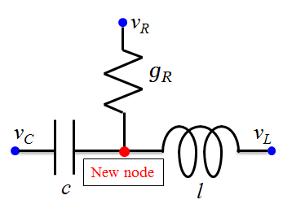
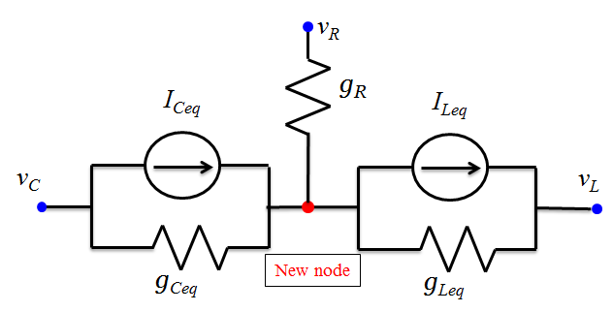
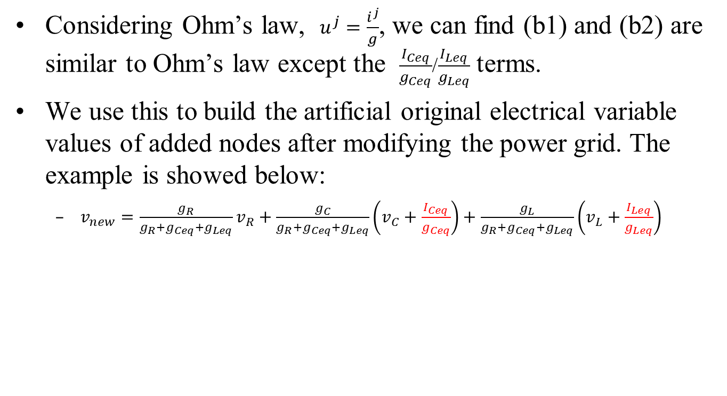
Pseudo-Node Value Estimation for Added Nodes
Considering Ohm’s law, $u^{j}=\frac{i^{j}}{g}$, we can find (b1) and (b2) are similar to Ohm’s law except the $\frac{I_{Ceq}}{g_{Ceq}}$/$\frac{I_{Leq}}{g_{Leq}}$ terms.
We use this to build the artificial original electrical variable values of added nodes after modifying the power grid. The example is showed below:
  $v_{new}=\frac{g_{R}}{g_{R}+g_{Ceq}+g_{Leq}}v_{R}+\frac{g_{C}}{g_{R}+g_{Ceq}+g_{Leq}}\left(v_{C}+\frac{I_{Ceq}}{g_{Ceq}}\right)+\frac{g_{L}}{g_{R}+g_{Ceq}+g_{Leq}}\left(v_{L}+\frac{I_{Leq}}{g_{Leq}}\right)$

Slide 25
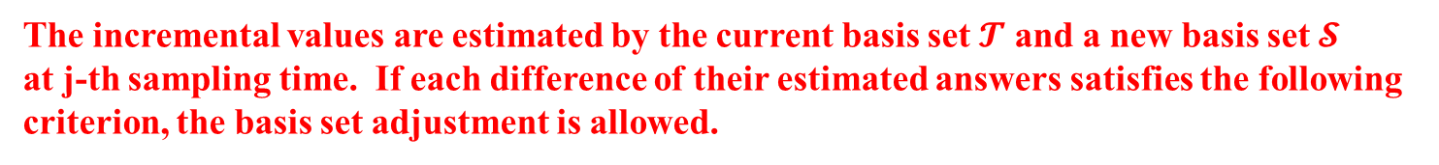
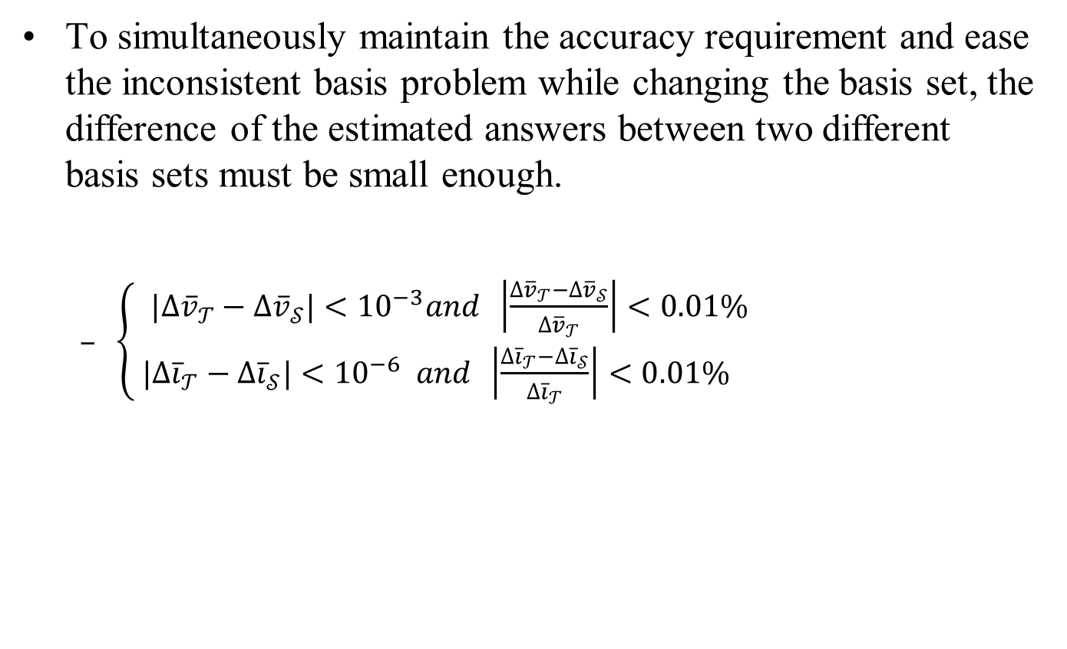
Basis Set Adjustment Criterion
To simultaneously maintain the accuracy requirement and ease the inconsistent basis problem while changing the basis set, the difference of the estimated answers between two different basis sets must be small enough.
  $\left\{\begin{matrix}{|∆\overline{v}}_{𝒯}−∆{\overline{v}}_{𝒮}|<{10}^{−3}and \left|\frac{{∆\overline{v}}_{𝒯}−∆{\overline{v}}_{𝒮}}{{∆\overline{v}}_{𝒯}}\right|<0.01\% \\ { |∆\overline{i}}_{𝒯} − {∆\overline{i}}_{𝒮}|<{10}^{−6} and \left|\frac{{∆\overline{i}}_{𝒯}−∆{\overline{i}}_{𝒮}}{∆{\overline{i}}_{𝒯}}\right|<0.01\% \end{matrix}\right.$
The incremental values are estimated by the current basis set $𝓣$ and a new basis set $𝓢$
at j-th sampling time. If each difference of their estimated answers satisfies the following
criterion, the basis set adjustment is allowed.

Slide 26
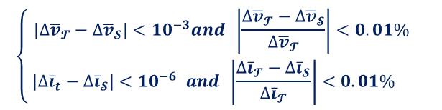
Basis Set Adjustment Criterion
An example of basis set adjustment.
$$\left\{\begin{matrix}{|∆\overline{v}}_{𝓣}−∆{\overline{v}}_{𝓢}|<{10}^{−3}and \left|\frac{{∆\overline{v}}_{𝓣}−∆{\overline{v}}_{𝓢}}{{∆\overline{v}}_{𝓣}}\right|<0.01\% \\ { |∆\overline{i}}_{t} − {∆\overline{i}}_{𝓢}|<{10}^{−6} and \left|\frac{{∆\overline{i}}_{𝓣}−∆{\overline{i}}_{𝓢}}{∆{\overline{i}}_{𝓣}}\right|<0.01\% \end{matrix}\right.$$

Slide 27
Adaptive Error Control Procedure
Adaptive error control procedure enhance the efficiency of incremental transient simulation.
  Choose suitable time points for adjusting the basis set
  Avoid extra computational power
An overview of adaptive error control procedure.

Slide 28
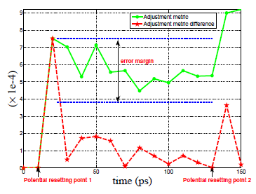
Adaptive Error Control Procedure
Potential Basis Resetting Point Memorization Scheme
  It wastes too much time and resource for checking the error gap node by node at each time step.
  Utilize the residual to search potential resetting sampling times
Adjustment metric is the root mean square value of non-zero part in the residual at j-th sampling time, $r^{j}$.
Adjustment metric difference is defined as $δ^{j}=\left|r^{j}−r^{j−1}\right|$

Slide 29
Experimental Results

Slide 30
Environment
The developed transient incremental simulator is implemented by C++ language.
It is tested on Linux
  CPU: Intel Xeon 2.4GHz
  RAM: 96G

Slide 31
OMP-like Solver
As the residual exceeds the given threshold during incremental transient analysis, the incremental simulation is restarted from the beginning with a new basis set for avoiding the basis inconsistence problem.

Slide 32
Experimental Result (1/6)
Number of Nodes | Number of Blocks | Modified Blocks | Hierarchical Runtime (sec) | GMRES |  |  | OMP-like |  |  | Proposed Method |  |  | Speedup
 |  |  |  | emax (mV) | emax (mV) | Runtime (sec) | emax (mV) | emax (mV) | Runtime (sec) | emax (mV) | emax (mV) | Runtime (sec) | [1] (X) | [13] (X) | OMP-like (X)
1.05M | 160 | 6 | 426.88 | 0.11 | 1.97e-4 | 128.28 | 0.05 | 6.17e-4 | 31.91 | 0.04 | 9.0e-4 | 8.97 | 47.6 | 14.3 | 3.6
1.86M | 180 | 7 | 1207.51 | 0.14 | 3.92e-3 | 197.16 | 0.27 | 2.82e-2 | 34.35 | 0.11 | 1.1e-3 | 15.24 | 79.2 | 12.9 | 2.3
2.54M | 220 | 9 | 2005.05 | 0.99 | 1.81e-3 | 211.06 | 0.94 | 1.56e-2 | 58.92 | 0.94 | 1.2e-3 | 17.16 | 116.8 | 12.3 | 3.4
4.60M | 220 | 9 | 3241.51 | 0.60 | 1.70e-3 | 291.23 | 0.56 | 1.07e-2 | 77.67 | 0.61 | 1.0e-2 | 29.04 | 111.6 | 10.0 | 2.7
We change several element values and the values of current drawn in different blocks.
The percentage of modified blocks is around 3.75% for each test circuit.
The proposed method achieves orders of magnitude speedup over hierarchical method, 10X speedup over GMRES, and 2.3X speedup over OMP-like method.
The maximum error is less than 1mV, and the average error is very small.
Reference:
M. Zhao, R. V. Panda, S. S. Sapatnekar, and D. Blaauw. Hierarchical analysis of power distribution networks.
IEEE TCAD, 21(2):159–168, 2002.
Y. Saad and M. H. Schultz. GMRES: A generalized minimal residual algorithm for solving non-symmetric linear
systems. SIAM J. Sci. Stat. Comput., 7:856-869,1986.

Slide 33
Experimental Result (2/6)
The distribution of incremental voltages at 420ps for the 1.05M test case obtained by
(a) the hierarchical method and (b) the proposed method.

Slide 34
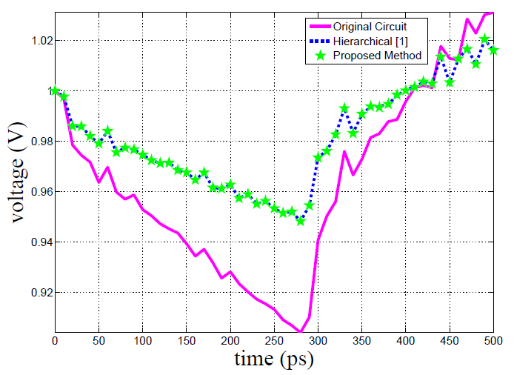
Experimental Result (3/6)
The voltage waveform at a node of the 1.05M test case.

Slide 35
Experimental Result (4/6)
Modified Blocks | Hierarchical Runtime (sec) | GMRES |  |  | OMP-like |  |  | Proposed Method |  |  | Speedup
 |  | emax (mV) | emax (mV) | Runtime (sec) | emax (mV) | emax (mV) | Runtime (sec) | emax (mV) | emax (mV) | Runtime (sec) | [1] (X) | [13] (X) | OMP-like (X)
1 | 430.57 | 0.13 | 2.50e-4 | 128.28 | 2.0e-3 | 8.8e-4 | 10.77 | 1.0e-3 | 1.0e-4 | 3.69 | 116.7 | 34.8 | 2.9
6 | 426.88 | 0.11 | 1.97e-4 | 128.28 | 5.2e-2 | 6.17e-4 | 31.91 | 4.0e-2 | 9.0e-4 | 8.97 | 47.6 | 14.3 | 3.6
29 | 427.10 | 0.20 | 7.71e-3 | 125.06 | 2.3e-1 | 4.88e-3 | 175.31 | 2.3e-1 | 3.0e-4 | 17.68 | 24.2 | 7.1 | 9.9
46 | 427.97 | 2.08 | 3.79e-2 | 119.04 | 3.5e-0 | 4.68e-2 | 722.66 | 2.4e-0 | 3.5e-2 | 28.02 | 15.3 | 4.2 | 25.8
To further discuss the influence of modified block percentage, the number of modified blocks of the test circuit with 1.05M nodes is varied from 1 to 46.
The maximum percentage of modified blocks is about 30% of the original power grid network, and the hundreds of element values are changed.
The proposed method maintains at least 4.2X speedup over GMRES under the same level of accuracy.
The proposed method is much more robust and efficient while facing significant modification of power grid.
The number of blocks is 160, and the number of sampling time is 50.

Slide 36
Experimental Result (5/6)
Number of Nodes | Number of Blocks | Modified Blocks | Added Ports | Deleted Nodes | Hierarchical Runtime (sec) | GMRES |  |  | Proposed Method |  |  | Speedup
 |  |  |  |  |  | emax (mV) | emax (mV) | Runtime (sec) | emax (mV) | emax (mV) | Runtime (sec) | [1] (X) | [13] (X)
1.05M | 160 | 13 | 10 | 10 | 426.45 | 0.39 | 8.52e-3 | 123.00 | 0.35 | 2.10e-3 | 11.10 | 38.4 | 11.1
1..05M | 160 | 15 | 20 | 20 | 427.04 | 3.70 | 4.53e-2 | 118.25 | 3.85 | 3.78e-2 | 14.15 | 30.2 | 8.4
4.60M | 220 | 13 | 10 | 10 | 3241.88 | 2.48 | 1.75e-2 | 277.82 | 2.75 | 4.36e-2 | 46.02 | 70.4 | 6.0
4.60M | 220 | 15 | 20 | 20 | 3167.51 | 2.59 | 1.89e-2 | 277.82 | 3.19 | 5.20e-2 | 51.01 | 62.1 | 5.4
To demonstrate the ability of the proposed method for simultaneously dealing with the adjusted values of elements and the modified topologies, we change several element values, delete nodes, and add nodes and ports.
It still keeps an order of magnitude speedup over the hierarchical method, 5.4X speedup over GMRES.
The maximum error is less than 4mV, and the average error is less than 0.1 mV.
the number of sampling time is 50.

Slide 37
Experimental Result (6/6)
Number of Sampling Times | Hierarchical Runtime (sec) | GMRES |  |  | Proposed Method |  |  | Speedup
 |  | emax (mV) | emax (mV) | Runtime (sec) | emax (mV) | emax (mV) | Runtime (sec) | [1] (X) | [13] (X)
50 | 277.25 | 0.34 | 3.92e-3 | 32.4 | 0.46 | 6.36e-3 | 2.34 | 118.5 | 13.8
250 | 482.12 | 0.85 | 3.31e-2 | 132.0 | 1.25 | 3.10e-2 | 10.70 | 45.3 | 12.3
500 | 720.84 | 1.33 | 2.19e-2 | 257.1 | 2.16 | 3.61e-2 | 57.39 | 12.6 | 4.5
750 | 1007.94 | 2.32 | 3.09e-2 | 390.9 | 3.47 | 4.88e-2 | 84.98 | 11.9 | 4.6
1000 | 1242.23 | 3.13 | 7.13e-2 | 530.9 | 4.01 | 6.24e-2 | 112.57 | 11.0 | 4.7
1250 | 1751.19 | 3.99 | 9.66e-2 | 670.6 | 4.01 | 7.32e-2 | 140.32 | 12.5 | 4.8
the number of node is 814K, and the number of blocks is 120.
The number of modified blocks is 4, the number of added nodes is 10 and the number of deleted nodes is 10
Generally, the estimated error might convey to the succeeding sampling time, so we test the proposed method with various numbers of sampling times.
The speedup ratio still maintains a good level, which is about 11 compared with hierarchical method and about 5 compared with GMRES.
It shows that the proposed method is quite robust and reliable for capturing the transient behavior under long simulation time.

Slide 38
Conclusions
An efficient and reliable incremental transient simulator for the power grid was developed.
The experimental results have shown it can fast, accurately, and robustly capture the transient behavior of the power grid after modifying its topologies or/and the values of existing elements.

Slide 39
Contact us
Chia Tung Ho
(CAD Dept. Macronix Intl. Co., Ltd. Hsinchu, Taiwan),
Yu Min Lee and Shu Han Wei
(ECE Dept., NCTU, Hsinchu, Taiwan),
Liang Chia Cheng
(ITRI, Hsinchu, Taiwan)
Email:{chiatungho@mxic.com.tw, yumin@nctu.edu.tw, littlelittle821@gmail.com, aga@itri.org.tw}

Slide 40
Thank you!

Slide 41
Q & A

Slide 42
Some Questions about Our Work
Q1: Why using pseudo-node value estimation method?
ANS1: We want a roughly artificial original electrical values of the added ports with certain error budget compared to the true answer. The effect is that it will not dominant the result while picking the important basis and enhance the performance of picking suitable bases.

Slide 43
Some Questions about Our Work
Q2: Why use hierarchical method?
ANS2:
There are two reasons for using the hierarchical technique.
  When the threshold of picking basis is fix, full chip incremental method may perform poorly in runtime while facing significant modification. The reason is it needs to pick lots of basis to achieve the defined accuracy level and may restart again and again during transient incremental simulation. In contrast, we just need to choose the suitable global region which is influenced by the significant modification by using hierarchical technique.
  Nowadays, the third generation simulator, such as Hsim, also use the hierarchical technique. As a result, our method can be combined into the flow with less efforts.

Slide 44
Some Questions from Reviewers
  Q1: Our current design are actually in the range of 500 million to 1 billion nodes. Since we can already re-analyze a small design with 1 million nodes relatively quickly on today's hardware, it would be more interesting to see how this technique scaled up to a much larger number of nodes where the incremental capabilities would enable dramatic improvements in real-life turn-around times.
  ANS: The question is a good question. Though we didn’t do parallel computing, our method can be parallelized. To deal with the large quantity of nodes, like 500 million - 1 billion, I believe it will perform pretty well while utilizing the parallel computing technique.

Slide 45
Some Questions from Reviewers
Q2: The basis reset point tracking scheme involves a trace-back-and-re-simulate process, whose complexity is unknown and case-dependent. Will there be cases in which a lot of tracing back and re-simulation is needed and runtime is hence significantly lengthened?
ANS: Yes, this part is truly case-dependent. This situation may happen and hence increase the runtime. Though we haven’t met the case needs a lot of tracking back scheme yet, I believe this part will be the future object. Furthermore, we have found if we have the suitable and sufficient bases, the transient incremental simulation will finish soon. I think this part also related to how to pick suitable and sufficient bases efficiently. I am looking forward to finding the upper bound of the proposed method.

Slide 46
Some Questions from Reviewers
Q3: It would be helpful if authors could provide the setup and basic information of the test benches.
ANS: The node degree in our test cases is four. However, our method isn’t restricted to the topology of the power grid network.

Slide 47
Back up

Slide 48
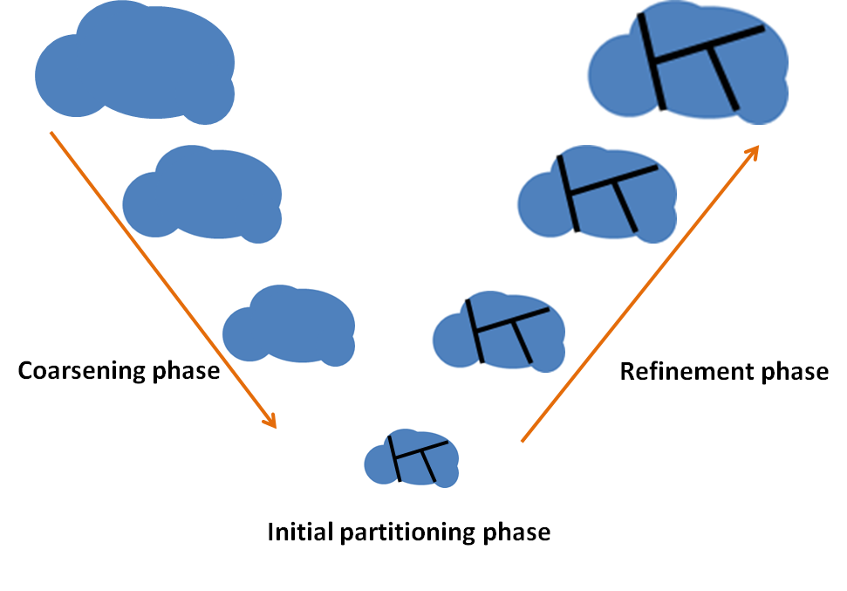
Partition Method: METIS
METIS has three phases
  Coarsening phase
  Initial partitioning phase
  Refinement phase
Reference: METIS, http://glaros.dtc.umn.edu/gkhome/views/metis/

Slide 49
Inconsistent Basis Issue of Incremental Circuit Simulation

Slide 50


Inconsistent Basis Issue (1/4)
Heuristically applying the incremental steady-state simulation methods to perform the incremental transient simulation by choosing bases repeatedly at different sampling times can cause the inconsistent problem of bases and lead to severe error or incontinuity.
Basis set $𝓣$
Basis set $𝓢$
Here, it is a case with 40 thousands nodes and the number of bases is changed
from 16 to 53 at time point 1.

Slide 51
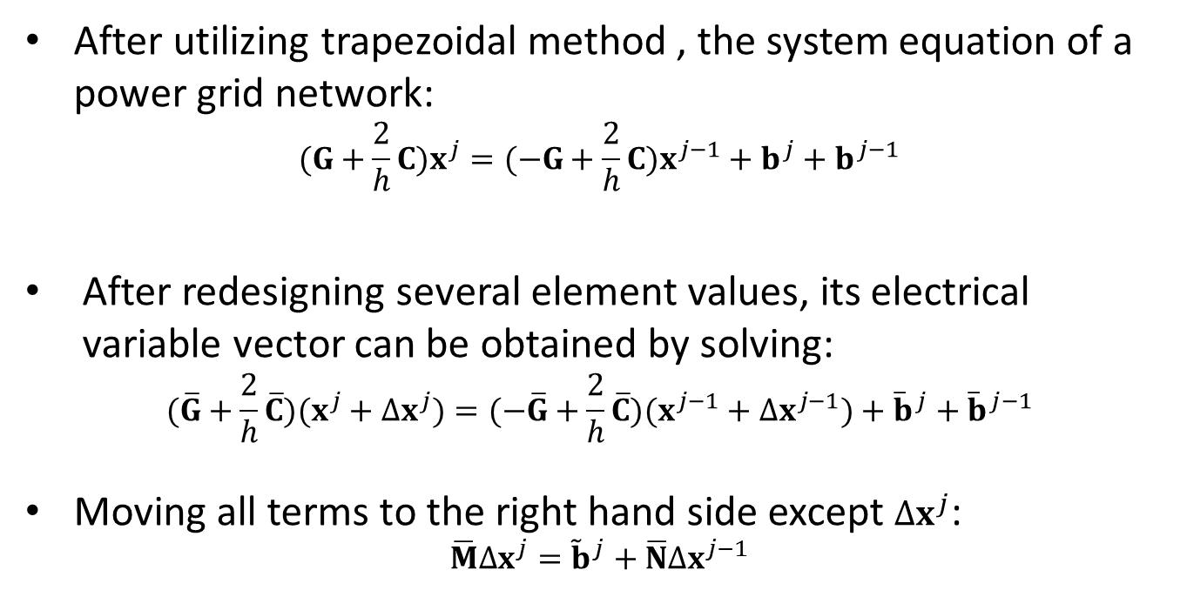
Inconsistent Basis Issue (2/4)
After utilizing trapezoidal method , the system equation of a power grid network:
  $$(G+\frac{2}{h}C)x^{j}=(−G+\frac{2}{h}C)x^{j−1}+b^{j}+b^{j−1}$$
  After redesigning several element values, its electrical variable vector can be obtained by solving:
  $$(\overline{G}+\frac{2}{h}\overline{C})(x^{j}+∆x^{j})=(−\overline{G}+\frac{2}{h}\overline{C})(x^{j−1}+∆x^{j−1})+{\overline{b}}^{j}+{\overline{b}}^{j−1}$$
Moving all terms to the right hand side except $∆x^{j}$:
$$\overline{M}∆x^{j}={\tilde{b}}^{j}+\overline{N}∆x^{j−1}$$
Here, $\overline{M}=\left(\overline{G}+\frac{2}{h}\overline{C}\right),\overline{N}=\left(−\overline{G}+\frac{2}{h}\overline{C}\right)$, and ${\tilde{b}}^{j}=−\left(\overline{G}+\frac{2}{h}\overline{C}\right)x^{j}+\left(−\overline{G}+\frac{2}{h}\overline{C}\right)x^{j−1}+{\overline{b}}^{j}+{\overline{b}}^{j−1}$

Slide 52
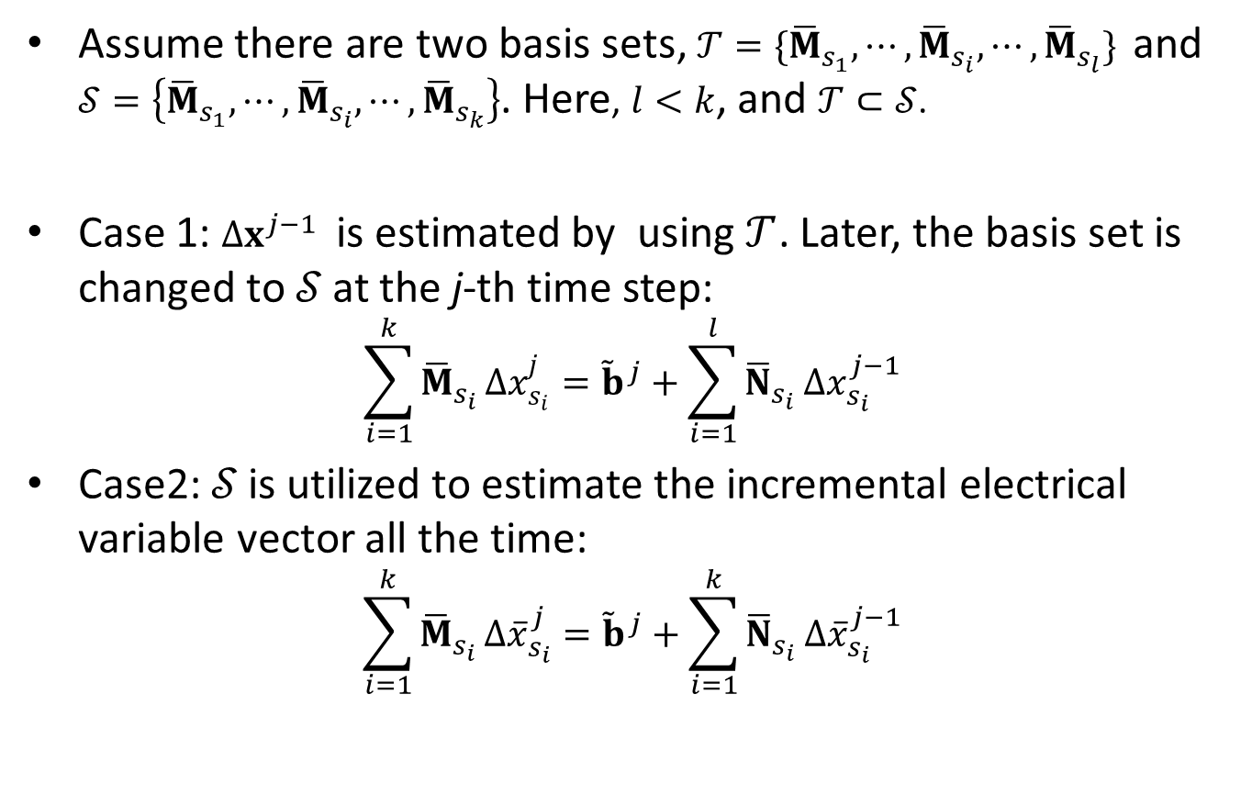
Inconsistent Basis Issue (2/4)
Assume there are two basis sets, $𝒯=\{{\overline{M}}_{s_{1}},⋯,{\overline{M}}_{s_{i}},⋯,{\overline{M}}_{s_{l}}\}$ and $𝒮=\left\{{\overline{M}}_{s_{1}},⋯,{\overline{M}}_{s_{i}},⋯,{\overline{M}}_{s_{k}}\right\}$. Here, $l<k$, and $𝒯⊂𝒮$.
Case 1: $∆x^{j−1}$ is estimated by using $𝒯$. Later, the basis set is changed to 𝒮 at the j-th time step:
$$\sum_{i=1}^{k}{{\overline{M}}_{s_{i}}}∆x_{s_{i}}^{j}={\tilde{b}}^{j}+\sum_{i=1}^{l}{{\overline{N}}_{s_{i}}}∆x_{s_{i}}^{j−1}$$
Case2: 𝒮 is utilized to estimate the incremental electrical variable vector all the time:
$$\sum_{i=1}^{k}{{\overline{M}}_{s_{i}}}∆{\overline{x}}_{s_{i}}^{j}={\tilde{b}}^{j}+\sum_{i=1}^{k}{{\overline{N}}_{s_{i}}}∆{\overline{x}}_{s_{i}}^{j−1}$$
a1
a2

Slide 53
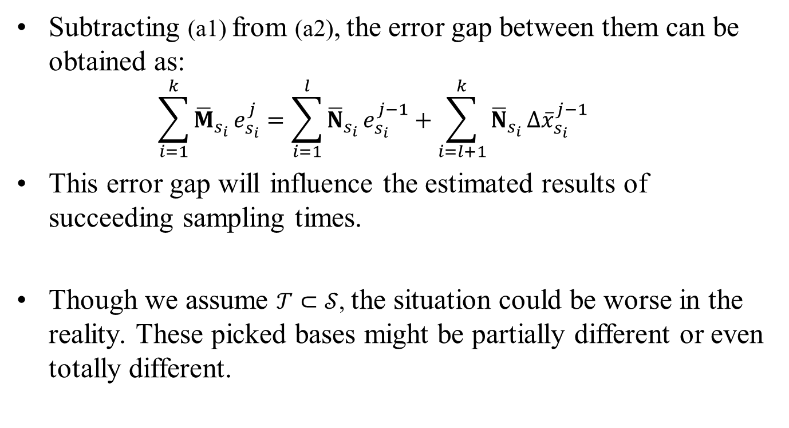
Inconsistent Basis Issue (4/4 )
Subtracting (a1) from (a2), the error gap between them can be obtained as:
  $$\sum_{i=1}^{k}{{\overline{M}}_{s_{i}}}e_{s_{i}}^{j}=\sum_{i=1}^{l}{{\overline{N}}_{s_{i}}}e_{s_{i}}^{j−1}+\sum_{i=l+1}^{k}{{\overline{N}}_{s_{i}}}∆{\overline{x}}_{s_{i}}^{j−1}$$
This error gap will influence the estimated results of succeeding sampling times.
Though we assume $𝒯⊂𝒮$, the situation could be worse in the reality. These picked bases might be partially different or even totally different.

Slide 54
Flow chart

Slide 55
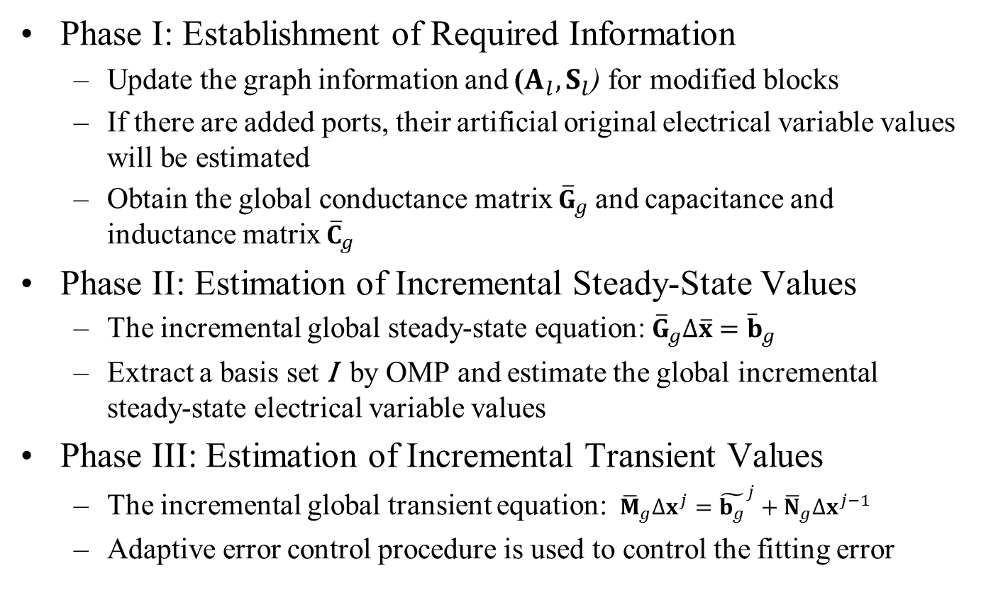
Flow Chart (1/2)
Phase I: Establishment of Required Information
  Update the graph information and ($A_{l}, S_{l}$) for modified blocks
  If there are added ports, their artificial original electrical variable values will be estimated
  Obtain the global conductance matrix ${\overline{G}}_{g}$ and capacitance and inductance matrix ${\overline{C}}_{g}$
Phase II: Estimation of Incremental Steady-State Values
  The incremental global steady-state equation: ${\overline{G}}_{g}∆\overline{x}={\overline{b}}_{g}$
  Extract a basis set I by OMP and estimate the global incremental steady-state electrical variable values
Phase III: Estimation of Incremental Transient Values
  The incremental global transient equation: ${\overline{M}}_{g}∆x^{j}={\tilde{b_{g}}}^{j}+{\overline{N}}_{g}∆x^{j−1}$
  Adaptive error control procedure is used to control the fitting error
Here, ${\overline{M}}_{g}={\overline{G}}_{g}+\frac{2}{h}$ ${\overline{C}}_{g}$, ${\overline{N}}_{g}={−\overline{G}}_{g}+\frac{2}{h} {\overline{C}}_{g}$, and ${\tilde{b_{g}}}^{j}=−{\overline{M}}_{g}x^{j}+{\overline{N}}_{g}x^{j−1}−S^{j}+u_{g}^{j−1}+u_{g}^{j}$.

Slide 56
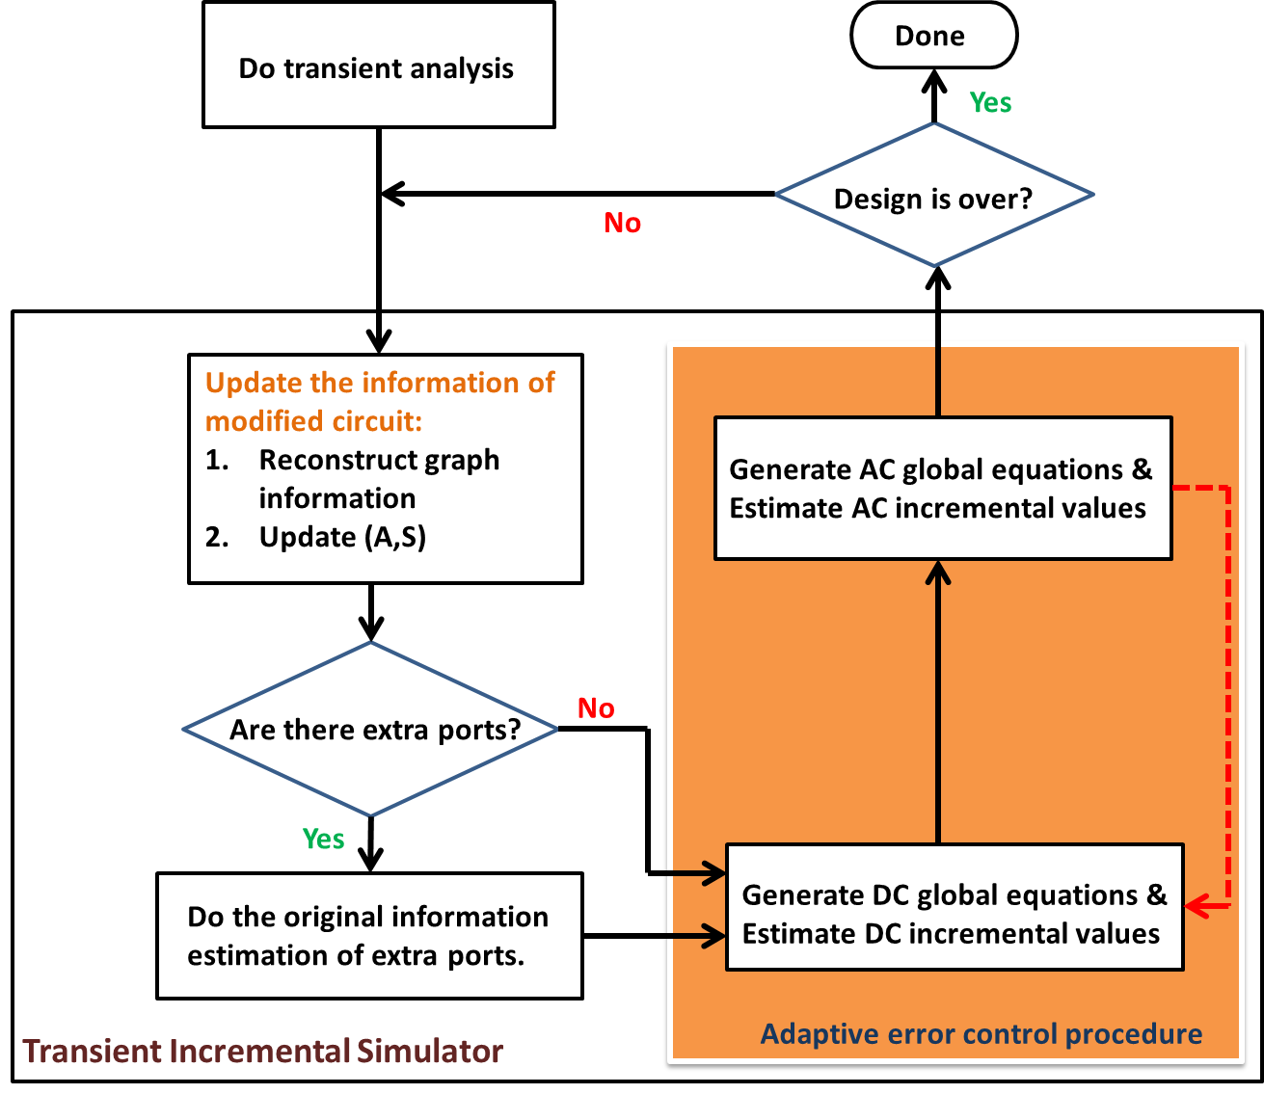
Flow Chart (2/2)

Slide 57
Adaptive Error Control Procedure
Basis Resetting Point Tracking Scheme
  Choose a suitable sampling time to reset the basis set for continuously finishing the incremental transient simulation.
It will track back, pick the nearest potential resetting point, and check whether the basis set adjustment criterion is satisfied.

