Slide 1

Coupling-Aware Force Driven Placement of TSVs and Shields in 3D-IC Layouts
Caleb Serafy and Ankur Srivastava
Dept. ECE, University of Maryland

Slide 2
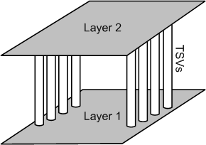
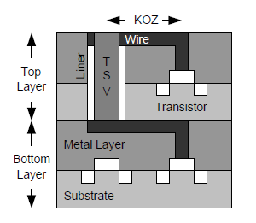
3D Integration
Vertically stack chips and integrate layers with vertical interconnects
  Through Silicon Vias (TSVs)
Advantages:
  Smaller footprint area
  Shorter global wirelengths
  Heterogeneous Integration
Disadvantages:
  TSV-TSV coupling
  TSV reliability
  Increased power density
  Trapped heat effect

Slide 3
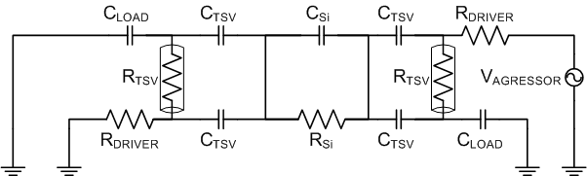
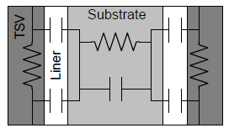
TSV-TSV Coupling
TSVs have large capacitance to substrate
Substrate is conductive: low noise attenuation
Coupling between TSVs must be minimized in order to maximize switching speed
SOLUTIONS: TSV spacing and TSV shielding

Slide 4
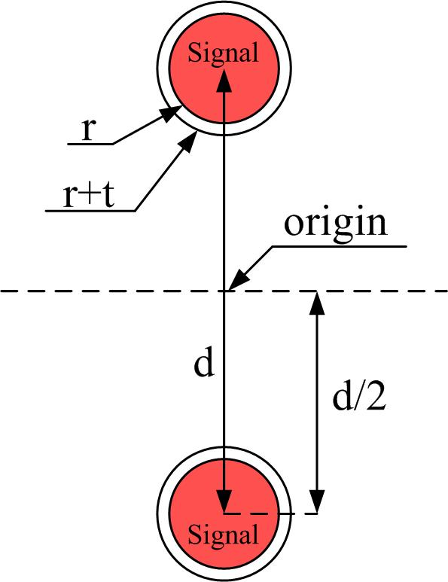
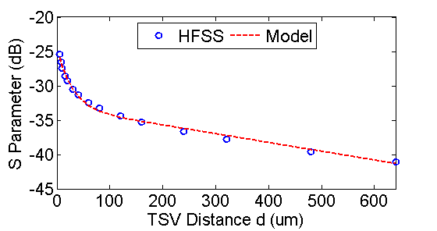
TSV spacing
Spacing between TSVs can reduce coupling
  But requires large distance
Shield insertion can reduce coupling when spacing is small

Slide 5
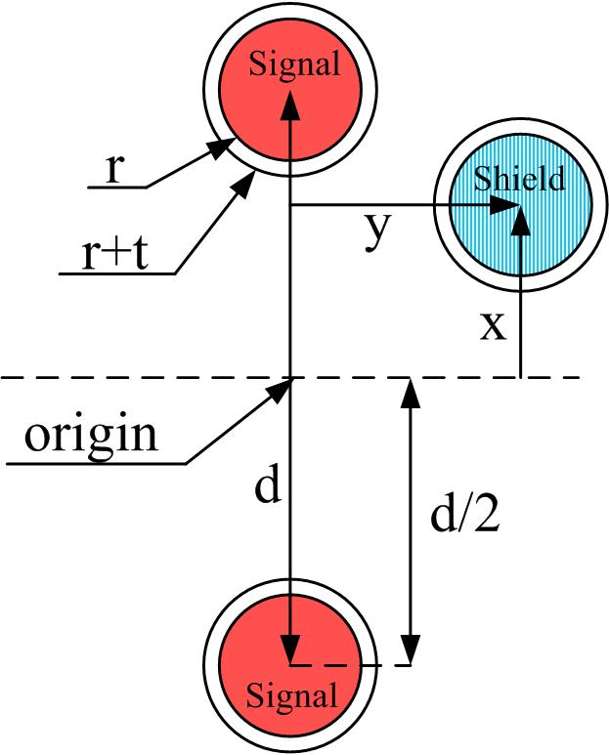
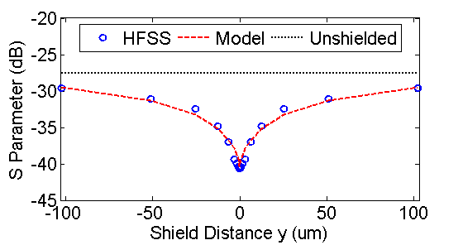
TSV spacing
Spacing between TSVs can reduce coupling
  But requires large distance
Shield insertion can reduce coupling when spacing is small
d=12

Slide 6
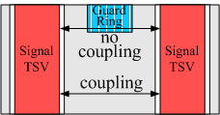
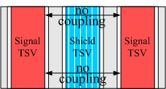

TSV Shielding
Shielding: place a grounded conductor between two wires
  EM waves cannot pass through shield, reducing coupling between wires
  Guard ring is less effective with TSVs
  TSVs require shielding throughout the
  thickness of the silicon substrate
  use GND TSV as shield
Optimal shield placement requires chip-scale coupling models
Analog Transistor

Slide 7
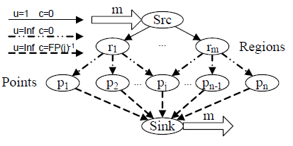
Previous Work
[Serafy et. al GLSVLSI’13]
Geometric model of coupling
  Circuit model of coupling too complex for chip-scale optimization
  Developed model of S-parameter based on relative TSV positions
  Used curve fitting on HFSS simulation data
Shield insertion algorithm
  Based on fixed signal TSV locations, place shield TSVs to minimize coupling
  Solved using MCF problem formulation
Avenue for improvement
  Shield insertion cannot mitigate coupling if spacing
  is too small
  Determine signal and shield positions simultaneously

Slide 8
Force-Driven Placement (FDP)
Input: Fixed transistor placement
Output: Placement for signal and shield TSVs
Objective: place signal and shield TSVs
  Minimize some cost function
Force: derivative of cost function
Solution: find total force F=0
Iteratively solve for F=0 and then update forces based on new placement

Slide 9
Forces
  Wirelength (WL) Force: pulls objects towards position with optimal wirelength
  Overlap Force: repels objects from one another when they overlap
  Coupling Force: repels each signal TSV from its most highly coupled neighbor
    Coupling evaluated using our geometric model
  Shielding Force: Pulls shield TSVs towards the signal TSVs it is assigned to

Slide 10
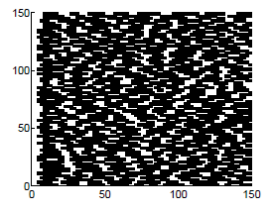
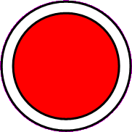
Proposed Algorithm
Assumption: Transistor cells are already placed, limiting the possible locations of TSVs (whitespace)
Step 0: assign each signal TSV to a whitespace region
Step 1: perform coupling aware placement until equilibrium
Step 2: insert shields using our shield insertion method
Step 3: repeat coupling aware placement until equilibrium

Slide 11
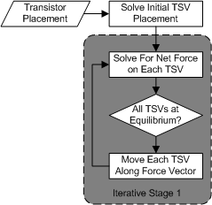
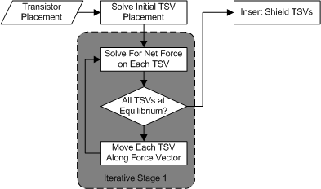
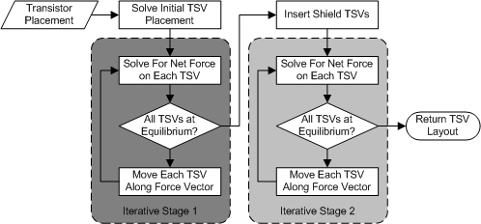
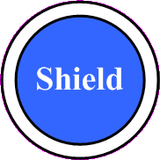
Proposed Algorithm
Assumption: Transistor cells are already placed, limiting the possible locations of TSVs (whitespace)
Step 0: assign each signal TSV to a whitespace region
Step 1: perform coupling aware placement until equilibrium
Step 2: insert shields using our shield insertion method
Step 3: repeat coupling aware placement until equilibrium
Coupling Force Repels TSVs
WL force attracts TSVs back together
Shield Reduces Coupling Force

Slide 12
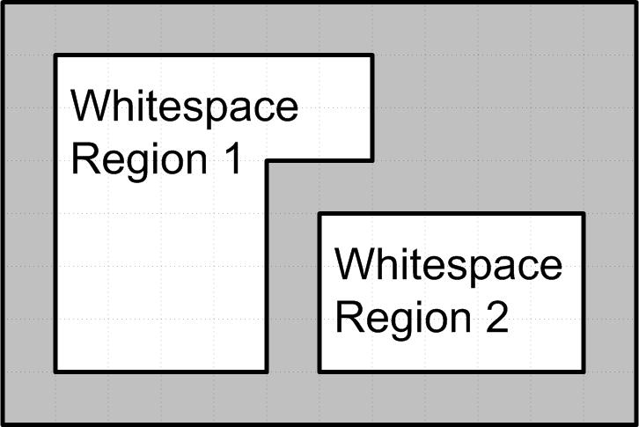
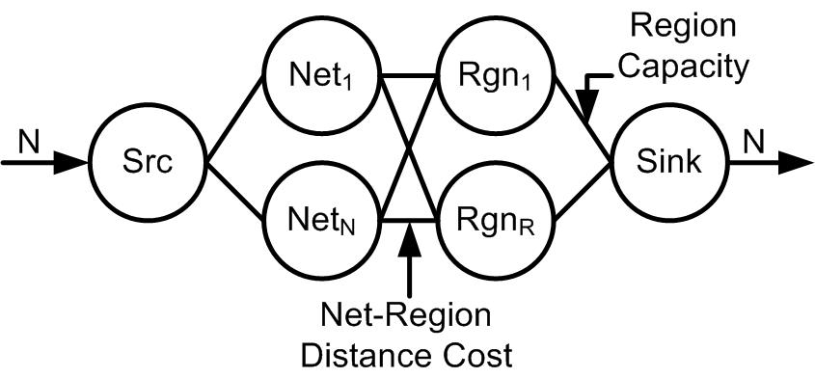
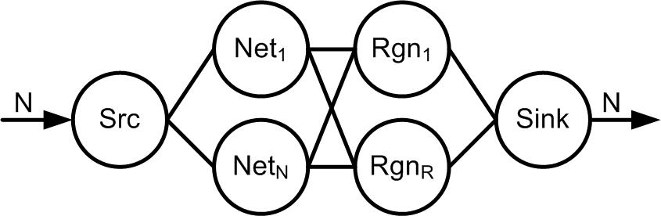
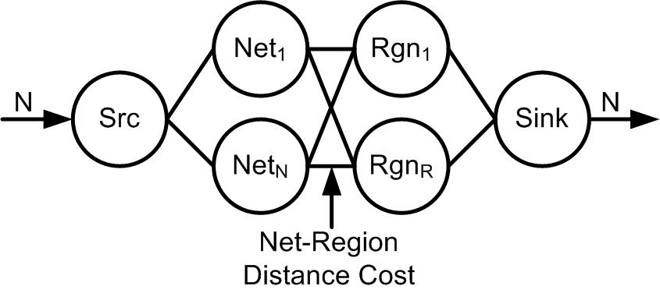
Initial Placement
Each signal TSV must be assigned to a whitespace region
  Once assigned TSVs cannot change regions
Objective:
  Minimize wirelength
  Constrain #TSV assigned to each region

Slide 13
Simulation Setup
Four Cases
  Traditional Placement: WL and overlap force only
  Placement with coupling force (CA)
  Placement with shield insertion (SI)
  CA+SI
 |  | Coupling Aware Placement
 |  | Without | With
Shield Insertion | Without | Traditional | CA
 | With | SI | CA+SI

Slide 14
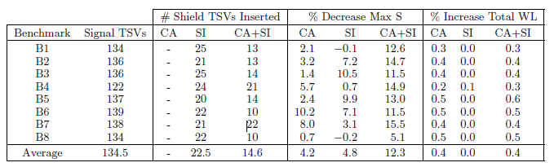
Experimental Results
CA+SI required less shields than SI alone
Improvement due to CA+SI is greater than the sum of CA and SI alone
Change in total WL is an order of magnitude smaller than improvement to coupling

Slide 15
Illustrative Example
Coupling Unaware
Coupling Aware
Without Shields
Traditional
CA
With Shields
SI
CA+SI

Slide 16
Future Work
We have shown that signal and shield TSV placement must be done simultaneously
Also, coupling aware placement and shield insertion are complementary techniques
This approach should be integrated with transistor placement
  Larger solution space
  No assumptions about TSV and transistor placement
  Optimize area
    Instead of adding a fixed amount of whitespace for TSVs during transistor placement

Slide 17
Questions?

Slide 18
Backup Slides

Slide 19
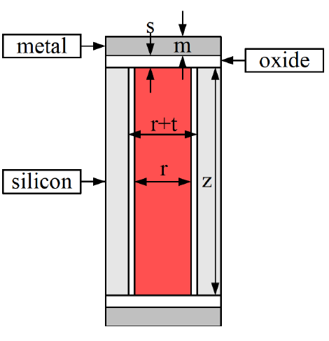
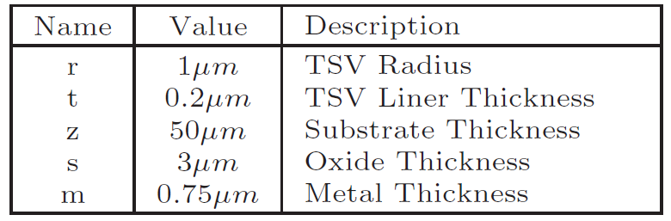
Simulating Coupling
S-parameter (S): ratio of energy inserted into one TSV to energy emitted by another
  Insertion loss, i.e. coupling ratio
HFSS: Commercial FEM simulator of Maxwell’s equations
  HFSS data is used as golden data to construct model
Our model is for specific physical dimensions. The modeling approach can be reapplied for different dimensions.

Slide 20
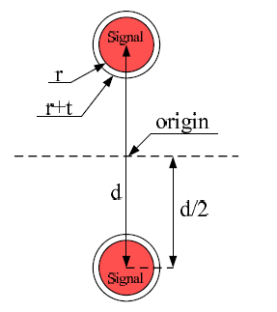
Modeling Approach
In HFSS:
  Model two signal TSVs
    Sweep distance d between them
  Add a shield
    Sweep d and shield distance y
    x value does not change results
  Add a second shield
    Sweep y₁ and y₂
Fit S(d,y₁,y₂) to HFSS data using curve fitting

Slide 21
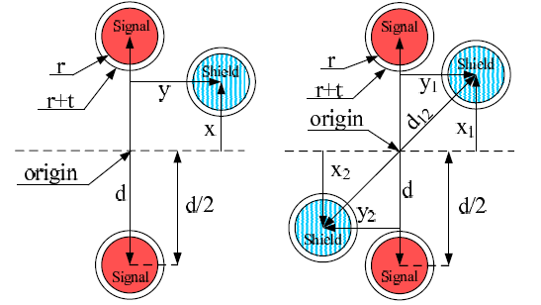
Modeling Approach
In HFSS:
  Model two signal TSVs
    Sweep distance d between them
  Add a shield
    Sweep d and shield distance y
    x value does not change results
  Add a second shield
    Sweep y₁ and y₂
Fit S(d,y₁,y₂) to HFSS data using curve fitting

Slide 22
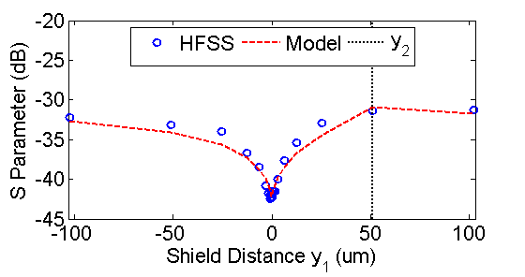
Modeling Approach
In HFSS:
  Model two signal TSVs
    Sweep distance d between them
  Add a shield
    Sweep d and shield distance y
    x value does not change results
  Add a second shield
    Sweep (x₁,y₁) and (x₂,y₂)
Fit S(d,x₁,y₁,x₂,y₂) to HFSS data using curve fitting

Slide 23
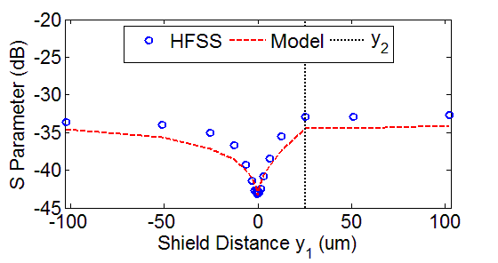
Modeling Approach
In HFSS:
  Model two signal TSVs
    Sweep distance d between them
  Add a shield
    Sweep d and shield distance y
    x value does not change results
  Add a second shield
    Sweep (x₁,y₁) and (x₂,y₂)
Fit S(d,x₁,y₁,x₂,y₂) to HFSS data using curve fitting

Slide 24
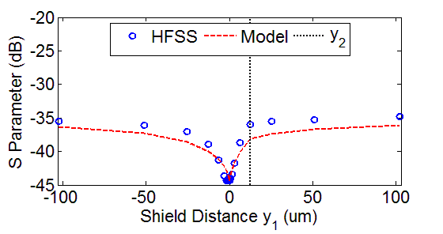
Modeling Approach
In HFSS:
  Model two signal TSVs
    Sweep distance d between them
  Add a shield
    Sweep d and shield distance y
    x value does not change results
  Add a second shield
    Sweep (x₁,y₁) and (x₂,y₂)
Fit S(d,x₁,y₁,x₂,y₂) to HFSS data using curve fitting

Slide 25
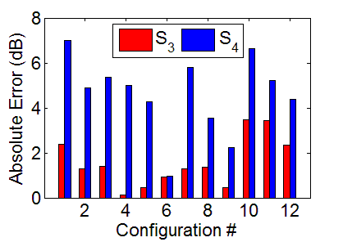
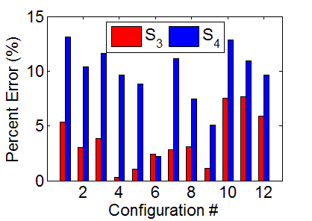
Extension and Validation
Double shield model:
  Add results from single shield model: S(d,y₁)+S(d,y₂)
  Superposition is not an accurate model
  Subtract overlap M(x₁,y₁,x₂,y₂)
Extension to n shields:
  Add results from single shield models: S(d,y₁)+…+S(d,y_{n})
  Subtract overlap M(x_{i},y_{i},x_{j},y_{j}) for each pair of shields
  Assumes higher order overlap is negligible
Create random distributions of 3 and 4 shields
Compare HFSS results to model results
Average Error:
  S3: 3.7 % S4: 9.4 %
  S3: 1.6 dB S4: 4.6 dB

Slide 26
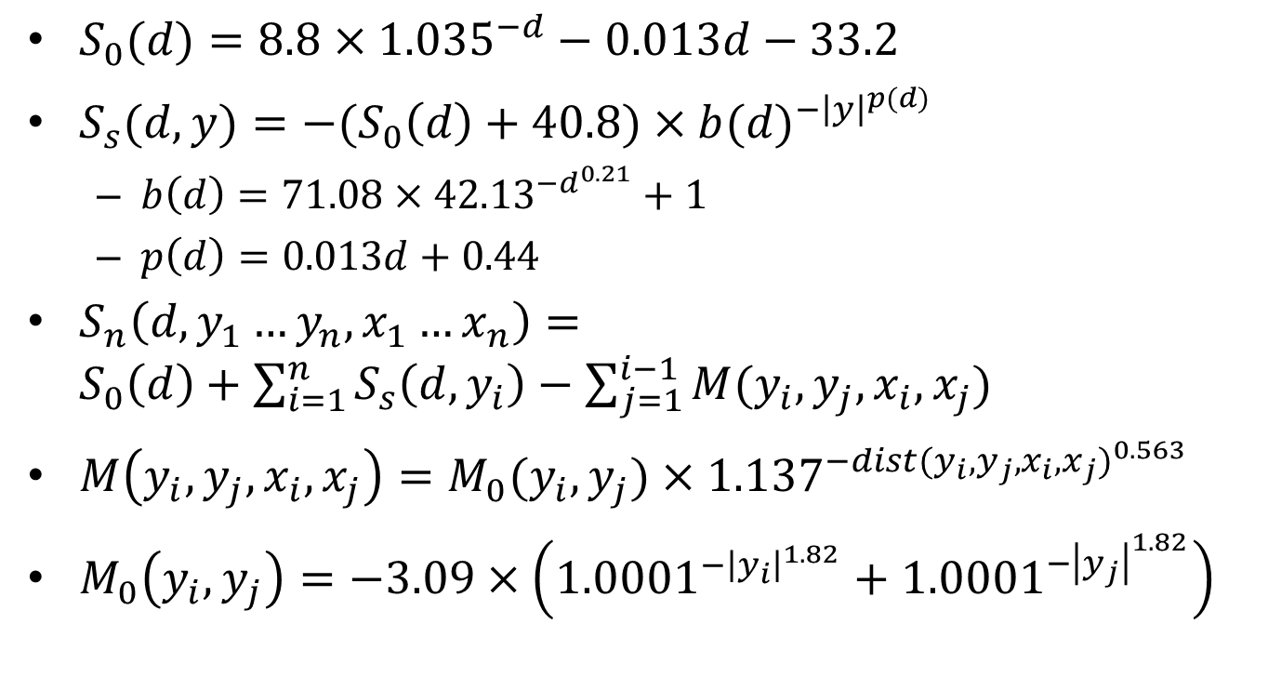
Coupling Model
$S_{0}(d)=8.8×{1.035}^{−d}−0.013d−33.2$
$S_{s}(d,y)=−(S_{0}\left(d\right)+40.8)×{b(d)}^{−{\left|y\right|}^{p(d)}}$
  $b\left(d\right)=71.08×{42.13}^{−d^{0.21}}+1$
  $p\left(d\right)=0.013d+0.44$
$S_{n}\left(d,y_{1}…y_{n},x_{1}…x_{n}\right)=S_{0}\left(d\right)+\sum_{i=1}^{n}{S_{s}\left(d,y_{i}\right)−\sum_{j=1}^{i−1}{M(y_{i},y_{j},x_{i},x_{j})}}$
$M\left(y_{i},y_{j},x_{i},x_{j}\right)=M_{0}(y_{i},y_{j})×{1.137}^{−{dist(y_{i},y_{j},x_{i},x_{j})}^{0.563}}$
$M_{0}\left(y_{i},y_{j}\right)=−3.09×\left({1.0001}^{−{\left|y_{i}\right|}^{1.82}}+{1.0001}^{−{\left|y_{j}\right|}^{1.82}}\right)$

Slide 27
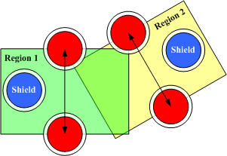
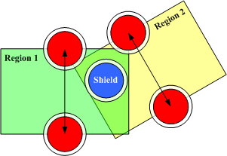
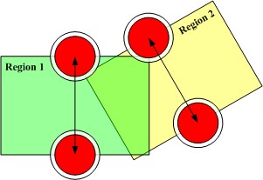
Shield Insertion Algorithm
[Serafy et. al GLSVLSI’13]
For each signal TSV pair we identify the region where a shield could improve the coupling of that pair
Assign a shield to each TSV pair using MCF problem formulation
Objective: provide shielding for each TSV pair while using least number of shields
  Take advantage of region overlap
Poor Solution
Good Solution

Slide 28
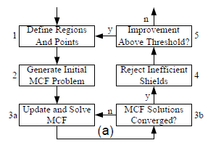
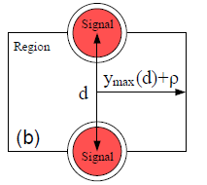
MCF Shield Insertion Algorithm
From Serafy et. al GLSVLSI’13
Each pair of signal TSVs defines a region
  A set of positions that are good candidates for shielding that pair
MCF problem: assigns a shield to each TSV pair
Objective: Maximize ratio of shielding added to shielding required (shielding ratio) for each TSV pair while using least number of shields

Slide 29
MCF Problem Formulation
From Serafy et. al GLSVLSI’13
Region node for each TSV pair
Point node for each whitespace grid point
Point cost proportional to total shielding ratio
True cost of each shield is independent of amount of flow carried
u = capacity
c = cost
Heuristic:
After each iteration scale cost by number of units of flow carried in previous iteration

Slide 30

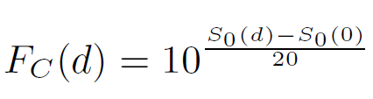
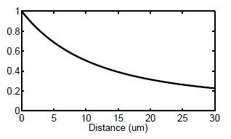
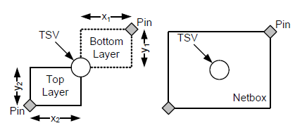
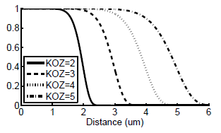

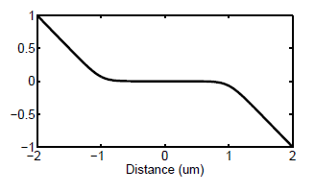
Placement Forces
F_{KOZ} is the overlap force
  Prevents a TSV from getting within the KOZ area of a transistor or another TSV
F_{WL} is the wirelength force
  Pushes each TSV towards its respective netbox
  TSVs inside the netbox have minimal WL and F_{WL} = 0
F_{C} is a new force which captures the coupling between two TSVs
  Coupling force is proportional to the coupling between two TSVs
  Each TSV has a coupling force from all other TSVs, but only the strongest coupling force is used to determine movement on each iteration
F_{Shielding} pushes shield TSVs towards each signal TSV they are assigned to
A: all signal TSVs assigned to this shield

Slide 31

Why max(F_{c})
Don’t let many loosely coupled TSVs overpower strongly coupled TSV

Slide 32
Raw Data
 | Traditional | CA | SI | CA+SI
B1 | -25.0 | -25.3 | -25.2 | -26.2
B2 | -25.3 | -25.5 | -26.1 | -26.5
B3 | -25.3 | -25.3 | -26.1 | -26.4
B4 | -25.3 | -25.6 | -25.2 | -26.5
B5 | -25.3 | -25.3 | -26.3 | -26.4
B6 | -25.3 | -26.3 | -26.1 | -26.4
B7 | -25.3 | -25.7 | -25.4 | -26.4
B8 | -25.2 | -25.3 | -26.1 | -26.4
AVG | -25.3 | -25.6 | -25.8 | -26.4

Slide 33
Improvement (dB)
 | CA | SI | CA+SI
B1 | -0.3 | -0.1 | -1.1
B2 | -0.2 | -0.8 | -1.2
B3 | 0.0 | -0.7 | -1.1
B4 | -0.3 | 0.1 | -1.2
B5 | 0.0 | -0.9 | -1.0
B6 | -0.9 | -0.7 | -1.0
B7 | -0.4 | 0.0 | -1.0
B8 | -0.1 | -0.9 | -1.2
AVG | -0.3 | -0.5 | -1.1

