Slide 1
Placement-Driven Partitioning for Congestion Mitigation in Monolithic 3D IC Designs
Shreepad Panth¹, Kambiz Samadi², Yang Du², and Sung Kyu Lim¹
¹Dept. of Electrical and Computer Engineering, Georgia Tech, Atlanta GA, USA
²Qualcomm Research, San Diego, CA, USA

Slide 2
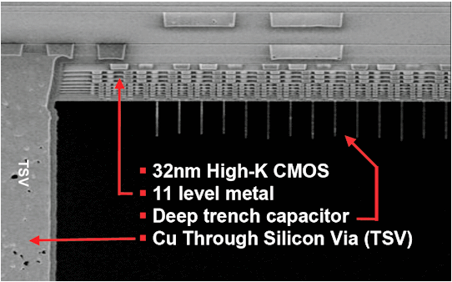
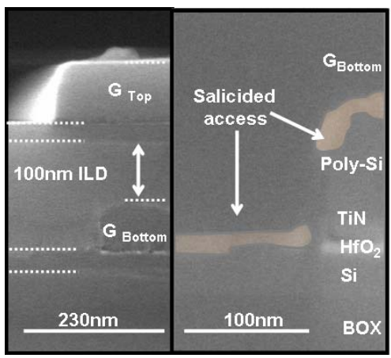
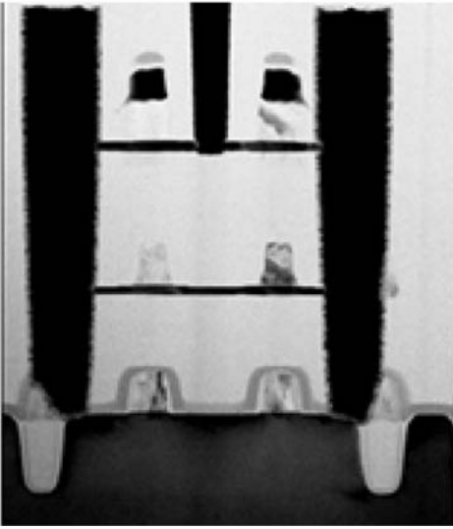
Monolithic 3D-ICs – An Emerging 3D Technology
IBM 32nm TSV-based 3D with eDRAM
TSV Size = 5-10um
MIV Size = 0.07 – 0.1um
TSV is very large compared to gates
TSV
High quality thin silicon
(single crystal)
Monolithic inter-tier via (MIV)
Gate
Monolithic 3D SRAM by Samsung (2010)
Monolithic 3D for general logic by LETI (2011)

Slide 3
Design Styles Available (1/2)
Transistor-level^{[1]}
  Each standard cell is folded
  Pin density increases significantly
  Footprint reduction is ~40%, not 50%
  Standard cell re-design required.
Block-level^{[2]}
  Functional blocks are 2D & they
  are floorplanned on to a 3D space
  Does not fully take advantage
  of the high density offered
[1] Y.-J. Lee, D. Limbrick, and S. K. Lim. Power Benefit Study for Ultra-High Density Transistor-Level Monolithic 3D ICs. DAC 2013
[2] S. Panth, K. Samadi, Y. Du, and S. K. Lim. High-Density Integration of Functional Modules Using Monolithic 3D-IC Technology. ASPDAC 2013

Slide 4
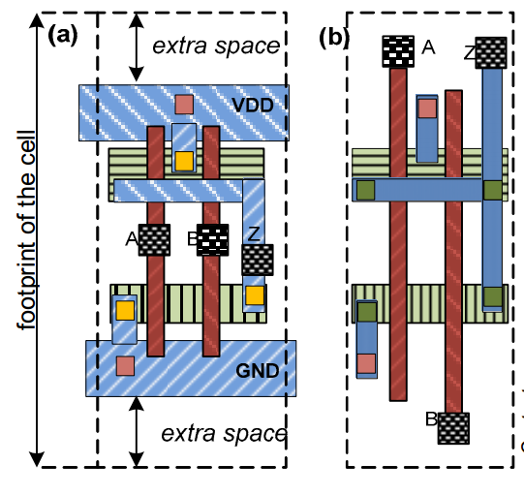
Design Styles Available (2/2)
CELONCEL^{[3]}
  Hybrid between transistor-level and gate-level 3D
  Footprint reduction is not 50%. Only ~ 40%
  Pin density is increased here as well
Gate-level
  Use existing standard cells & place them in 3D
  No prior work
  Several parallels in TSV-based 3D, but
  we show that those approaches
  are inferior
[3] S Bobba et al. “CELONCEL: Effective Design Technique for 3-D Monolithic Integration targeting High Performance Integrated Circuits” ASPDAC 2011

Slide 5
Contributions
This is the first work to study routability in gate-level monolithic 3D ICs
  Improvements are reported as reduction in detail-routed wirelength, not just a reduction in global router overflow
We present a probabilistic 3D routing demand model and use it to develop a O(N) min-overflow partitioner.
  This reduces wirelength by up to 4% and power-delay product by up to 4.33%
We present a commercial router based MIV insertion algorithm
  This reduces the routed WL by up to 14.8% compared to placement-based MIV insertion
We demonstrate that monolithic 3D ICs can still beat 2D with reduced metal layer count
  On average, with 1 less metal layer, the WL is better by 19.2% and the power-delay product by 12.1%

Slide 6
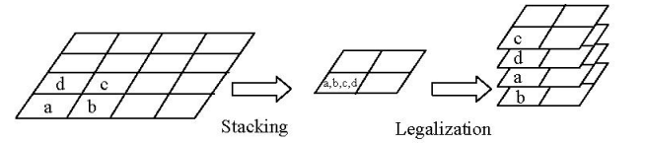
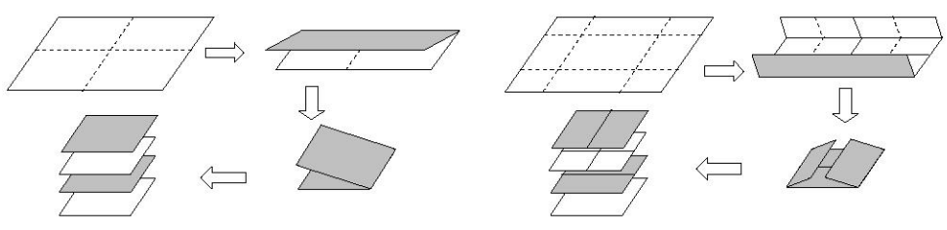
Existing Work on 3D Gate-level Placement (1/2)
Current work only focuses on TSV-based placement
  The number of 3D connections are limited in TSV-based 3D
(1) Scaling or folding-based approach^{[4]}
  Other papers^{[5]} have shown this technique to have inferior quality
  Cannot handle any pre-placed hard macros which are common in today’s designs
  Purely HPWL driven
Scaling
Folding
[4] J. Cong, G. Luo, J. Wei, and Y. Zhang. “Thermal-Aware 3D IC Placement Via Transformation”. ASPDAC 2007.
[5] J. Cong and G. Luo. “A Multilevel Analytical Placement for 3D ICs”. ASPDAC 2009.

Slide 7
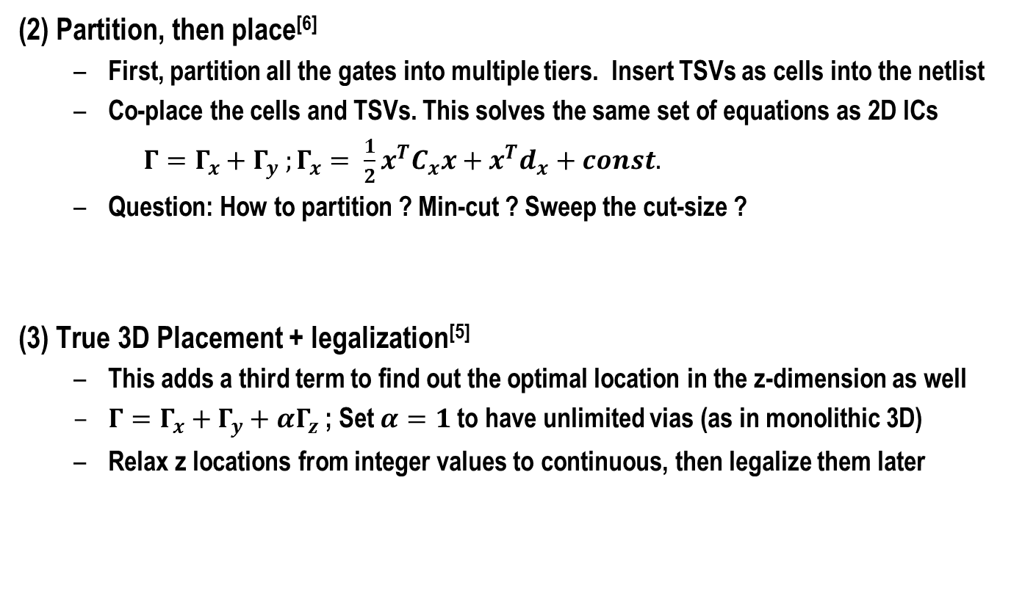
Existing Work on 3D Gate-level Placement (2/2)
(2) Partition, then place^{[6]}
  First, partition all the gates into multiple tiers. Insert TSVs as cells into the netlist
  Co-place the cells and TSVs. This solves the same set of equations as 2D ICs
  $Γ=Γ_{x}+Γ_{y} ;Γ_{x}= \frac{1}{2}x^{T}C_{x}x+x^{T}d_{x}+const.$
  Question: How to partition ? Min-cut ? Sweep the cut-size ?
(3) True 3D Placement + legalization^{[5]}
  This adds a third term to find out the optimal location in the z-dimension as well
  $Γ=Γ_{x}+Γ_{y}+αΓ_{z}$; Set $α=1$to have unlimited vias (as in monolithic 3D)
  Relax z locations from integer values to continuous, then legalize them later
[5] J. Cong and G. Luo. “A Multilevel Analytical Placement for 3D ICs”. ASPDAC 2009.
[6] D. Kim, K. Athikulwongse, and S. Lim. “A study of Through-Silicon-Via Impact on the 3D Stacked IC Layout”. ICCAD 2009.

Slide 8
Monolithic 3D Placement Problem
The z dimension is negligible compared to x & y
MIVs are so small that they can be considered to be (almost) free
If a cell has as fixed x & y location, any choice of z location will have roughly the same 3D HPWL
Proposed idea:
  Use a 2D placer to first obtain x & y locations.
  Compute z locations as a post-process
Top Tier
Bottom Tier
Less than 1 um
A few mm

Slide 9
Using a 2D Placer for M3D Placement
First, make the M3D footprint 50% of 2D
Partitioning bin
(10um)
In a 2D placer, simply double the placement capacity of each global bin (for two-tier) . We use our implementation of KraftWerk2^{[7]}
Partition the design, maintaining local area balance within each partitioning bin
“Placement-driven Partitioning”
[7] P. Spindler, U. Schlichtmann, and F. M. Johannes. “Kraftwerk2 - AFast Force-Directed Quadratic Placement Approach Using an
Accurate Net Model”. TCAD 2008.

Slide 10
M3D: Unique Optimization Opportunity
Heavy routing congestion
Initial partitioning solution & routing
Re-partition to reduce demand in congested regions
Same HPWL (apart from the <1 um required for the extra MIV)
Since congested regions are avoided, routed WL will be much lower
We propose a partitioner that minimizes the total overflow on routing edges

Slide 11
Overall Design Flow
Min-cut partitioning
Modified 2D Placement
Min-overflow partitioning
3D Routing Demand Model
Top-off placement
This is to ensure that the target density is met after partitioning
MIV Insertion
Insert MIVs into whitespace
Tier by Tier Route
Use Cadence Encounter to global & detail route
3D Timing & Power Analysis
Load tier netlists, SPEF as well as top-level netlists & SPEF into Synopsys Primetime

Slide 12
3D Routing Demand Model: (1) Decomposing Multi-Pin Nets Into Two Pin Nets
Given a set of points
to route in 3D
Project to a 2D Plane
Use FLUTE^{[8]} to construct a 2D RSMT
Expand to 3D
What if the tier of red cell is changed ?
Reuse existing 2D RSMT
Re-expand to 3D
(Very Quick)
[8] C. Chu and Y.-C. Wong. “FLUTE: Fast Lookup Table Based Rectilinear Steiner Minimal Tree Algorithm for VLSI Design”. TCAD 2008

Slide 13


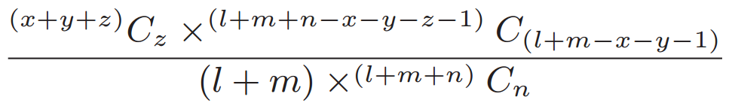
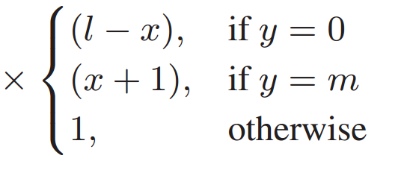
3D Routing Demand Model: (2) 3D Probabilistic Demand Model for each two-pin Net
Consider the 3D routing sub-graph of one two pin net
Top view
Unfurled view
Irrespective of number of bends, #MIV = #Tiers – 1 → Unlimited bends allowed
Each bend represents a local via → The maximum number of allowed bends is 2^{[9]}
[9] U. Brenner and A. Rohe. “An Effective Congestion Driven Placement Framework” TCAD 2003.

Slide 14
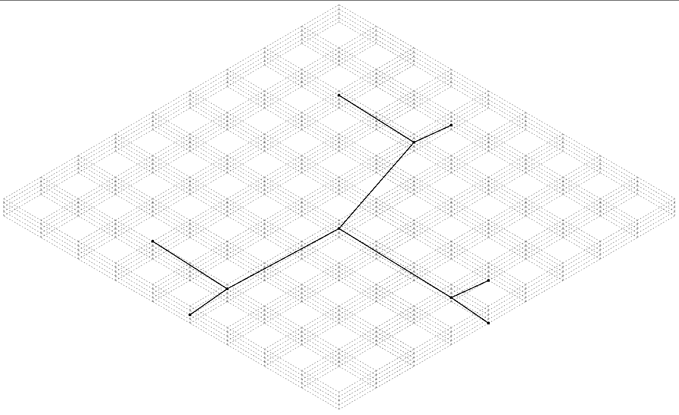
Five Tier Example – RST construction
Original points to route
Steiner Point

Slide 15
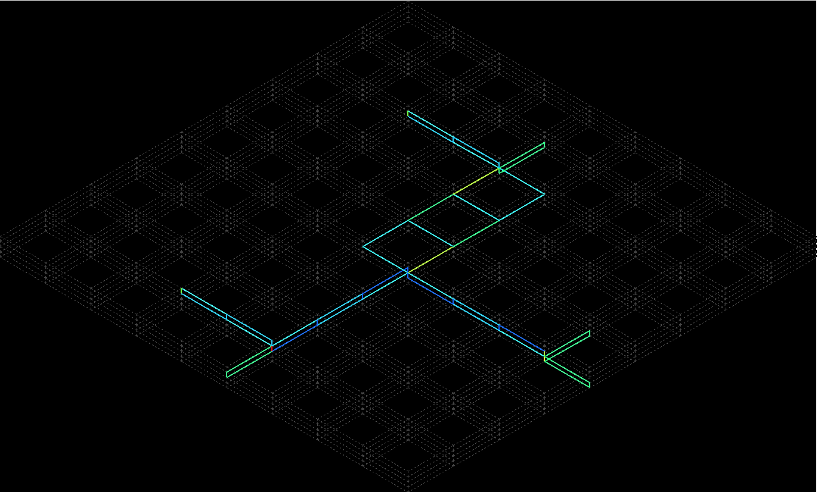
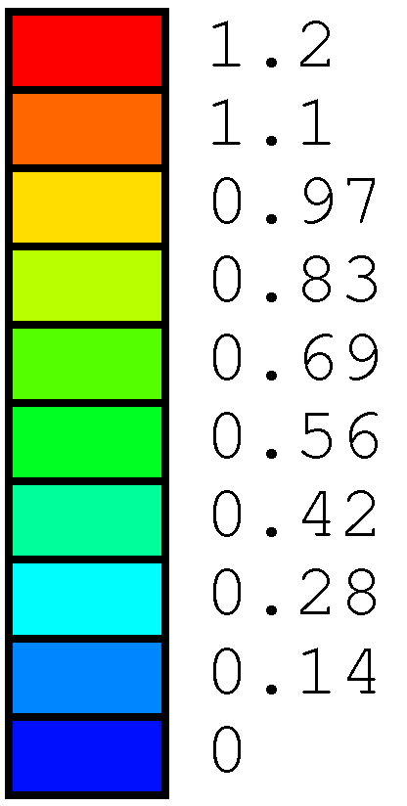
Five Tier Example – Demand Estimation

Slide 16
Incremental Gain Update : Why won’t it work ?
If a cell changes its tier, what other cells are affected ?
All nets in affected regions need to be updated → very slow
Solution: Consider only a few cells at a time, not all the cells in the chip
Nets removed
Nets added

Slide 17
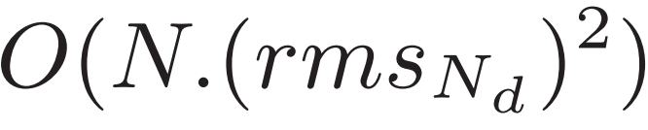
Proposed Min-Overflow Partitioner
Mark all nets “invalid”
Two stages:
  Build : All steps shown
  Refine : The orange steps are skipped
Min-overflow (Cells of net):
  Very similar to min-cut partitioner
  We look at the overflow among all valid nets, not just the current one.
  Time complexity = O(C²), where C is the cells in this net
Overall time complexity =
Sort nets by HPWL
All nets done ?
Yes
No
Mark net as valid
Min-overflow ( Cells of net )
Stop

Slide 18
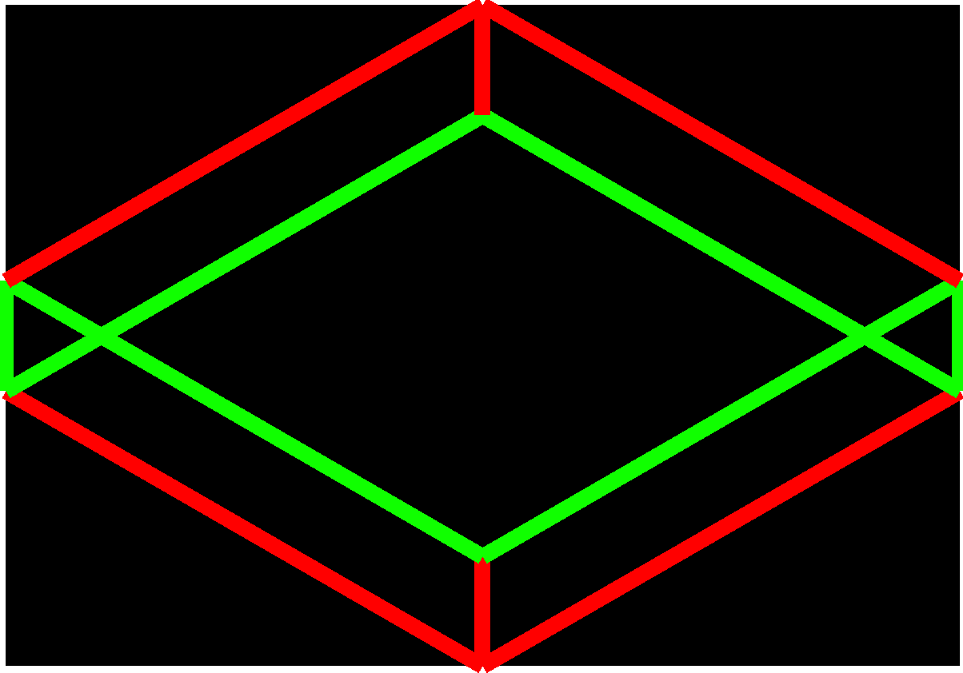
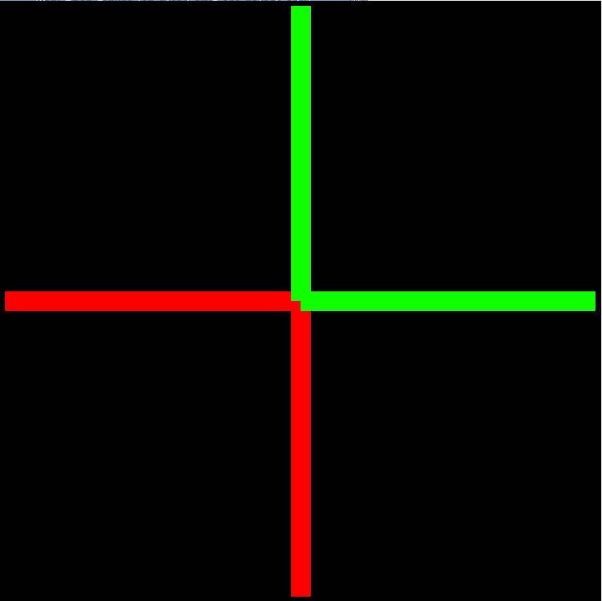
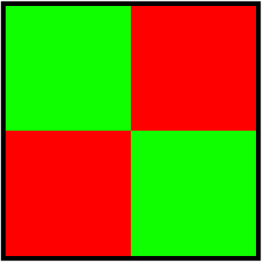
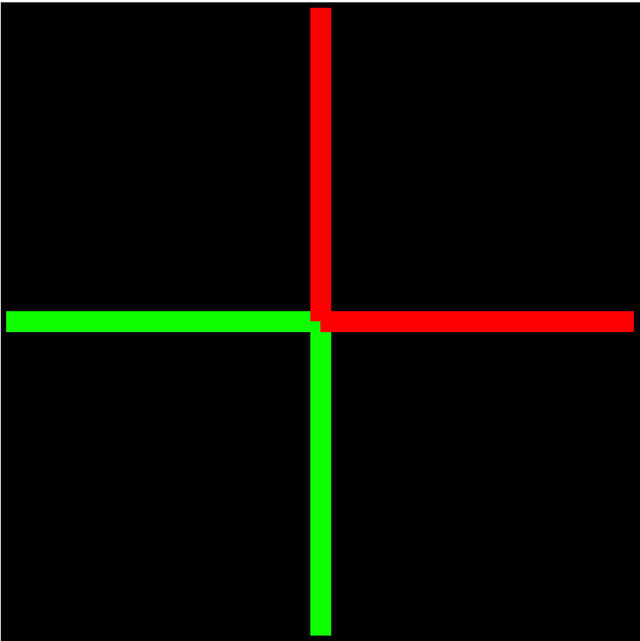
Representing a 3D Routing Grid using 2D Maps
Consider the simple 3D routing grid with certain routing values on each edge
We show the top view using placement bins (dual of the above graph)
Green = 0.17
Red = 0.33
Die 0
MIV
Die 1

Slide 19
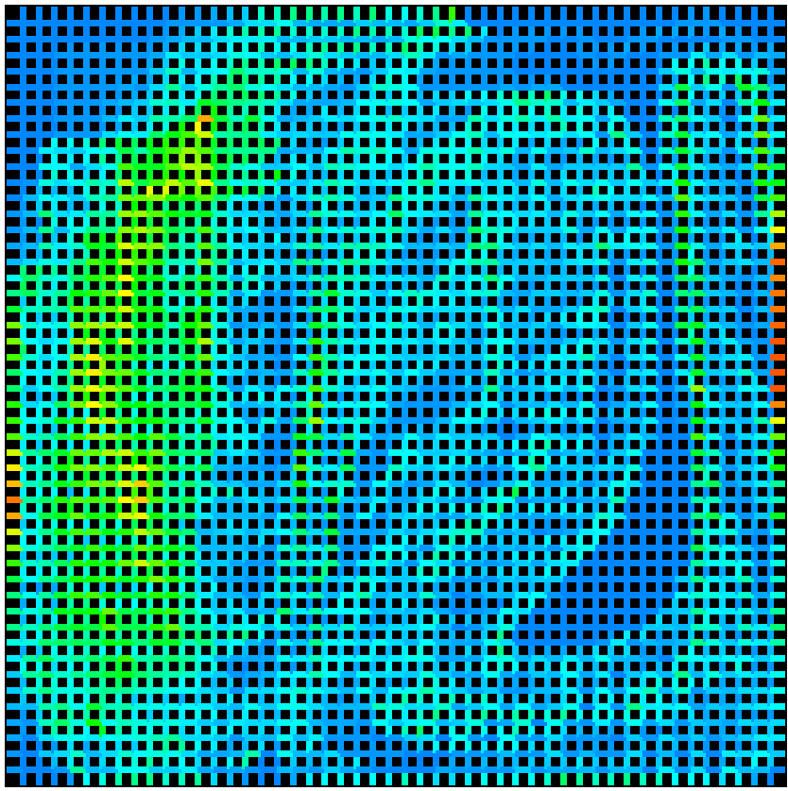
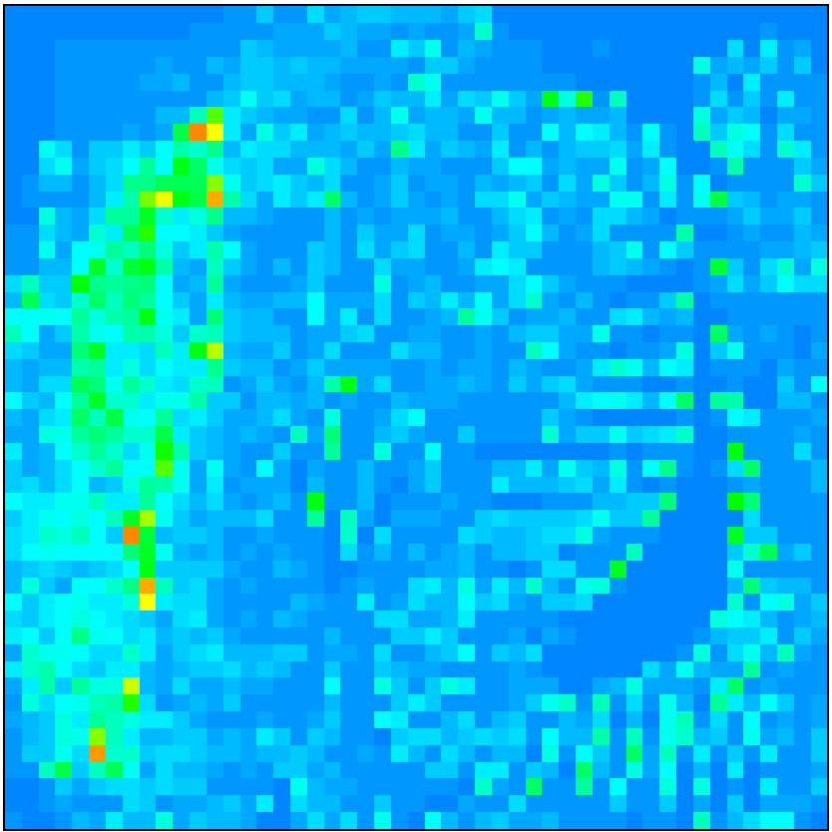
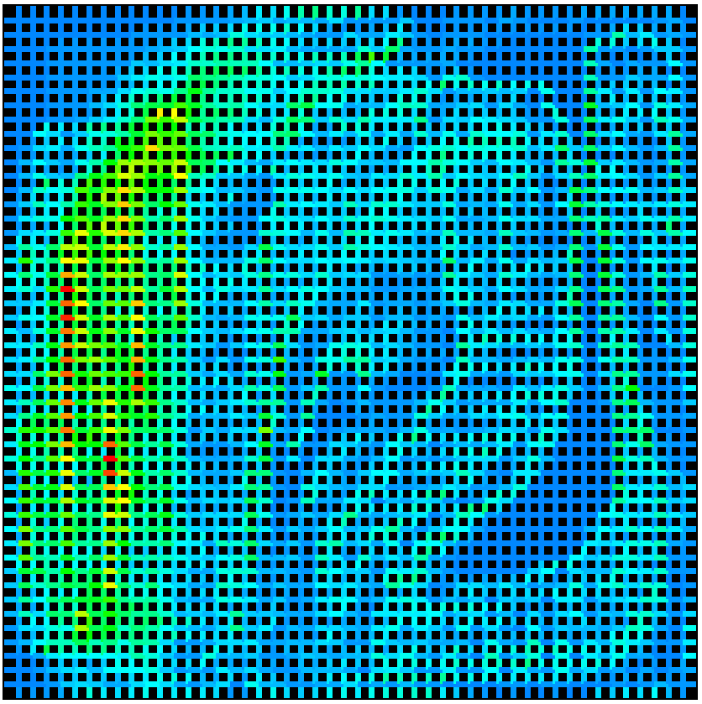
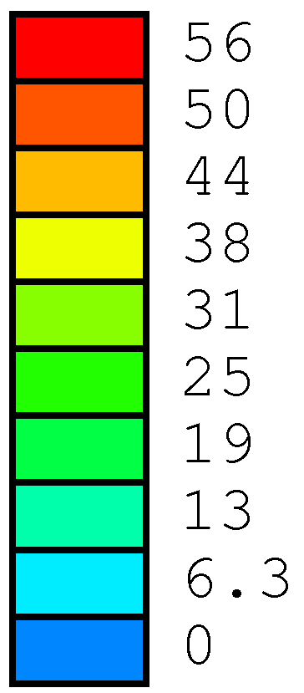
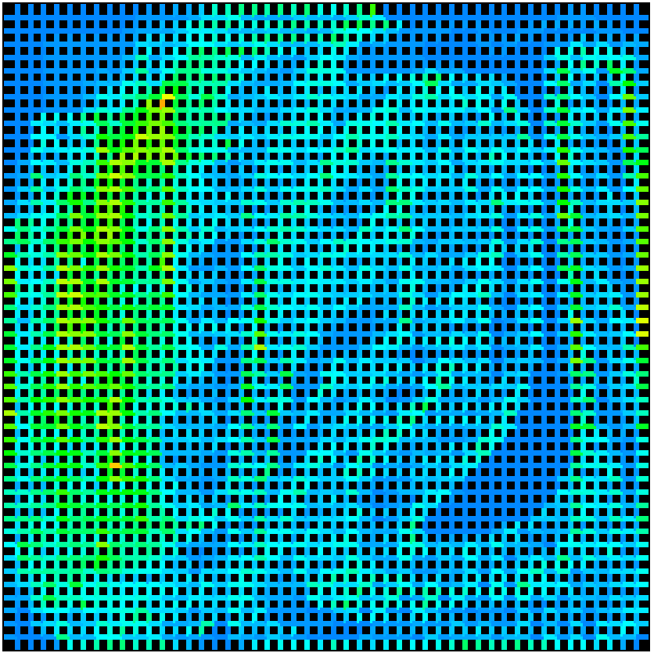
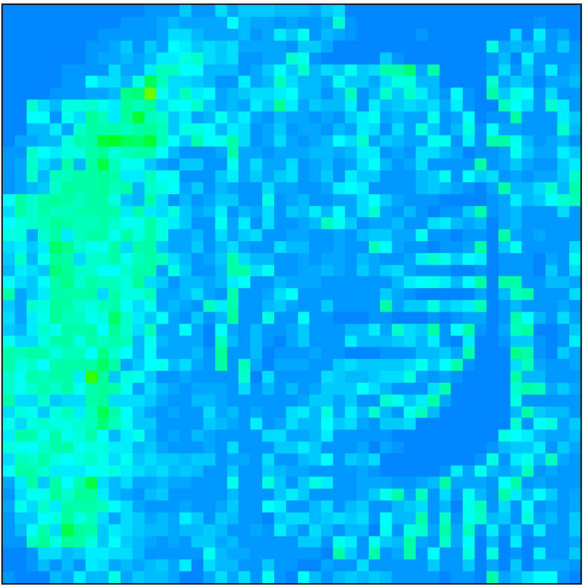
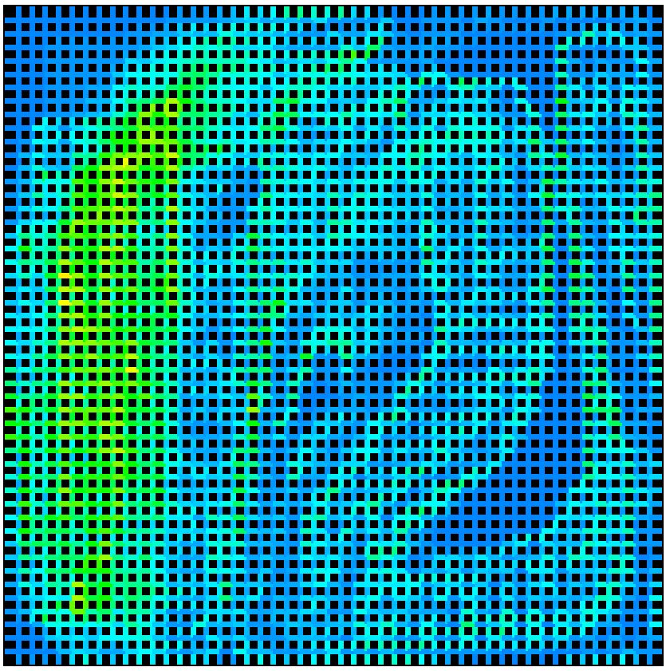
Demand Maps
Tier 0
MIV layer
Tier 1
Min - Cut
Min - Overflow
Much higher MIV usage

Slide 20
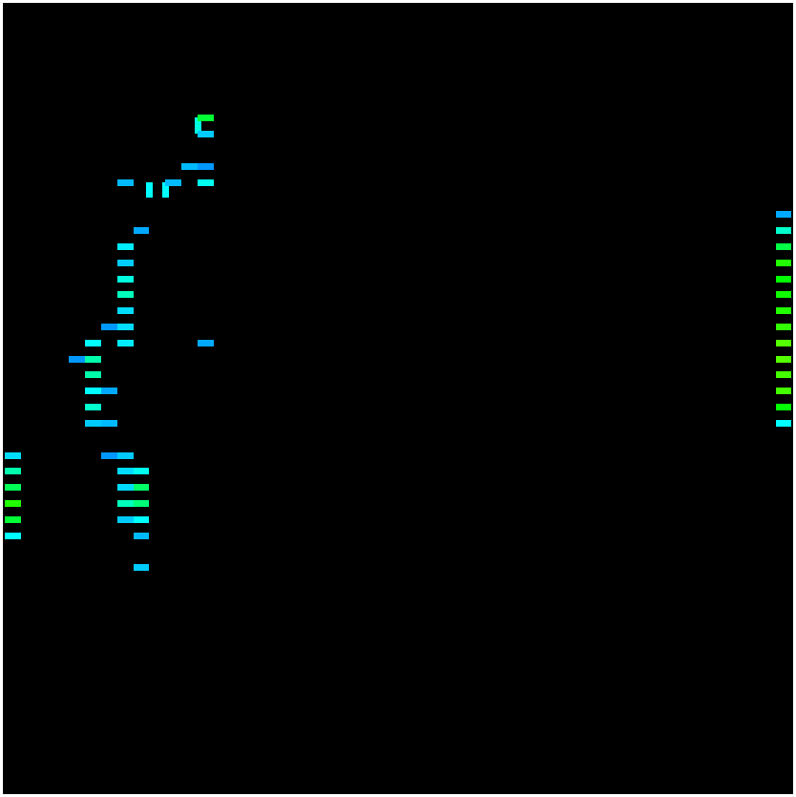
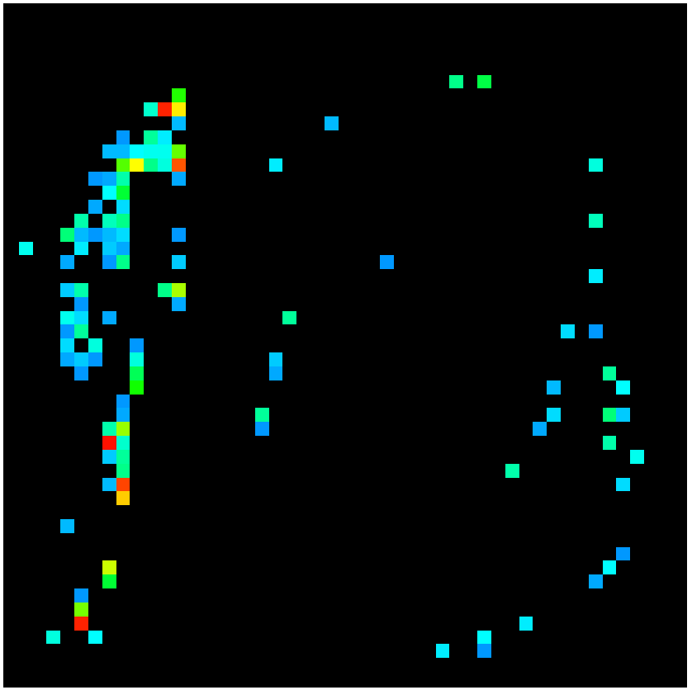
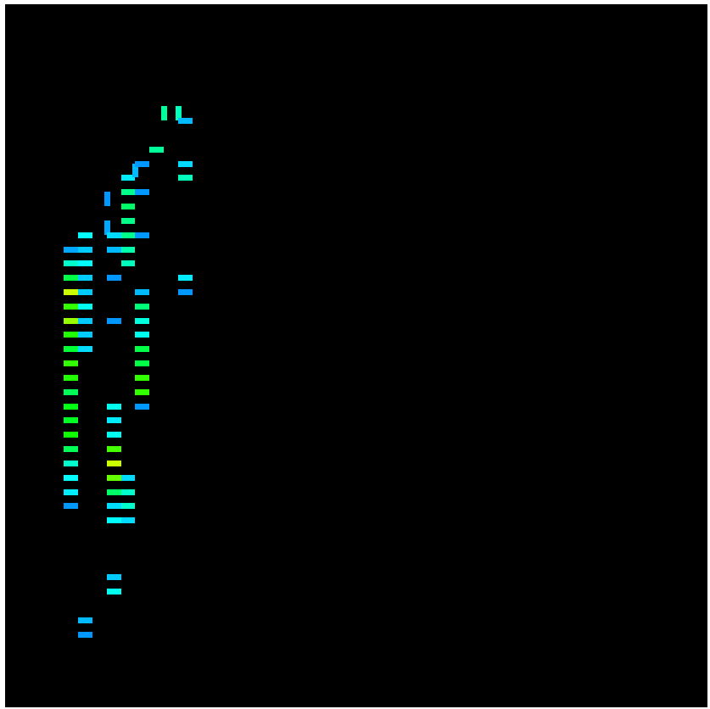
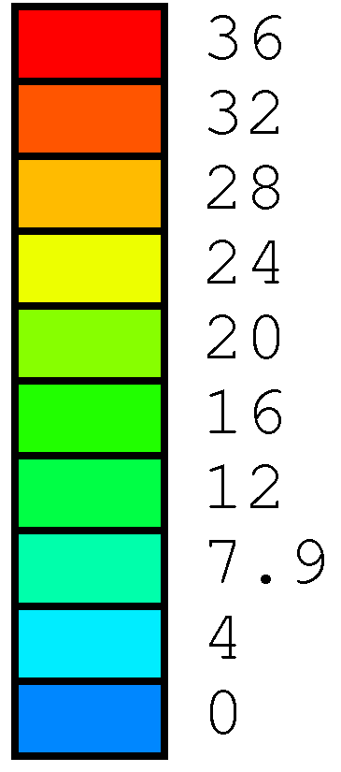
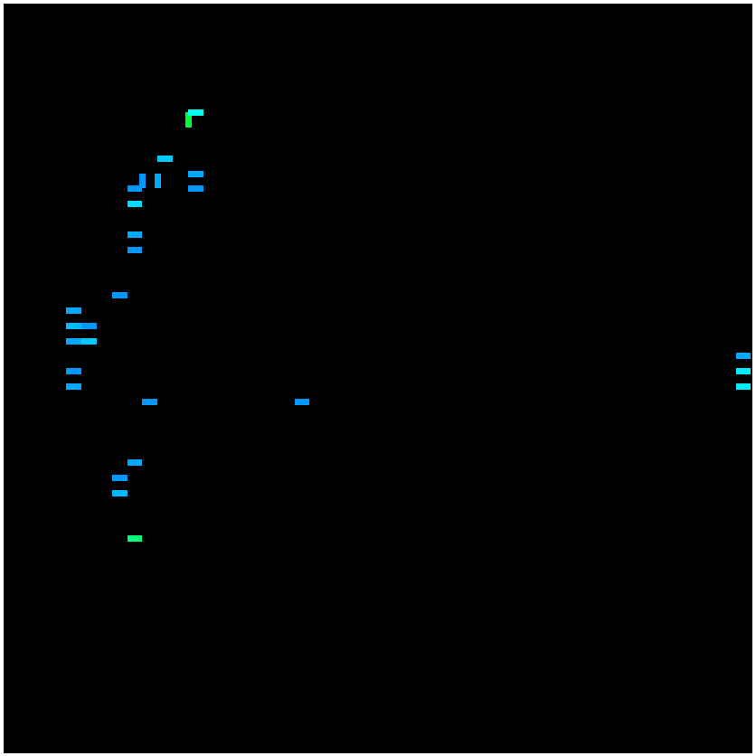
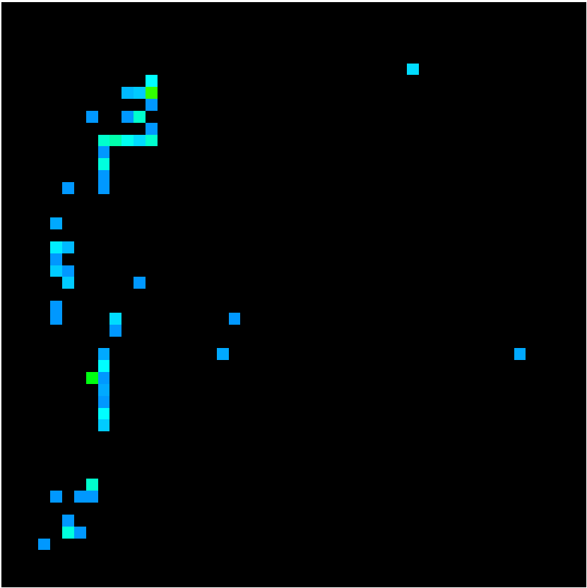
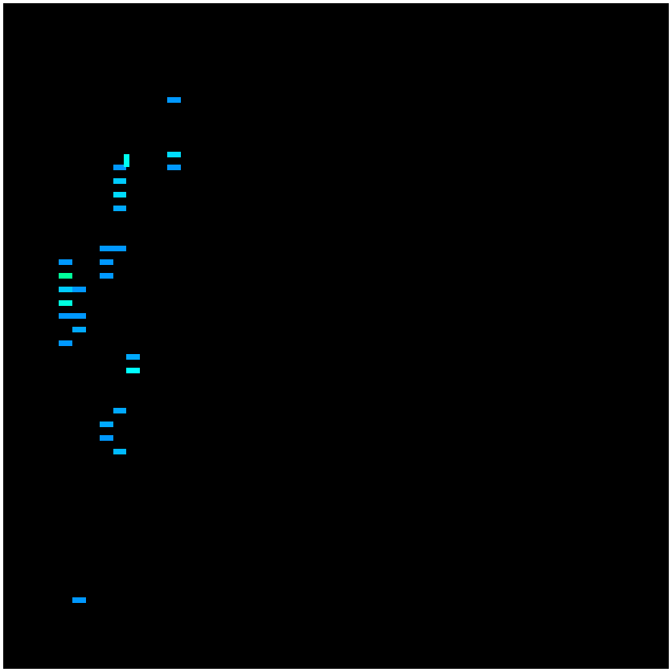
Overflow Maps
Tier 0
MIV layer
Tier 1
Min - Cut
Min - Overflow

Slide 21
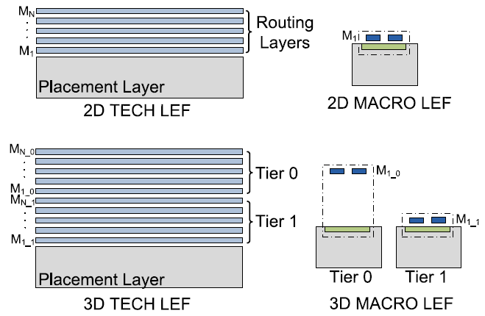
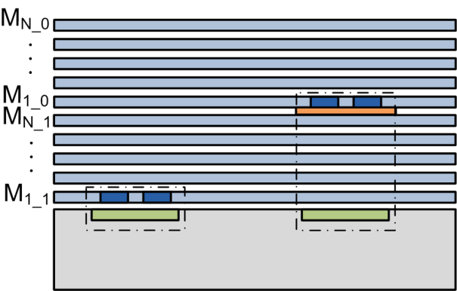
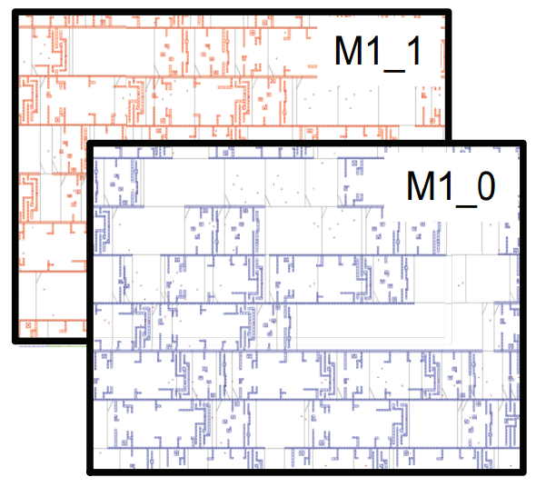
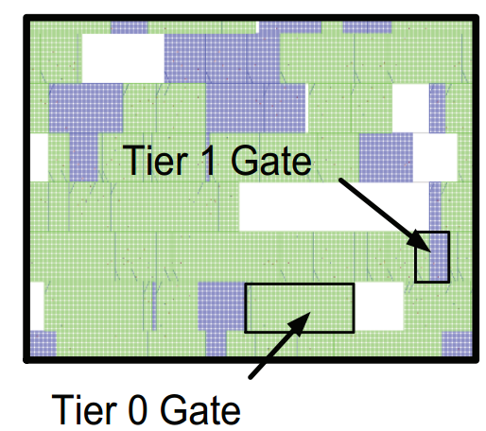
Router-Based MIV Insertion (1/2)
Routing blockage to prevent MIV insertion
All gates are then placed in the same placement layer
LEF files are modified for 3D
Encounter screenshots
No overlap in the routing layers

Slide 22
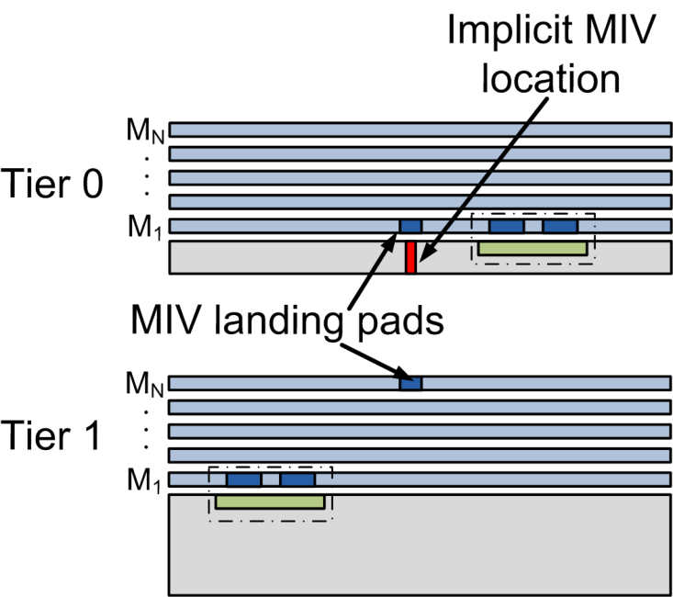
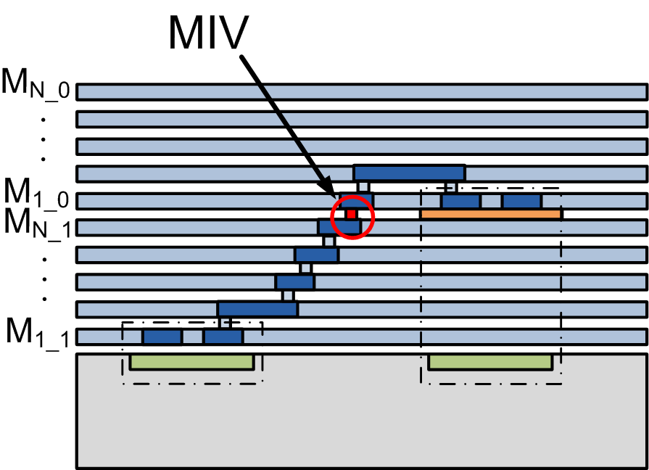
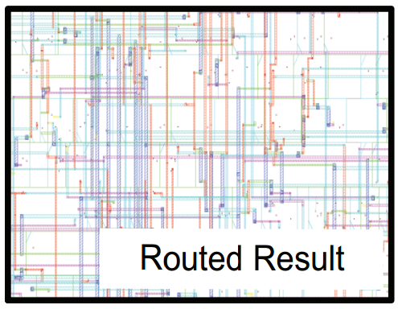
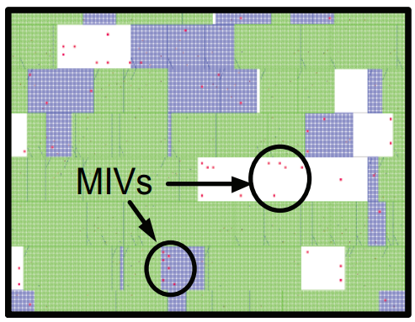
Router-Based MIV Insertion (2/2)
Route with Encounter
Create separate verilog/DEF for each tier
Encounter screenshots

Slide 23
Benchmarks and Technology Assumptions
Design | #Gates | #Nets | Cell Area (mm²) | Target period (ns) | # Metal Layers
mul_64 | 21,671 | 22,399 | 0.078 | 1.2 | 4
rca_16 | 67,086 | 75,786 | 0.262 | 0.4 | 4
aes_128 | 133,944 | 138,861 | 0.348 | 0.5 | 5
jpeg | 193,988 | 238,496 | 0.739 | 1.5 | 4
fft_256 | 488,508 | 492,499 | 1.833 | 1.0 | 5
Benchmarks synthesized in a 28nm library
MIV diameter = 100nm, R = 2Ω, C = 0.1fF ^{[1]}
We focus on two-tier implementations
[1] Y.-J. Lee, D. Limbrick, and S. K. Lim. Power Benefit Study for Ultra-High Density Transistor-Level Monolithic 3D ICs. DAC 2013

Slide 24
Summary of Results to Follow
Overall comparisons
  2D vs. min-cut 3D vs. min-overflow 3D
Placement engine comparisons
  3D Craft^{[5]}
  Partition-then-place^{[6]}
Impact of router-based MIV insertion
Impact of metal layer reduction in monolithic 3D
Scalability of the algorithm
[5] J. Cong and G. Luo. “A Multilevel Analytical Placement for 3D ICs”. ASPDAC 2009.
[6] D. Kim, K. Athikulwongse, and S. Lim. “A study of Through-Silicon-Via Impact on the 3D Stacked IC Layout”. ICCAD 2009.

Slide 25
Benefit of Routability-Driven Partitioning
This enables us to reduce 1 metal layer in monolithic 3D & still see an average benefit of 19.2% w.r.t. WL & 12.1% w.r.t. power delay product when compared to 2D
Min-overflow partitioning offers up to 4% reduction in routed WL & 4.33% reduction in power-delay product

Slide 26
Placement Engine Comparison – 1
Comparison to 3D-Craft^{[5]}
3D-Craft does not support density control → unroutable results. So, we only compare HPWL.
[5] J. Cong and G. Luo. “A Multilevel Analytical Placement for 3D ICs”. ASPDAC 2009.

Slide 27
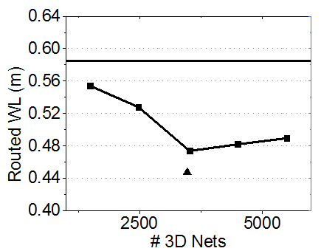
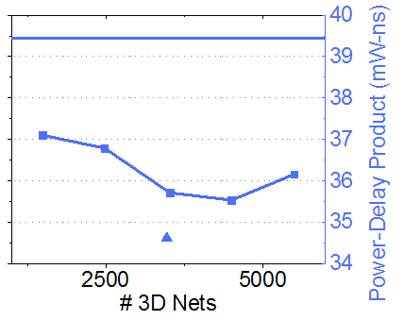
Placement Engine Comparison – 2
Compare with partition-then-place technique^{[6]}
mul_64 benchmark
2D
Partition-then-place
Placement-driven partitioning
[6] D. Kim, K. Athikulwongse, and S. Lim. “A study of Through-Silicon-Via Impact on the 3D Stacked IC Layout”. ICCAD 2009.

Slide 28
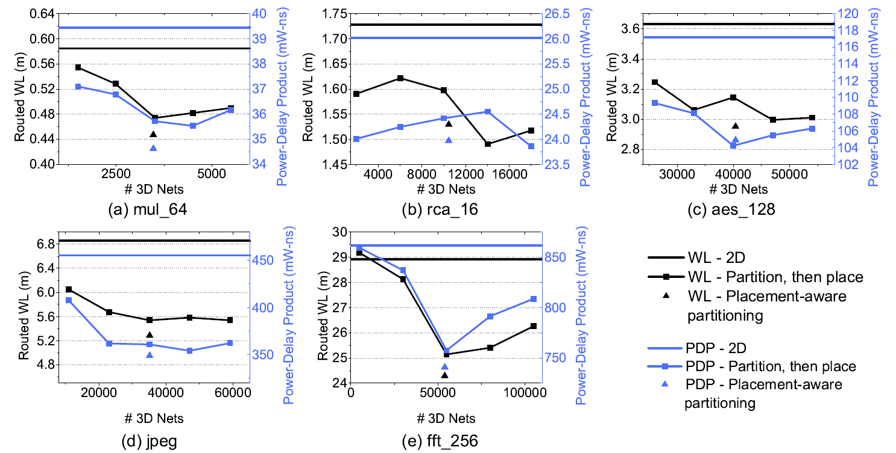
Placement Engine Comparison – 2 (Contd.)
No need to sweep cutsize & up to 5.7% better routed WL & 2.57% better PDP

Slide 29
Impact of Router-Based MIV Insertion
Existing works co-place TSVs & cells. MIVs can also be handled in a similar manner^{[6]}
Up to 14.8 % reduction in routed WL & 5.8% reduction in PDP
mul_64 & fft_256 are un-routable in placement-based MIV insertion
[6] D. Kim, K. Athikulwongse, and S. Lim. “A study of Through-Silicon-Via Impact on the 3D Stacked IC Layout”. ICCAD 2009.

Slide 30
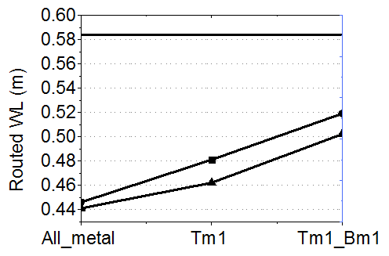
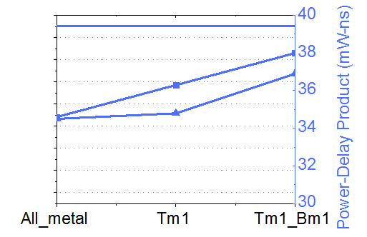
Impact of Metal Layer Reduction
Mul_64 benchmark
2D
Min-cut
Min-overflow

Slide 31
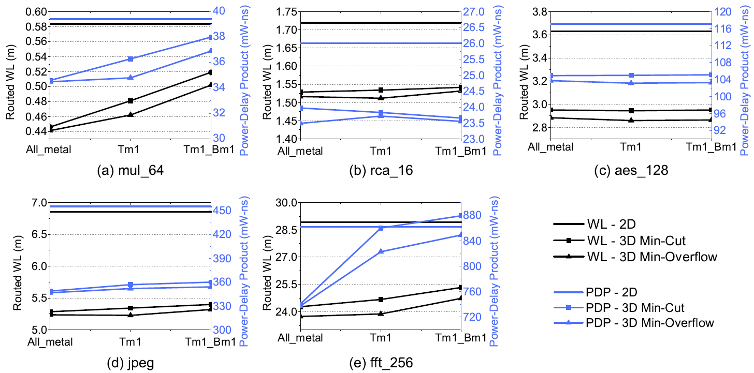
Impact of Metal Layer Reduction (Contd.)
Min-overflow helps more when routing resources are reduced

Slide 32
Runtime Comparison
The runtime of our min-overflow partitioner scales linearly with the number of nets
Circuit | # Nets | Norm. | Runtime (s) | Norm
mul_64 | 22,399 | 1.000 | 100 | 1.000
rca_16 | 75,786 | 3.383 | 416 | 4.16
aes_128 | 138,861 | 6.199 | 542 | 5.42
jpeg | 238,496 | 10.647 | 2688 | 26.88
fft_256 | 492,499 | 21.987 | 2998 | 29.98

Slide 33
Summary
2D engine + post-placement partitioning is sufficient for monolithic 3D ICs
A min-overflow partitioner was developed
  This reduces wirelength by up to 4% and power-delay product by up to 4.33%
A commercial router based MIV insertion algorithm was developed
  This reduces the routed WL by up to 14.8% compared to placement-based MIV insertion
Monolithic 3D ICs with reduced metal layer counts still beat 2D ICs
  On average, with 1 less metal layer, the WL is better by 19.2% and the power-delay product by 12.1%

Slide 34
Thank you.
Questions ?

