Slide 1
FPGA Place & Route Challenges
Rajat Aggarwal
Sr Director, FPGA Implementation Tools
March 31st, 2014

Slide 2
Agenda
FPGA Evolution
Placement Challenges
Routing Challenges
Open Areas of Research

Slide 3
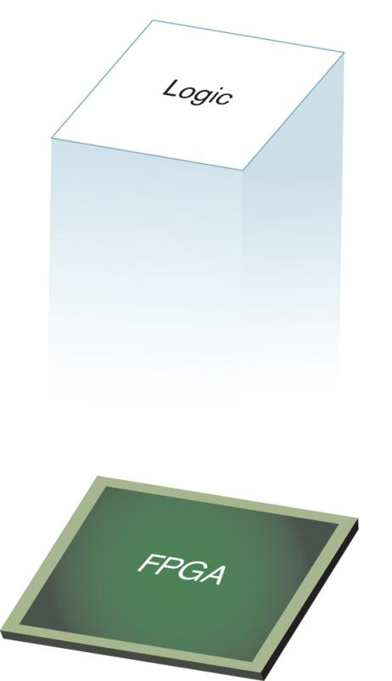
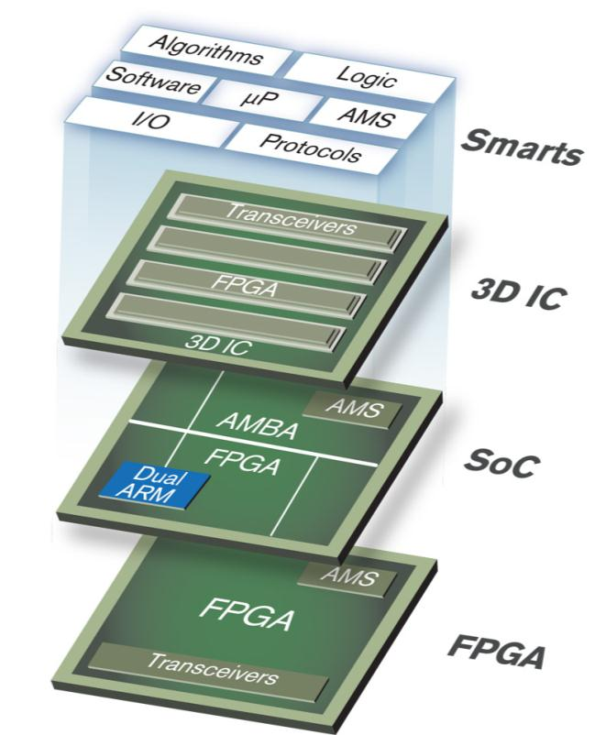
FPGA Technology Evolution
Programmable Logic Devices
Enables Programmable “Logic”
All Programmable Devices
Enables Programmable “Systems Integration”
Notes:
Take-Away: Our 20nm story must be tied back to our 28nm breakout to fully understand our strategy and vision
To set the context for our 20nm story, it helps to know what exactly changed at 28.
Originally, most people traditionally thought of us as just a programmable ‘logic’ design company, as on the left,
Yet at 28nm we made a significant break-out from being a ‘programmable logic’ company to being an ‘ALL PROGRAMMABLE” company by providing not just FPGAs, but SoC and 3D IC devices, essentially employing ‘All’ forms of programmable technologies; this meant going beyond beyond digital to analog mixed signal (AMS), beyond programmable hardware to software, and beyond single die to multi-die 3DIC implementations.
This new portfolio enables much more than programmable ‘logic’ design, but ‘programmable systems integration’, in effect putting more and more functionality into a single device. By doing this customers maximize overall system performance, lower total system power, and reduce overall BOM cost .

Slide 4
Device Sizes Over last 5 Xilinx Generations
 | Logic Cells | LUTs | FFs | Distributed RAM | DSP | Block RAM | IOs
V4 220 | 200,448 | 178,176* | 178,176 | 1,392 | 96 | 6,048 | 960
V5 330 | 330,000 | 207,360 | 207,360 | 3,420 | 192 | 10,368 | 1200
V6 760 | 758,784 | 474,240 | 948,480 | 8,280 | 864 | 25,920 | 1200
V7 2000T ⁺ | 1,954,560 | 1,221,600 | 2,443,200 | 21,550 | 2160 | 46,512 | 1200
US 440 ⁺ | 4,407,480 | 2,518,560 | 5,037,120 | 28,700 | 2880 | 88,600 | 1456
Biggest devices in each Xilinx architecture family
Lots of other components such as: PCIe, MMCMs, PLLs, GTs not shown
* - V4 used LUT4. All other families use LUT6
⁺ - 3D devices

Slide 5
Increased Complexity
Increase of around 15x-30x over last the 10 years
A lot more hardened blocks in the devices

Slide 6
Increased Complexity - Challenges
Fast Changing
  New architecture every 2 years
  More special modules/IPs with strict performance requirements
Turnaround Time
  Customer expectation of 3-4 turns per day on largest devices
    Translates to 2-3 hours runtime for the entire flow
  Multi-threading/Multi-Processing/Incremental Flows
Performance
  Heterogeneous blocks with fixed discrete locations
  Large devices with skewed aspect ratios pose routing challenges
  Simultaneous optimization of Power, Timing and Congestion metrics

Slide 7
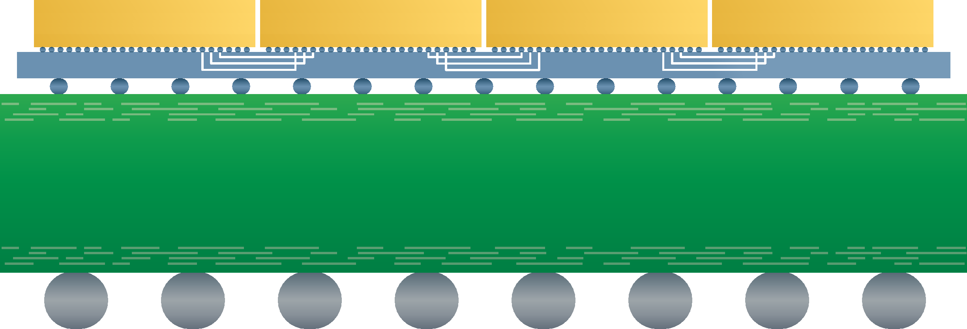
3D FPGAs
Multiple adjacent Super Logic Regions (SLRs)
Super Long Lines (SLLs) cross from SLR, over interposer, to SLR
10K-15K SLLs between adjacent SLRs
  Compared to 1.2K-1.4K IOs per FPGA
SLR
SLR
SLR
SLR
Package Substrate
V7 2000T
SLR
SLLs
SLR
SLLs
SLR
SLLs
SLR

Slide 8
3D FPGAs - Challenges
P&R Tools need to make the SSI devices seamless to Customers
  No floorplanning requirements
  Minimal performance impact
  Congestion management
CLB, BRAM, DSP | HR (3.3V) I/O | HP (1.8V) I/O | CMT | GTP | GTX | GTH | CFG, AES, XADC | Clock Routing

Slide 9
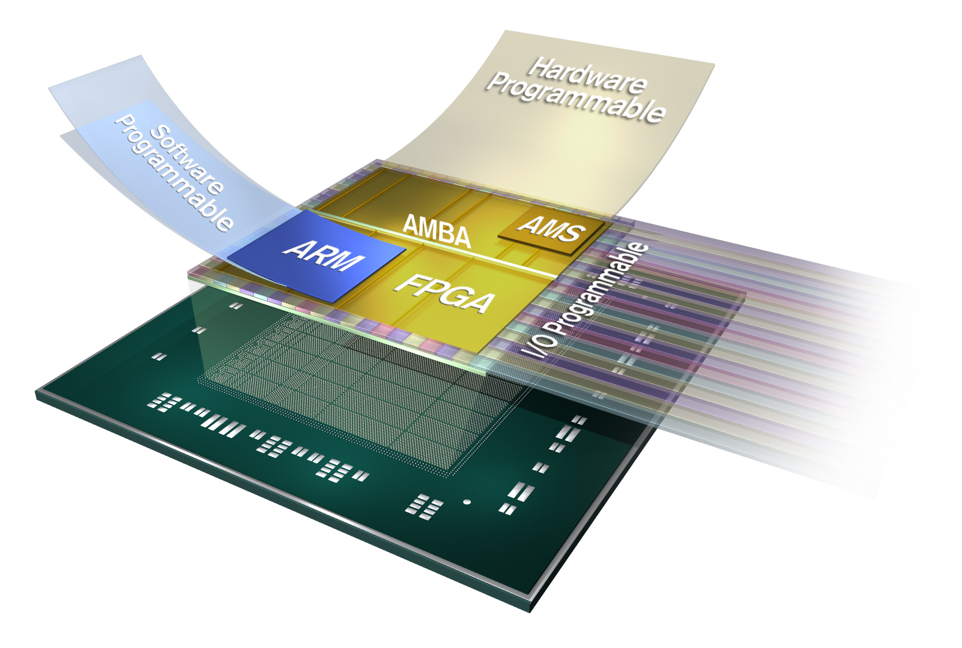
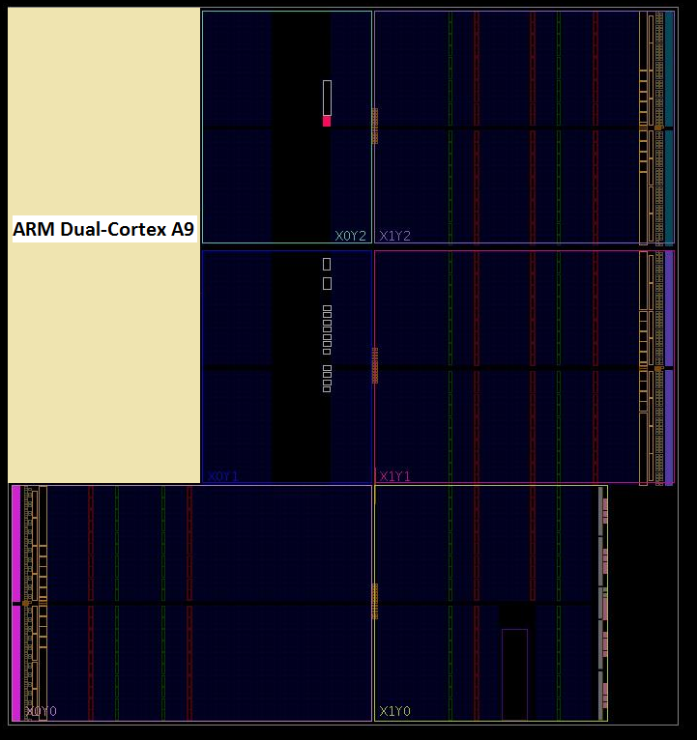
Programmable SoCs - Challenges
Embedded Dual ARM Cortex-A9 MPCore
Challenges
  Congestion management at the Processor Boundary
  New IPs interfacing with the Processor

Slide 10
Agenda
FPGA Evolution
Placement Challenges
Routing Challenges
Open Areas of Research

Slide 11
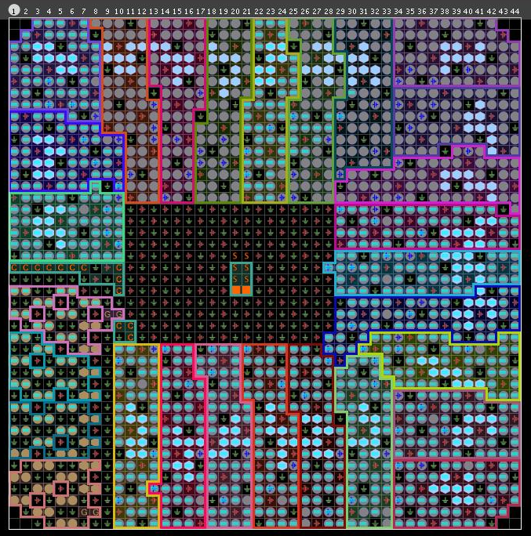
IO Banking Rules and Compatibility
IO Bank:
  group of IO sites that share common VREF and VCCO voltages
Only IOs with compatible standards can go to the same IO Bank
Compatibility Rules
  Numerous and complicated
  Change from architecture to architecture

Slide 12

UltraScale Clocking Architecture
Flexible ASIC style clocking network
Clocking network defined by software
IOx52
Clocking
PCIe
Clocking
IOx52
IOx52
Clocking
CoreIO
Clocking
IOx52
IOx52
Clocking
CoreIO
Clocking
IOx52
IOx52
Clocking
CFG IO
Clocking
IOx52
XAMS
IOx52
Clocking
Config
Clocking
IOx52
IOx52
Clocking
PCIe
Clocking
IOx52
IOx52
Clocking
PCIe
Clocking
IOx52
IOx52
Clocking
CoreIO
Clocking
IOx52
IOx52
Clocking
CoreIO
Clocking
IOx52
IOx52
Clocking
CFG IO
Clocking
IOx52
XAMS
IOx52
Clocking
Config
Clocking
IOx52
IOx52
Clocking
PCIe
Clocking
IOx52

Slide 13
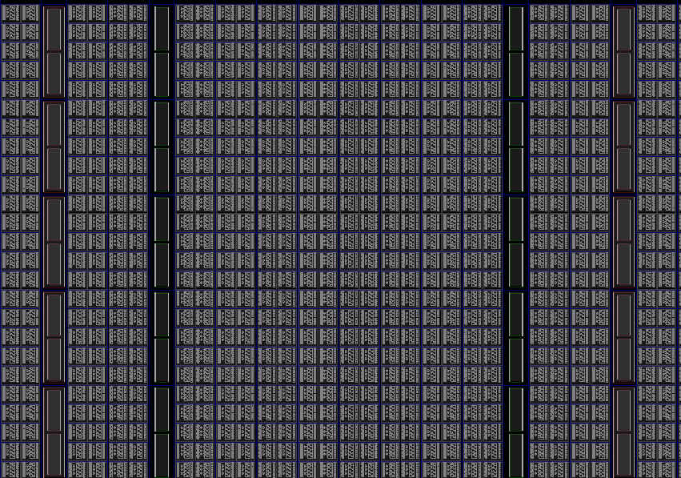
Placement Challenges
Heterogeneous Placement
  Handle Multiple Resources
  Discrete Resource (DSP/Block-RAM)
  Not Always One-to-One map (example: LUTRAM)
FPGA Legalization
  Example: Control Sets
  Complex, time consuming and changing
BRAMs
DSPs
DSPs
BRAMs

Slide 14
Agenda
FPGA Evolution
Placement Challenges
Routing Challenges
Open Areas of Research

Slide 15
Interconnect delays are not Monotonic
minDly = 40
maxDly = 100
A
B
minDly = 10
maxDly = 15
minDly = 30
maxDly = 80
C
minDly = 50
maxDly = 80
D
E
minDly = 20
maxDly = 40
F
Delay(A➔C➔D➔F) > Delay(A➔B➔E➔F)
Manhattan Distance(A➔C➔D➔F) < Manhattan Distance(A➔B➔E➔F)

Slide 16
Routing tracks already exist
minDly = 40
maxDly = 100
A
B
minDly = 10
maxDly = 15
minDly = 30
maxDly = 80
C
minDly = 50
maxDly = 80
D
E
minDly = 20
maxDly = 40
F
Unit delays of these wires can differ substantially
Small changes can generate jump in delays
  Best Path: SlowMaxDly = 155ps
  Next Best Path: SlowMaxDly = 175ps

Slide 17
Need to Optimize Multiple Corners at once
minDly = 40
maxDly = 100
A
B
minDly = 10
maxDly = 15
minDly = 30
maxDly = 80
C
minDly = 50
maxDly = 80
D
E
minDly = 20
maxDly = 40
F
Constraint: FastMinDly > 80ps, SlowMaxDly < 180ps
Path (A➔C➔D➔F)
  FastMin = 90ps, SlowMax = 175ps
Path (A➔B➔E➔F)
  FastMin = 70ps, SlowMax = 155ps

Slide 18
Agenda
FPGA Evolution
Placement Challenges
Routing Challenges
Open Areas of Research

Slide 19
Open Areas of Research
Incremental Flows
Ultrafast compilations for small changes
Emulation and OpenCL markets
Evaluation
Fast and accurate evaluation of new architectures
Create new methods of Abstractions
3D FPGAs
Adoption is set to increase more and more
Scalability
Design size 750K ➔ 2.0M ➔ 4.4M ➔ ?
Need to deliver 2x-3x scalability every 2 years
Massive Multi-threading? Multi-Processing?
Different configurations with non-identical dice

