Slide 1
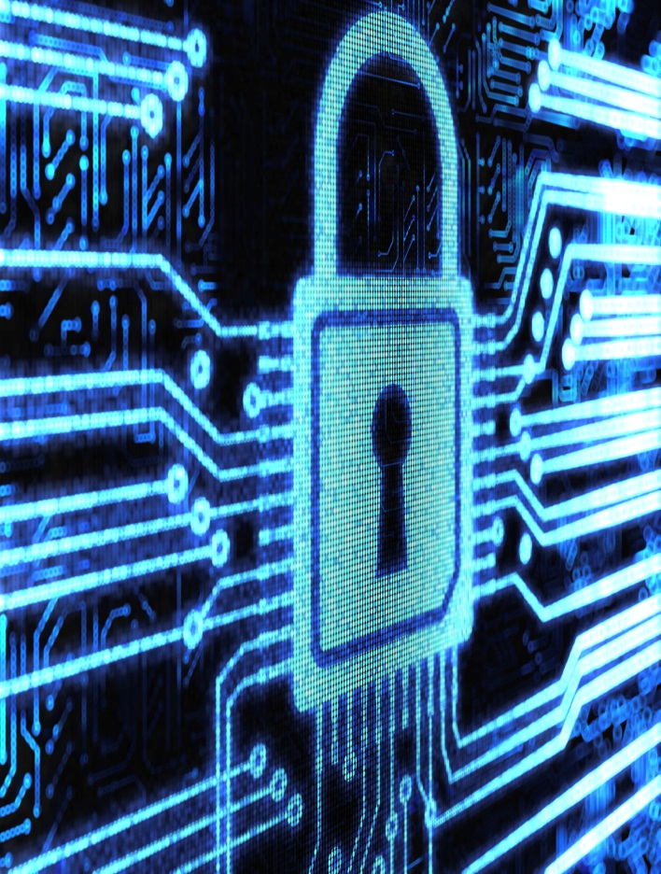
Hardware Cybersecurity
Serge Leef
Vice President and General Manager
New Ventures
System Level Engineering Division

Slide 2
Outline
Why is “hardware security” important
Characterizing threat vectors
Countermeasure strategies
Hardware Trojans
Counterfeiting
This presentation re-uses, with permission, materials previously presented by:
  M. Tehranipoor – University of Connecticut & CHASE Center
  O. Sinanoglu – New York University, Abu Dhabi
  R. Karri – New York University, NY
  A. Iqbal – Apple Computer & Massachusetts Institute of Technology
  K. Bernstein – DARPA

Slide 3
Why is “hardware security” important

Slide 4
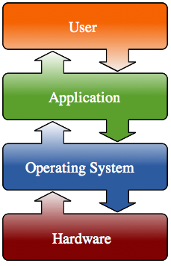
Layers of information processing
Notes:
This is a conceptual diagram of different layers in any modern information processing or computer system.
Attacks have been common on the user, application and operating system layer. Some examples inlcude
User : Social Engineering Attack / Malicious Scripts
Application : Malwares
Operating Systems : Viruses
Hardware ? : Hardware attacks are not as common as the other types of hacks. However, the vulnerabilities exist we will discuss a few cases where hardware vulnerabilities are brought up to light by news media and government investigations.

Slide 5
Attacks at different layers
Social Engineering
Malware / Macros
Viruses/ Trojans
??
Notes:
This is a conceptual diagram of different layers in any modern information processing or computer system.
Attacks have been common on the user, application and operating system layer. Some examples inlcude
User : Social Engineering Attack / Malicious Scripts
Application : Malwares
Operating Systems : Viruses
Hardware ? : Hardware attacks are not as common as the other types of hacks. However, the vulnerabilities exist we will discuss a few cases where hardware vulnerabilities are brought up to light by news media and government investigations.

Slide 6
Relative Impact
1 - 100
10,000 – 100,000
~100 Million
~100 Million
Hardware is the root of trust; Even a small malicious modification can be devastating to system security
Notes:
Since the hardware is usually the root of trust in a system, even small malicious modifications of the hardware can be devastating to system security.
For example, A vulnerability in intel processor will affect millions of PCs. Not only windows but also Mac, Linux and other X86 based OS.
We will see in the subsequent slides how these vulnerabilities can be designed in into the hardware : Something which is referred to as hardware Trojan.
A hardware trojan is a cleverly designed piece of circuitry, which looks like a normal circuit for some functionality, but is intended for infiltration. We will have a deeper dive on Trojans in later sections of this presentation.
If the Trojan is cleverly designed, Cannot be fixed cheaply without replacing the hardware itself.
Cannot be detected until the actual attack
We will be discussing these vulnerabilities. But first see if these are even real. Have there been any incidents wherein a hardware has been compromised .

Slide 7

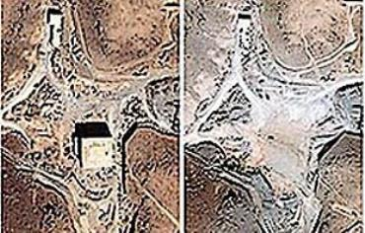
Syrian Radar Case
“September 2007, Israeli jets bombed a suspected nuclear installation in northeastern Syria. Among the many mysteries still surrounding that strike was the failure of Syrian radar, supposedly state of the art, to warn the Syrian military of the incoming assault. It wasn’t long before military and technology bloggers concluded that this was an incident of electronic warfare and not just any kind. Post after post speculated that the commercial off-the-shelf microprocessors in the Syrian radar might have been purposely fabricated with a hidden “backdoor” inside. By sending a preprogrammed code to those chips, an unknown antagonist had disrupted the chips’ function and temporarily blocked the radar”
Source : IEEE spectrum, 2007
Notes:
Lets start with this first one published in IEEE spectrum.
Its about an Israeli Missile attack on northern Syria. Despite of having a latest state of the art Radar technology the Syrian Military did not get an early notification of the attack.
Experts speculate the microprocessor in the Syrian radar had a build in hidden backdoor through which the radar could be disabled by sending a preprogrammed code wirelessly.
The question is how did this infected microprocessor get inside the Syrian radar ?
Syria would have bought this microprocessor from a company in America !! It was Possibly designed in an Israel and manufactured in China.
It is also alleged that during the Cold War, the Central Intelligence Agency (CIA) produced microchips with ―kill switch circuits and shipped them to the Soviet Union. The microchips failed as designed and resulted in a 3-kiloton explosion and destruction of a Siberian natural gas pipeline.

Slide 8

CNN Report 10 June, 2012
Counterfeit parts compromise the US Supply Chain and present a
growing threat to national security. Current safeguards are
ineffective; they put American lives and DoD missions at risk.
Notes:
About a year ago, SASC reported back on a study they did on the security risks posed by compromised supply chain
They issued this report as a result of the study
This CNN videoclip is the news report on the release of the study
I researched the claims in the video and found they were true. And unfortunately found a lot more examples
Since the video many more parts found, and many more policies and doctrines defined, but no effective new Supply Chain protections
DARPA IS THE RIGHT PLACE TO TAKE ON A PROBLEM LIKE THIS

Slide 9
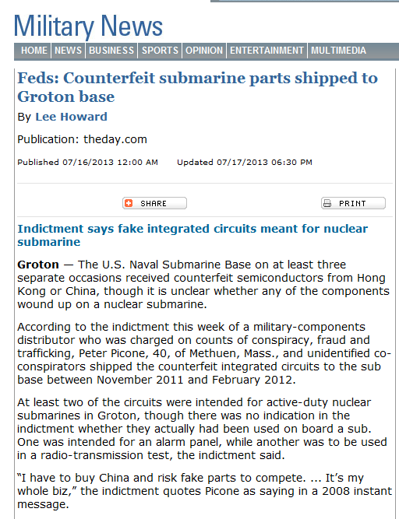
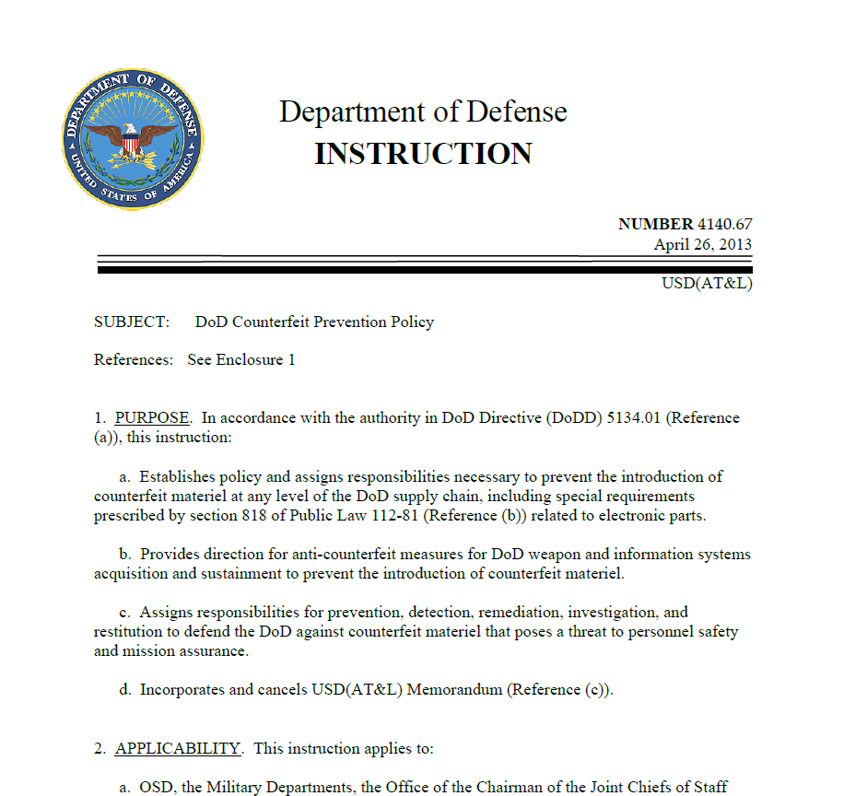
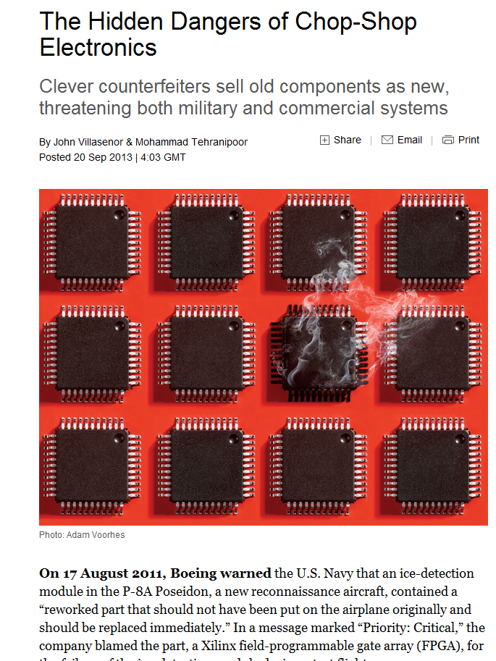
Supply Chain Control is a Critical Problem
Dept. of Defense Instruction
NUMBER 4140.67, 26 April 2013
Distributor indicted for supplying counterfeits
to Grumman Electric Boat, July 2013
SPECTRUM Magazine
October, 2013, pp. 41-45
Notes:
Infiltration of the supply chain with counterfeit parts is receiving a lot of attention
Grumman Electric Boat Division supplier Peter Picone prosecuted
Recent Spectrum article discussing the growing SC threat
Caused DoD Instruction to be issued mandating the use of supply chain protections – drove an inferior solution

Slide 10
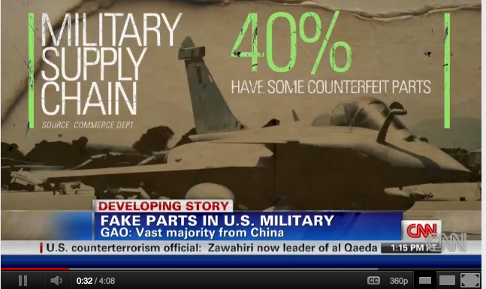
Counterfeit Chips in Military
http://www.youtube.com/watch?v=H5z5F7SQuX0
Notes:
According to a news Item from CNN, 40% chips in the military warfare systems are counterfeit.
To be more precise, they are either infected or recycled. Both detrimental to the security of these critical systems.
The Syrian Radar Case talked about disabling a radar. Imagine if the destination coordinates of a launched missile could be changed !!

Slide 11
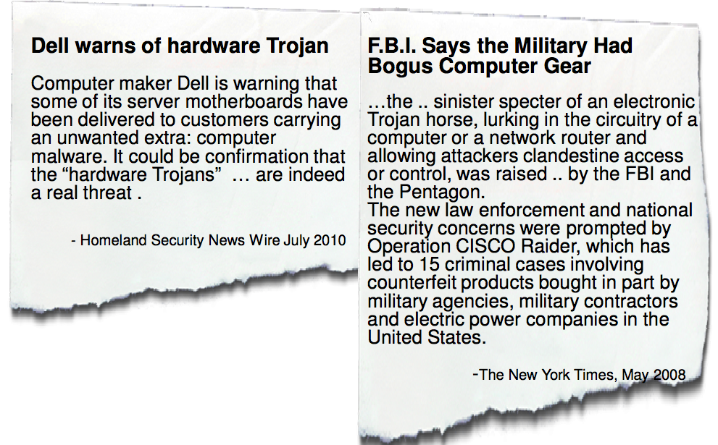
More Cases
Notes:
More cases from Consumer electronics. There are incidents about security vulnerabiliities in Router chips. Fake Cisco routers etc.
I have posted some cased on stellar which talk about all the cases I discussed and also some more.
Healthcare
: Stealin gof records
Disabling a pcamaker ..

Slide 12
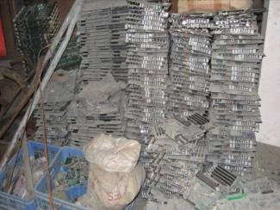

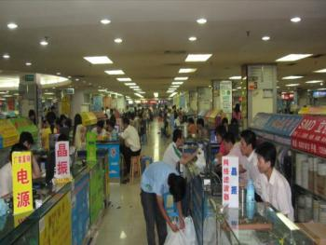
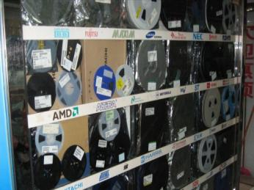
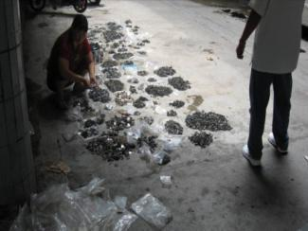
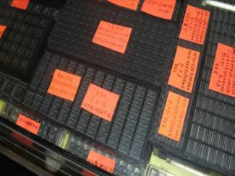
US Electronic Waste is a Contributing Factor
Received in
Developing Country
Resold
Shipping from/to U.S.
Repackaged
Removed from
boards and sorted
Refurbished and remarked
All images courtesy of SMT Corporation
Notes:
- Uncontrolled heating during part removal can cause die cracks or delamination, leading to immediate or latent failures.
- Mishandling or sanding of parts can cause latent Electrostatic Discharge (ESD) failures.

Slide 13
Characterizing threat vectors

Slide 14
Security Implications of Outsourced Manufacturing
Compromising the IC supply chain for sensitive commercial and defense applications becomes easy.
Attacker could substitute Trojan ICs for genuine ICs during the process.
Attacker could subvert the fabrication process itself by implanting additional Trojan circuitry into the IC mask.
Fragmentation makes it easy for the counterfeit / recycled ICs to enter the supply chain.
Notes:
So what are the security implications of reuse of third party IPS and outsourced manufacturing
Loss of control on supply chain
Possibility of malicious code during the design stage
Possibility of fake and recycled ICs entering into the supply chain.

Slide 15
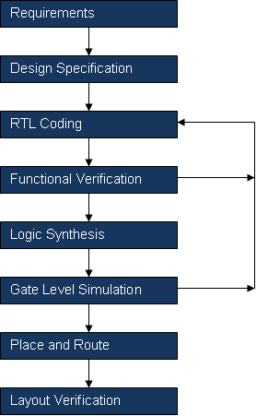
IC Design Flow
Lots of Third party IP and Code Reuse
Complicated Scripts, Third Party tools
Physical Placement of Gates, Heavy use of tcl scripts
Notes:
So this is a generic IC design flow.
Starts with requirements
Requirements are translated to design specifications by manually by engineers
A design is entered or encoded in a design representation language of choice. In digital design its called RTL
The RTL or coded design is verified for functionality
After that the RTL Is synthesized or translated into actual logic gates depending upon a specific technology – Via software.
Verification is done on gate level again
And then the gates are laid out and geometrical shapes are drawn for fabrication.

Slide 16
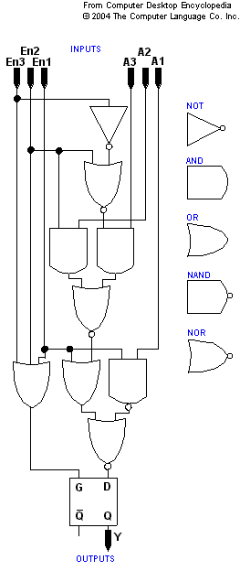
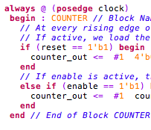
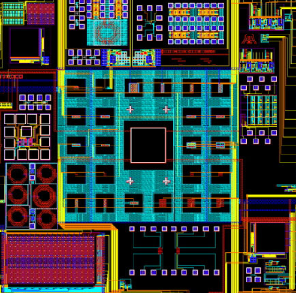
Different Views of a Design
RTL
GDSII
NETLIST
Notes:
During Design, we have three different views of the same design along the process. RTL is translated into gates via synthesis and gates are translated to a geometric shape file via layout and physical placement and connecting the gates.
Netlist Generation and GDS generation is heavily driven by scripts used on tools. There is a lot f re-use of the scripts. Many times the scripts are modified versions of open source scripts available on the internet.

Slide 17
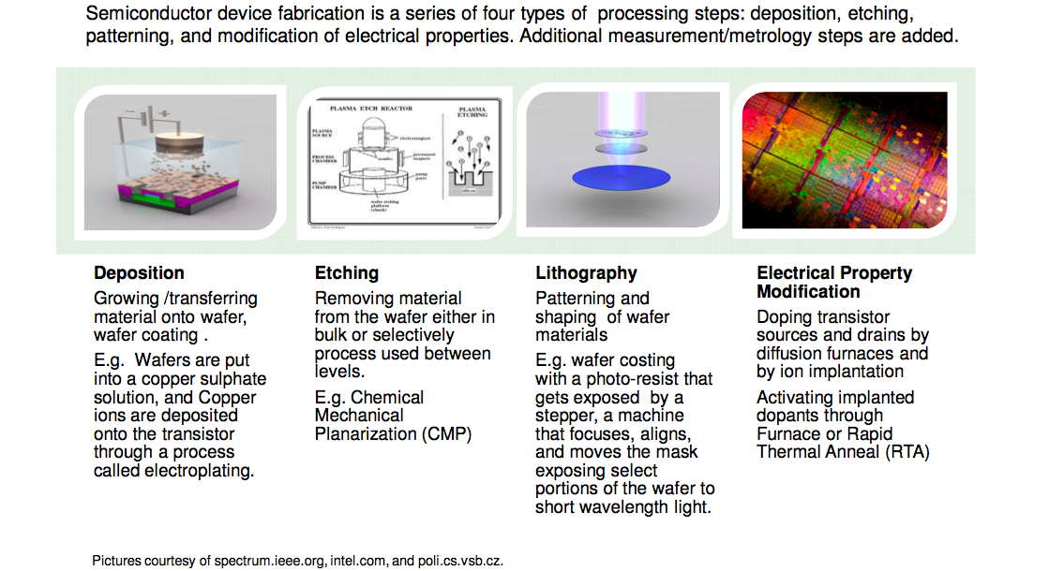
Semiconductor Manufacturing Process
Notes:
We discussed design, Lets have an overview of the manufacturing process.
The key steps that you many want to remember are :
-- Mask Preparation
-- Etching Transistors on Silicon Wafers
-- Connecting the Transistors via metallization.
-- Packaging and Test.
It’s a 2 month cycle typically from wafer to packaged chip.

Slide 18





Impact of Globalization
Core
Core Vendor
Core Vendor
Core Vendor
SOC
Core 2
Core 3
μP
μP
Core 1
Core 4
ASIC
ASIC
SOC integrator
μP
μP
SOC
Si Fab
Design complexity and time-to-market pressures
Fabrication cost (foundry cost = ~$5B)
Distributed IC design flow ➔ Security vulnerabilities
Notes:
Before getting into the hardware trojans though, I would like to briefly talk about the impact of globalization on the integrated circuit design and development flow. In the past, a chip design company used to design the entire chip from scratch, and they would own their own manufacturing facilities, where they would go ahead and do the fabrication.
With the complexity of the design today, this cannot be afforded. Today, a chip, or a system-on-a-chip integrator simply buys design blocks, called cores, from third party vendors. Maybe a company is specialized in processors, so I can buy a processor core design from them. They would simply sell me their IP and they would submit an encrypted electronic file that describes their design. I can obtain many cores from different sources, which could be in India, China, Europe, wherever the expertise and the cost-effectiveness is, then I can merge them into one bit design, my system-on-a-chip. Where do I fabricate this? I can do it China.
This type of a design and fabrication flow introduces security vulnerabilities at multiple points during the flow.

Slide 19
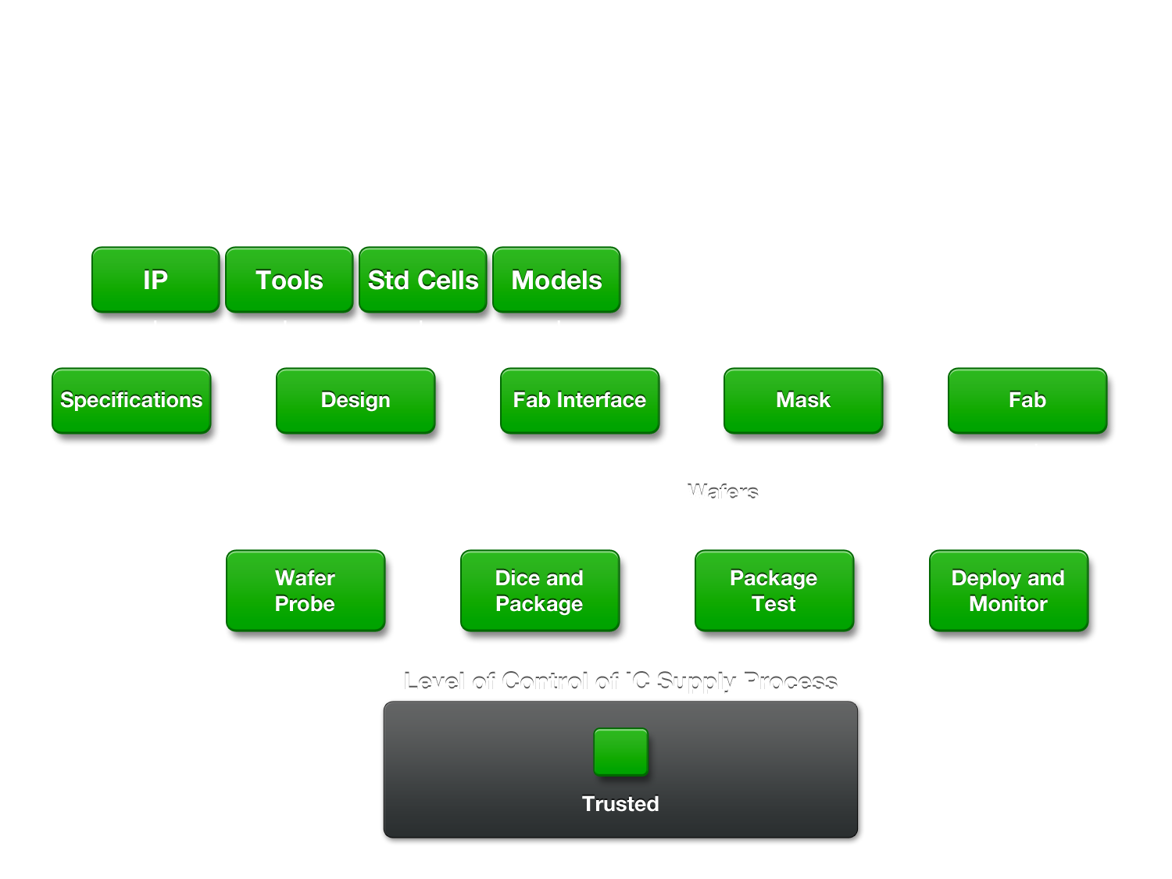
Evolution of IC Supply Chain
IC Supply Chain in the Past

Slide 20
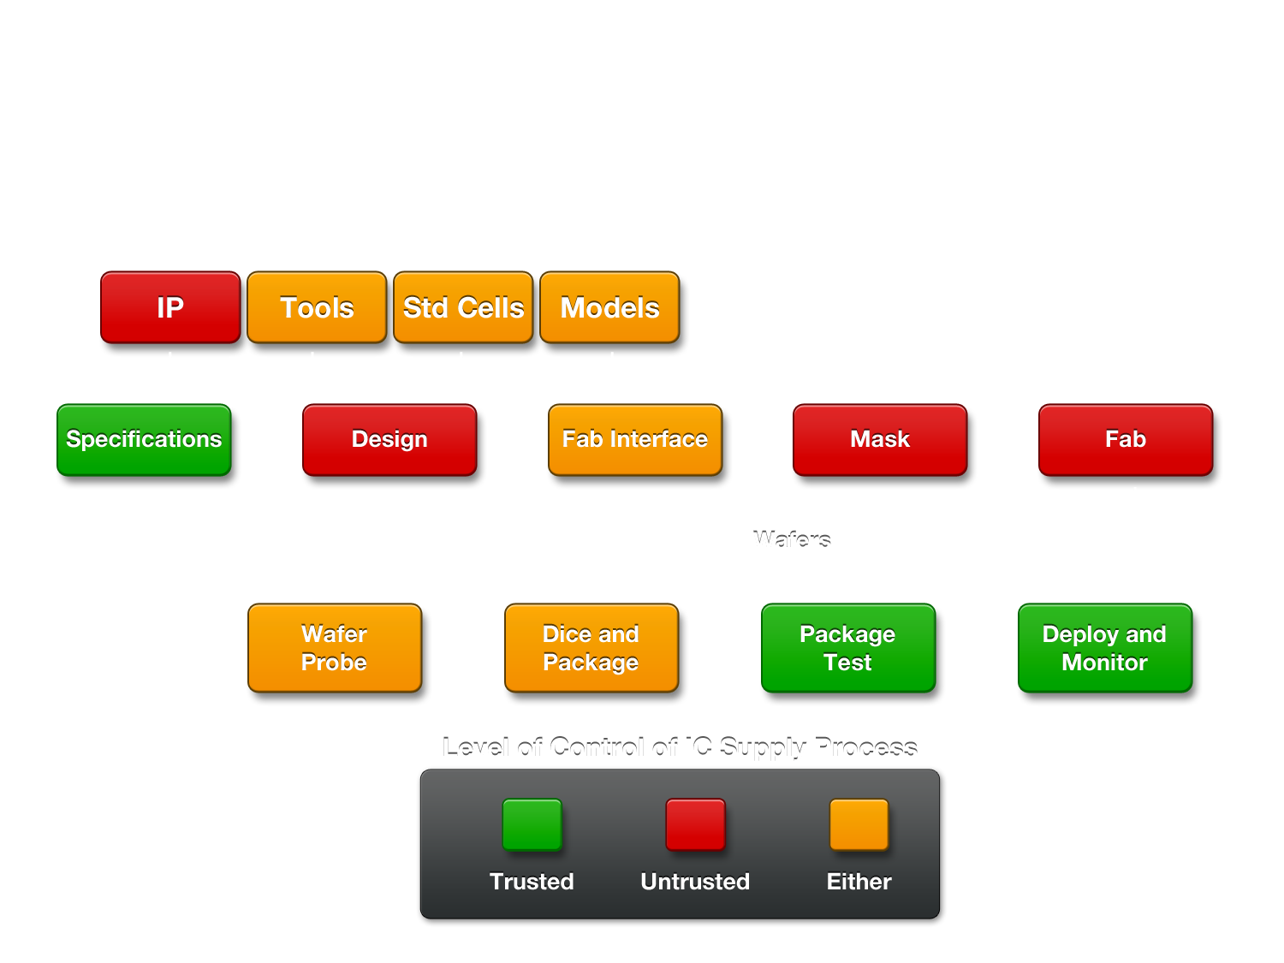
Evolution of IC Supply Chain
Current IC Supply Chain

Slide 21
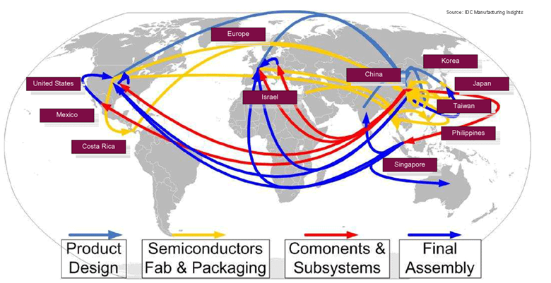
Electronics Supply Chain is Global
Global nature of supply chain makes chain-of-custody unworkable
Semi Design
Semi Manufacturing & Packaging
Printed Circuit Board Production
Printed Circuit Board Distribution
Source: IDC Manufacturing Insights & Booz Allen analysis
Lifecycle shown for a single JSF component
– Component changes hands 15 times before final install

Slide 22
Trusted Silicon in an Untrusted Environment
Untrusted
network
Untrusted
network
Data
Secure Tunnel (VPN)
Users
“VPN” for Trusted Silicon
Untrusted
supply chain
IC
Design
Supply Chain Protection Solution
Users

Slide 23
Countermeasure strategies

Slide 24
Attributes of Superior Supply Chain Authentication Tech
Extremely low cost, with minimal impact to the component manufacturer, distributor, or end-user, as well as to the host component itself;
Effective at mitigating most supply chain security threats;
Be simple, very fast, and executable by untrained operators;
Trustworthy, reliable, and prohibitively difficult to spoof;
Executable at any place, time along supply chain, providing instant results on-site;
Performed using a inexpensive interrogation equipment;
Standardized and widely adopted by government and industry;
Manufacturable in high volume using standard foundry processes; and
A value-add to the end-product; recognized and requested by the consumer.

Slide 25


Slide 26
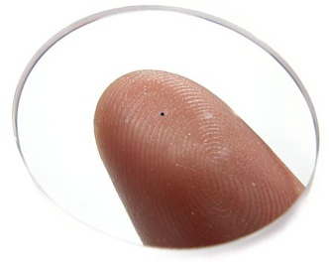
SHIELD: The DARPA Supply Chain Solution
SHIELD Target Spec
100µm x 100µm
(0.01 mm² Area)
100K Devices
100 MHz Clock Rate
50 µW Total Power
T ≤ 120°C
<1¢ per dielet
HW Root-of-Trust
Fragile Key Storage
Full Encryption Engine
Unpowered
Passive Sensors
Inductive Powering
and Communication
Microscopic
SHIELD dielet
Image courtesy of http://www.hitachi.com/New/cnews/030902.html
  DARPA SHIELD will develop the ability to provide:
  100% assurance against certain known threat modes;
  quickly, on demand, at any step of the supply chain; and
  essentially for free.
SHIELD makes counterfeiting too expensive and too hard to do.
Notes:
On the tip of this index finger is our proposed SHIELD dielet solution, microscopic
With scaling you can get a lot of function nowadays on a part that size.
It will contain a hdware root of trust, a complete encryption engine, sensors that do not consume power, and induction
Secret key never comes off chip; public key never comes off server.

Slide 27
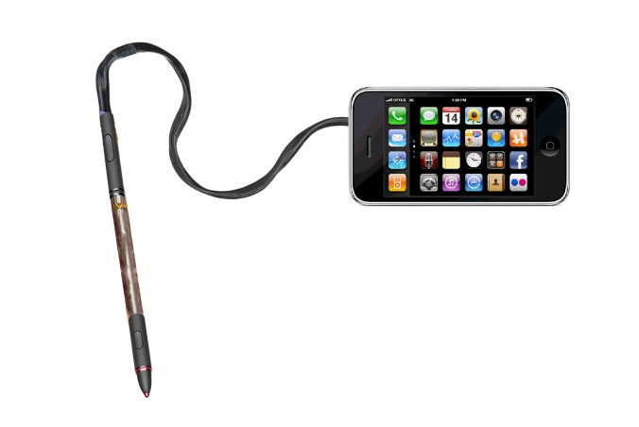
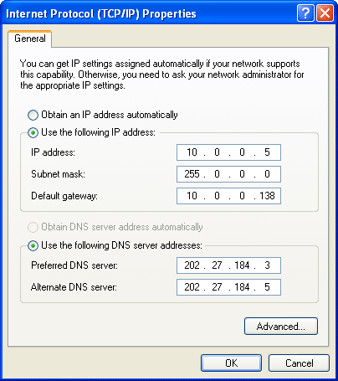
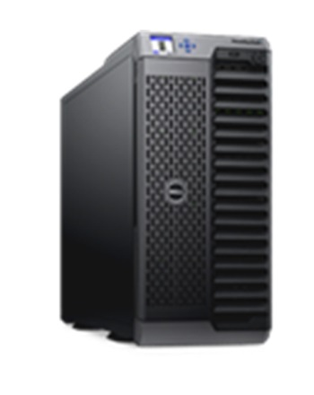
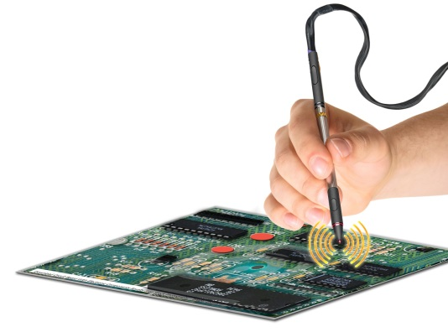
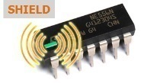
SHIELD Exemplary CONOP
TCPIP Address
(VPN)
Dielet Smartphone Server
Serial ID No.
1. Serial ID Upload
-Database with Dielet Serial ID
Fab Name, Fab Date, Part No.
Random Challenge Generator
Encryption
Engine
w/ Crypto Key
2. Challenge Download
Encrypted Challenge
Decryption Engine w/Crypto key;
decrypt; compare to original challenge
Temp Extremes
Xray Exposure
Light Exposure
3. Appliance Data
3. Encrypted Sensors
-Sensors Status -Test Date
-Auditor Identity -Key Requests
4. Authentication Out

Slide 28
Securing the supply chain is a great goal, but…
Dielet-based approach – cheaper and more tamper-resistant strategies are possible
RFID – Size and cost goals are very aggressive relative to the current state of the art
Authentication is not enough – odometers and activation measurably raise security and should be addressed as well

Slide 29
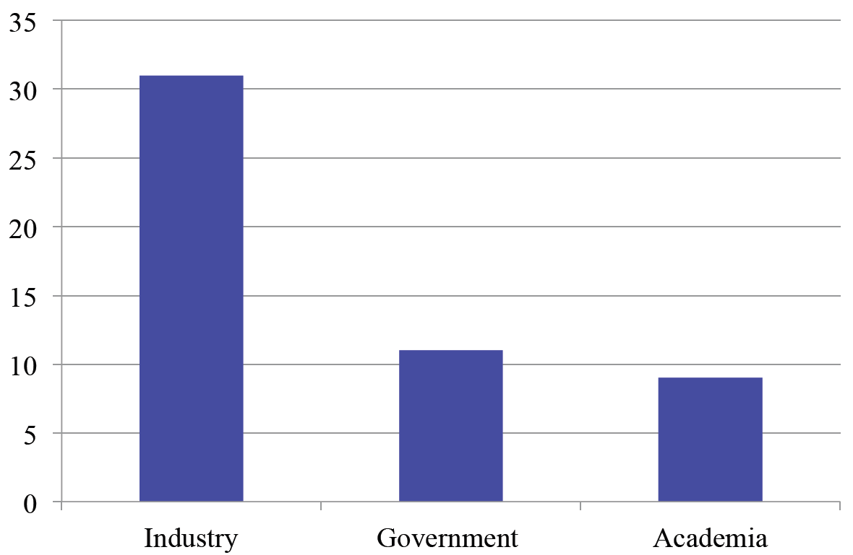

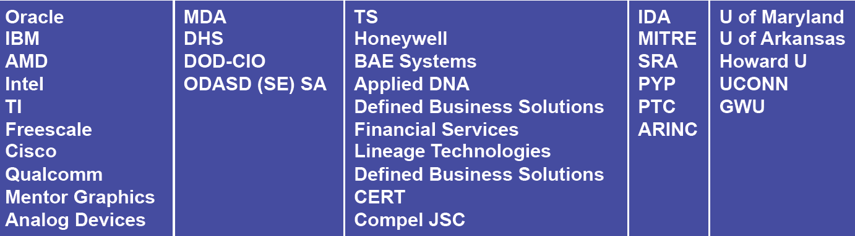
CHASE Survey

Slide 30
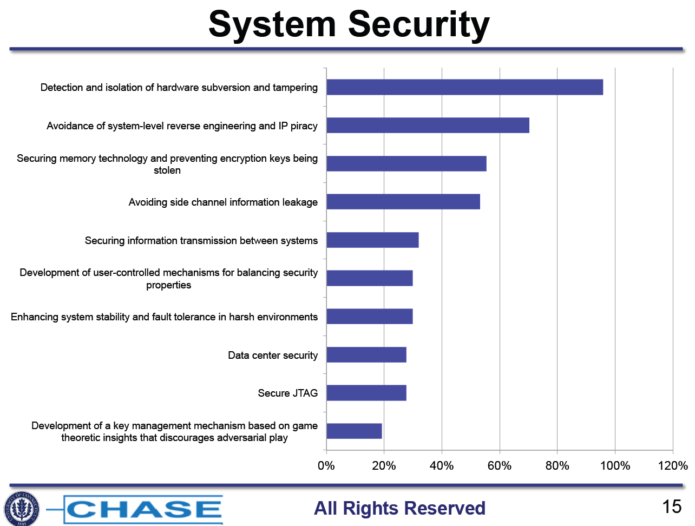
Notes:
Developing operational independence from cyber automation systems for operational continuity
Availability of Formal Methods tools for High Assurance Certification.
Harmonizing system security concerns with system safety concerns to build safe and secure products. Isolation of secure functions while proposing a catalog part (that by essence should be open).
Assessment of threat environments where fabrication occurs.
I addition to detection and isolation is the location of the subversions and the replacement and or resilience recovery with provided virtual functions.
What is a harsh environment? I would choose "enhancing system stability and fault tolerance" as a top 5 problem however the "in harsh environments" phrase leads me to think that the results will be useful only for a small subset of the community that is at risk. ! A box for validating a systems security here might be good (differentiate between detecting subversion, and detecting faulty/vulnerable design and implementation.)

Slide 31
Hardware Trojans

Slide 32
Hardware Trojans
A malicious circuit put inside a chip which is harmless in normal operation until it gets triggered by a preset internal or an external condition.
Notes:
Monitor for a specific but rare trigger condition
– e.g., a specific bit pattern in received data packet or on a bus – until a timer reaches a particular value.
Change or augment the intended functionality of a chip with malicious functions.
Look genuine ICs with normal input/output behavior during testing and normal use.
Tampering is very difficult to detect and mitigate
Trojans may be inserted during the design or manufacturing
Capable of inflicting catastrophic damage
_{Disabling encryption}
Clock disruption to shut down the chip or affect its synchronization
Adding glitches to compromise system integrity and security
Destruction of the operating environment of original circuit
Shutting down power (kill-switch),
generating noise to disrupt critical signals, or increasing thermal gradients on the chip possibly causing burn out
Modify chip’s parametric properties E.g. delay by modifying wire and transistor geometries

Slide 33
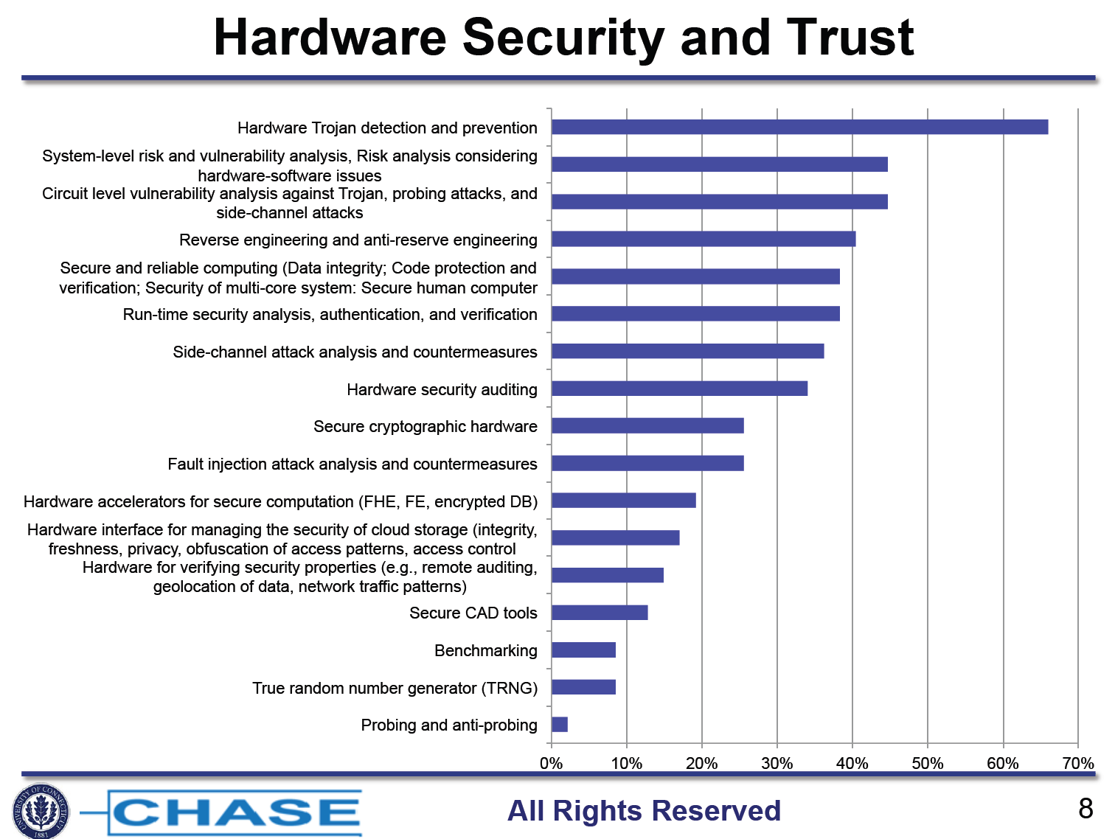
Notes:
It is not realistic to assume that all components of a computer system are trustworthy. I believe that obtaining a trustworthy computation out of untrusted components is an important subject in hardware security and trust.
Our company suggests that you included System-level risk and vulnerability analysis in the Circuit level vulnerability analysis against Trojan, probing attacks, and side-channel attacks.
Defining architectures to address hardware security as well as functional safety. Reverse engineering and anti-reserve engineering could also mean FW or SW reverse engineering. This is the highest threat we have to face.
Supply chain vulnerability testing (for malicious taint) ! We must recognize that we currently have a great many tools to detect and categorize hardware threats, if we choose to use them. However as feature sizes of circuits on chips gets smaller (e.g. <14nm) we will no longer have the means to conduct the analyses necessary to verify the presence or absence of unwanted features and functionality. Investments in metrology must be made now if we are to stay abreast of technological evolution in chip architectures and manufacturing. In the absence of metrology we will
have no chance but to use stringent management and access controls to safeguard designs, reticles, fabrication and assembly of chipsets and devices therefrom.
The hardest aspects for security and trust will be establishing testable requirements for integrity, and resiliency in system design and development.
If fault injection and side channels were together I would have voted for them as a joint entry.

Slide 34
Trust Issue: Hardware Trojans
Rogue hardware injected into the design/chip
  Untrusted cores (design phase)
  Untrusted fab (fabrication phase)
Triggered at mission mode by
  Special date and time
  Receipt of a special SMS/email
Attacks (payload = malicious action):
  Kill switch: Breaking the system (overt)
  Backdoor: Gaining access to the system. E.g., sending confidential data off-chip (covert)
The Hacker in Your Hardware, Villasenor, Sci. American 2010
Notes:
The end result can be so called hardware trojans, which is rogue hardware injected into the design or chip for malicious purposes. They can come in the cores provided third party vendors, or they can be injected in the manufacturing fabs during fabrication.
They are difficult to catch as they have a triggering mechanism; an hardware trojan hardware would sit idle and do nothing until it gets triggered, which is long after the manufacturing testing is done, and this chip is shipped to customers. It could be triggered on a particular date, or upon a certain even such as the receipt of a special SMS.
When triggered, the hardware trojan can cause the chip to fail, which is called an overt attack as the user would be aware of the consequences then, or could create a backdoor in the system providing a remote access to intruders, which is called a covert attack.

Slide 35
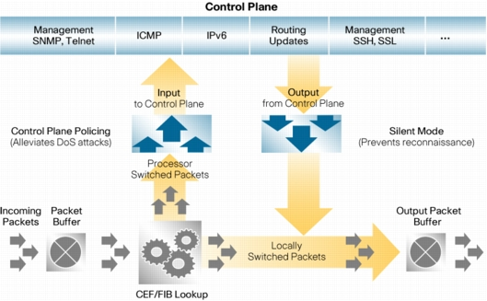

Threat Example
Carrier of a contaminated conrol message
redirected
Unpublished control message travels around the internet and is unrecognized and ignore by most routers
When a router containing a hardware Trojan in the control plane sees such message, it takes action to re-direct data
Source: Cisco web site

Slide 36
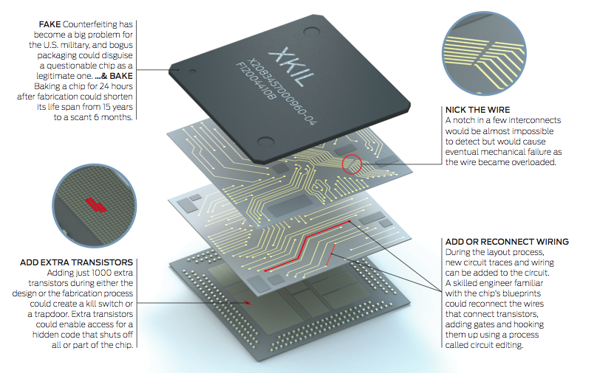
Different types of In Silicon Attacks
DARPA initiated the Trust in ICs program.
Source : Thehuntforthekillswitch.http://www.spectrum.ieee.org/semiconductors/ design/the-hunt-for-the-kill-switch.
Notes:
1. Changing Process Parameters on the manufacturing lines
2. Adding Transistors
3. Adding / deleting connections.

Slide 37
Why is Trojan Detection Difficult
Low probability of triggering during test
  Test time is expensive.
  Consider testing a million chips per production bath
  Even a small chip today has a billion nodes and 2 billion states.
  Test are for known use cases
  Very difficult to test for Unknown Unknowns!
Large number of gates in modern chips
  Exhaustive simulations are extremely computation and memory intensive.
  Obfuscation occurs during synthesis
  No signature of Trojan circuits. They look just like normal hardware
  Low probability Triggers are finite state machines that can change states when time or input data changes
  Nano-scale devices and high system complexity make detection through physical inspection almost impossible.
  Inspection through destructive reverse engineering does not guarantee absence of Trojans in ICs not destructively inspected.
  Audits not very effective at catching bugs
A Hardware Trojan is near impossible to detect in tests because its designed to trigger in mission mode.
Notes:
You don’t test for unknown unknowns ..
Every Hardware trojan incident is a zero day attack
A very simple trojan with just one payload node and 4 trigger nodes can have 10^9 triggers and 10^11 possible Trojan instances in a ~500 gate circuit. To put this into perspective

Slide 38
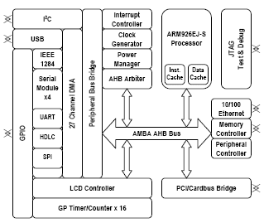

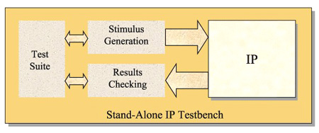
Design time vulnerability
In a typical IP-based design, each block can originate from different sources
Incoming IP blocks are verified to confirm promised functionality
Additional verification may be done to confirm proper interaction with other IP blocks operating in the system context
A key question that does NOT get asked in this process is: “does this block do anything ELSE?”
Possible countermeasures:
  Scan incoming IP for Trojan signatures
  Insert run-time detection mechanisms
UART
UART

Slide 39
Possible Trojan solution: Run-time Detection
Passive monitoring of interactions on PCB
Built-in rules cover common attack models (i.e. bus locking, etc…)
Active, possibly run during POST
Take control of the bus and attempt to provoke undesired system behaviors
Built-in rules cover common attack models (i.e. bus locking, etc…)
SNOOPER
“Monitor”
Mode
Built-in Rules
SNOOPER
“Drive”
Mode
Built-in Rules
CPU
IRQ
CPU
IRQ
Custom Rules
Custom Rules
Controllers
I/O
Controllers
I/O
Memory
Memory
Notes:
unclear, from the title I expect that you will contrast passive and active. Passive is on the left, there is the word "passive" there. Active is presumably on the right, but it's not clear.

Slide 40
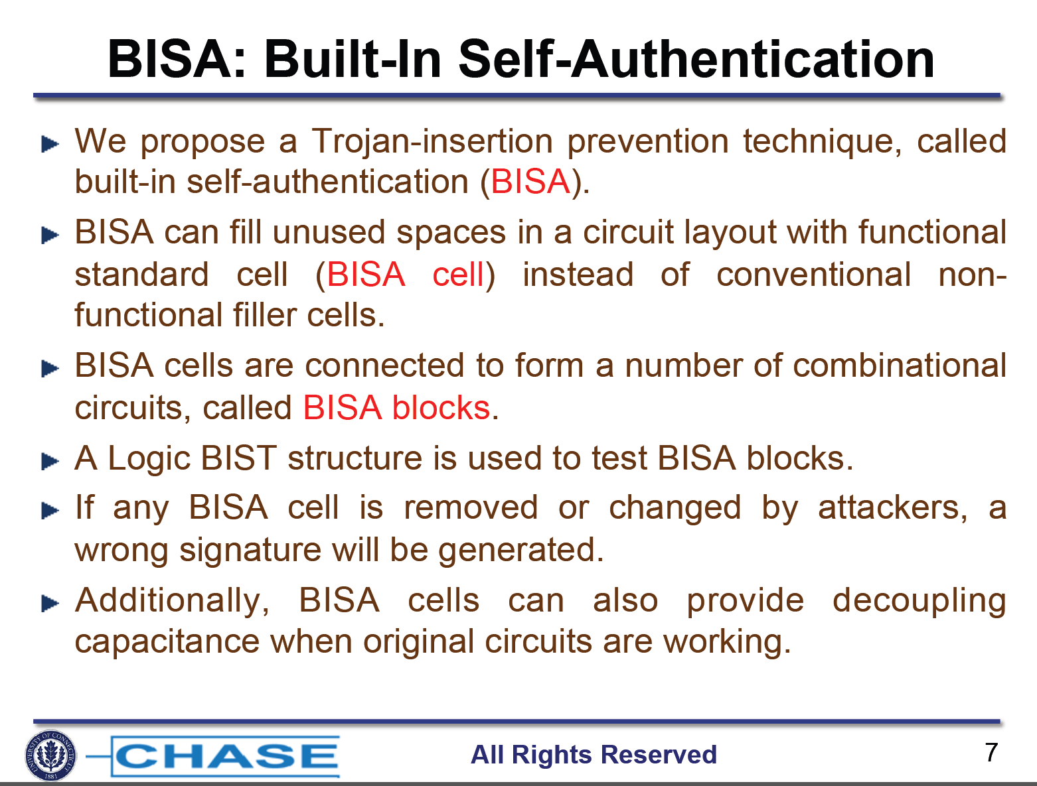

Slide 41
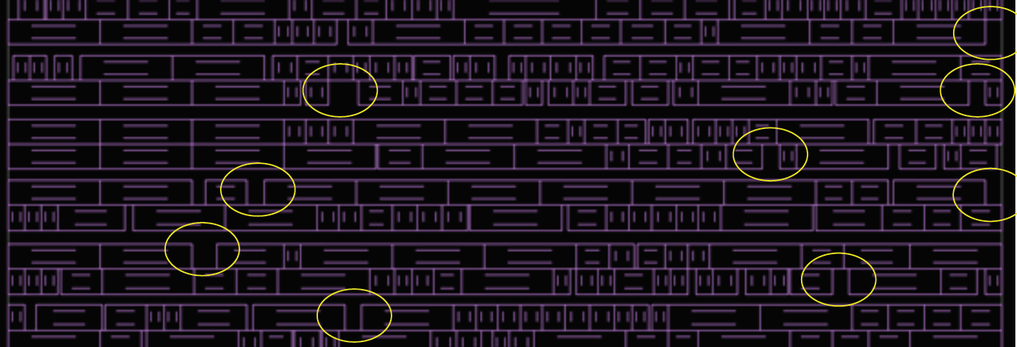
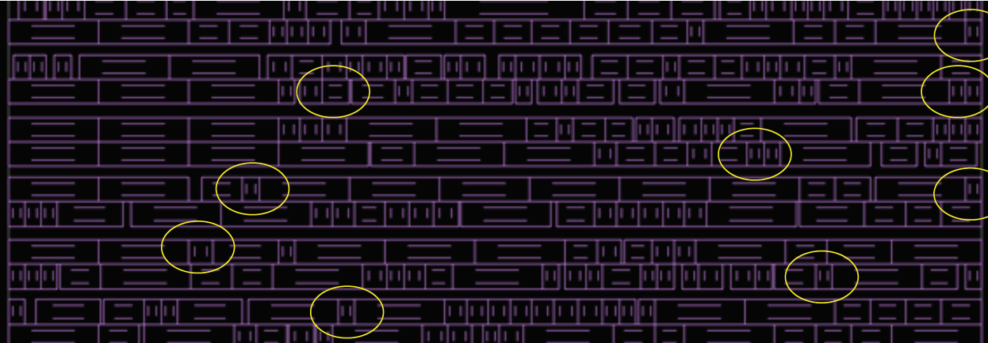
BISA – Before and After

Slide 42
Counterfeiting

Slide 43
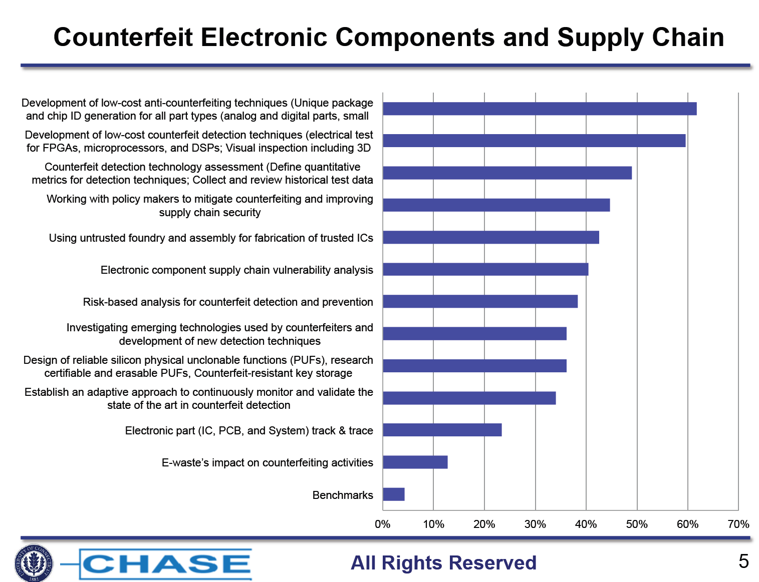
Notes:
Need scalable means for detecting and reporting ICT supply chain risks attributable to counterfeits, defects, and tainted components to mitigate risks of potentially delivering, accepting, or integrating defective, non-conforming components.
Need standardized taxonomies for addressing ICT components, processes, and associated means for detection/diagnostics:
Used to categorize risk characteristics of defective, nonconforming components: 1. counterfeit components (containing unauthorized parts), 2. defective components (containing flawed or poor quality parts), and 3. tainted components (containing exploitable constructs, such as malware, exploitable weaknesses and vulnerabilities).
Used to categorize characteristics of non-conforming packaging.
Used to categorize characteristics of various means to assert or determine authenticity or conformance of components, including packaging.
Used to associate detection/diagnostic capabilities with respective risk characteristics.
Used to identify gaps in tools and automation capabilities or opportunities for technology improvement
1 and AMS-RF, 2 can existing test data (on-chip) be used for PUFs?
Please consider: Bring consistency about what risk to a system the different types of artifact testing can identify, or contribute towards identifying, and how those observations and the risks they help identify can be shared and used to evaluate mitigations
If an electronic component supply chain vulnerability analysis has not been published then it should be done so that the industry knows where to put its resources. I thought one or more had been published.

Slide 44
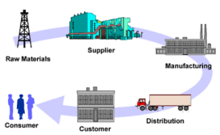
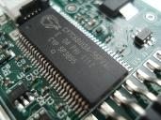



Trust Issue: Counterfeit Chips
Counterfeit ICs:
Used ICs provided by untrustworthy suppliers, which
are “recycled” from used or defective circuit boards
Malicious
supplier
Recycled IC
Used or defective
circuit boards
Electronic
supply chain
$$$ loss, reliability!!!
Other Counterfeit IC Types:
Stolen/Reverse-Engineered IP, Over-production

Slide 45
Trust Issue: Counterfeit Chips
*SEMI, “Innovation is at risk as semiconductor equipment and materials industry loses up to $4 billion annually due to IP infringement,” 2008

Slide 46
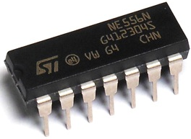
Common Industry Supply Chain Misconceptions ¹
¹ B. Hamilton, NSWC Crane, Testimony at SASC Briefing, 9 September, 2013
“Counterfeit components are a 1-in-1,000,000 risk.”
  Independent Distributors say that from 0.5% to 35% of
  their incoming product is suspected counterfeit.
“Only bad distributors sell counterfeit components.”
  Most counterfeit parts sold to contractors come from legitimate independent distributors lacking effective screening techniques
“Only expensive components are counterfeited.”
  DoC reports that over 60% of counterfeit
  parts have a sale value of $10 or less.
“Counterfeit parts will be detected by electrical tests.”
  More than half of all counterfeit components
  have the correct (or equivalent) die.
Image courtesy of: http://www.rkonlinestore.co.uk/556-dual-timer-ic-16-pin-dip-pack-of-1-391-p.asp
Notes:
Brett Hamilton (Crane) recognized government expert in diagnosing, analyzing counterfeit components
DARPA IS THE RIGHT PLACE TO FIX THIS. We have the insight to take on a problem of this scope.
Past solutions wrap paper around the problem: Policies, doctrines, business practices, etc.

Slide 47
DoD is Especially Vulnerable to Counterfeits
  DoD applications present severe demands on components
  which make them especially vulnerable to compromise.
  DoD electronic components require high reliability, serviceability.¹
  Compromised component failures risk DoD missions, soldier’s lives.
  Long design cycles (10+ years) and product lifetimes (30+ years) causes components in the bill-of-material to become obsolete.¹
  $10-$50 parts become $8000 parts once they are obsolete¹ –
  providing motivation for recycling, and less-reputable suppliers.
  Whole off-shore industries supply bogus obsolete parts and clone current parts (with or without malicious changes).
  Most common current component supply problems
  Recycled components
  Remarked parts (Mfr date, grade)
  Clones / copies
    Unlicensed overproduction
    Test rejects / sub-std parts
    Repackaged OEM chips
¹ NAVSEA Crane internal report
Notes:
By nature of DoD, lives and missions depend on component integrity
Long Acquisition cycles almost encourage counterfeiting – parts become obsolete
We’ve only been talking about financially-motivated counterfeits : cloning also suggests TRUST-like exploits
Extraction / heating of parts to melt solder; ESD damage; physical damage; dirt; aging - all of them cause system to fail

Slide 48
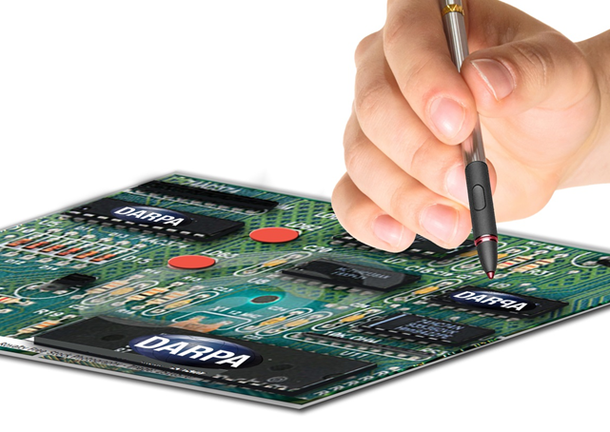
Authentication?
Image courtesy of DARPA

Slide 49
Authentication is not enough:
Additional mechanisms to be considered for higher security levels
On-chip odometers address recycling threat
  On chip structures that count some physical events like power cycles, memory accesses or other inexpensively measurable values
  Data in the odometer is encrypted; reset to ‘0’ indicates an attack
  Can be accessed at the authentication time
Activation – chips do not work as manufactured
  Only the IP rights holder would have the necessary keys needed to activate chips
  Different degrees of activation need to be offered to enable the customer to make trade-offs between security and costs
  Pre-existing test methods should be accommodated
  Power-up, event-based or periodic activation would offer highest security levels

Slide 50
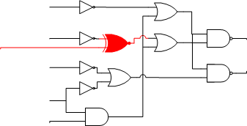
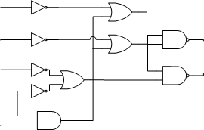
Possible activation solution: Logic Encryption
Concept: Add gates throughout design connected to a key
  Generate a 256 bit encryption key K[0..255]
  Modify netlist to inject 256 XOR or XNOR gates throughout the design
  Gates inserted are pre-determined by the bit in the key
  Injection sites should be off critical path and cause max errors on wrong key
  Manufacture devices at a potentially un-trustworthy fab
  Place a 256 bit key in tamper-proof location in the design after fabrication
Open questions
  How to find best injection sites
  How to avoid critical timing paths
  How to implement tamper-proof locations for the encryption key
1
0
1
EDA Tool
0
key register
0
1
1
0
1
Ideas: UM & NYU

Slide 51
Different types of solution are needed
Offline authentication
  Valid chip contain a unique key that can be verified offline
  Unauthorized chips work but can be identified (if in possession)
One-time activation using global key
  As-manufactured chips do not work
  Key needs to be entered to activate the chip
One-time activation using unique key
  Same as above but key is unique for each chip
Power-up activation using unique key
  Chip is not activated permanently, each use must be activated

Slide 52
Solution Space for Supply Chain Protection
Waste
Power-up
unique key
cost
One-time
unique key
One-time
global key
Offline authentication
Impossible
security

Slide 53
Framework approach enables multiple parties to partner and contribute to a scalable solution
Crypto
Engines
Authentication
Odometers
Global Activation
Unique Activation
Readout
Technologies
Keystores
Unique ID
Technologies

