Slide 1
Physical Design and FinFETs
Rob Aitken
ARM R&D
San Jose, CA
(with help from Greg Yeric, Brian Cline, Saurabh Sinha, Lucian Shifren, Imran Iqbal, Vikas Chandra and
Dave Pietromonaco)

Slide 2

What’s Ahead?
The Scaling Wall?
EUV around the corner?
Slope of multiple
patterning
Avalanches from resistance,
variability, reliability, yield, etc.
Crevasses of Doom
Scaling getting rough
Trade off area, speed, power, and (increasingly) cost

Slide 3
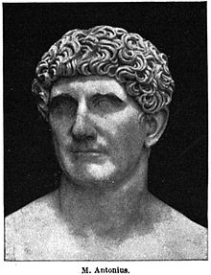
20nm: End of the Line for Bulk
Barring something close to a miracle, 20nm will be the last bulk node
  Conventional MOSFET limits have been reached
  Too much leakage for too little performance gain
Bulk replacement candidates
  Short term:
    FinFET/Tri-gate/Multi-gate,
    or FDSOI (maybe)
  Longer term (below 10nm):
    III-V devices, GAA, nanowires, etc.
I come to fully
deplete bulk,
not to praise it

Slide 4
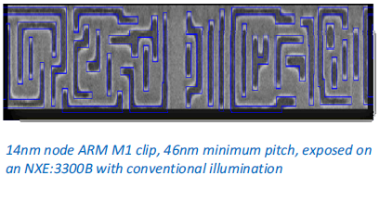
A Digression on Node Names
Process names once referred to half metal pitch and/or gate length
  Drawn gate length matched the node name
  Physical gate length shrunk faster
  Then it stopped shrinking
Observation: There is nothing in a 20nm process that measures 20nm
Node | 1X Metal Pitch
Intel 32nm | 112.5nm
Foundry 28nm | 90nm
Intel 22nm | 80nm
Foundry 20-14nm | 64nm
Sources: IEDM, EE Times
Source: ASML keynote, IEDM 12

Slide 5
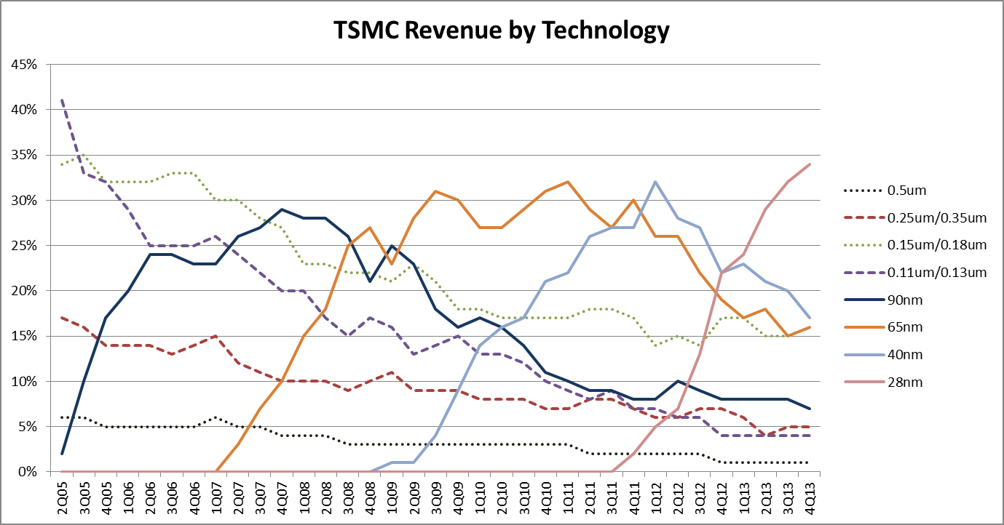
40nm – Past Its Prime?
28!
20?
16??
Source: TSMC financial reports

Slide 6
Technology Scaling Trends
The Good Old Days
Interconnect
Patterning
Lithography scaling
Transistors
Wires negligible
Complexity
HKMG
Strain
PMOS
NMOS
Planar CMOS
Strong RET
LE, <λ
LE, ~λ
Al wires
CU wires
1970
1980
1990
2000
2010
2020
Notes:
Now, to best appreciate what we see coming in the future, let’s back up and look at the landscape of the past.

Slide 7
Technology Scaling Trends
Extrapolating Past Trends OK
Interconnect
Delay ~ CV/I
Patterning
Transistors
Power ~ CV²f
Complexity
Area ~ Pitch²
HKMG
Strain
PMOS
NMOS
Planar CMOS
Strong RET
LE, <λ
LE, ~λ
Al wires
CU wires
1970
1980
1990
2000
2010
2020
Notes:
For the most part, during this period, it has been reasonably accurate to predict circuit performance with fairly simple extrapolations of trends.
This is how the ITRS calculates things.

Slide 8
Technology Scaling Trends
Extrapolating Past Trends OK
Interconnect
Delay ~ CV/I
Patterning
Transistors
Power ~ CV²f
Complexity
Area ~ Pitch²
FinFET
LELE
HKMG
Strain
PMOS
NMOS
Planar CMOS
Strong RET
LE, <λ
LE, ~λ
Al wires
CU wires
1970
1980
1990
2000
2010
2020
Notes:
Now here in 2014 we face a significant bump in technology complexity as double patterning (two litho/etch steps) comes online in 20nm and then FinFETs come shortly after that.

Slide 9
Technology Complexity Inflection Point?
Extrapolating Past Trends OK
Core IP Development
?
Interconnect
Delay ~ CV/I
Patterning
Transistors
Power ~ CV²f
Complexity
Area ~ Pitch²
FinFET
LELE
HKMG
Strain
Strong RET
PMOS
NMOS
Planar CMOS
LE, <λ
LE, ~λ
Al wires
CU wires
1970
1980
1990
2000
2010
2020
Notes:
But this talk is about technology forecasting. 20/16/14…those technologies and products are already in the pipeline. For forecasting, we need to look farther out…out to the horizon in which we have time to react in terms of processor roadmaps.
And an over-reaching questions is– have we hit a technology complexity inflection point?

Slide 10
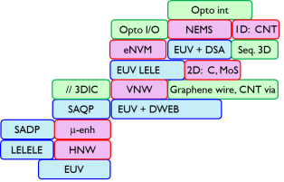
Technology Complexity Inflection Point?
Interconnect
Patterning
Transistors
Complexity
FinFET
LELE
HKMG
Strain
Strong RET
PMOS
NMOS
Planar CMOS
LE, <λ
LE, ~λ
Al wires
CU wires
1970
1980
1990
2000
2010
2020
Notes:
Dennard scaling broke down, had to add strain. Moore’s law upheld with clever patterning tricks. But performance, power, and area scaling still held close to expectation from process scaling.

Slide 11
Future Technology
Opto int
Spintronics
Opto I/O
NEMS
1D:CNT
eNVM
EUV + DSA
Seq. 3D
Interconnect
EUV LELE
2D:C, MoS
// 3DIC
VNW
Graphene wire, CNT via
Patterning
SAQP
EUV + DWEB
Transistors
SADP
μ-enh
LELELE
HNW
Complexity
LELE
EUV
FinFET
W LI
Cu doping
Planar CMOS
LE
10nm
7nm
5nm
3nm
Al / Cu / W wires
2005
2010
2015
2020
2025
Notes:
Here’s what we are watching for in PTM land. Complexity is generally going up and to the right, but not in every specific case.
Directly on our PTM roadmap is the mobility-enhanced device (compound semiconductors, usually in the form of Quantum Well FETs, as published by Intel for instance). We can compare these to the nanowires. It appears IMEC is pushing the Vertical Nanowire (VNW) for 7nm but Horizontal (HNW is closer to the existing FinFET).
Somewhere in the 2023 time frame it is quite possible that we might find ourselves with NO silicon in the technology. Probably a good idea to broaden the name from “silicon”.
All of the patterning items are on our to-do list. IBM 10nm POR is shown, which uses both triple patterning (LELELE) and Self Aligned Double Patterning.
EUV or quad patterning comes after that. EUV will likely need a secondary cut mask, which can be done with Direct Write E-Beam or Directed Self Assembly. (ASML, IMEC collaboration)
Not a lot of investment in anything opto at this point. Monitoring it for use as just I/O or for use inside the chip for global interconnect.

Slide 12
Future Transistors
Opto int
Spintronics
Opto I/O
NEMS
1D: CNT
eNVM
EUV + DSA
Seq. 3D
Interconnect
EUV LELE
2D: C, MoS
// 3DIC
VNW
Graphene wire, CNT via
Patterning
SAQP
EUV + DWEB
Transistors
SADP
μ-enh
LELELE
HNW
Complexity
LELE
EUV
FinFET
W LI
Cu doping
Planar CMOS
LE
10nm
7nm
5nm
3nm
Al / Cu / W wires
2005
2010
2015
2020
2025
Notes:
Changing the material is a lot more complicated than just changing the mobility number in our SPICE models. Band gap difference and density of state differences will lead to different on/off characteristics, and practical considerations such as good oxides and contacts are TBD. HNW should be relatively safe for designers experiences with FinFETs, but VNW will be a new paradigm of layout entirely. Graphene likewise should be not too much more complicated than standard FETs, but CNT presents entirely new levels of design complexity owing to extreme variability.

Slide 13
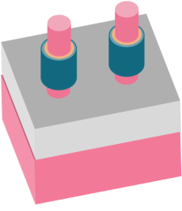
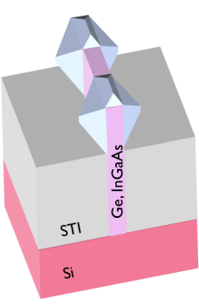
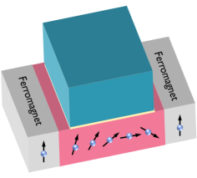
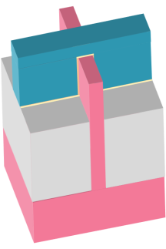
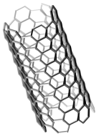
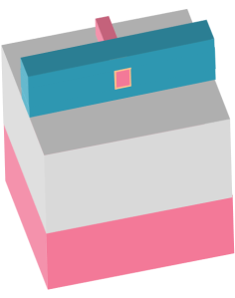
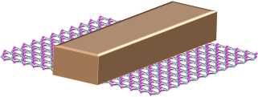
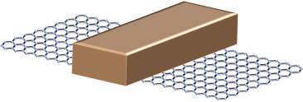
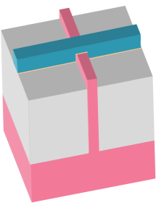
Future Transistors
Opto int
Spintronics
Opto I/O
NEMS
1D:CNT
eNVM
EUV + DSA
Seq. 3D
Interconnect
EUV LELE
2D:C,MoS
// 3DIC
VNW
Graphene wire, CNT via
Patterning
SAQP
EUV + DWEB
Transistors
SADP
μ-enh
LELELE
HNW
Complexity
LELE
EUV
FinFET
W LI
Cu doping
Planar CMOS
LE
10nm
7nm
5nm
3nm
Al / Cu / W wires
2005
2010
2015
2020
2025
Notes:
Changing the material is a lot more complicated than just changing the mobility number in our SPICE models. Band gap difference and density of state differences will lead to different on/off characteristics, and practical considerations such as good oxides and contacts are TBD. HNW should be relatively safe for designers experiences with FinFETs, but VNW will be a new paradigm of layout entirely. Graphene likewise should be not too much more complicated than standard FETs, but CNT presents entirely new levels of design complexity owing to extreme variability.

Slide 14

Where is this all going?
Direction 1: Scaling (“Moore”)
  Keep pushing ahead 10 > 7 > 5 > ?
  N+2 always looks feasible, N+3 always looks very challenging
  It all has to stop, but when?
Direction 2: Complexity (“More than Moore”)
  3D devices
  eNVM
Direction 3: Cost (Reality Check)
  Economies of scale
  Waiting may save money, except at huge volumes
  Opportunity for backfill (e.g. DDC, FDSOI)
  For IOT, moving to lower nodes is unlikely
Direction 4: Wacky axis
  Plastics, printed electronics, crazy devices

Slide 15
3-Sided Gate
W_{FINFET} = 2*H_{FIN} + T_{FIN}
Drain
Gate
Source
H_{FIN}
T_{FIN}
STI
STI
Notes:
Current between the source and drain can be much better controlled in this structure.

Slide 16
Width Quantization
T_{FIN}
H_{FIN}
1.x * W
Notes:
With the finFET, we don’t get to change the fin at all. Those parameters are set by the device physics.

Slide 17
Width Quantization
+1 Fin Pitch
→ 2 x W
1.x * W
Notes:
The only thing we can do to increase drive strength is to add another fin. So this is what we refer to as “width quantization”. Drive strength is 1x, 2x, 3x, and so on.

Slide 18
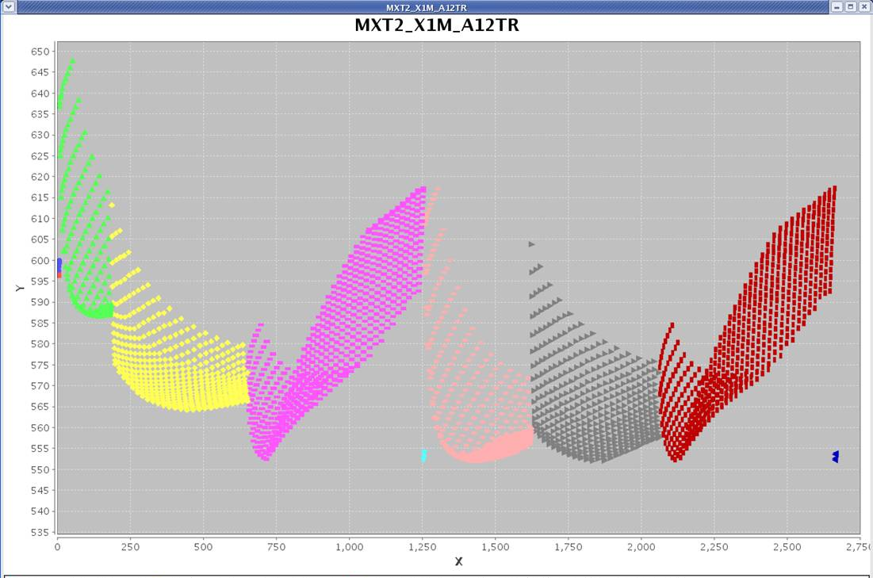
Width Quantization and Circuit Design
Standard cell design involves complex device sizing analysis to determine the ideal balance between power and performance
Notes:
Here, I’m showing a set of cell optimization simulations, where the Y axis is timing and the X axis are the various optimization simulations across different groups of transistors within the cell, varying the device widths in allowable increments.
All of the colored dots are legal with bulk devices, but as you can imagine, only a smaller number of discrete points will be legal with the finFETs. It turns out that this issue is not as bad as you might think– more or less along the lines of this figure, where we got fairly close to the less constrained planar minimum in the yellow set. That is, for any given cell. But that is not the full issue with width quantization.

Slide 19
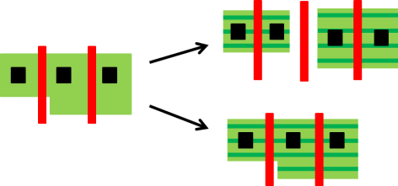
Fin Rules and Design Complexity

Slide 20
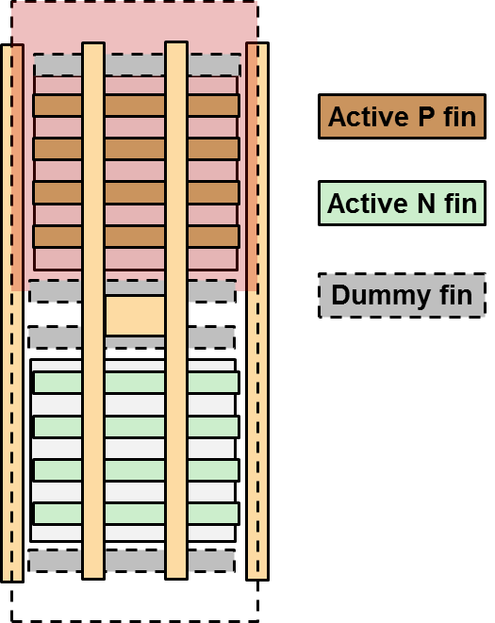
Allocating Active and Dummy Fins

Slide 21
Standard Cell Exact Gear Ratios
Cell Track Height (64nm metal pitch)
Active Fin Pitch | 8 | 9 | 10 | 11 | 12 | 13
40 |  |  | 12
41
42
43
44 |  |  |  | 12
45
46
47
48 |  | 8 |  |  | 12
Values in Table: Number of active fins per cell
1nm design grid. Fin Pitch 40-48nm.
Half-tracks used to fill in gaps (e.g. 10.5)
Notes:
It’s actually a bit more complicated than that. It turns out there aren’t a lot of options for reasonable fin pitches.
This is what we refer to as the gear ratio problem. It’s an important point because only if the fin pitch equals the metal pitch do we see what I have labeled “Business As Usual”. For only that fin pitch can standard cell designers take the design rules and make whatever cell height we want.
For smaller fin pitches, we can fill in this table with more solutions if we allow small variations in fin pitch.

Slide 22
Non-Integer Track Heights
Standard
Flexible
Colorable
VDD
VDD
VDD
VDD
1
1
1
2
2
2
3
3
3
4
4
10.5 Metal 2 router tracks
4
A
Y
5
5
5
6
6
6
7
7
7
8
8
8
9
9
VSS
VSS
VSS
VSS
Notes:
The we have the router coming through in the higher level of metal, on the pre-defined tracks.

Slide 23
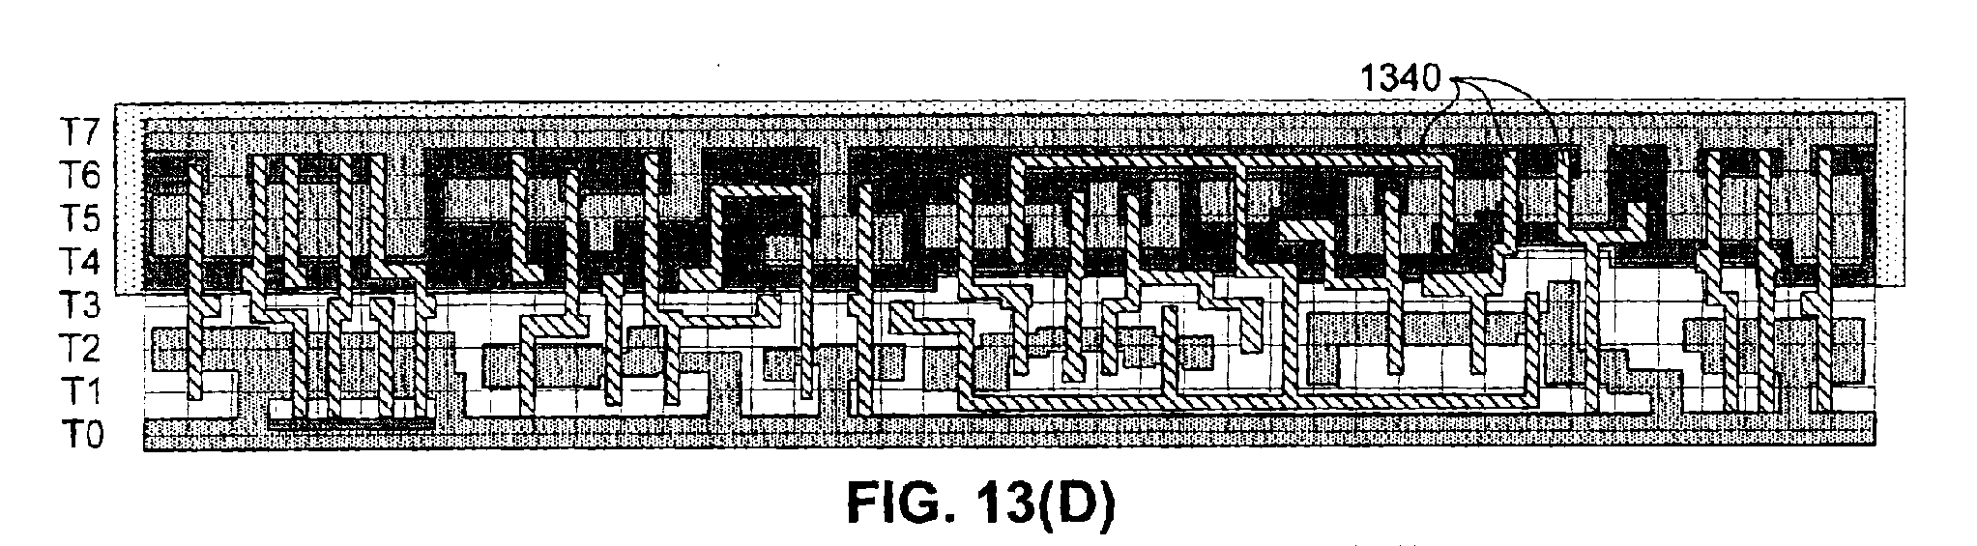
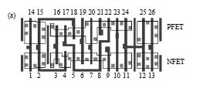
The Cell Height Delusion
Shorter cells are not necessarily denser
The lack of drive problem
The routing density problem
  Metal 2 cell routing
  Pin access
  Layer porosity
  Power/clock networking

Slide 24
Metal Pitch is not the Density Limiter
M1
M1
M2
T-2-S
Metal 1 Pitch
Tip to side spacing, minimum metal area both limit port length
Metal 2 pitch limits the number (and placement) of input ports
Via to via spacing limits number of routing to each port
  Assume multiple adjacent landings of routing is required
Results in larger area to accommodate standard cells
Will not find all problems looking at just a few “typical” cells

Slide 25
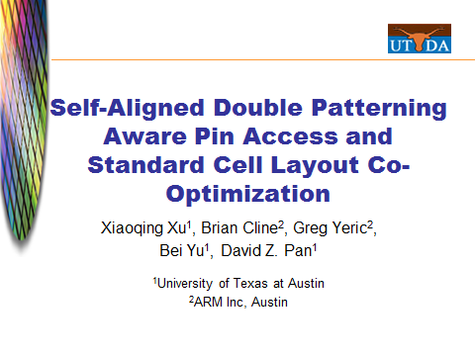
Pin Access is a Major Challenge

Slide 26
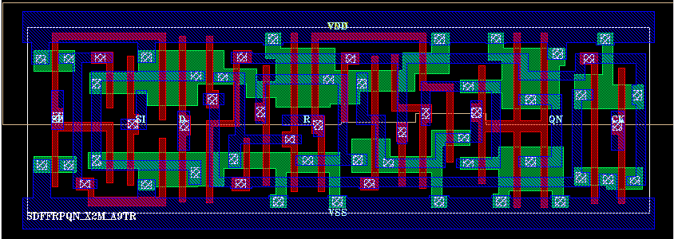
65nm flip flop
Why DFM was invented
None of the tricks used in this layout are legal anymore
  3 independent diffusion contacts in one poly pitch
  2 independent wrong-way poly routes around transistors and power tabs
  M1 tips/sides everywhere
LI, complex M1 get some trick effects back
Can’t get all of them back

Slide 27
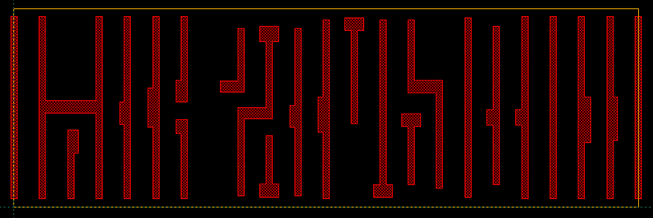
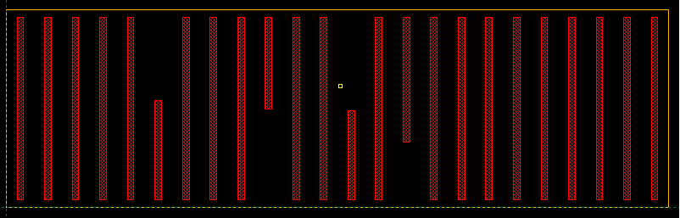
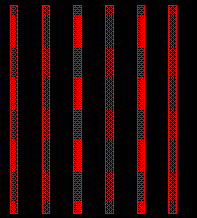
Poly Regularity in a Flip-Flop
45nm
32nm
<32nm
32nm
Notes:
At 32nm, some of the foundry processes still allowed perpendicular poly, but the penalty enforced via linewidth control was too much to justify. Fully collinear gate shapes like this will often incur a penality in terms of increased poly pitches, but the end result is better than with the poly irregularity.

Slide 28
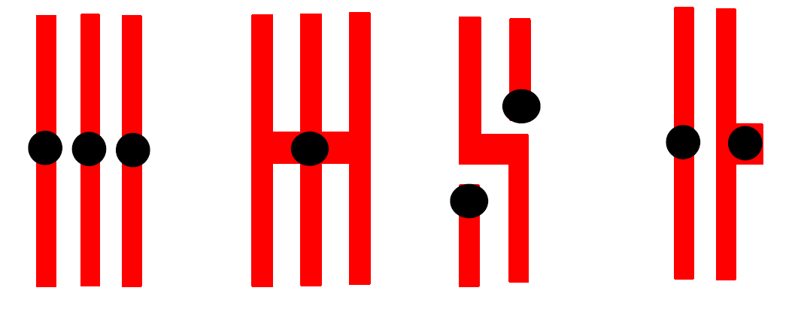
Key HD Standard Cell Constructs
All are under threat in new design rules
  Special constructs often used
Contact every PC is key for density, performance

Slide 29
Contacted Gate Pitch
Goal: contact each gate individually with 1 metal track separation between N and P regions
Loss of this feature leads to loss of drive
Loss of drive leads to lower performance (hidden scaling cost)
FinFET extra W recovers some of this loss
~30% slower
Lost drive capability same wire loads

Slide 30

Below 28nm, Double Patterning is Here

Slide 31
Trouble for Standard Cells
Two patterns can be used to put any two objects close together
Subsequent objects must be spaced at the same-mask spacing
  Which is much, much bigger (bigger than without double patterning!)
Classic example: horizontal wires running next to vertical ports
Two body density not a standard cell problem, 3 body is
With power rails, can easily lose 4 tracks of internal cell routing!
OK
OK
OK
OK
OK
Bad
OK
Bad

Slide 32
Even More Troubles for Cells
Patterning difficulties don’t end, there.
  No small U shapes, no opposing L ‘sandwiches’, etc.
  So several ‘popular’ structures can’t be made
“Hiding” double patterning makes printable constructs illegal
Not to mention variability and stitching issues…
Have to turn
vertical overlaps
into horizontal ones
But that blocks
neighboring sites
No Coloring
Solution

Slide 33
Many Troubles, Any Hope?
Three body problem means peak wiring density cannot be achieved across a library
Standard cell and memory designers need to understand double patterning, even if it’s not explicitly in the rules
Decomposition and coloring tools are needed, whether simple or complex
LELE creates strong correlations in metal variability that all designers need to be aware of
With all of the above, it’s possible to get adequate density scaling going below 20nm (barely)
Triple patterning, anyone?
What this means: Custom layout is extremely difficult. It will take longer than you expect!

Slide 34
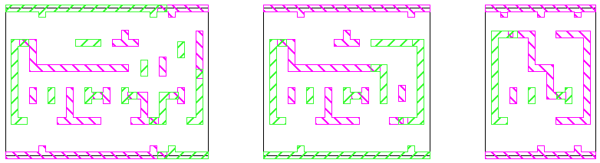
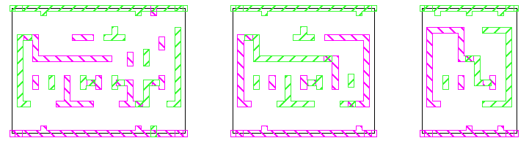
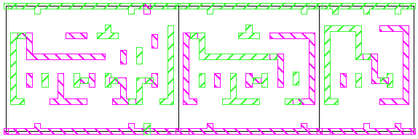
Placement and Double Patterning
3-cells colored without boundary conditions
3-cells colored with ‘flippable color’ boundary conditions
3-cells placed conflict resolved through color flipping
Notes:
it can be coded

Slide 35
FinFET Designer’s Cheat Sheet
Fewer Vt, L options
Slightly better leakage
New variation signatures
  Some local variation will reduce
    xOCV derates will need to reduce
    Better tracking between device types
    Reduced Inverted Temperature Dependence
Little/no body effect
  FinFET 4-input NAND ~ planar 3-input NAND
Paradigm shift in device strength per unit area
  Get more done locally per clock cycle
  Watch the FET/wire balance (especially for hold)
  Expect better power gates
  Watch your power delivery network and electromigration!

Slide 36
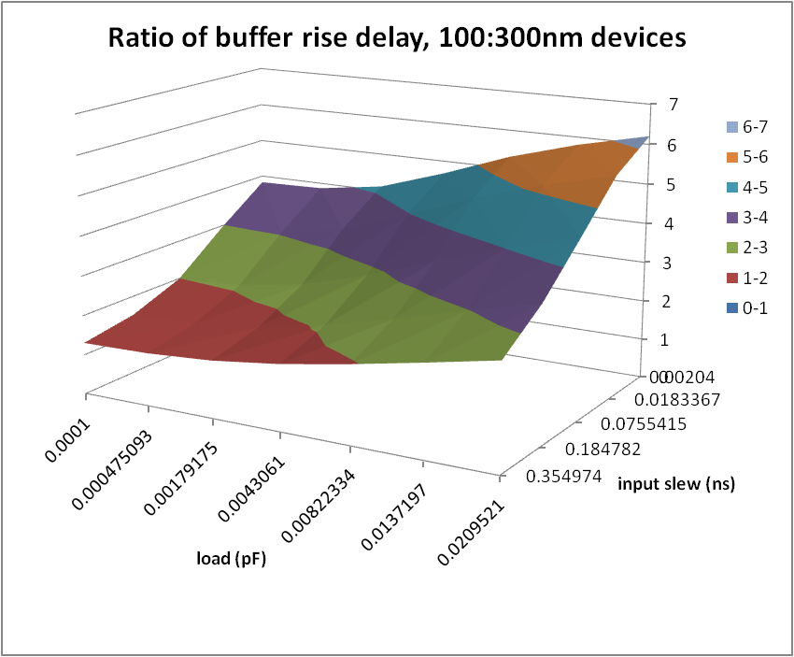
There’s No Such Thing as a Scale Factor

Slide 37
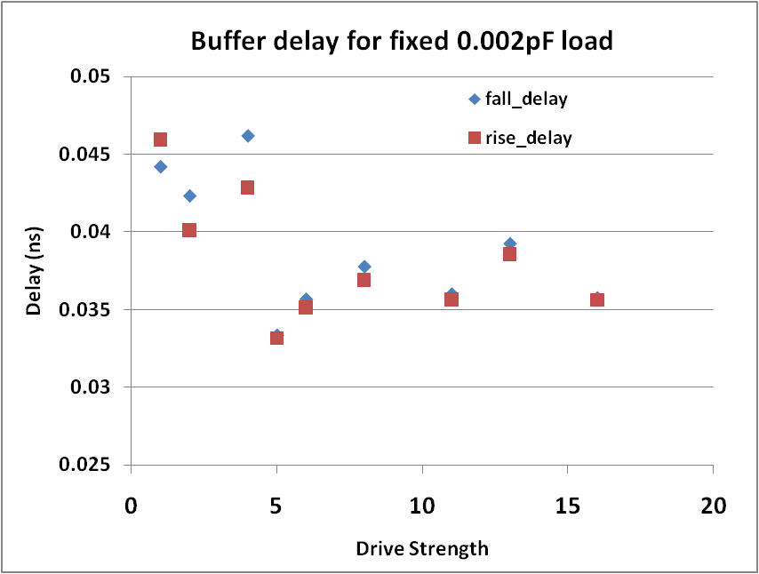
Self-Loading and Bad Scaling
Relative device sizing copied from 28nm to 20nm library
Results in X5 being the fastest buffer
Problem due to added gate capacitance with extra fingers
Can usually fix with sizing adjustments, but need to be careful

Slide 38
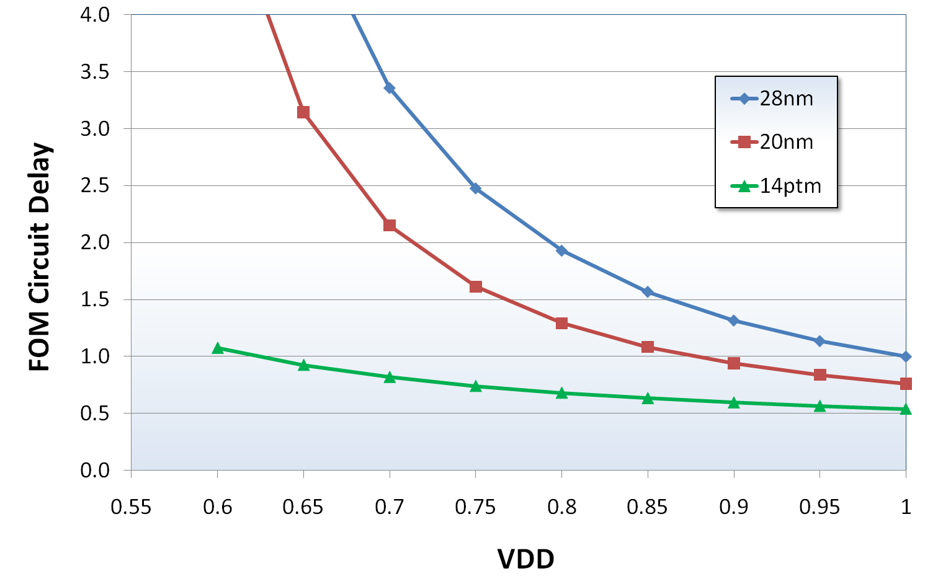
FinFET and Reduced VDD
14ptm: ARM Predictive Technology Model
FOM ➔ “Figure of Merit” representative circuit
Notes:
So let me just cut to the chase and take a look at some finFET data. Here’s a plot with a fairly famous format showing circuit delay vs. VDD.
What I’m examining here is a relatively simple FOM or Figure of Merit circuit delay, which is just a simple collection of NANDs and NORs and Inverters with some typical wire loads thrown in. The predictive device I have chosen for 14nm has similar static power to the 20nm device which is fairly representative of real 20nm process.
Note that the Y-axis scale here is The key take away here is that we can expect the transition to 14nm and finFETs to provide a benefit similar to what has been discussed publicly by other companies. Keep in mind the scale here– this is a big jump-- The final determination on VDD will involve a lot of varying details, it will most likely be 0.8V give or take, but really in any point along that range we should be able to see a decent performance scaling along with the very attractive power savings that comes with power supply reduction.

Slide 39
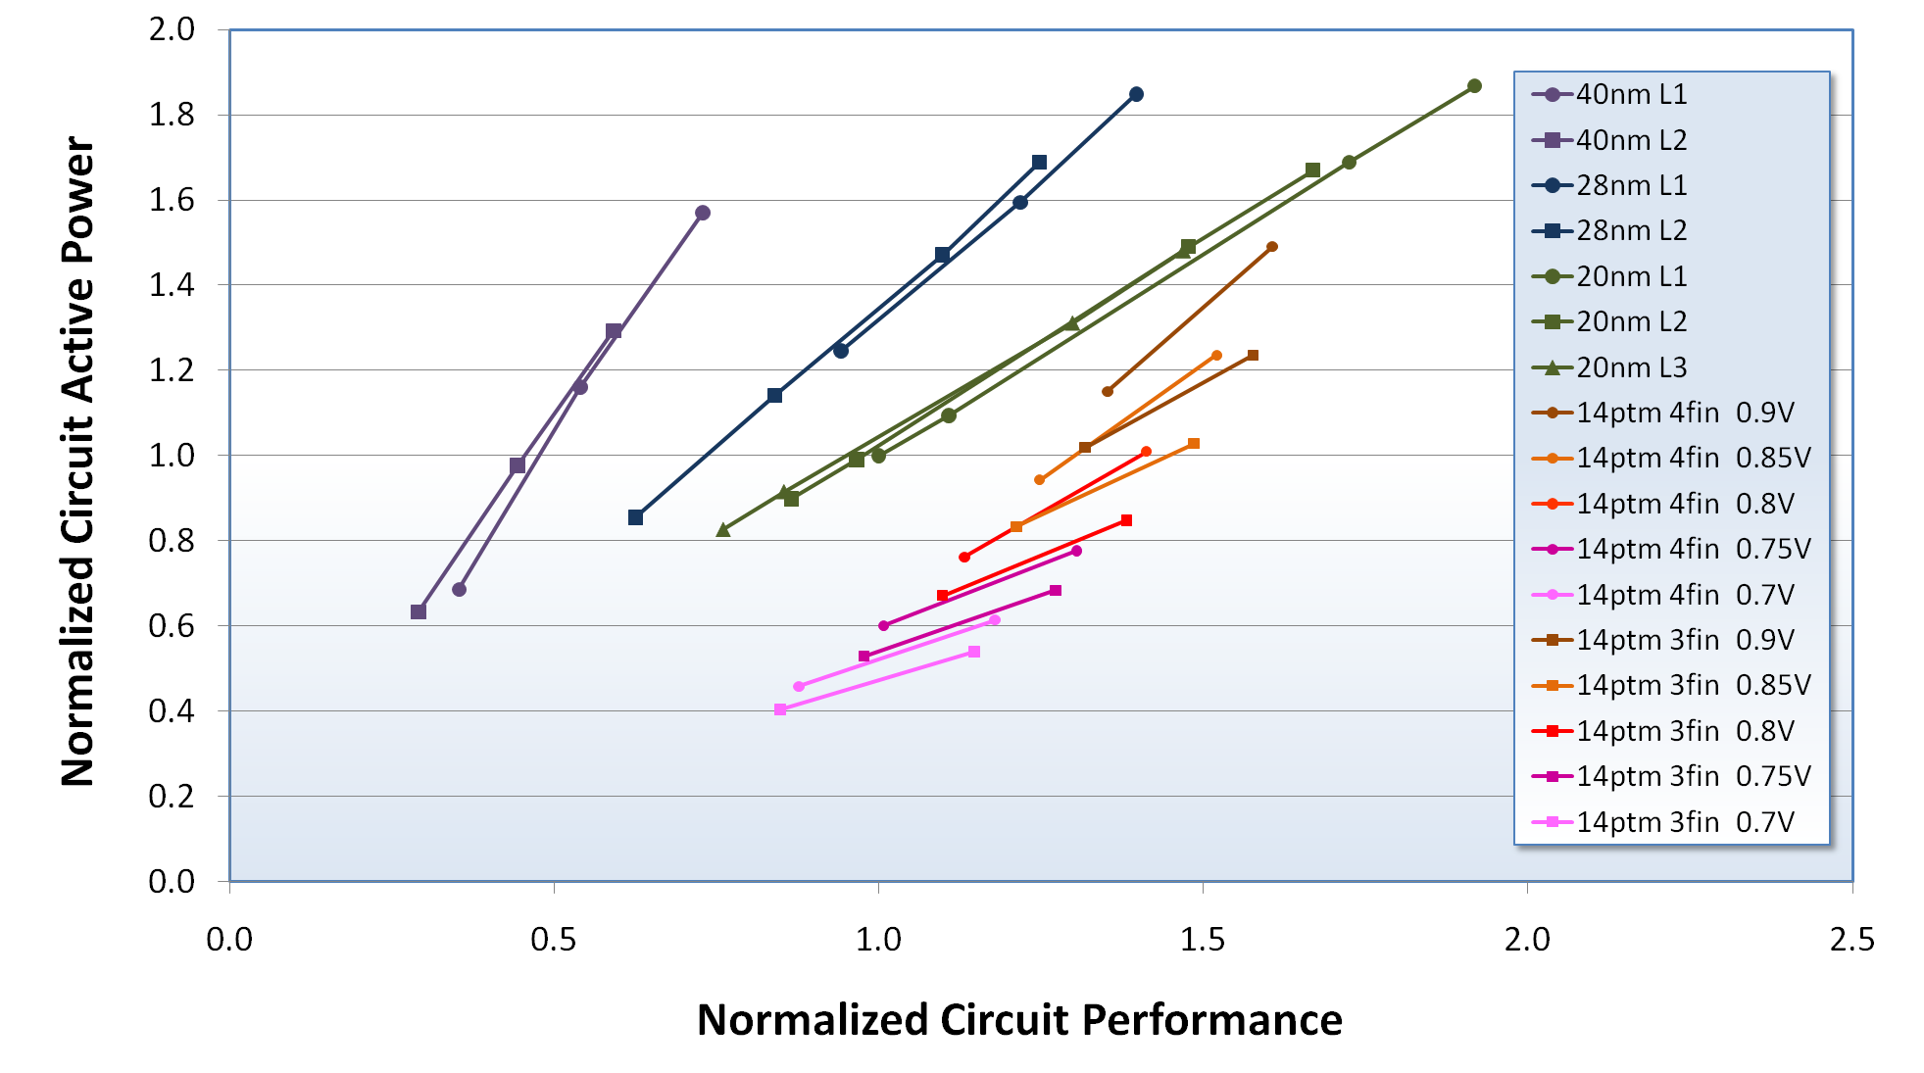
Circuit FOM Power-Performance
Circuit is Figure of Merit is average of INV, NAND, and NOR chains with various wire loads
28nm
20nm
40nm
ARM
Predictive
Models
Notes:
The point here is that within a reasonable range of possible outcomes, 14nm FinFETs present the potential for a very good step in technology node scaling for power and performance from the specific viewpoint of low power standard cells.

Slide 40
FinFET Current Source Behavior

Slide 41

Three Questions
How fast will a CPU go at process node X?
How much power will it use?
How big will it be?
How close are we to the edge?
Is the edge stable?

Slide 42
The Answers
How fast will a CPU go at process node X?
  Simple device/NAND/NOR models overpredict
How much power will it use?
  Dynamic power? Can scale capacitance, voltage reasonably well
  Leakage? More than we’d like, but somewhat predictable
How big will it be?
  This one is easiest. Just need to guess layout rules, pin access and placement density. How hard can that be?

Slide 43
ARM PDK – Development & Complexity
Predictive PDK
Electrical Models
(BSIM CMG)
V_{th}
σ
DRC
LVS
Temperature Dependence
Extraction
(ITF Standard)
TechLEF
(LEFDEF Standard)
Lithography Dependence
FinFET Parameter Handling
Mask Layer Derivations
Stack Composition
R&C Matching
Lithography Dependence
Notes:
This is just a small snapshot of all of the things we’re developing simultaneously.
I’ve listed the things we’re doing along with all of the languages and syntaxes we’re supporting. I think the breadth is pretty impressive.

Slide 44
Predictive 10nm Library
2 basic litho options: SADP and LELELE
2 fin options: 3 fin and 4 fin
  10 and 12 fin library height
Gives 4 combinations for library
  54 cells
  2 flops
  Max X2 drive on non INV/BUF
  NAND, NOR plus ADD, AOI, OAI, PREICG, XOR, XNOR
Can be used as-is to synthesize simple designs

Slide 45
10nm TechBench Studies – Node to Node

Slide 46
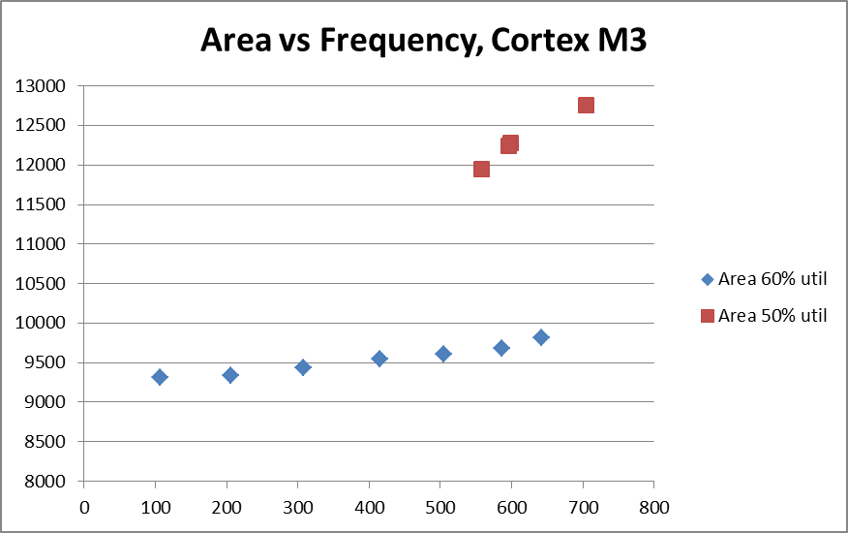
Preliminary Area and Performance
Not a simple relationship
Frequency targets in 100 MHz increments
60% gets to 640 MHz with 700 MHz target
50% gets to 700 MHz with 1GHz target
Likely limited by small library size

Slide 47
What’s Ahead?
The original questions remain
  How fast will a CPU go at process node X?
  How much power will it use?
  How big will it be?
New ones are added
  How should cores be allocated?
  How should they communicate?
  What’s the influence of software?
  What about X? (where X is EUV or DSA or III-V or Reliability or eNVM or IOT or ….)
Collaboration across companies, disciplines, ecosystems

Slide 48

Fin

